Slide 1
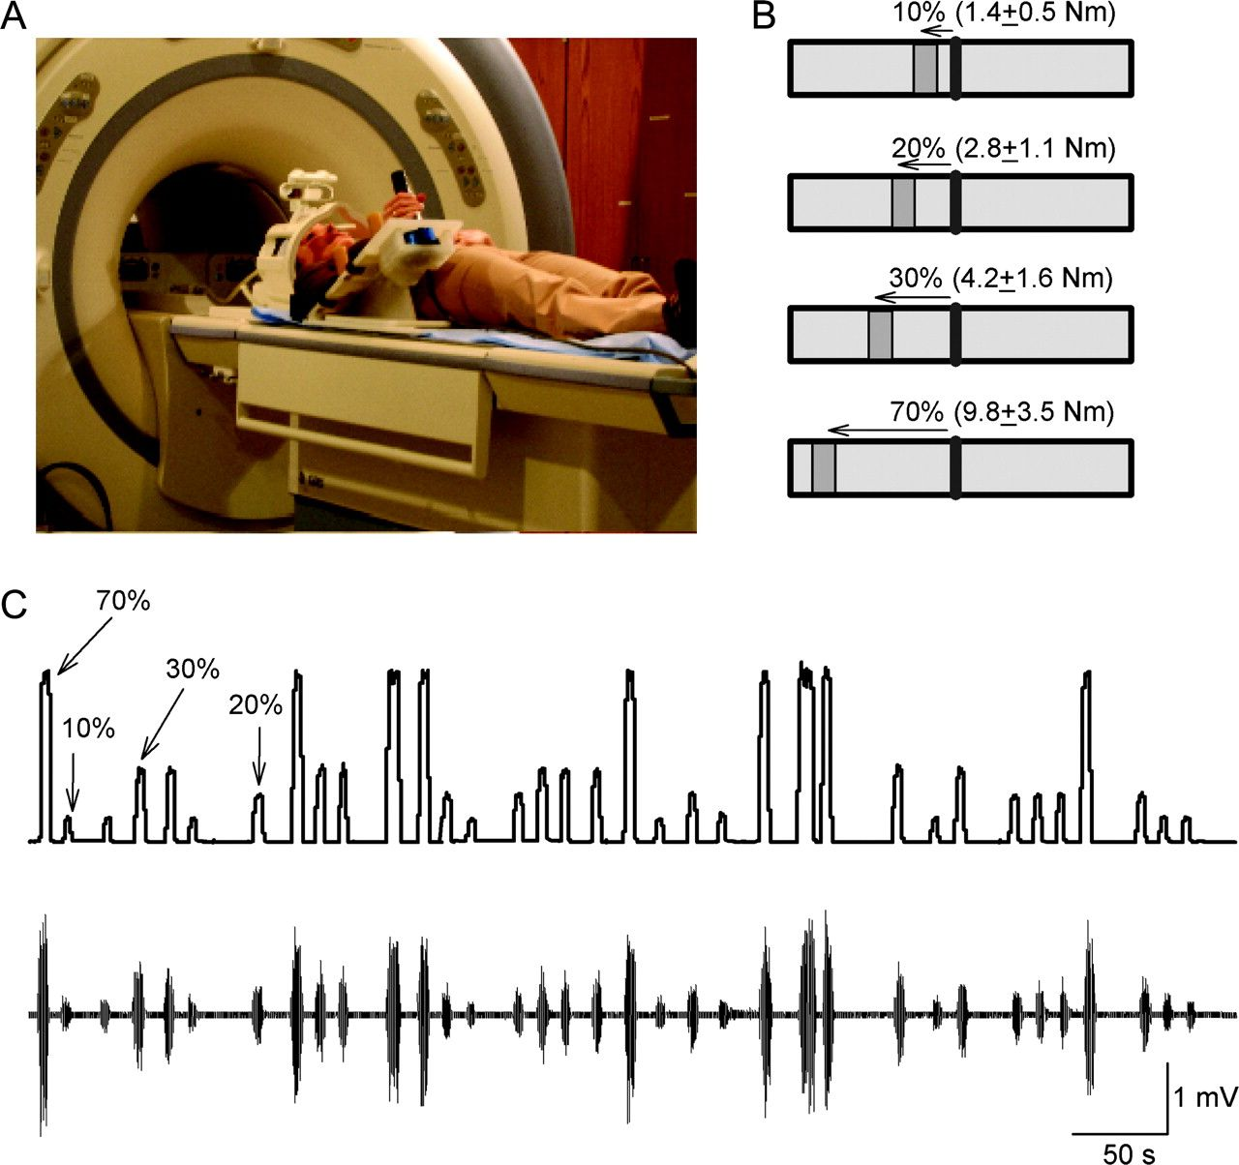
Figure 1. Experimental setup. (A) Schematics of the experimental setup. Subjects lay in the MRI scanner with their ...
Notes:
Figure 1. Experimental setup. (A) Schematics of the experimental setup. Subjects lay in the MRI scanner with their right arm attached to a custom device during performance of different levels of right wrist flexion force. (B) Diagram showing the visual display presented to all subjects during testing. The black vertical line in the center shows the cursor that subjects were instructed to move by performing right isometric wrist flexion force over the manipulandum. The “GO” signal (dark gray box located to the left of the cursor) was also the target to where subjects had to move the cursor, maintaining it in position for 2 s. The distance between cursor and target related to the magnitude of force required to accomplish each task, normalized to the maximal wrist flexion force determined in each participant. (C) Traces showing force and EMG recordings after MRI artifact correction in the right FCR (primary mover) on a representative subject. Note the randomized presentation of the force trials during testing.
Unless provided in the caption above, the following copyright applies to the content of this slide: Published by Oxford University Press 2009.

Slide 2
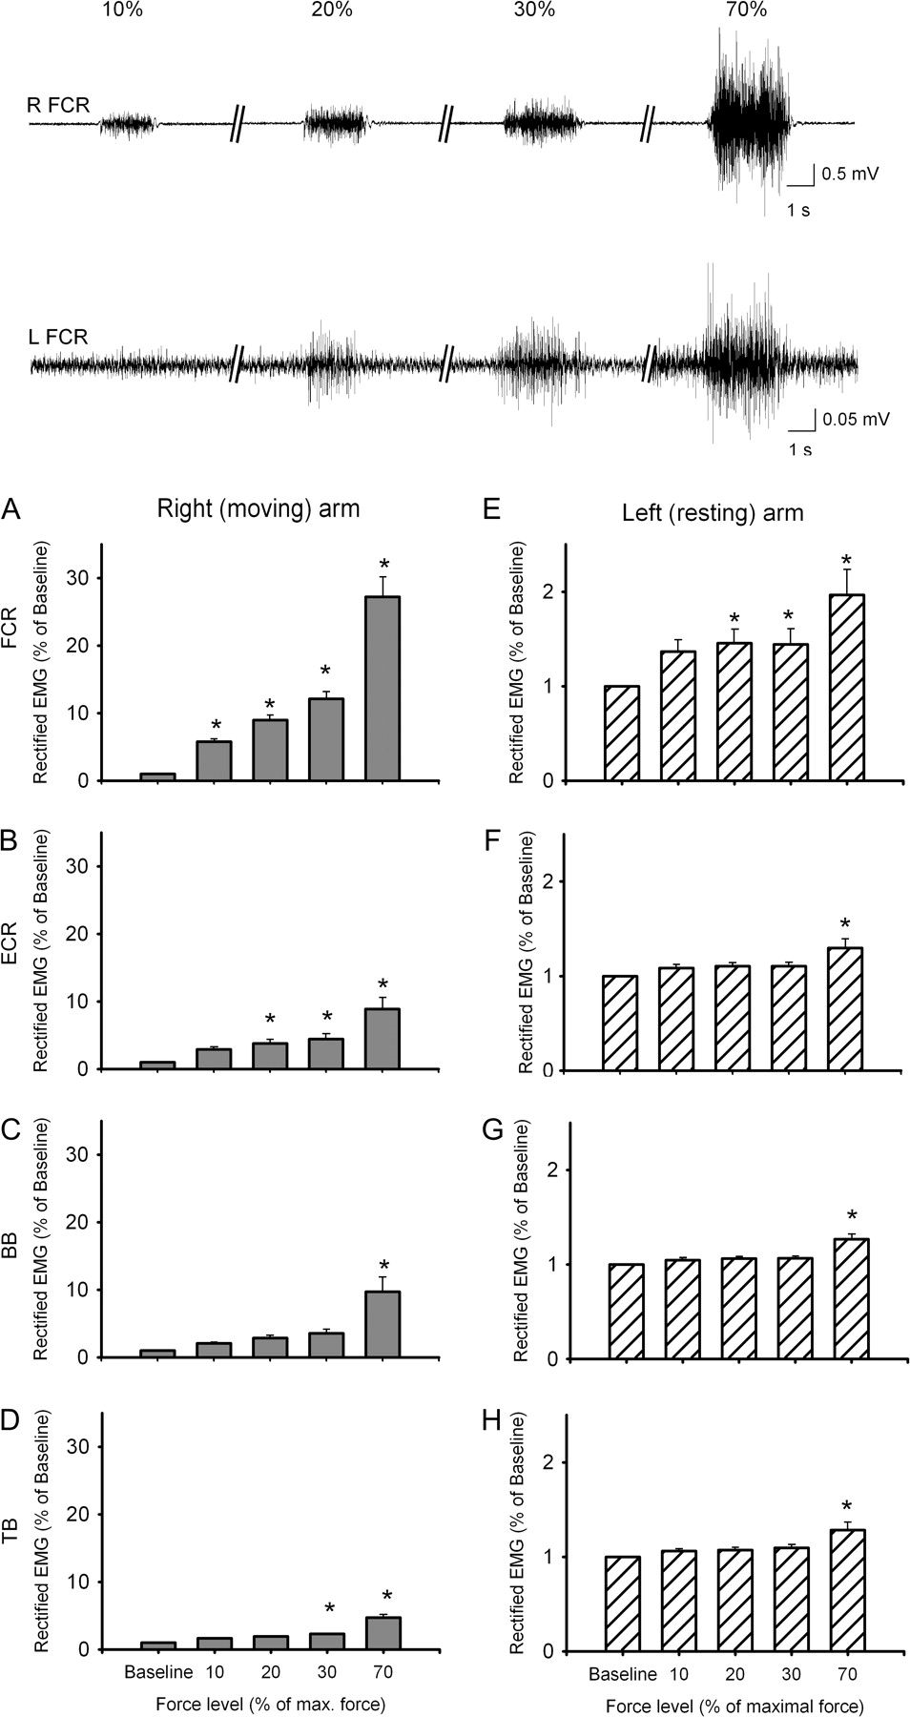
Figure 2. EMG data in left and right arm muscles. Traces show EMG activity after MRI artifact correction in a ...
Notes:
Figure 2. EMG data in left and right arm muscles. Traces show EMG activity after MRI artifact correction in a representative subject in the right (upper traces, R FCR) and left (lower traces, L FCR) FCR muscle during 10%, 20% 30%, and 70% of maximal right wrist force. Note the presence of mirror EMG activity in the left FCR during 20%, 30%, and 70% of maximal right wrist force. The bar graphs show group EMG data after MRI artifact correction. In all graphs, the abscissa shows the conditions tested (10%, 20%, 30%, and 70%) and the ordinate shows the mean rectified EMG activity (expressed as a percent of baseline mean rectified EMG activity) in all muscles tested in the right arm: (A) FCR, (B) ECR, (C) BB, and (D) TB and left arm: (E) FCR, (F) ECR, (G) BB, and (H) TB. Error bars indicate standard errors; *P < 0.05. Abbreviations: flexor carpis radialis (FCR), extensor carpi radialis (ECR), biceps brachii (BB), and triceps brachii (TB) muscles.
Unless provided in the caption above, the following copyright applies to the content of this slide: Published by Oxford University Press 2009.

Slide 3
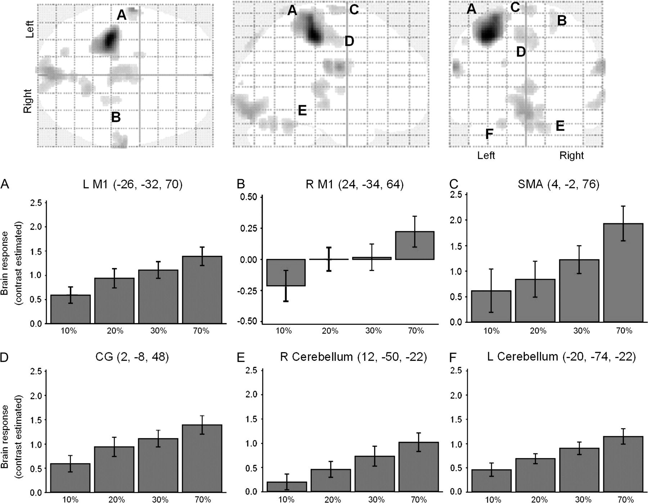
Figure 3. Force-related brain network. Brain areas that showed a significant linear increase in BOLD signal activity at ...
Notes:
Figure 3. Force-related brain network. Brain areas that showed a significant linear increase in BOLD signal activity at all force levels (random-effects analysis, within-subjects ANOVA, FDRcorr. P < 0.05; glass-brain figures). The graphs show the main effects of force in the peak voxel of these force-related brain areas. In all graphs, the abscissa shows the conditions tested (10%, 20%, 30%, and 70%) and the ordinate shows the contrast estimate (average Beta values for each condition). Note that in all displayed areas, there is a linear increase of BOLD signal activity with increasing levels of force. Abbreviations: L M1 (left primary motor cortex), R M1 (right primary motor cortex), SMA (supplementary motor area), and CG (caudal cingulate). Cluster threshold ≥5.
Unless provided in the caption above, the following copyright applies to the content of this slide: Published by Oxford University Press 2009.

Slide 4
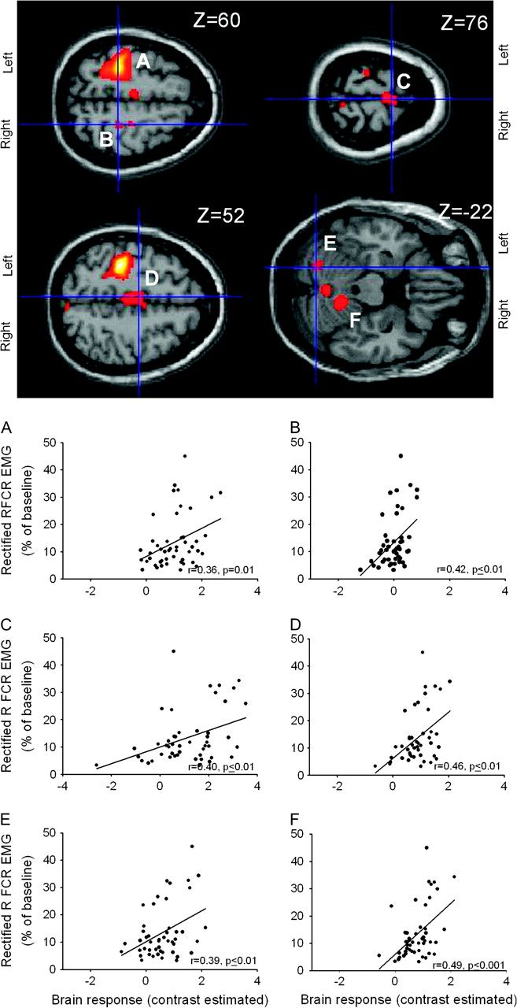
Figure 4. Correlation between BOLD signal and right FCR EMG activity (primary mover). Force-related brain areas shown ...
Notes:
Figure 4. Correlation between BOLD signal and right FCR EMG activity (primary mover). Force-related brain areas shown in Figure 3 were chosen for correlations with EMG activity present in the right FCR (primary mover). In all graphs, the abscissa shows the contrast estimate (average Beta values for each condition) and the ordinate shows the mean rectified right FCR EMG activity across force levels. Note that the brain regions showing a significant correlation with EMG activity in the right FCR were left (A) and right (B) M1, SMA (C), caudal cingulate (D), left (E) and right (F) cerebellum. The functional maps are displayed on the canonical T1-weighted single subject MNI brain. R-values represent Pearson's correlation coefficient.
Unless provided in the caption above, the following copyright applies to the content of this slide: Published by Oxford University Press 2009.

Slide 5
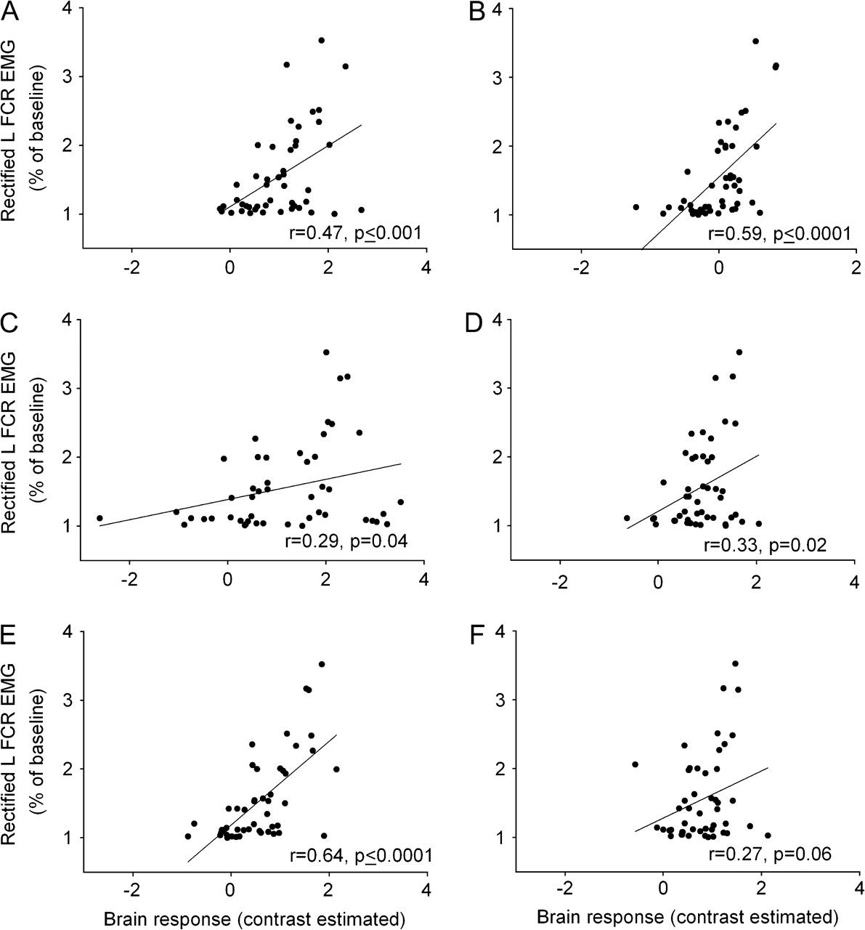
Figure 5. Correlation between BOLD signal and mirror EMG activity. Force-related brain areas shown in Figure 3 were ...
Notes:
Figure 5. Correlation between BOLD signal and mirror EMG activity. Force-related brain areas shown in Figure 3 were chosen for correlations with mirror EMG activity present in the left FCR. In all graphs, the abscissa shows the contrast estimate (average Beta values for each condition) and the ordinate shows the mean rectified left FCR EMG activity during all force levels. Note that a significant correlation between mirror EMG activity in the left FCR and brain activity in the left M1 (A), right M1 (B), SMA (C), caudal cingulate (D), and left cerebellum (E). A correlational trend was found between mirror EMG in the left FCR and the right cerebellum (F). R-values represent Pearson's correlation coefficient.
Unless provided in the caption above, the following copyright applies to the content of this slide: Published by Oxford University Press 2009.

Slide 6
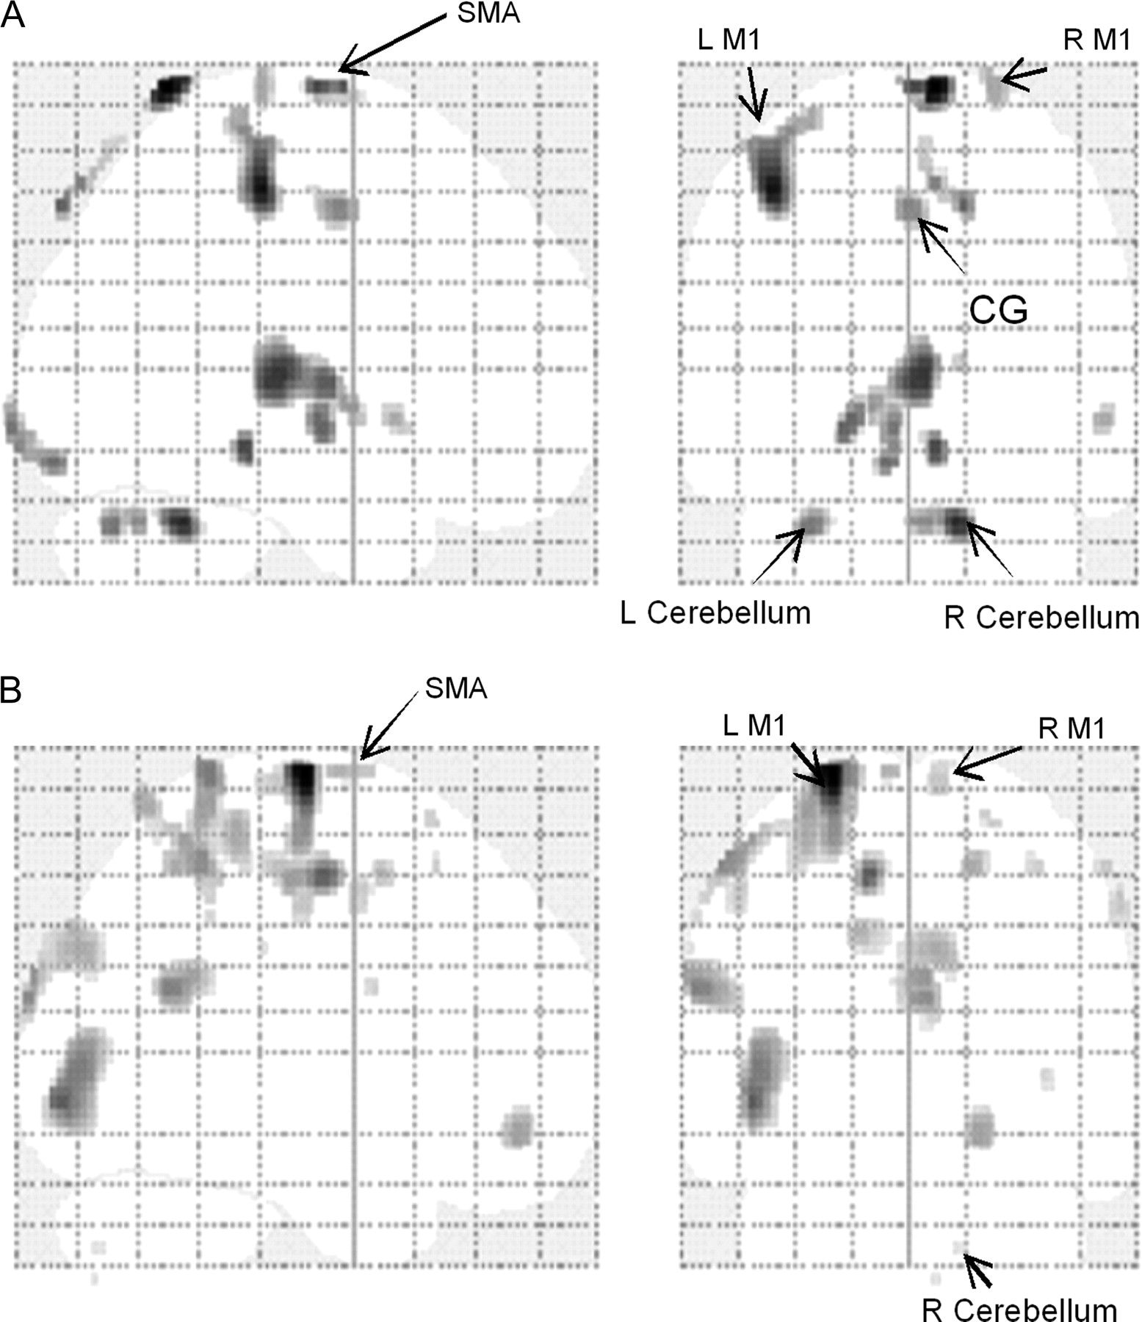
Figure 6. Multiple regression analyses. The figure shows activation in brain regions that were uniquely accounted for ...
Notes:
Figure 6. Multiple regression analyses. The figure shows activation in brain regions that were uniquely accounted for by the right FCR EMG (A) and the left FCR EMG (B). These areas included bilateral M1, SMA, caudal cingulate, and the cerebellum. All activation results were FDR corrected at P > 0.05. Note that all displayed areas are within the clusters seen in the linear trend analysis (Fig. 3). Abbreviations: L M1 (left primary motor cortex), R M1 (right primary motor cortex), SMA (supplementary motor area), and CG (caudal cingulate).
Unless provided in the caption above, the following copyright applies to the content of this slide: Published by Oxford University Press 2009.

