Slide 1
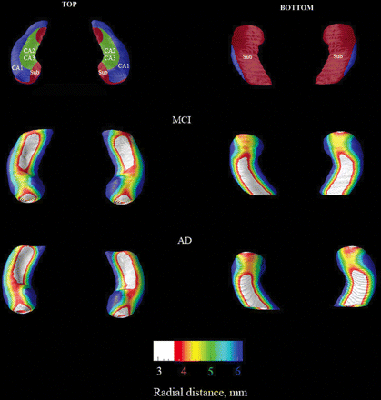
Fig. 1 Group average radial distance maps in Alzheimer's disease (bottom row) and MCI subjects (middle row). The top ...
Notes:
Fig. 1 Group average radial distance maps in Alzheimer's disease (bottom row) and MCI subjects (middle row). The top row is a schematic representation of the hippocampal subfields mapped onto a representative hippocampal surface [definitions based on Duvernoy (1988) and West and Gunderson (1990)].
Unless provided in the caption above, the following copyright applies to the content of this slide: © The Author (2006). Published by Oxford University Press on behalf of the Guarantors of Brain. All rights reserved. For Permissions, please email: journals.permissions@oxfordjournals.org

Slide 2
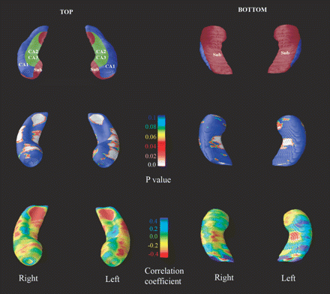
Fig. 2 Statistical 3D maps of hippocampal radial atrophy in native space. As in Fig. 1 the top row is a schematic ...
Notes:
Fig. 2 Statistical 3D maps of hippocampal radial atrophy in native space. As in Fig. 1 the top row is a schematic representation of the hippocampal subfields mapped onto a representative hippocampal surface [definitions based on Duvernoy (1988) and West and Gunderson (1990)]. The significance maps (middle row) are the result of a 3D-surface-based logistic regression analysis and show the regions where hippocampal atrophy is significantly associated with diagnosis of Alzheimer's disease (as opposed to MCI). The correlation maps (bottom row) show the regional strength of the association between hippocampal atrophy and clinical diagnosis with positive correlations showing an association with diagnosis of Alzheimer's disease.
Unless provided in the caption above, the following copyright applies to the content of this slide: © The Author (2006). Published by Oxford University Press on behalf of the Guarantors of Brain. All rights reserved. For Permissions, please email: journals.permissions@oxfordjournals.org

