Slide 1
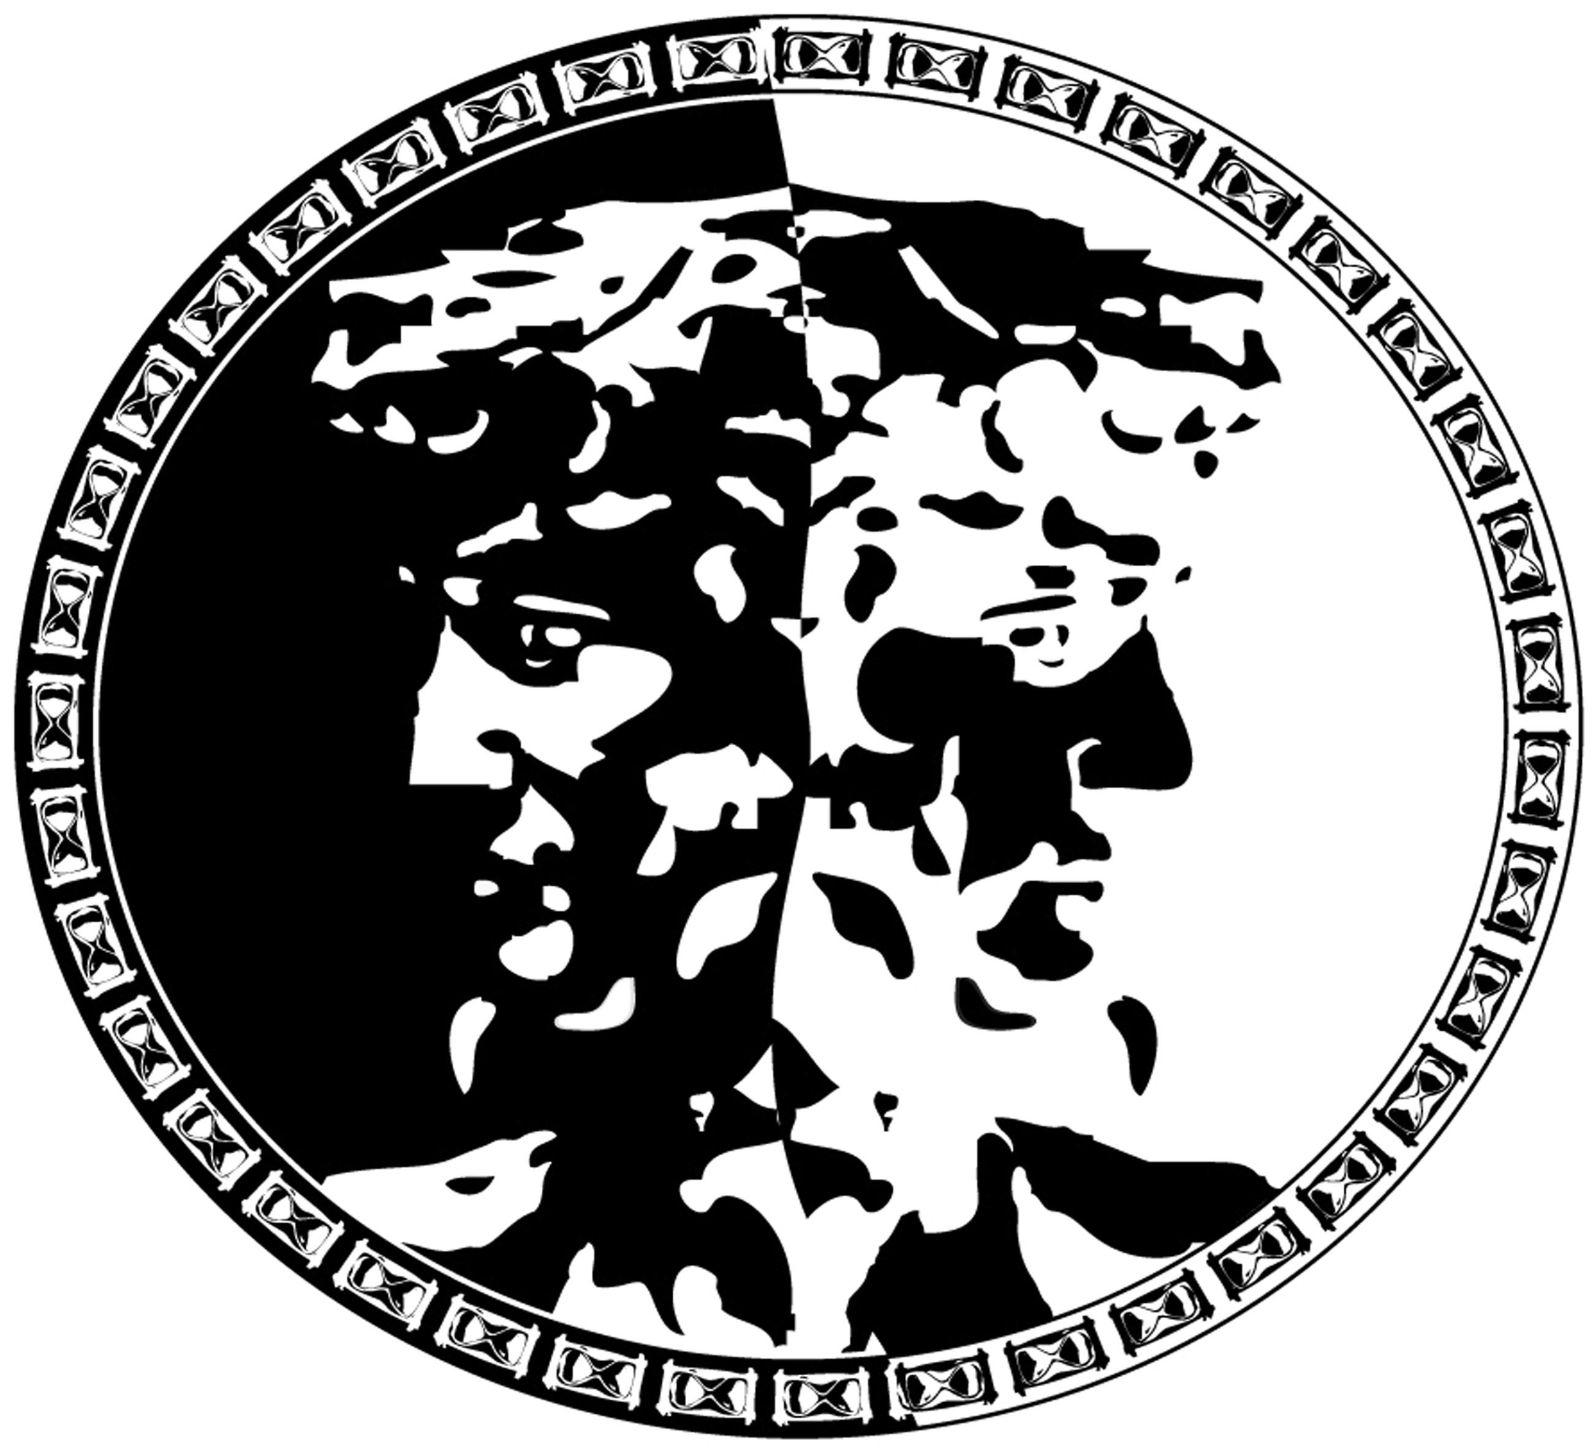
Figure 1. Janus was the Roman god of gateways, transitions, and time, and is usually depicted as having two, ...
Notes:
Figure 1. Janus was the Roman god of gateways, transitions, and time, and is usually depicted as having two, non-identical faces pointing in opposite directions, as above. Thus, figuratively (and in fact geometrically) the two faces of Janus are an apt representation for the two faces of gravity.
Unless provided in the caption above, the following copyright applies to the content of this slide: © The Author 2015. Published by Oxford University Press on behalf of British Society for the Philosophy of Science. All rights reserved. For Permissions, please email: journals.permissions@oup.com

