Slide 1
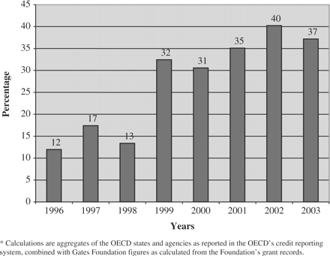
Figure 1. Funding for communicable disease control as a percentage of total donor spending on health and population*
Notes:
Figure 1. Funding for communicable disease control as a percentage of total donor spending on health and population*
Unless provided in the caption above, the following copyright applies to the content of this slide: © The Author 2006. Published by Oxford University Press in association with The London School of Hygiene and Tropical Medicine. All rights reserved.

Slide 2
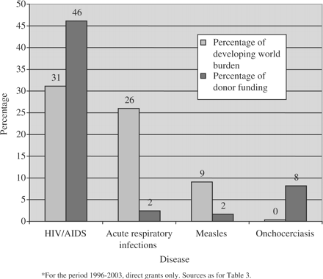
Figure 2. Percentage of developing world burden and percentage of donor funding for selected communicable diseases*
Notes:
Figure 2. Percentage of developing world burden and percentage of donor funding for selected communicable diseases*
Unless provided in the caption above, the following copyright applies to the content of this slide: © The Author 2006. Published by Oxford University Press in association with The London School of Hygiene and Tropical Medicine. All rights reserved.

Slide 3
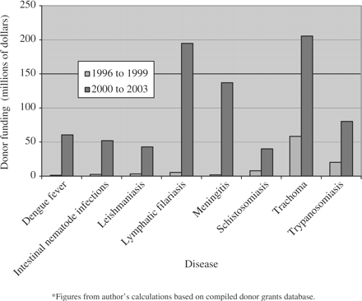
Figure 3. Donor funding in direct grants across two time periods for selected diseases*
Notes:
Figure 3. Donor funding in direct grants across two time periods for selected diseases*
Unless provided in the caption above, the following copyright applies to the content of this slide: © The Author 2006. Published by Oxford University Press in association with The London School of Hygiene and Tropical Medicine. All rights reserved.

Slide 4
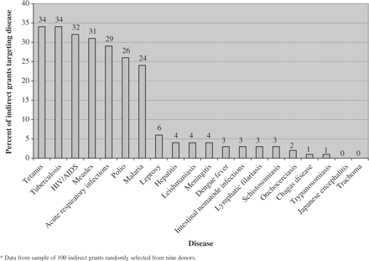
Figure 4. Percentage of indirect grants targeting diseases*
Notes:
Figure 4. Percentage of indirect grants targeting diseases*
Unless provided in the caption above, the following copyright applies to the content of this slide: © The Author 2006. Published by Oxford University Press in association with The London School of Hygiene and Tropical Medicine. All rights reserved.

