Slide 1
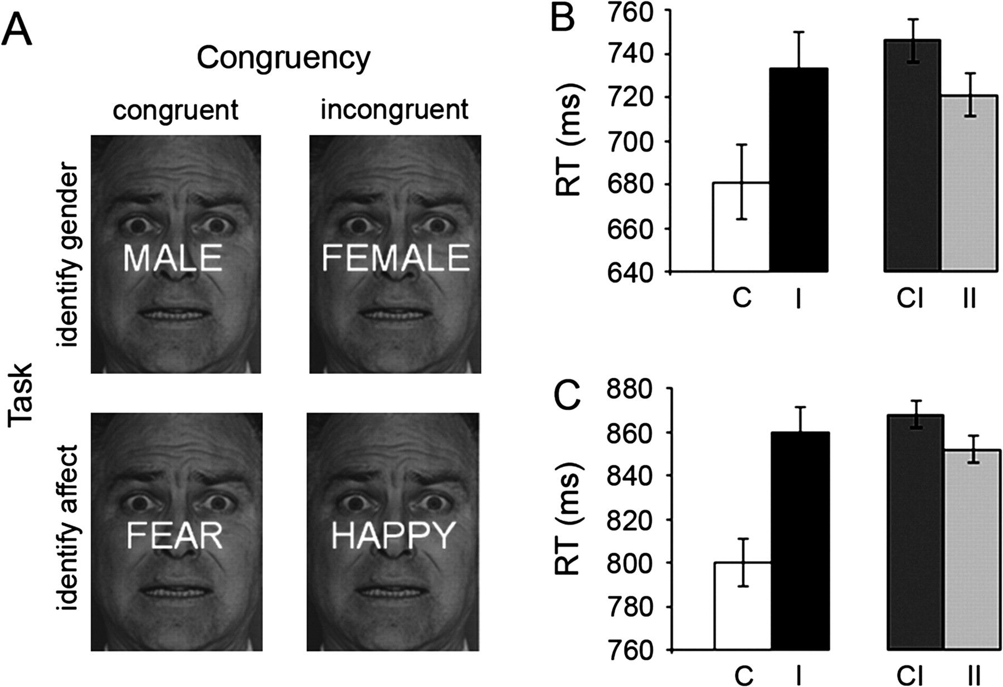
Figure 1. Experimental protocol and behavioral results. (A) The experimental design varied task (“nonemotional”: the ...
Notes:
Figure 1. Experimental protocol and behavioral results. (A) The experimental design varied task (“nonemotional”: the identification of the gender of the faces, “emotional”: the identification of facial affect) and stimulus congruency (semantically congruent or incongruent distracter words), while keeping face stimuli identical. (B, C) Left panels: mean RTs (±standard error of the mean [SEM]) for congruent (C) and incongruent (I) trials. Right panels: mean RTs (±SEM) for incongruent trials, split up by whether the trials were preceded by a congruent trial (CI = low conflict resolution) or by an incongruent trial (II = high conflict resolution), plotted for (B) the nonemotional task and (C) the emotional task.
Unless provided in the caption above, the following copyright applies to the content of this slide: © The Author 2007. Published by Oxford University Press. All rights reserved. For permissions, please e-mail: journals.permissions@oxfordjournals.org

Slide 2
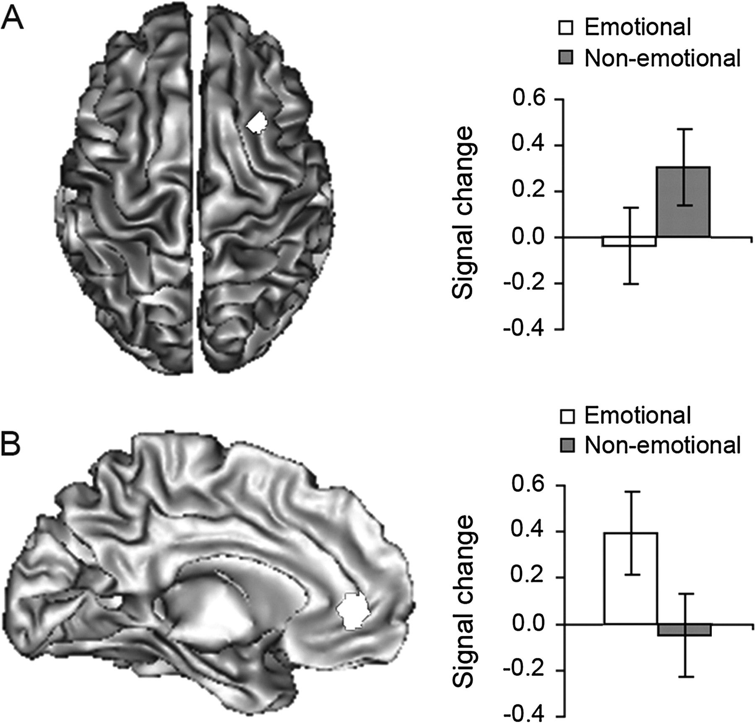
Figure 2. Effects of conflict resolution. (A) Left panel: an activation overlay for activity associated with conflict ...
Notes:
Figure 2. Effects of conflict resolution. (A) Left panel: an activation overlay for activity associated with conflict resolution (high conflict resolution [II] trials minus low conflict resolution [CI] trials) during the nonemotional task in the right LPFC (MNI x 38, y 16, z 54; 39 voxels) is displayed on the dorsal cerebral surface (left is left), at P 20 voxels. Right panel: mean cluster signal changes (beta ± SEM) associated with conflict resolution (high conflict resolution minus low conflict resolution trials) are plotted as a function of task. The right LPFC was exclusively activated during conflict resolution in the nonemotional task. (B) Left panel: an activation overlay for activity associated with conflict resolution (high conflict resolution [II] trials minus low conflict resolution [CI] trials) during the emotional task in the rACC (MNI x −12, y 44, z −2; 81 voxels) is displayed on the medial surface of the left hemisphere, at P 20 voxels. Right panel: mean cluster signal changes (beta ± SEM) associated with conflict resolution (high conflict resolution minus low conflict resolution trials) are plotted as a function of task. The rACC was exclusively activated during conflict resolution in the emotional task.
Unless provided in the caption above, the following copyright applies to the content of this slide: © The Author 2007. Published by Oxford University Press. All rights reserved. For permissions, please e-mail: journals.permissions@oxfordjournals.org

Slide 3
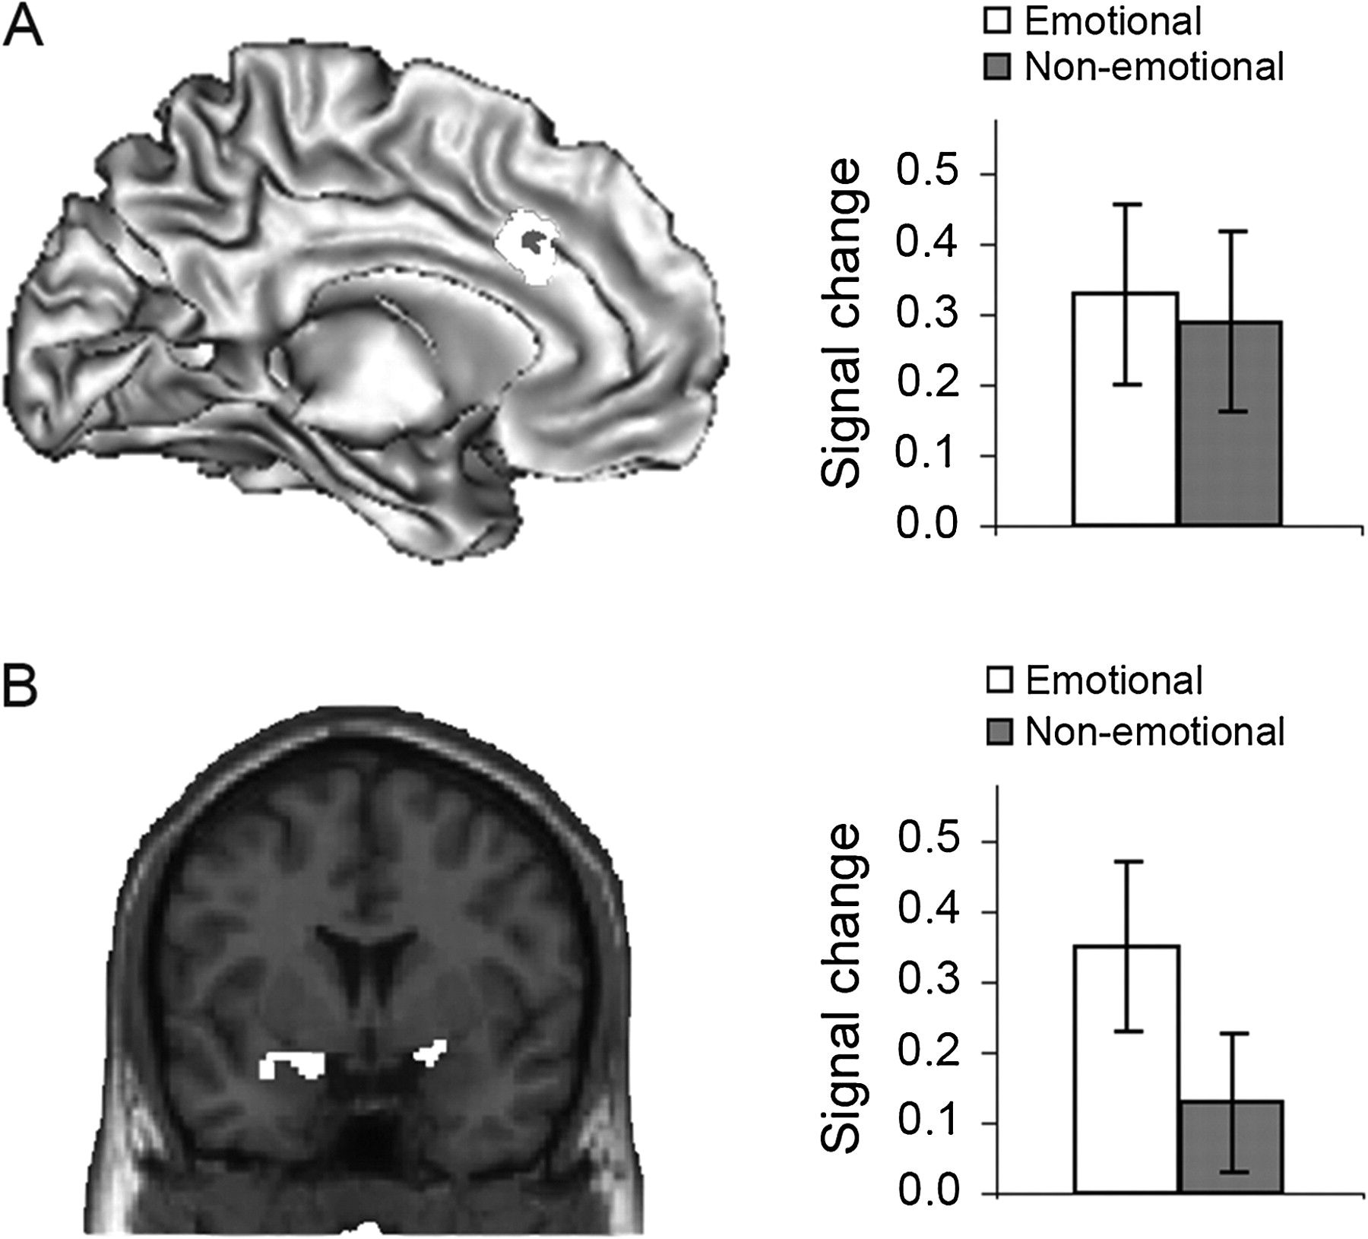
Figure 3. Effects of conflict generation/conflict monitoring. (A) Left panel: activation overlays for nonemotional and ...
Notes:
Figure 3. Effects of conflict generation/conflict monitoring. (A) Left panel: activation overlays for nonemotional and emotional conflict-related activity (low conflict resolution [CI] trials minus high conflict resolution [II] trials) are displayed on the medial surface of the left hemisphere, at P 20 voxels. The left dACC was susceptible to conflict in both the emotional task (white cluster, MNI x 12, y 28, z 24; 288 voxels) and the nonemotional task (gray cluster, MNI x −6, y 12, z 40; 25 voxels). Right panel: mean cluster signal changes (beta ± SEM) associated with conflict processing (low conflict resolution minus high conflict resolution trials) are plotted as a function of task. (B) Left panel: an activation overlay for conflict-related activity during the emotional task in the amygdala (left: MNI x −14, y, 4, z, −16; 81 voxels; right: MNI x 20, y 0, z −10; 56 voxels) is displayed on a rostral brain slice (left is left), at P 10 voxels. Right panel: mean cluster signal changes (beta ± SEM) associated with conflict processing (low conflict resolution minus high conflict resolution trials) are plotted as a function of task.
Unless provided in the caption above, the following copyright applies to the content of this slide: © The Author 2007. Published by Oxford University Press. All rights reserved. For permissions, please e-mail: journals.permissions@oxfordjournals.org

Slide 4
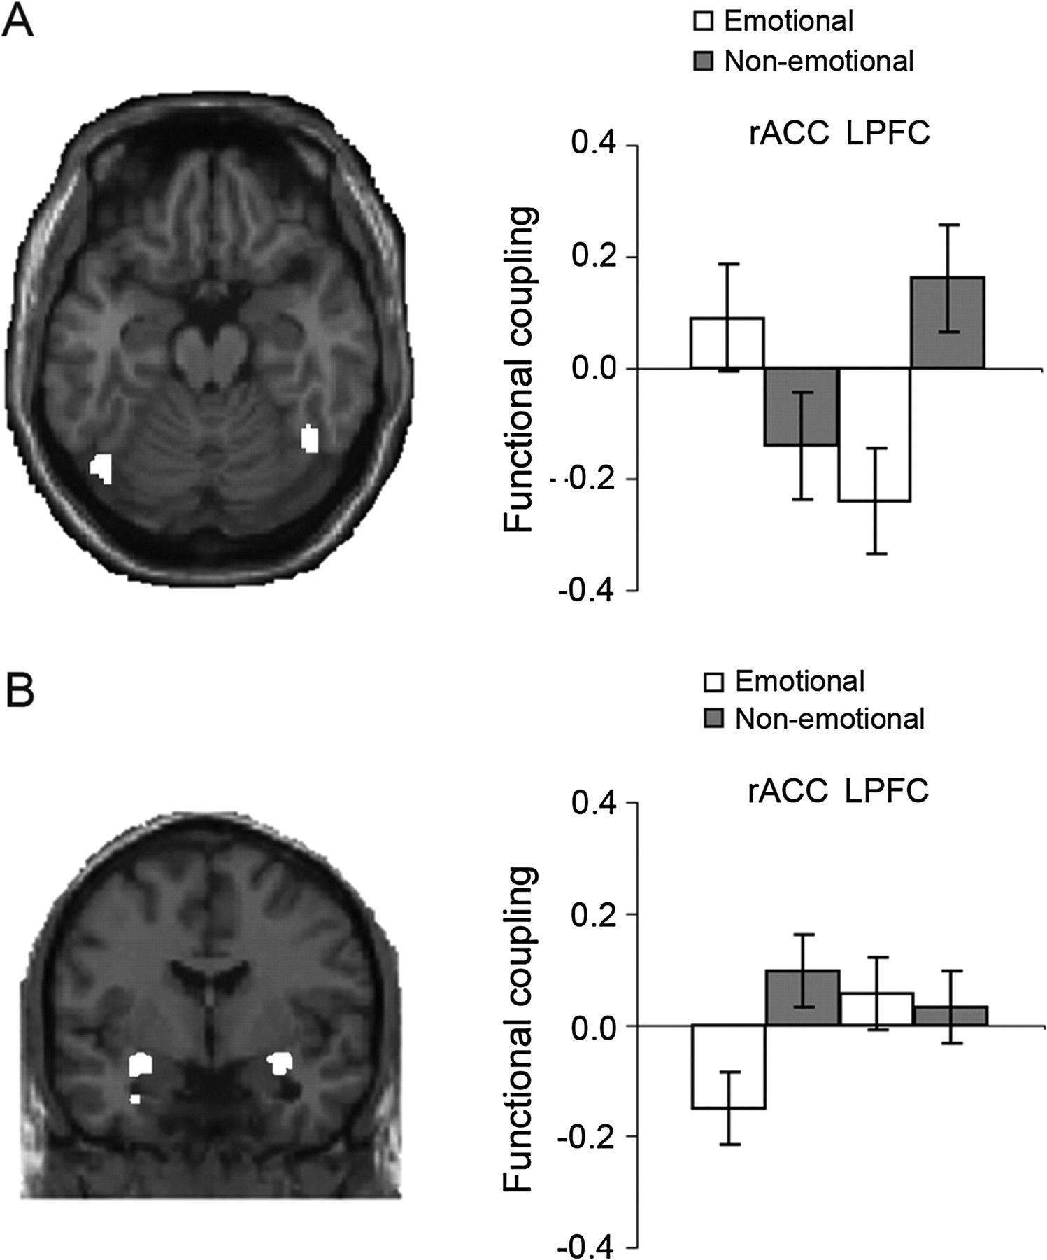
Figure 4. Functional connectivity of conflict resolution. (A) Left panel: an activation overlay of voxels in the FFA ...
Notes:
Figure 4. Functional connectivity of conflict resolution. (A) Left panel: an activation overlay of voxels in the FFA (left: MNI x −46, y −70, z −20; 64 voxels; right: MNI x 46, y −52, z −24; 42 voxels) that covary positively with LPFC activity during the resolution of nonemotional conflict is displayed on an axial brain slice (left is left), at P 10 voxels. Right panel: mean cluster functional coupling (beta ± SEM) during conflict resolution is plotted as a function of task (emotional vs. nonemotional) and source region (rACC vs. LPFC). (B) Left panel: an activation overlay of voxels in the amygdala (left: MNI x −30, y −6, z −14; 78 voxels; right: MNI x 32, y 0, z −12; 71 voxels) that covary negatively with rACC activity during the resolution of emotional conflict is displayed on a rostral brain slice (left is left), at P 10 voxels. Right panel: mean cluster functional coupling (beta ± SEM) during conflict resolution is plotted as a function of task (emotional vs. nonemotional) and source region (rACC vs. LPFC).
Unless provided in the caption above, the following copyright applies to the content of this slide: © The Author 2007. Published by Oxford University Press. All rights reserved. For permissions, please e-mail: journals.permissions@oxfordjournals.org

