Slide 1
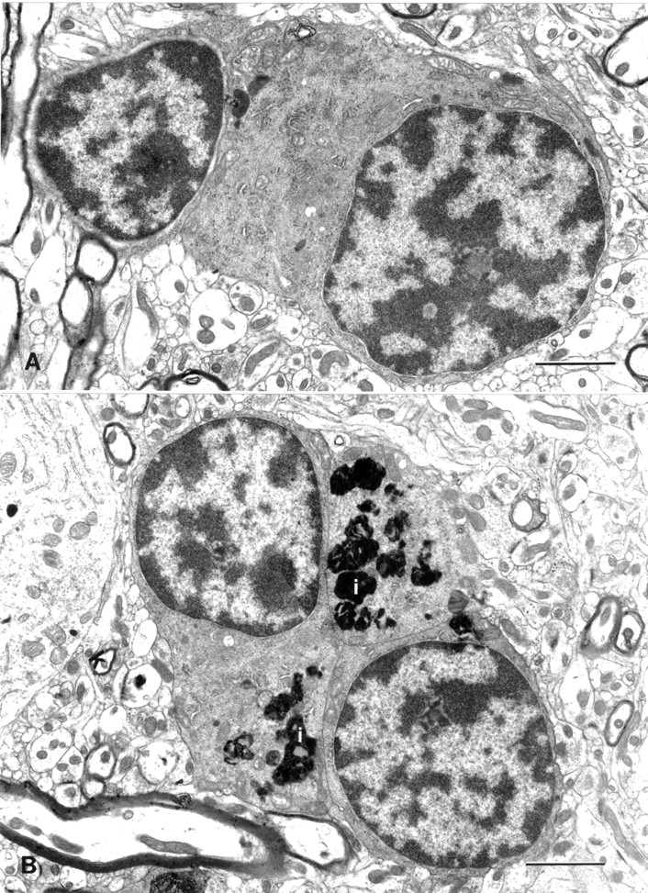
Figure 1. Electron micrographs of oligodendrocytes in layer 4C of monkey primary visual cortex. (A) Two ...
Notes:
Figure 1. Electron micrographs of oligodendrocytes in layer 4C of monkey primary visual cortex. (A) Two oligodendrocytes from a young (5-year-old) monkey; AM 16. (B) A group of three oligodendrocytes from an old (28-year-old) monkey; AM 15. Note the dense inclusion bodies (i) in the cytoplasm. Scale bars = 2 µm.
Unless provided in the caption above, the following copyright applies to the content of this slide:

Slide 2
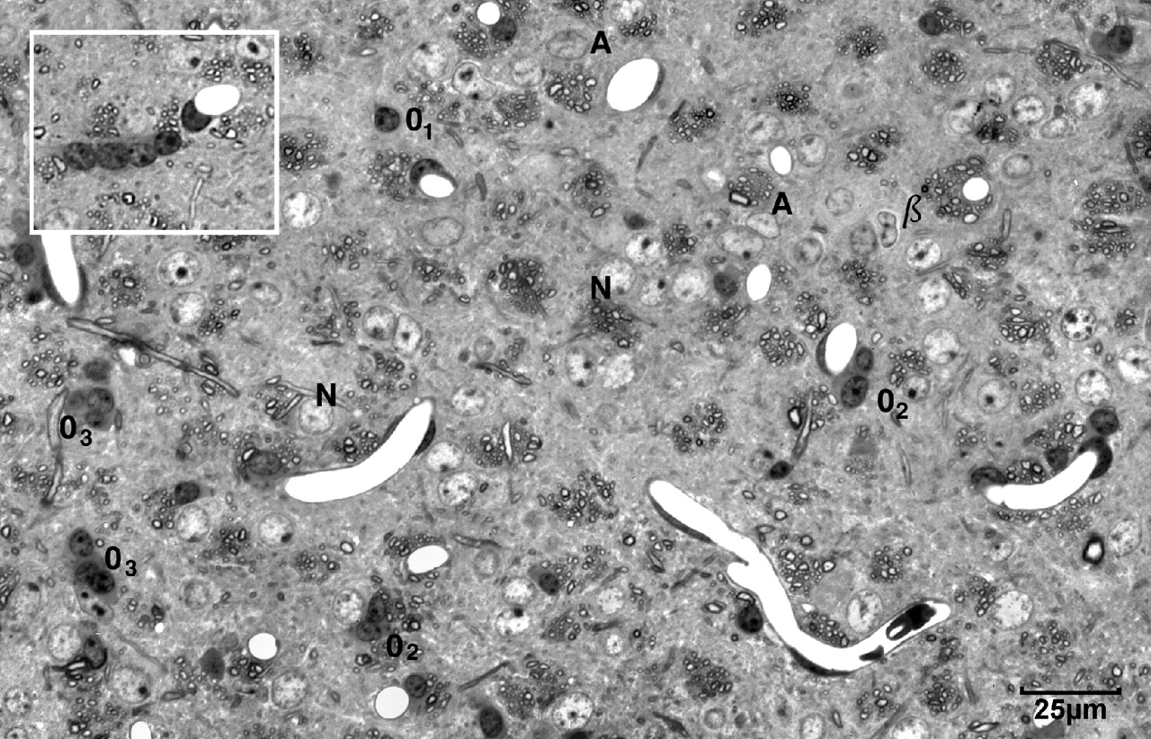
Figure 2. Light micrograph of a semi-thick horizontal section through layer 4Cβ of a 29-year-old monkey to ...
Notes:
Figure 2. Light micrograph of a semi-thick horizontal section through layer 4Cβ of a 29-year-old monkey to show the distinctions between the appearances of the various types of cells. Oligodendrocytes have dark rounded nuclei and they may occur singly (O), in pairs (O2) or in groups of three (O3). Astrocytes (A) have pale nuclei that are not as large and round as those of neurons (N). Note the bean shaped nucleus of a β astrocyte (β). The insert shows a row of four oligodendrocytes in a 27-year-old monkey. Scale bar = 25 µm.
Unless provided in the caption above, the following copyright applies to the content of this slide:

Slide 3
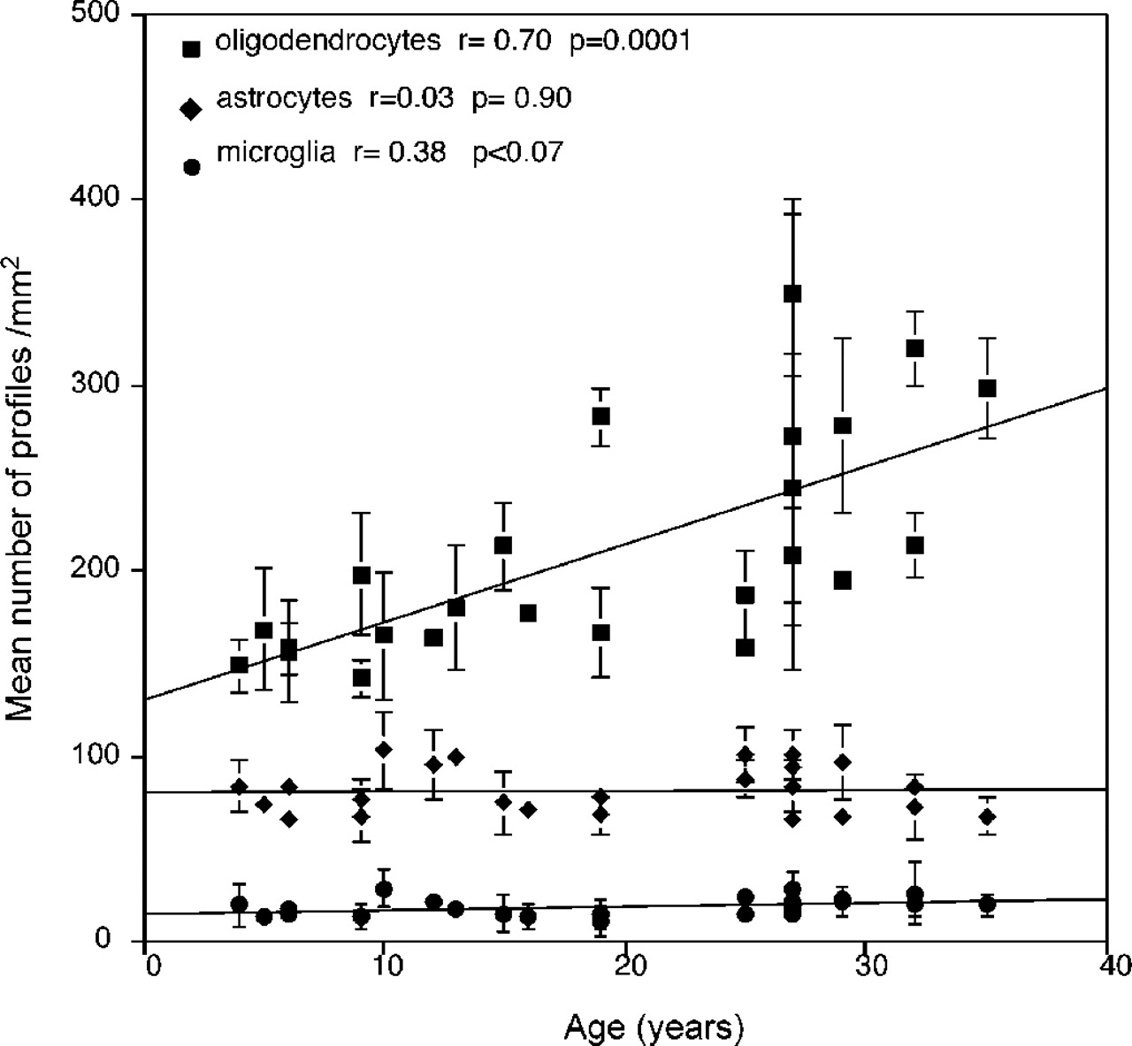
Figure 3. Plot of mean numbers of profiles of oligodendrocytes, astrocytes and microglial cell profiles that ...
Notes:
Figure 3. Plot of mean numbers of profiles of oligodendrocytes, astrocytes and microglial cell profiles that display nuclei, per mm2 of semi-thick, horizontal semi-thick sections through layer 4Cβ of area 17 versus age.
Unless provided in the caption above, the following copyright applies to the content of this slide:

Slide 4
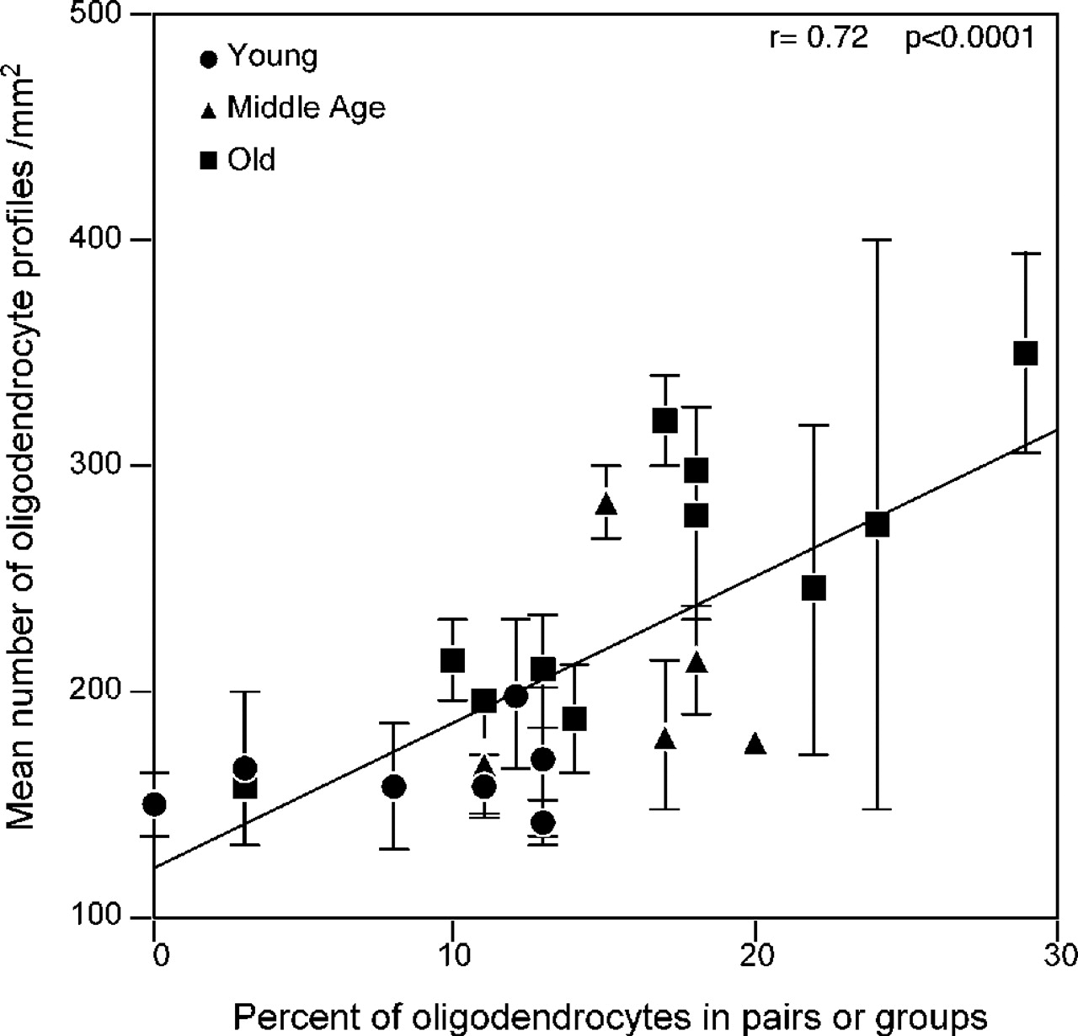
Figure 4. Plot of the percentage of oligodendrocyte profiles that occur in pairs, groups and rows versus the ...
Notes:
Figure 4. Plot of the percentage of oligodendrocyte profiles that occur in pairs, groups and rows versus the mean number of oligodendrocyte profiles per mm2. Based on semi-thick, horizontal sections through layer 4Cβ of area 17.
Unless provided in the caption above, the following copyright applies to the content of this slide:

Slide 5
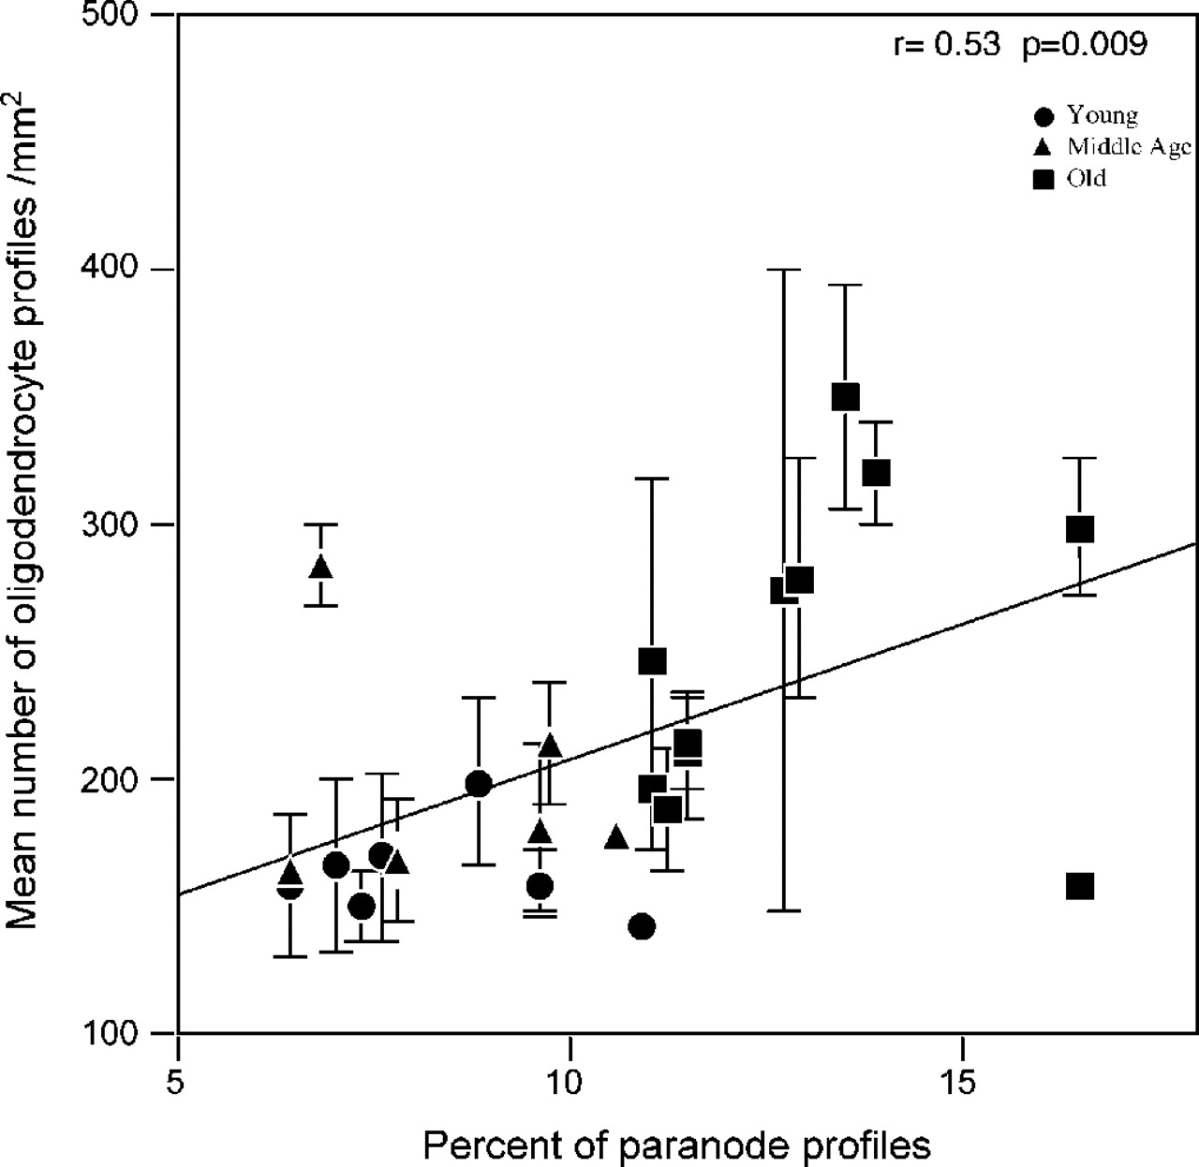
Figure 5. A plot of the percentage of paranodal profiles in transverse thin sections through the myelinated ...
Notes:
Figure 5. A plot of the percentage of paranodal profiles in transverse thin sections through the myelinated nerve fiber bundles in layer 4Cβ versus the mean number, per mm2, of oligodendroglial profiles that display nuclei.
Unless provided in the caption above, the following copyright applies to the content of this slide:

Slide 6
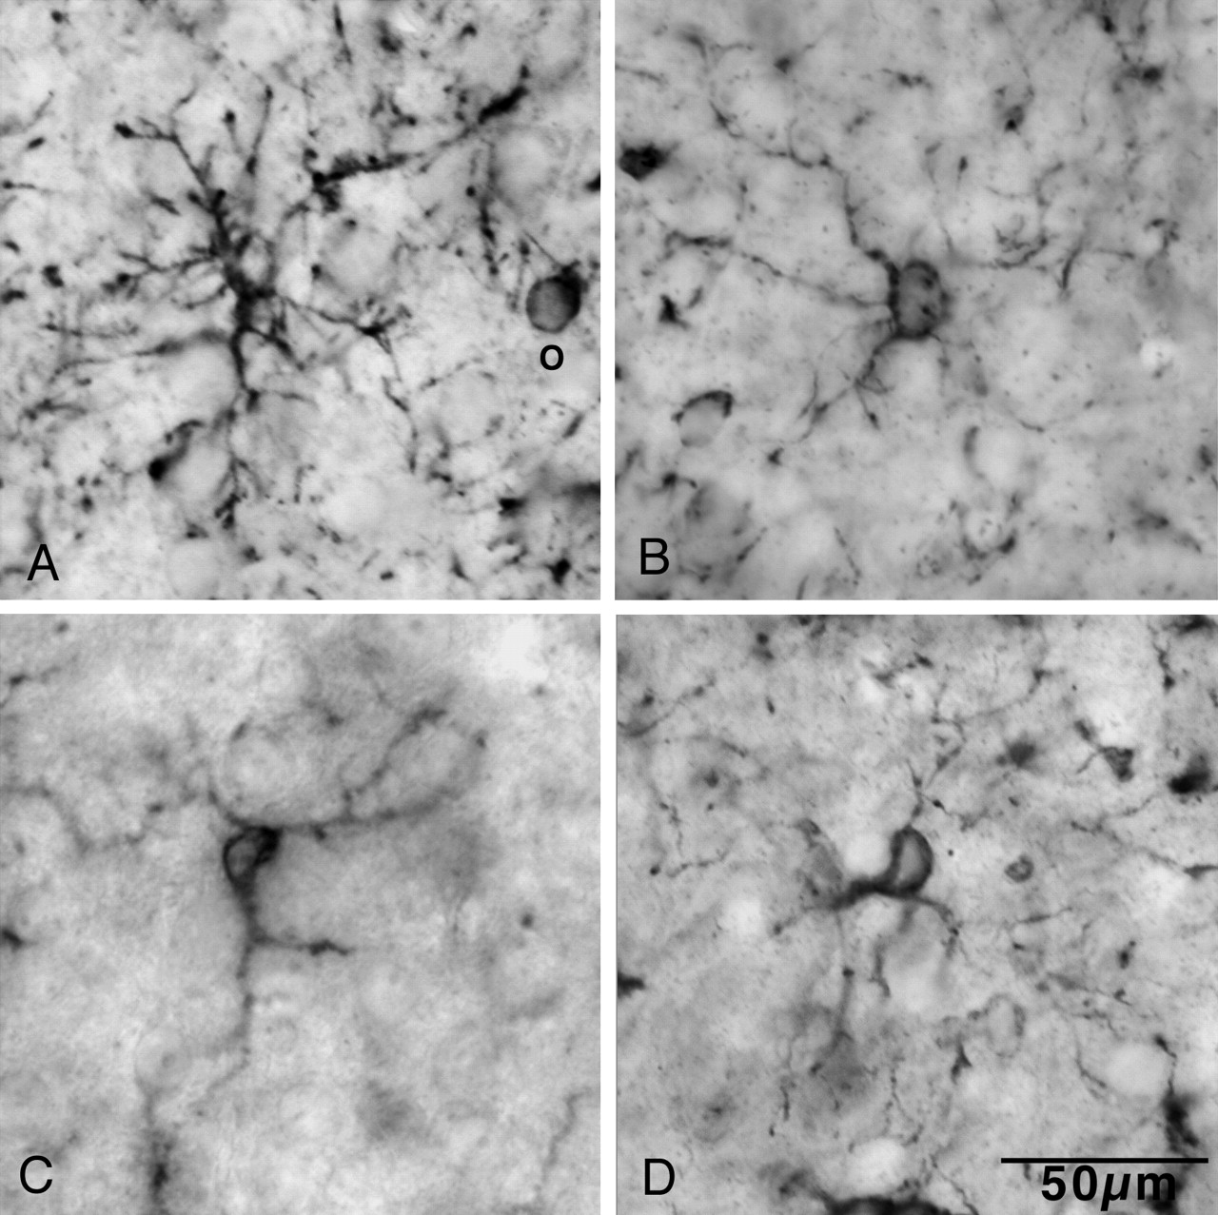
Figure 6. Light micrographs of cells labeled by an antibody to NG2. (A) This cell has many processes that ...
Notes:
Figure 6. Light micrographs of cells labeled by an antibody to NG2. (A) This cell has many processes that radiate from the cell body, branch and have short extensions passing into the surrounding neuropil. Note the labeled oligodendrocyte (O). (B) This cell has thin, irregular processes with thin extensions. (C) A cell with few processes. Its cell body is elongate and the nucleus is seen as a pale oval in the middle of the cell body. (D) This cell also has an oval cell body that shows the pale nucleus. Thin processes extend from both poles of the cell body. Scale bar = 50 µm.
Unless provided in the caption above, the following copyright applies to the content of this slide:

Slide 7
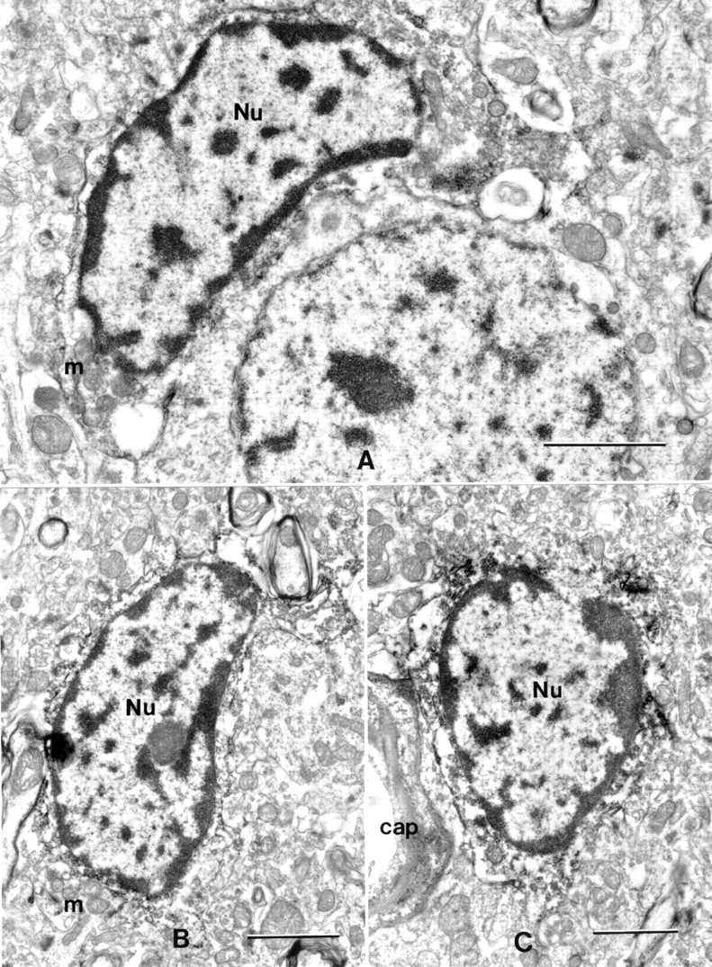
Figure 7. Electron micrographs of cells labeled by the NG2 antibody. The silver intensified DAB reaction ...
Notes:
Figure 7. Electron micrographs of cells labeled by the NG2 antibody. The silver intensified DAB reaction product appears as dark granules on the surface and in the cytoplasm. All of the cells have bean-shaped or oval nuclei (Nu) in which there is a layer of heterochromatin beneath the nuclear envelope and patches of heterochromatin throughout the nucleoplasm. The nuclei have rather irregular outlines and much of the cytoplasm is disrupted. However, it can be seen that the mitochondria (m) are stubby and that the cisternae of rough ER are short. The cell in (A) is next to a neuron and the cell in (C) is adjacent to a capillary (cap). Scale bars = 2 µm.
Unless provided in the caption above, the following copyright applies to the content of this slide:

Slide 8
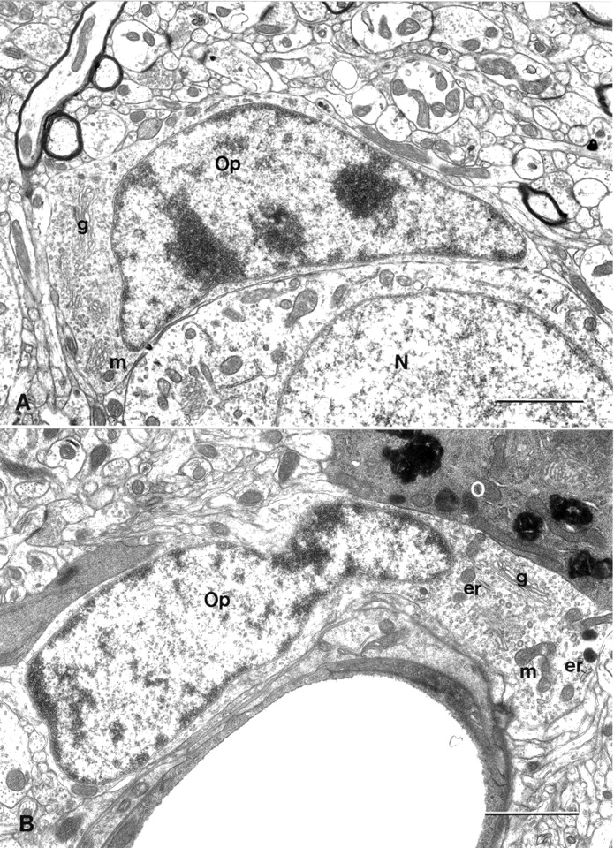
Figure 8. (A) This progenitor cell is from a 5-year-old monkey (AM 16) and is lying adjacent to a neuron (N). ...
Notes:
Figure 8. (A) This progenitor cell is from a 5-year-old monkey (AM 16) and is lying adjacent to a neuron (N). Like the NG2-labeled cells, this cell has a nucleus with an irregular outline and heterochromatin lying both beneath the nuclear envelope and dispersed throughout the nucleus. The cell has a somewhat irregular shape. The mitochondria (m) are small and stubby and the Golgi apparatus (g) is well developed. (B) An oligodendroglial progenitor (Op) from a 25-year-old monkey (AM 17) lying adjacent to a capillary. The cell has an irregular nucleus with heterochromatin beneath the nuclear envelope. Only a thin trim of pale cytoplasm surrounds the nucleus, but there is abundant cytoplasm at one pole of the cell, which shows the small stubby mitochondria (m), part of the Golgi apparatus (g), short cisternae of rough endoplasmic reticulum (er) and polyribosomes. Note the contrasting dark cytoplasm of the adjacent oligodendrocyte (O). Scale bars = 2 µm.
Unless provided in the caption above, the following copyright applies to the content of this slide:

Slide 9
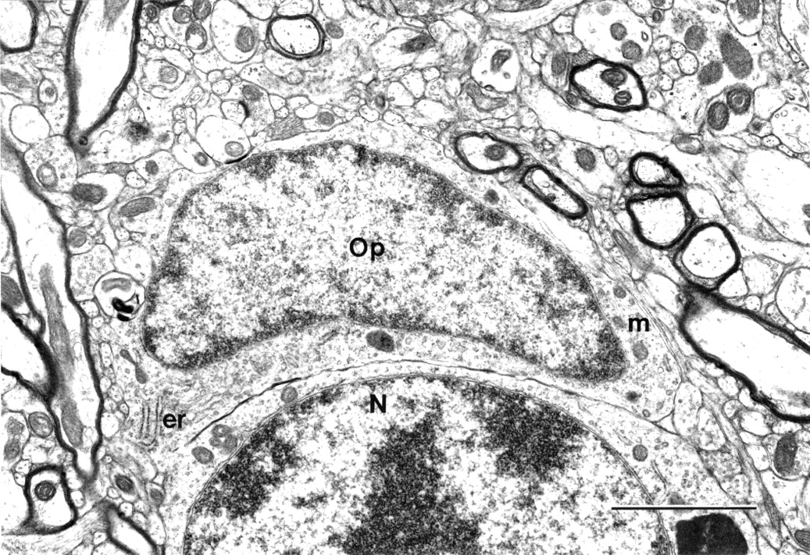
Figure 9. An oligodendroglial progenitor cell (Op) from a 35-year-old monkey (AM 13). The cell is lying ...
Notes:
Figure 9. An oligodendroglial progenitor cell (Op) from a 35-year-old monkey (AM 13). The cell is lying adjacent to a neuron (N). The nucleus has a rim of heterochromatin beneath the irregular nuclear envelope and dark patches of chromatin throughout the nucleus. The cell has a somewhat irregular outline and the thin rim of cytoplasm contains a few short cisternae of rough endoplasmic reticulum (er) and small mitochondria (m). Scale bar = 2 µm.
Unless provided in the caption above, the following copyright applies to the content of this slide:

