Slide 1
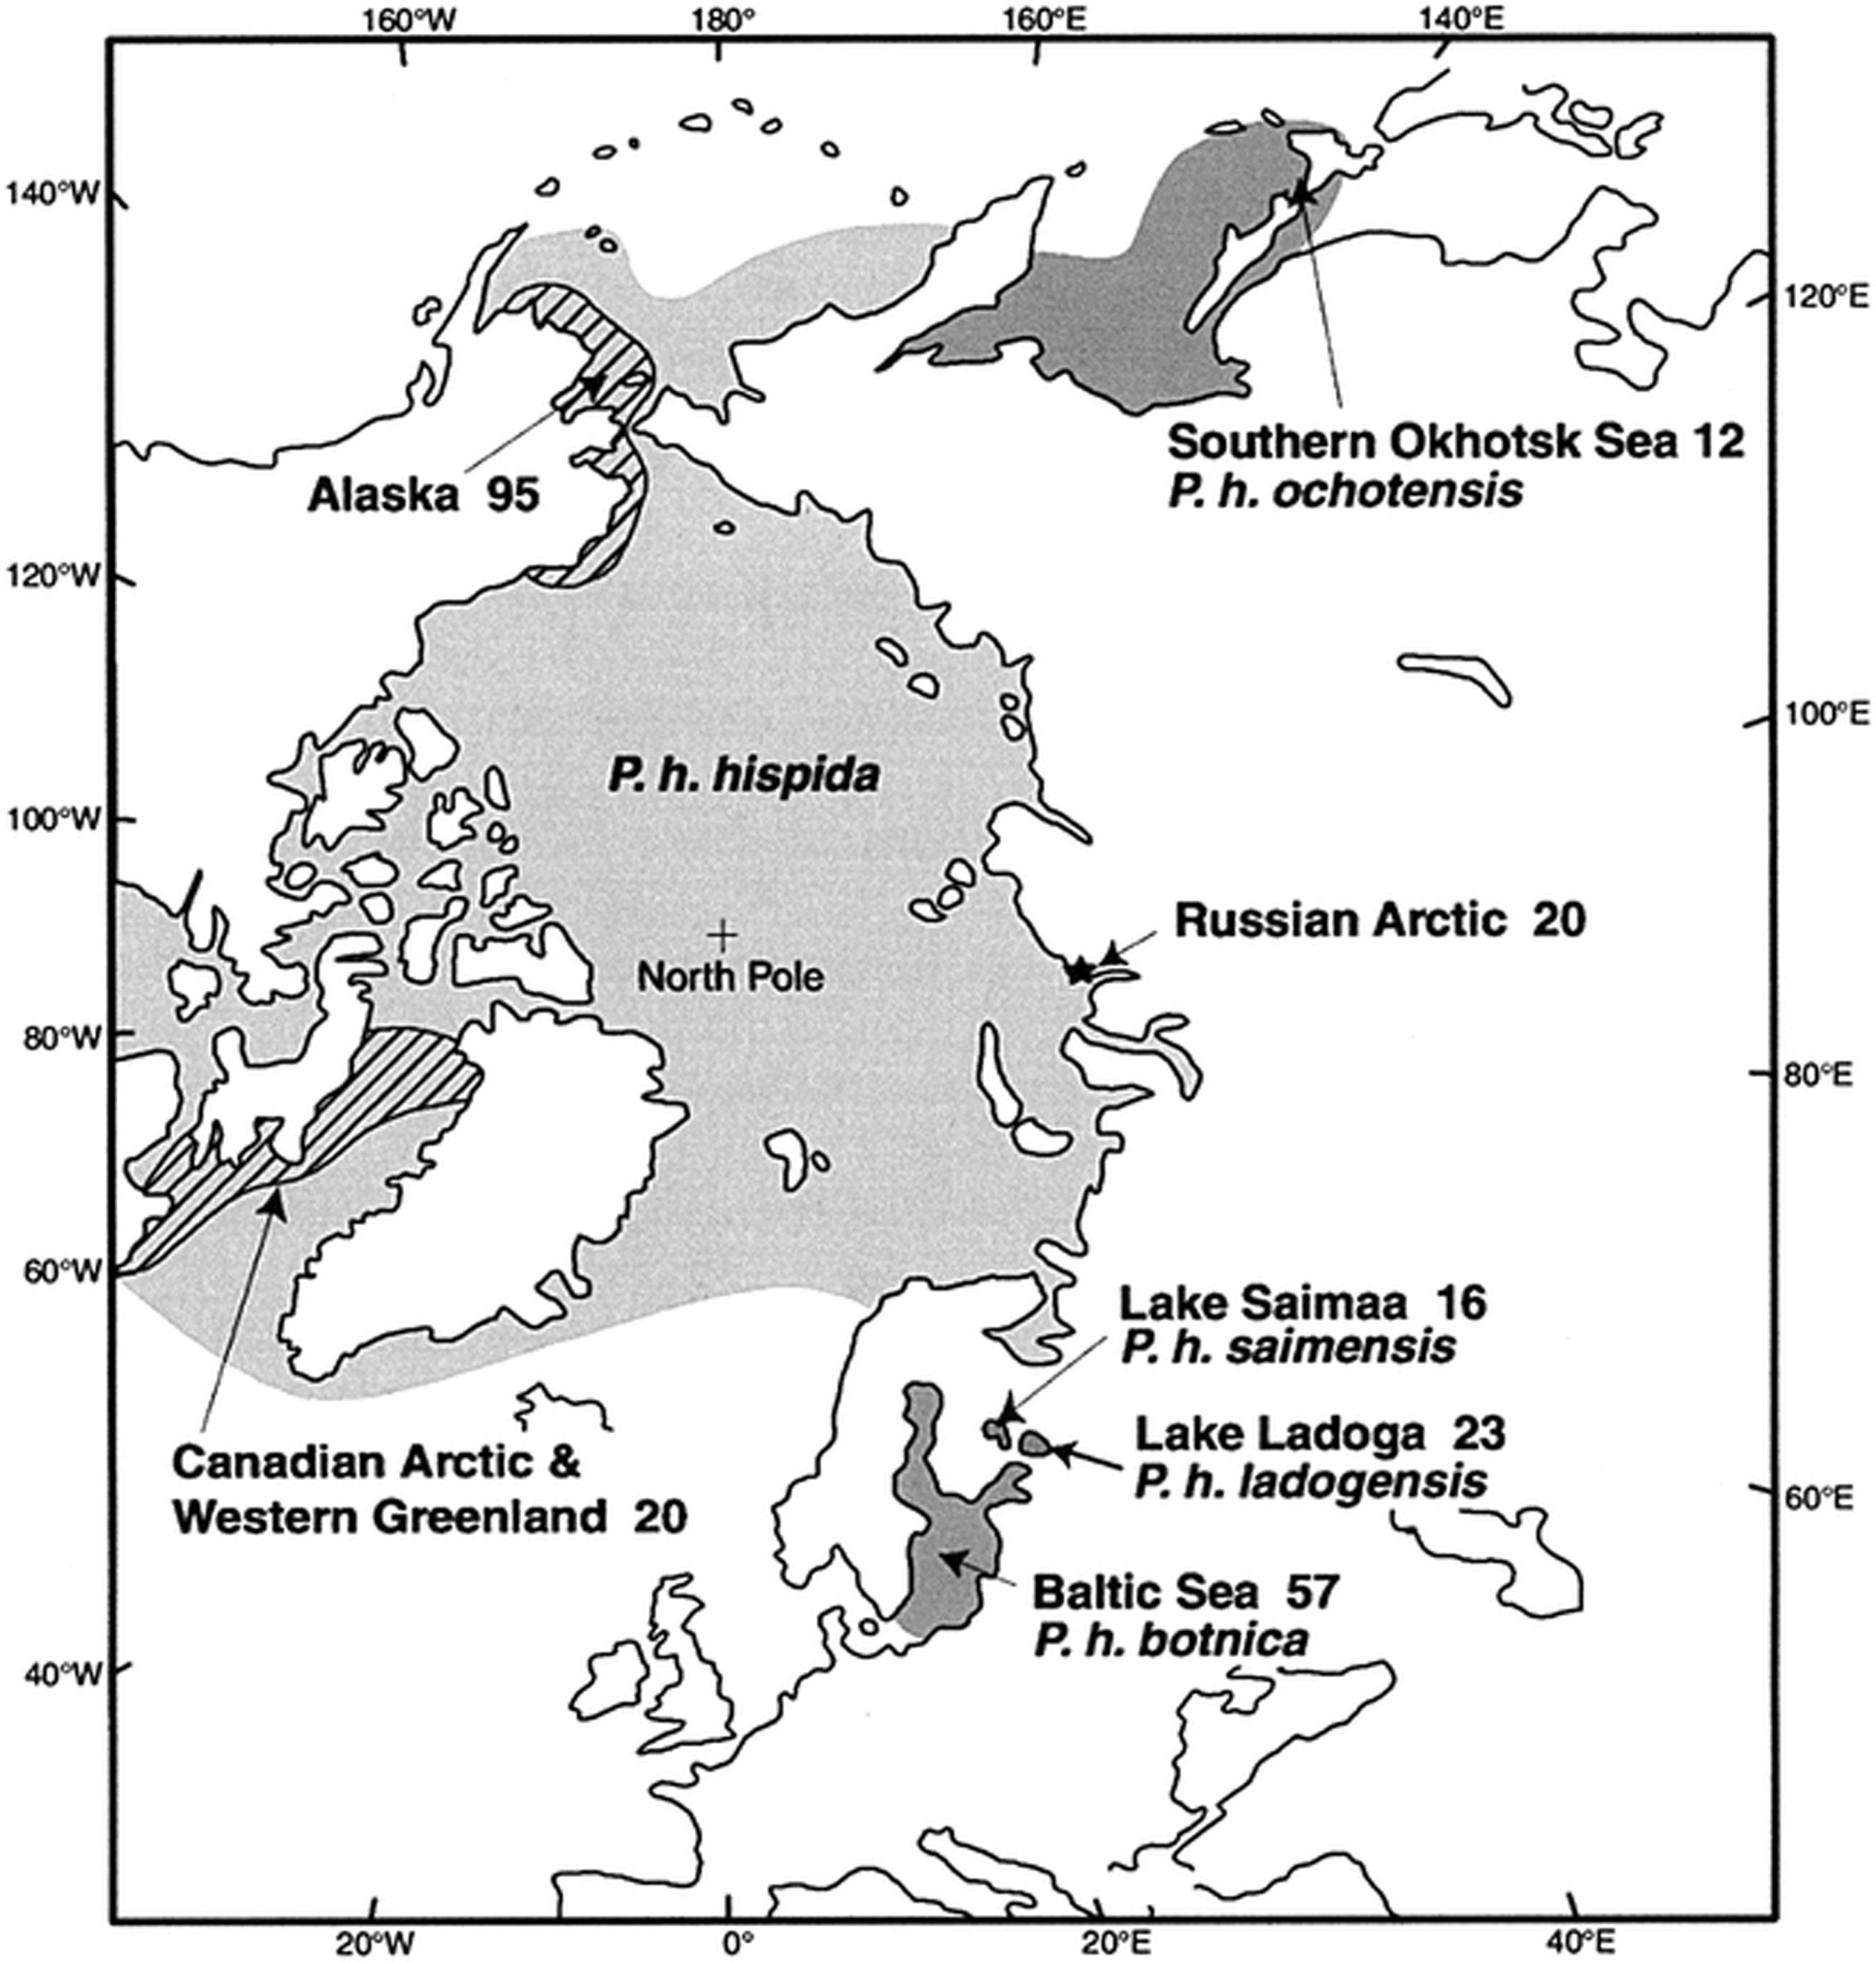
Fig. 1. Polar view showing geographic ranges of P. hispida subspecies, and localities and numbers of the specimens ...
Notes:
Fig. 1. Polar view showing geographic ranges of P. hispida subspecies, and localities and numbers of the specimens used in the present study. Localities of Alaskan and Canadian Arctic specimens are indicated by the hatched area, and Dikson, where Russian Arctic sample was obtained, is indicated by a star
Unless provided in the caption above, the following copyright applies to the content of this slide: American Society of Mammalogists

Slide 2
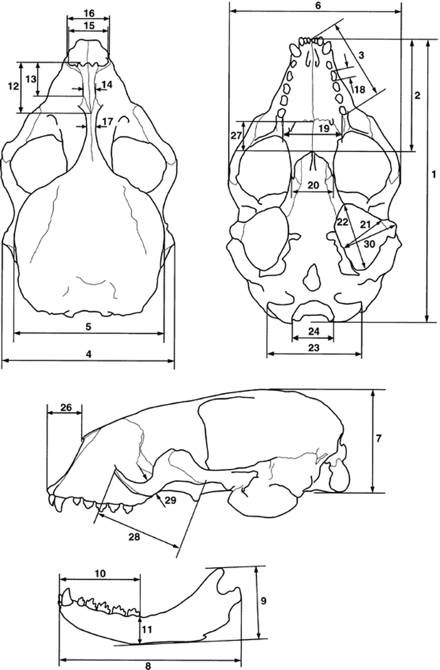
Fig. 2. Skull measurements of P. hispida. Numbers refer to characters listed in Appendix II
Notes:
Fig. 2. Skull measurements of P. hispida. Numbers refer to characters listed in Appendix II
Unless provided in the caption above, the following copyright applies to the content of this slide: American Society of Mammalogists

Slide 3
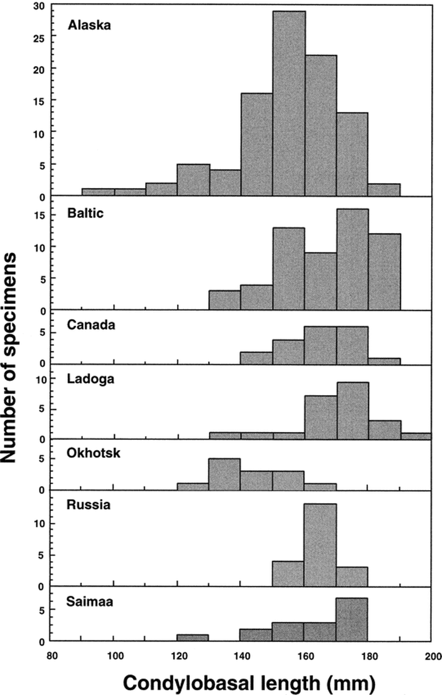
Fig. 3. Frequency distribution of the condylobasal lengths of P. hispida specimens from different localities
Notes:
Fig. 3. Frequency distribution of the condylobasal lengths of P. hispida specimens from different localities
Unless provided in the caption above, the following copyright applies to the content of this slide: American Society of Mammalogists

Slide 4
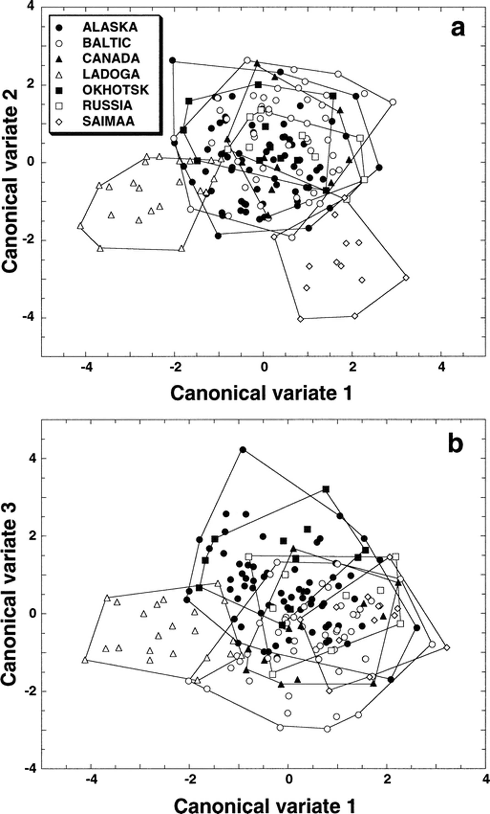
Fig. 4. Scatter plots of a) the 1st versus 2nd and b) the 1st versus 3rd canonical discriminant variates based on the ...
Notes:
Fig. 4. Scatter plots of a) the 1st versus 2nd and b) the 1st versus 3rd canonical discriminant variates based on the size-free multiple-group principal component scores for all specimens
Unless provided in the caption above, the following copyright applies to the content of this slide: American Society of Mammalogists

Slide 5
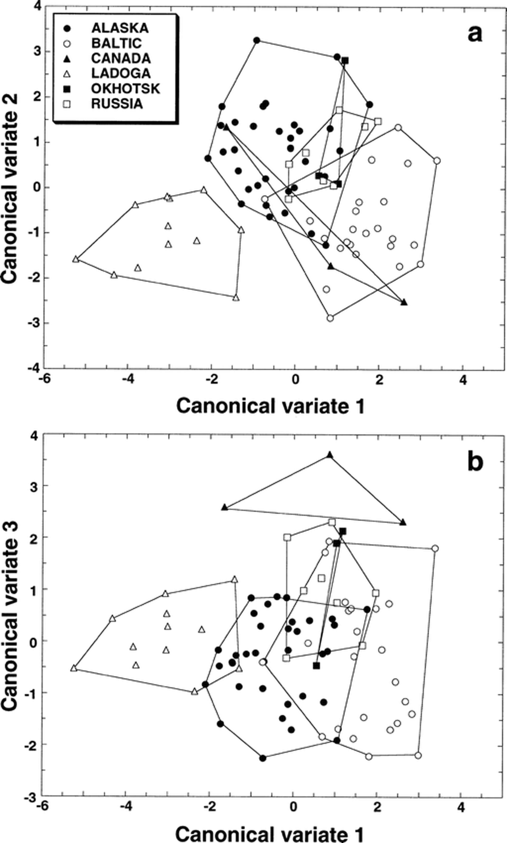
Fig. 5. Scatter plots of a) the 1st versus 2nd and b) the 1st versus 3rd canonical discriminant variates based on the ...
Notes:
Fig. 5. Scatter plots of a) the 1st versus 2nd and b) the 1st versus 3rd canonical discriminant variates based on the size-free multiple-group principal component scores for male specimens
Unless provided in the caption above, the following copyright applies to the content of this slide: American Society of Mammalogists

Slide 6
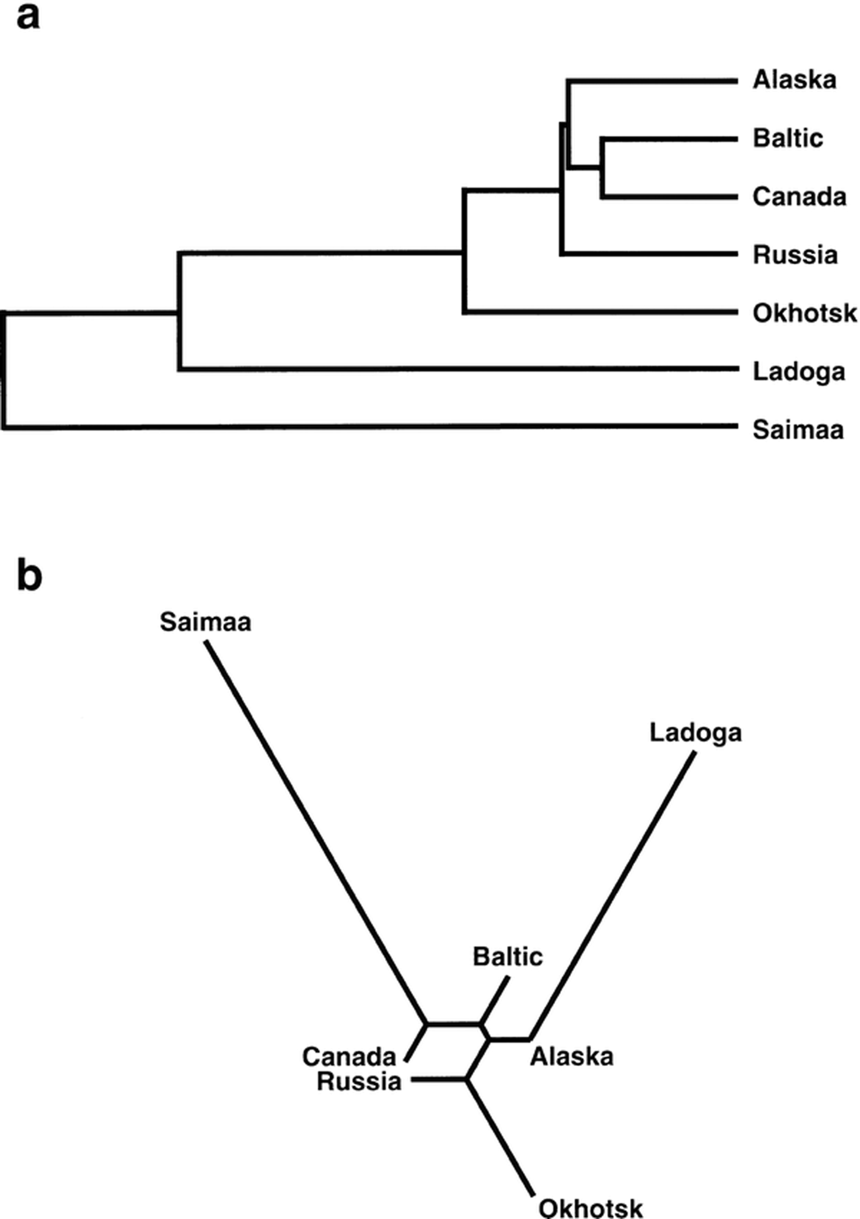
Fig. 6. a) UPGMA and b) neighbor-joining phenograms based on the Mahalanobis distances obtained from the size-free ...
Notes:
Fig. 6. a) UPGMA and b) neighbor-joining phenograms based on the Mahalanobis distances obtained from the size-free multiple-group principal component scores for all specimens
Unless provided in the caption above, the following copyright applies to the content of this slide: American Society of Mammalogists

