Slide 1
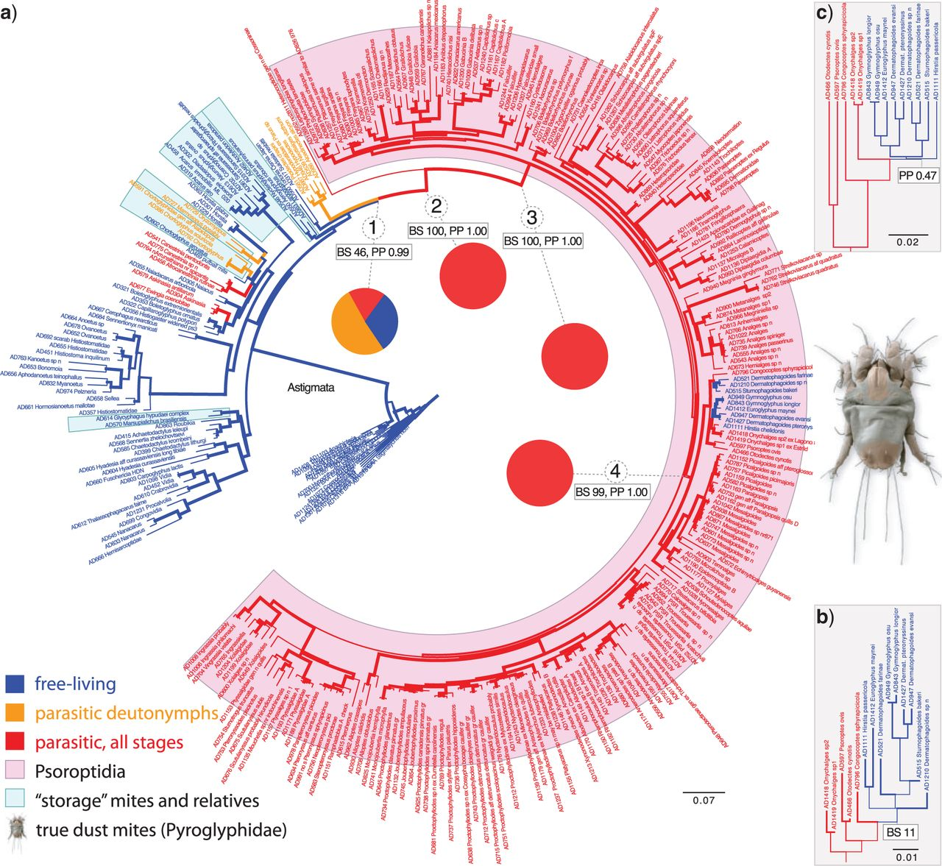
Figure 1 Phylogram of pyroglyphid house dust mites and outgroups inferred by ML analysis a) (315 taxa, 6164 sites, ...
Notes:
Figure 1 Phylogram of pyroglyphid house dust mites and outgroups inferred by ML analysis a) (315 taxa, 6164 sites, nuclear rDNA and protein-coding genes translated into amino acids). Four numbered key nodes leading to the dust mites are supplemented with bootstrap support values, posterior probabilities (BA), and pie charts showing results of ancestral character state reconstruction for ecology (parasitic and parasitic as deutonymphs vs. free-living) for these nodes (here values for Bayesian 1-rate Markov model are shown, see Table 2 for probabilities calculated using other methods). Node 1 = Hypoderatidae+Heterocoptidae+Psoroptidia; 2 = Heterocoptidae+Psoroptidia; 3 = Psoroptidia; 4 = EP complex. b) ML tree of HSP70 (315 taxa, 569 amino acids, part of tree shown). c) BEAST species tree analysis (46 taxa, 4146 nt, protein-coding genes only, part of tree shown). The inferences are uncertain if in the dust mites a free-living state evolved twice a) or once as suggested by the HSP70 topology b) or species tree topology inferred from protein-coding genes c). Both scenarios have low support. Scale bars represent expected changes per site. Bootstrap support or posterior probability of 70–100% is shown by proportionally increased line weight (see actual values and taxon names in Supplementary Figs. S3–S5).
Unless provided in the caption above, the following copyright applies to the content of this slide: © The Author(s) 2013. Published by Oxford University Press, on behalf of the Society of Systematic Biologists. All rights reserved. For Permissions, please email: journals.permissions@oup.com

Slide 2
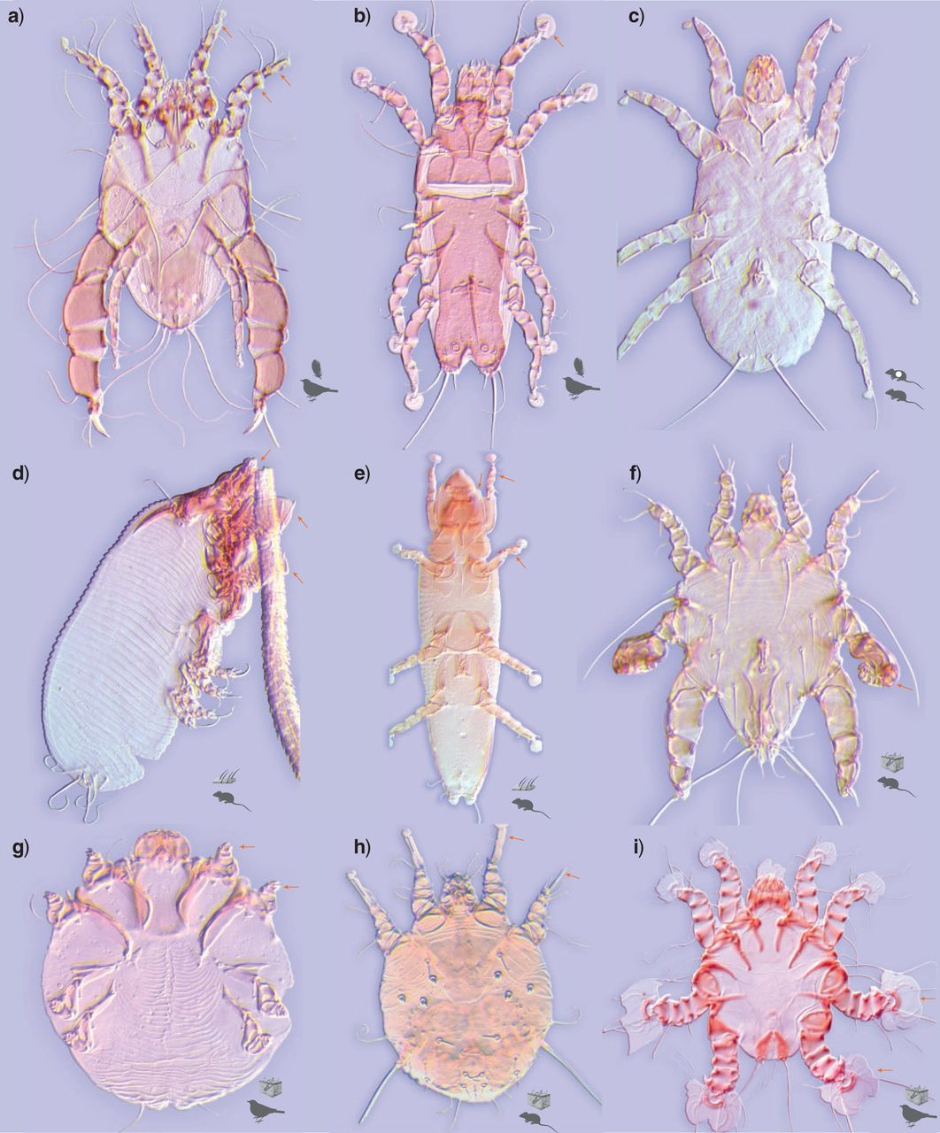
Figure 2 Specialization to parasitic life style in Psoroptidia. a) Analges sp.: anterior legs with apophyses, spines, ...
Notes:
Figure 2 Specialization to parasitic life style in Psoroptidia. a) Analges sp.: anterior legs with apophyses, spines, and modified setae (arrows) aiding in maneuvering among barbs of undertail covert feathers (museum voucher BMOC 05-1023-001), b) Amerodectes sp.: cylindrical body shape matching the mite restricted environment—spaces between barbs of primary feathers of the wing, the ambulacra (arrows) are enlarged to hold on during the flight (BMOC 84-1002-001), c) Yunkeracarus otomys: extreme reduction of body setae, intranasal parasite of rodents (BMOC 91-1350-114), d) Labidocarpellus eonycteris: legs and gnathosoma are modified (arrows) to attach to the host hair, associated with bats (MAH 85-0131-001), e) Listrophorus squamiferus: body elongated, legs and gnathosoma are modified (arrows) to attach to the host hair, associated with rodents (BMOC 93-1010-001), f) Myocoptes japonensis: legs III (arrow) are modified to attach to the host hair, skin parasite of rodents (BMOC 93-1010-001), g) Knemidokoptes jamaicensis: legs are extremely short, body spherical, skin-burrowing on birds' legs (BMOC 99-0420-011), h) Sarcoptes scabiei: same as above, ambulacra extremely elongated (arrows), skin-burrowing on humans and domestic animals (BMOC 82-0521-030) and i) Heteropsorus sp.: ambulacra hypertrophied to attach to the upper skin of birds' wings (BMOC 07-1015-093).
Unless provided in the caption above, the following copyright applies to the content of this slide: © The Author(s) 2013. Published by Oxford University Press, on behalf of the Society of Systematic Biologists. All rights reserved. For Permissions, please email: journals.permissions@oup.com

