Slide 1
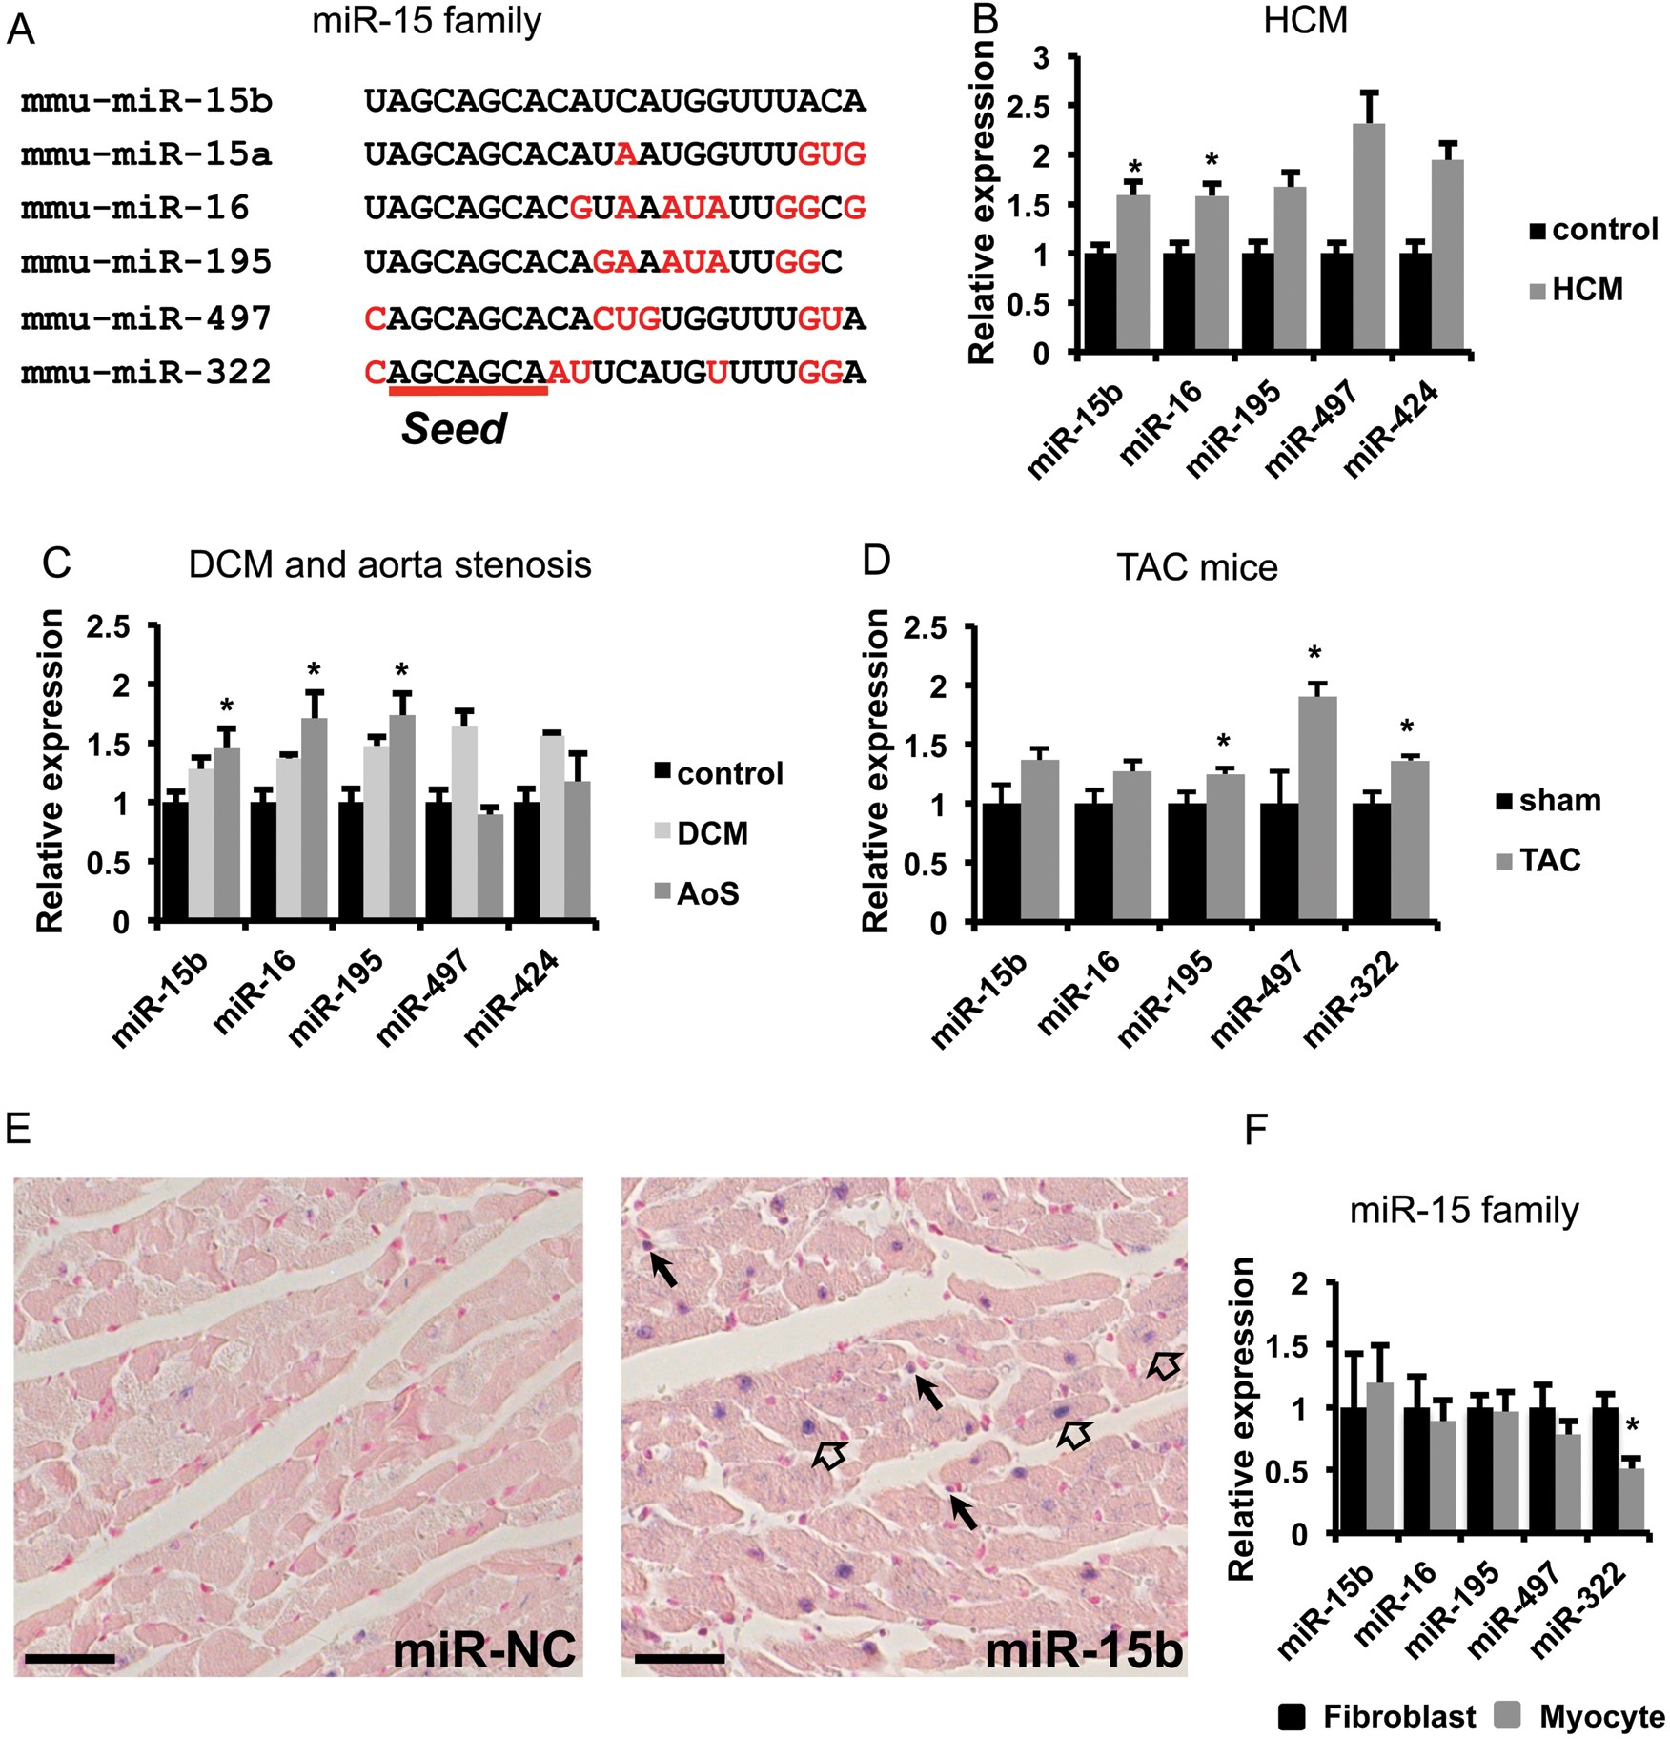
Figure 1 MiR-15 family expression in the heart. (A) miR-15b is part of the miR-15 family that includes six miRNAs, ...
Notes:
Figure 1 MiR-15 family expression in the heart. (A) miR-15b is part of the miR-15 family that includes six miRNAs, which all share a common seed sequence. Differences in nucleotides compared with the miR-15b sequence are depicted in red. (B) The miR-15 family is up-regulated in human end-stage HCM (n = 8) compared with healthy control hearts (n = 5). (C) In human hearts, up-regulation of the miR-15 family is also observed in end-stage dilated cardiomyopathy (n = 5), and aorta stenosis patients (n = 10) compared with healthy control hearts (n = 5). (D) The complete miR-15 family is up-regulated after 4 weeks of TAC in mice (n = 5). (E) In situ hybridization shows expression of miR-15b in cardiomyocytes (open arrows) and interstitial cells (black arrows). Scale bar = 50 µm. (F) Real-time PCR shows comparable expression levels of the miR-15 family in cultured cardiomyocytes and fibroblasts, except for miR-322 which is higher expressed in fibroblasts (n = 3). MiRNA levels in real-time PCR were normalized to U6. *P-value < 0.05 compared with the control group.
Unless provided in the caption above, the following copyright applies to the content of this slide: Published on behalf of the European Society of Cardiology. All rights reserved. © The Author 2014. For permissions please email: journals.permissions@oup.com.

Slide 2
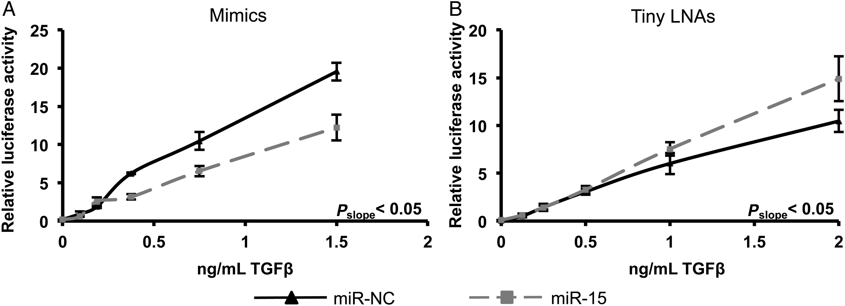
Figure 2 The miR-15 family inhibits the TGFβ-pathway. (A) Overexpression of miR-15b in HepG2 cells transfected with a ...
Notes:
Figure 2 The miR-15 family inhibits the TGFβ-pathway. (A) Overexpression of miR-15b in HepG2 cells transfected with a CAGA-luciferase reporter results in decreased luciferase activity compared with the negative control (NC) mimic, which indicates that the canonical TGFβ-pathway is inhibited. (B) Inhibition of the miR-15 family in HepG2 cells results in an increased activation of the CAGA-luciferase reporter by TGFβ. n = 6, P < 0.05 for the difference in slope of luciferase activation between the NC and miR-15 transfected cells.
Unless provided in the caption above, the following copyright applies to the content of this slide: Published on behalf of the European Society of Cardiology. All rights reserved. © The Author 2014. For permissions please email: journals.permissions@oup.com.

Slide 3
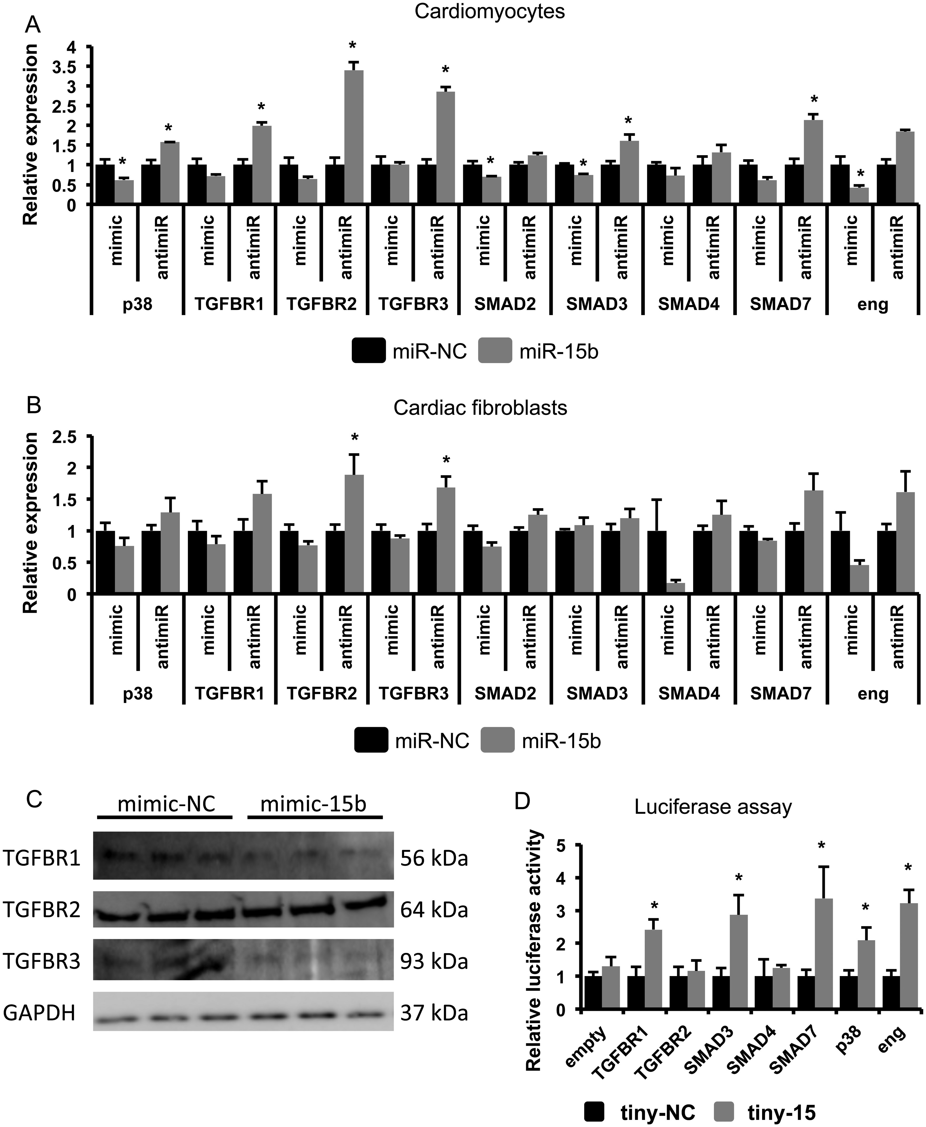
Figure 3 The miR-15 family targets numerous genes in the TGFβ-pathway. (A) mRNA levels detected by real-time PCR of ...
Notes:
Figure 3 The miR-15 family targets numerous genes in the TGFβ-pathway. (A) mRNA levels detected by real-time PCR of predicted miR-15 target genes in cardiomyocytes and (B) fibroblasts with overexpression (mimic) and knockdown (antimiR) of miR-15b levels. mRNA levels are normalized to Hypoxanthine Phosphoribosyltransferase 1 (HPRT) levels. (C) Protein levels of TGFBR1 and 3, but not of TGFBR2, are down-regulated after overexpression of miR15b in cardiomyocytes. GAPDH is shown as loading control. (D) Luciferase assays using reporters with the respective 3′UTR subcloned behind the luciferase gene suggest direct targeting of TGFBR1, SMAD3, SMAD7, p38, and endoglin after knockdown of the miR-15 family using tiny LNAs. n = 3 for real-time PCR and luciferase assays. *P < 0.05 compared with negative control (NC) transfected cells.
Unless provided in the caption above, the following copyright applies to the content of this slide: Published on behalf of the European Society of Cardiology. All rights reserved. © The Author 2014. For permissions please email: journals.permissions@oup.com.

Slide 4
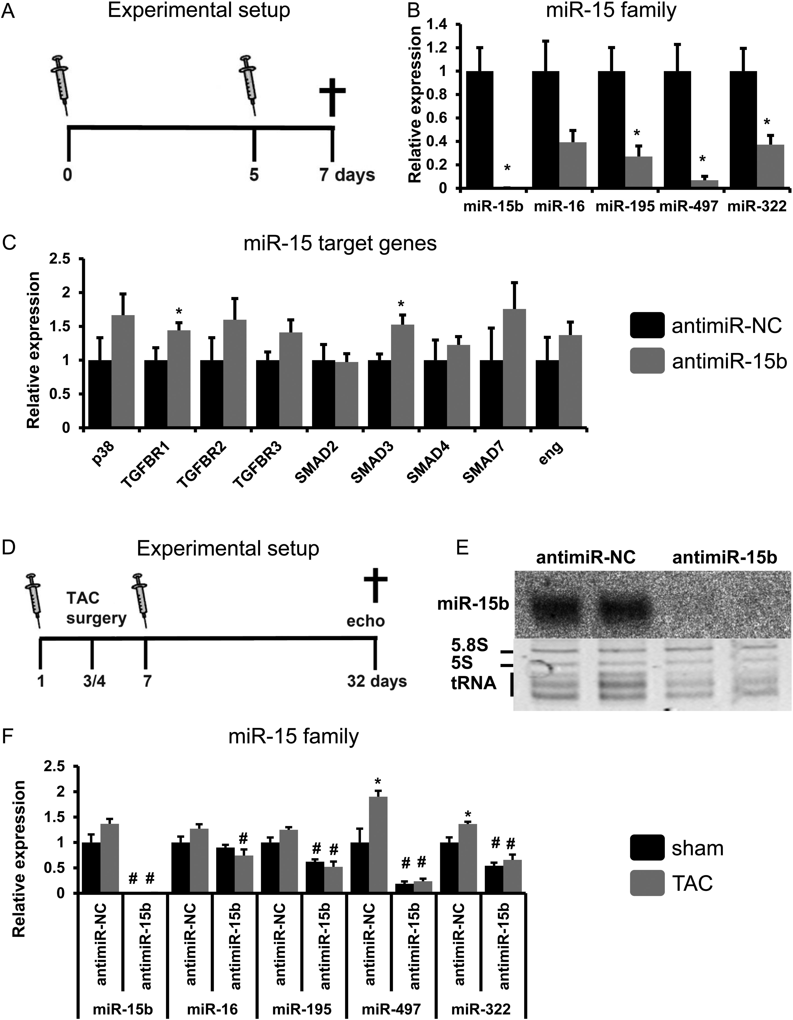
Figure 4 Inhibition of miR-15b in mice results in the up-regulation of target genes. (A) Design of the first antimiR ...
Notes:
Figure 4 Inhibition of miR-15b in mice results in the up-regulation of target genes. (A) Design of the first antimiR study. (B) Real-time PCR shows complete loss of miR-15b and a strong inhibition of the other family members in antimiR-15b injected mice. (C) Real-time PCR of predicted miR-15 family target genes shows up-regulation of TGFBR1 and SMAD3 in the myocardium after injections of antimiR-15b. (D) Design of the second antimiR study. (E) Northern blot shows complete loss of miR-15b in antimiR injected mice. (F) Real-time PCR shows the inhibition of miR-15 family members by antimiR-injections. MiRNA levels are normalized to U6 and mRNA levels to HPRT levels. n = 5 for antimiR-NC and antimiR-15b injected mice. *P < 0.05 compared with antimiR-NC control (A/B/C). n = 5 antimiR-NC sham, n = 8 antimiR-NC TAC, n = 6 antimiR-15b sham, n = 9 antimiR-15b TAC. *P < 0.05 compared with sham and #P < 0.05 compared with antimiR-NC (D/E/F).
Unless provided in the caption above, the following copyright applies to the content of this slide: Published on behalf of the European Society of Cardiology. All rights reserved. © The Author 2014. For permissions please email: journals.permissions@oup.com.

Slide 5
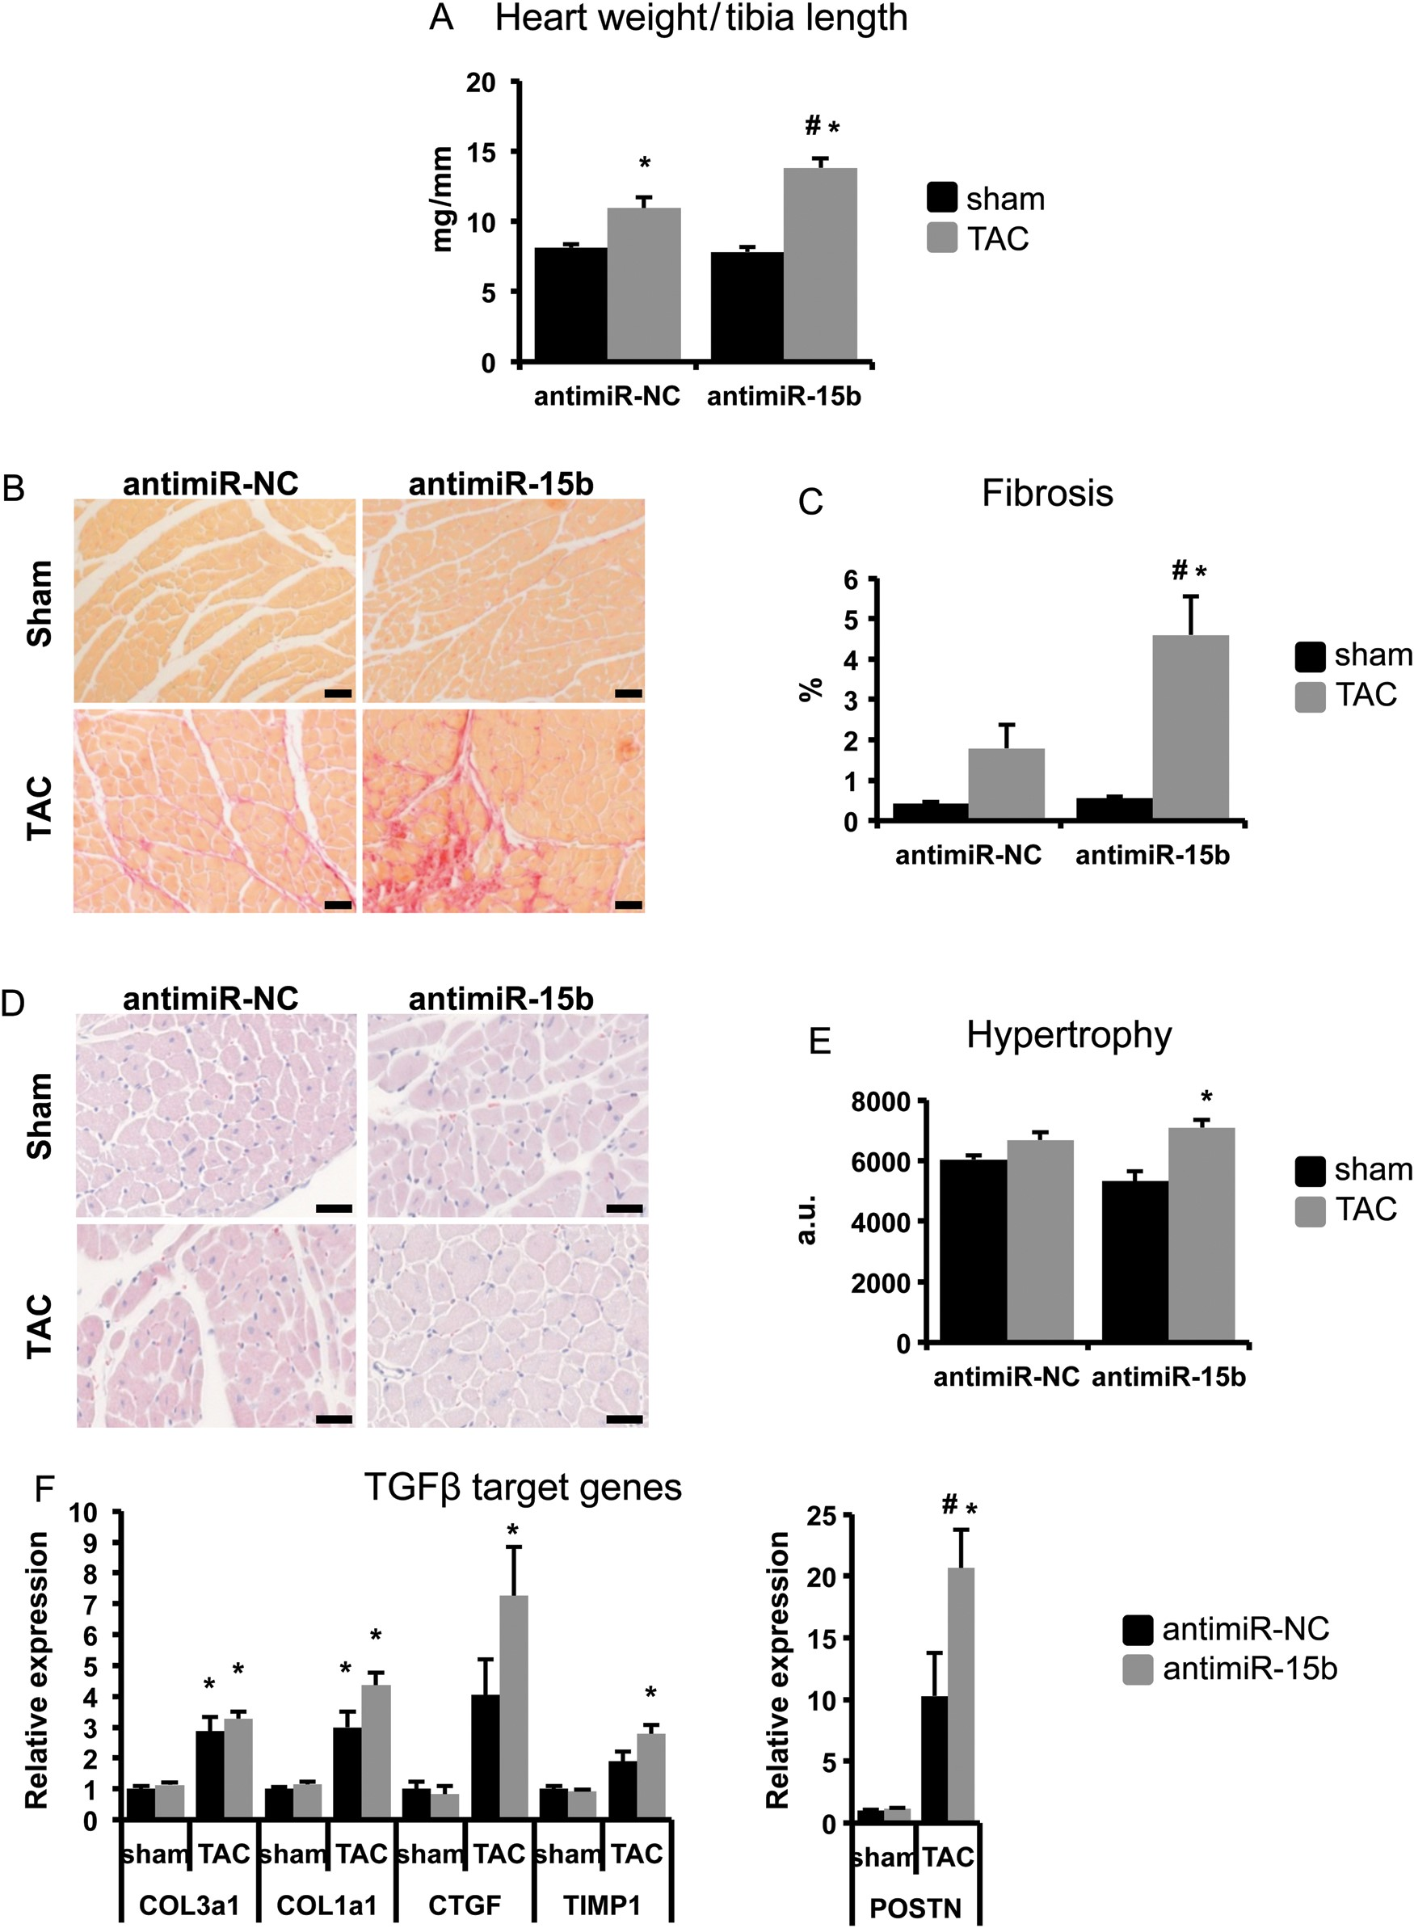
Figure 5 Inhibition of miR-15b aggravates cardiac remodelling after TAC. (A) Inhibition of miR-15b results in a ...
Notes:
Figure 5 Inhibition of miR-15b aggravates cardiac remodelling after TAC. (A) Inhibition of miR-15b results in a stronger increase in heart weight corrected for tibia length after TAC. (B) Representative pictures of picrosirius red sections to determine fibrosis, which is increased after inhibition of miR-15b as quantified in (C). (D) Representative pictures of H&A sections, which were used to measure cell sizes, which are quantified in (E) and show a stronger increase in cardiomyocyte hypertrophy after inhibition of miR-15b. Arbitrary units (a.u.) denote the number of pixels per myocyte in the cross-sectional plane. (F) Some downstream target genes of the TGFβ-pathway are significantly increased after TAC surgery in the antimiR-15b injected animals (POSTN), while other targets show a trend towards increased expression (COL1a1, CTGF, TIMP1). n = 5 antimiR-NC sham, n = 8 antimiR-NC TAC, n = 6 antimiR-15b sham, n = 9 antimiR-15b TAC. Scale bar = 50 µm, *P < 0.05 compared with sham and #P < 0.05 compared with antimiR-NC.
Unless provided in the caption above, the following copyright applies to the content of this slide: Published on behalf of the European Society of Cardiology. All rights reserved. © The Author 2014. For permissions please email: journals.permissions@oup.com.

Slide 6
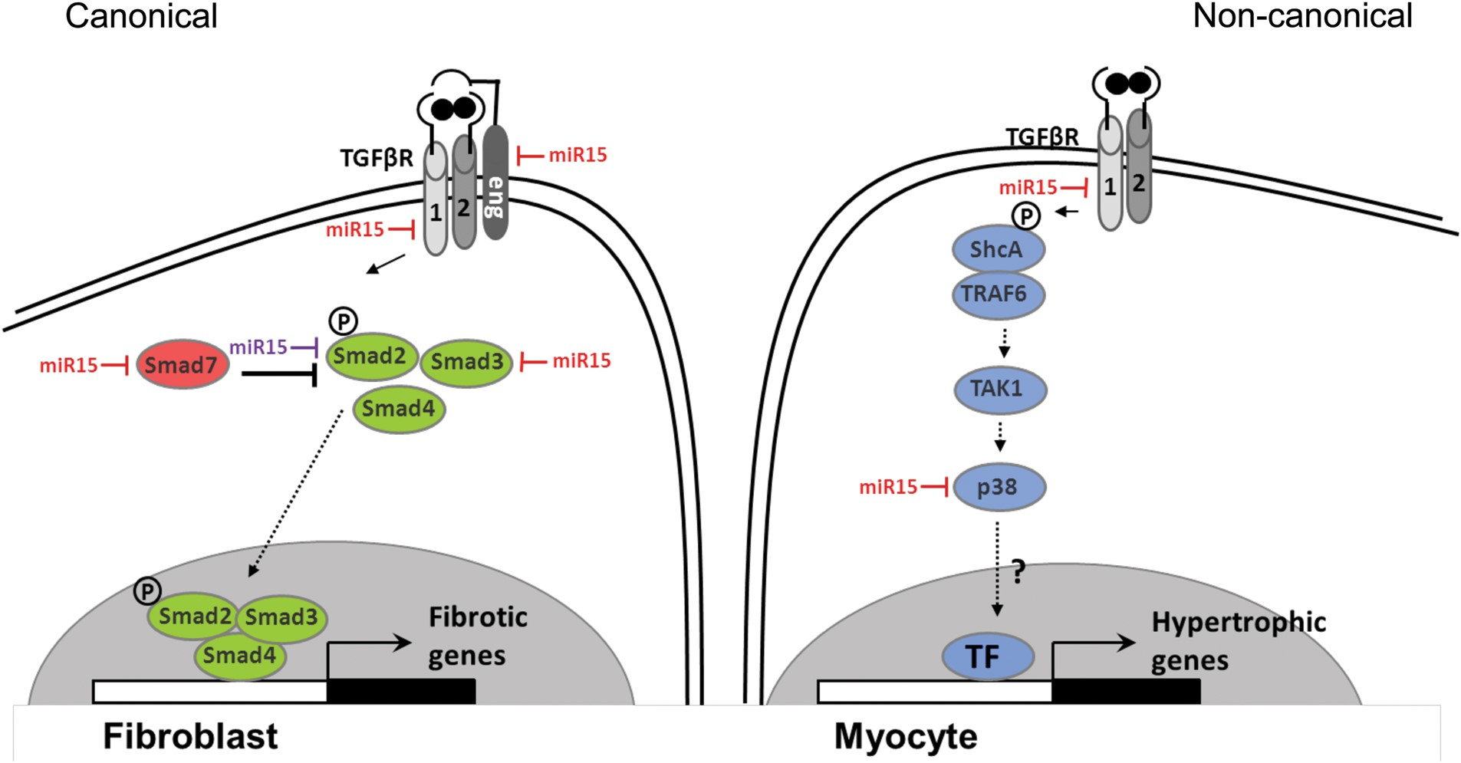
Figure 6 Putative model for the regulation of the TGFβ-pathway by the miR-15 family. The canonical TGFβ-pathway is ...
Notes:
Figure 6 Putative model for the regulation of the TGFβ-pathway by the miR-15 family. The canonical TGFβ-pathway is mainly active in cardiac fibroblasts and the non-canonical pathway in cardiomyocytes. The miR-15 family represses the expression of several genes in the canonical (TGFBR1, endoglin, SMAD3, SMAD7) and non-canonical TGFβ-pathway (TGFBR1, p38); miR-15 depicted in red. Although the 3′UTR of TGFBR1, SMAD3, SMAD7, p38, and endoglin were responsive to knockdown of the miR-15 family in luciferase assays, we did not provide evidence that these effects are direct, since we did not mutate the miR-15 binding sites in the 3′UTR. The expression of SMAD2 was also regulated by miR-15, but we were unable to test whether the 3′UTR of SMAD2 responded to the miR-15 family knockdown, therefore we depicted miR-15 for this target in purple.
Unless provided in the caption above, the following copyright applies to the content of this slide: Published on behalf of the European Society of Cardiology. All rights reserved. © The Author 2014. For permissions please email: journals.permissions@oup.com.

