Slide 1
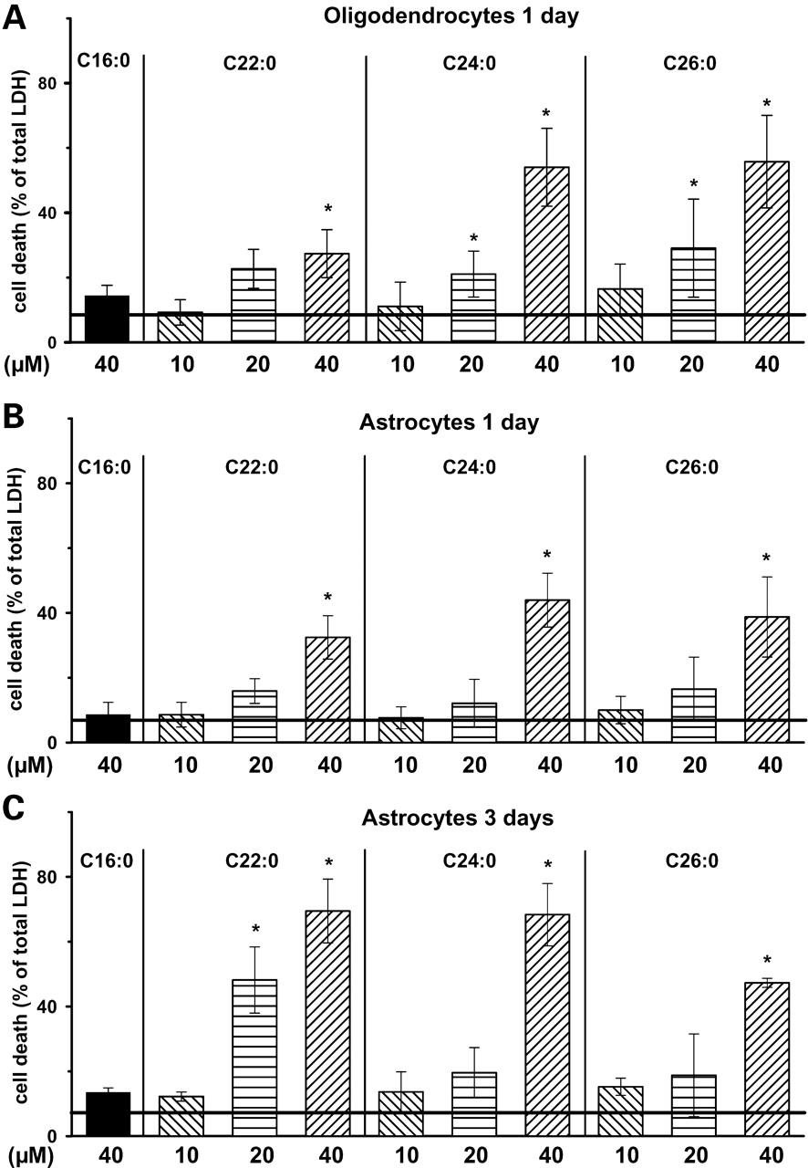
Figure 1. Cell death induction in oligodendrocytes (A) and astrocytes (B and C) by VLCFA application. Cells were ...
Notes:
Figure 1. Cell death induction in oligodendrocytes (A) and astrocytes (B and C) by VLCFA application. Cells were incubated with docosanoic- (C22:0), tetracosanoic- (C24:0) and hexacosanoic acids (C26:0) and Palm (C16:0) for time period and concentrations indicated. The supernatant was collected and LDH activity was analysed as percent of total activity. The amount of total LDH activity is LDH activity of lysed cells plus that of supernatant. The horizontal black line represents the LDH activity measured with vehicle α-cyclodextrin; 1 mg/ml alone. Data shown are means from four individual cell preparations and analysis was performed twice for each condition. *P < 0.05 compared with control.
Unless provided in the caption above, the following copyright applies to the content of this slide: © The Author 2008. Published by Oxford University Press. All rights reserved. For Permissions, please email: journals.permissions@oxfordjournals.org

Slide 2
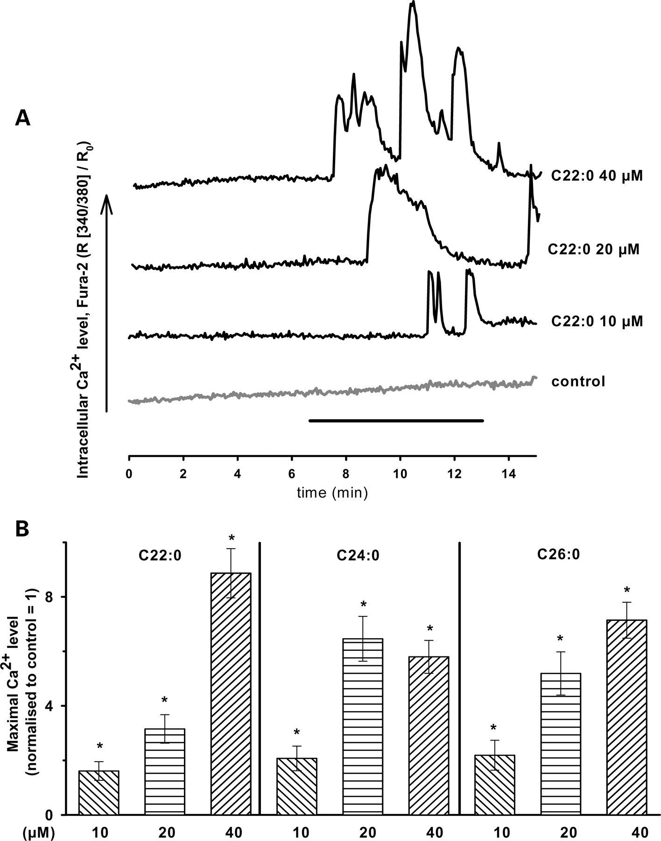
Figure 2. VLCFAs induce deregulation of intracellular Ca²⁺ homeostasis. Influence of VLCFA on intracellular ...
Notes:
Figure 2. VLCFAs induce deregulation of intracellular Ca2+ homeostasis. Influence of VLCFA on intracellular Ca2+ concentration of primary oligodendrocytes. (A) Kinetics of Ca2+ response due to acute application of various concentrations of C22:0 and as control the vehicle α-cyclodextrin (1 mg/ml). The black line (from 6.5 to 13.5 min) indicates the application period. Fura-2 AM fluorescence ratio R (340/380 nm) was normalized to the initial ratio (R0), obtained at 1.5 min. (B) Quantitative average analysis of maximal Ca2+ increase due to the application of VLCFA (C22:0, C24:0, C26:0). The maximal values of Fura-2 AM fluorescence ratio R (340/380 nm) were normalized to control experiment with the vehicle alone (α-cyclodextrin 1 mg/ml). Data represent results from at least three individual preparations and more than 15 individual oligodendrocytes each. *P < 0.05 compared with control.
Unless provided in the caption above, the following copyright applies to the content of this slide: © The Author 2008. Published by Oxford University Press. All rights reserved. For Permissions, please email: journals.permissions@oxfordjournals.org

Slide 3
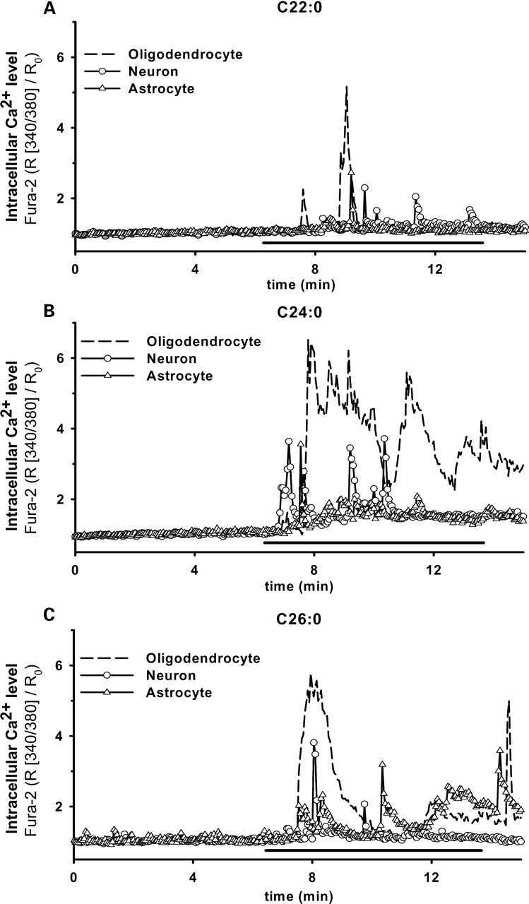
Figure 3. Ca²⁺ responses of hippocampal oligodendrocytes, astrocytes and neurons to VLCFA application. ...
Notes:
Figure 3. Ca2+ responses of hippocampal oligodendrocytes, astrocytes and neurons to VLCFA application. Intracellular Ca2+ concentrations in cells exposed to C22:0, C24:0 and C26:0 at a concentration of 40 µm (A–C). Kinetics of Ca2+ response due to the application of VLCFA, as indicated by the black line (from 6.5 to 13.5 min) in oligodendrocytes, astrocytes and neurons. Given are representative traces of single cells. Fura-2 AM fluorescence ratio (340/380 nm) was normalized to the initial ratio (R0) at 1.5 min.
Unless provided in the caption above, the following copyright applies to the content of this slide: © The Author 2008. Published by Oxford University Press. All rights reserved. For Permissions, please email: journals.permissions@oxfordjournals.org

Slide 4
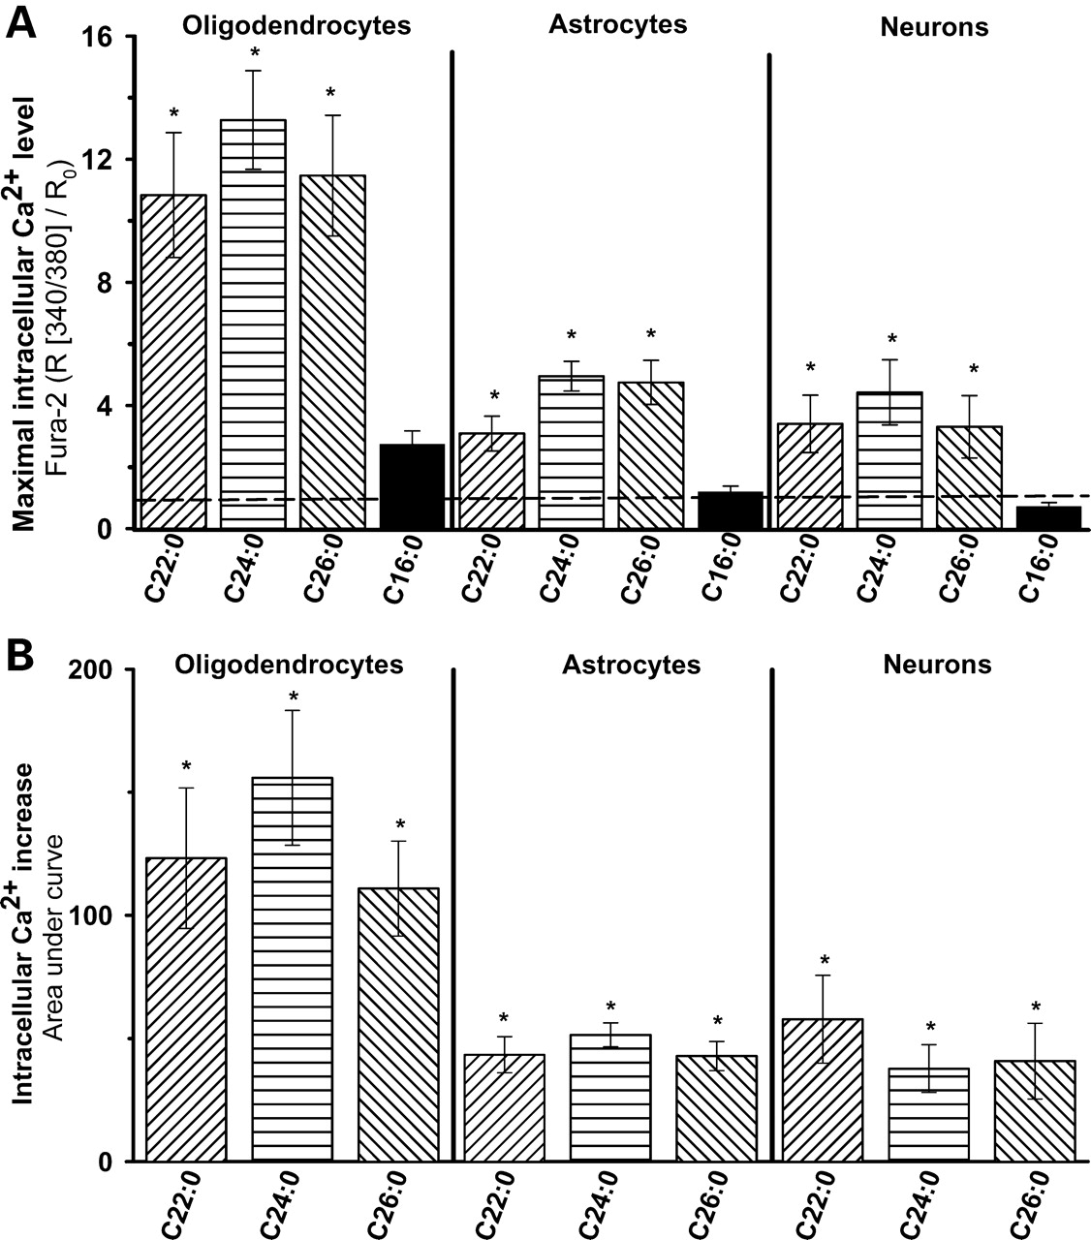
Figure 4. (A) Quantitative analysis of maximal calcium increase of Fura-2 AM fluorescence ratio (340/380 nm, normalized ...
Notes:
Figure 4. (A) Quantitative analysis of maximal calcium increase of Fura-2 AM fluorescence ratio (340/380 nm, normalized to control) due to VLCFA (40 µm) application. The horizontal line represents the Ca2+ level under control conditions with α-cyclodextrin (1 mg/ml) in the respective cells. (B) Area under the curve (Fura-2 R (340/380)/R0) was analysed (baseline = mean of first Y-axis data). Data were obtained from at least three individual preparations and from more than 15 individually identified oligodendrocytes, astrocytes and neurons each. *P < 0.05 compared with control.
Unless provided in the caption above, the following copyright applies to the content of this slide: © The Author 2008. Published by Oxford University Press. All rights reserved. For Permissions, please email: journals.permissions@oxfordjournals.org

Slide 5
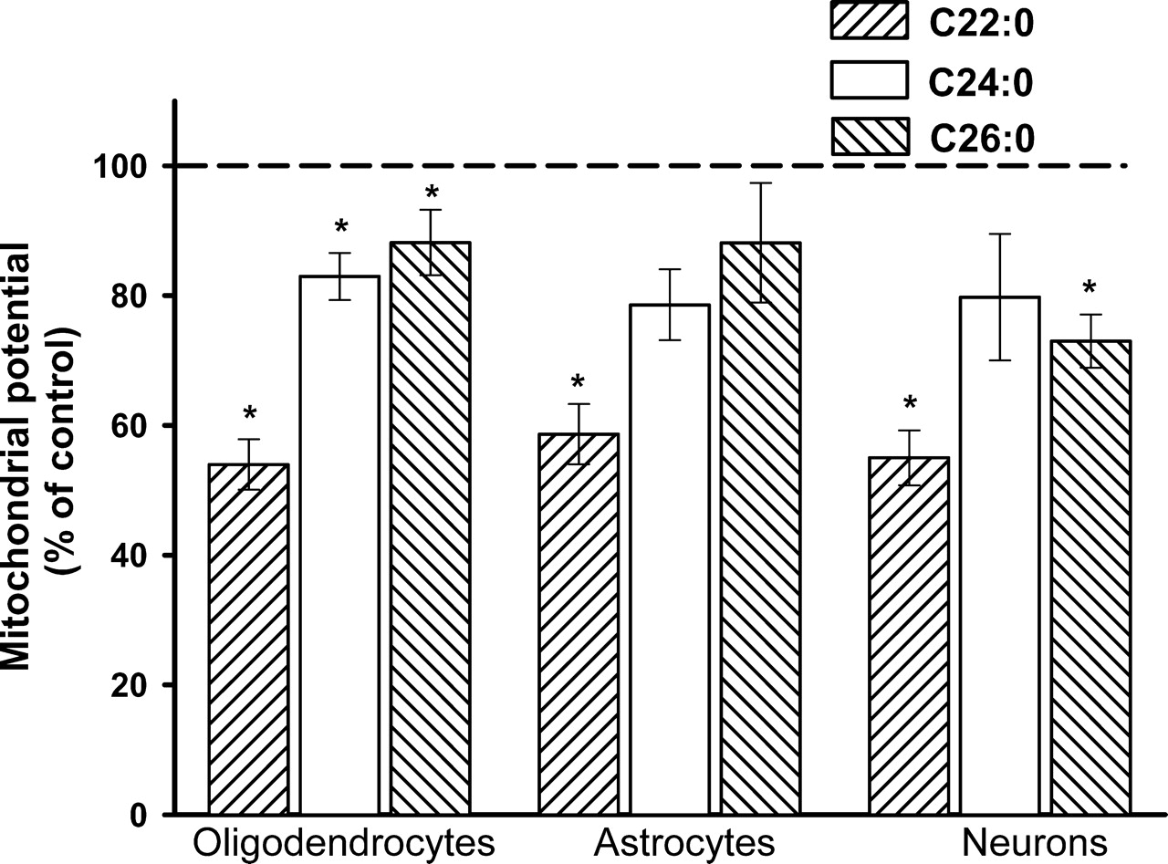
Figure 5. Effect of VLCFA (C22:0, C24:0, C26:0) application on membrane potential of mitochondria in rat brain ...
Notes:
Figure 5. Effect of VLCFA (C22:0, C24:0, C26:0) application on membrane potential of mitochondria in rat brain oligodendrocytes, astrocytes and neurons, detected by Rh123 accumulation. Incubation of neural cells with VLCFA (40 µm, 10 min) causes a decrease in mitochondrial membrane potential. Quantitative analysis of release of Rh123 after the application of VLCFA as % of control (α-cyclodextrin 1 mg/ml). Dashed horizontal line indicates the 100% control level. The values represent Rh123 release by combined application of uncoupler FCCP (4 µm) and F1F0-ATPase inhibitor oligomycin (10 µm), as described in Materials and Methods. Data shown are means from at least three individual cell preparations with more than 15 individually identified oligodendrocytes, astrocytes and neurons each. *P < 0.05 compared with control.
Unless provided in the caption above, the following copyright applies to the content of this slide: © The Author 2008. Published by Oxford University Press. All rights reserved. For Permissions, please email: journals.permissions@oxfordjournals.org

Slide 6
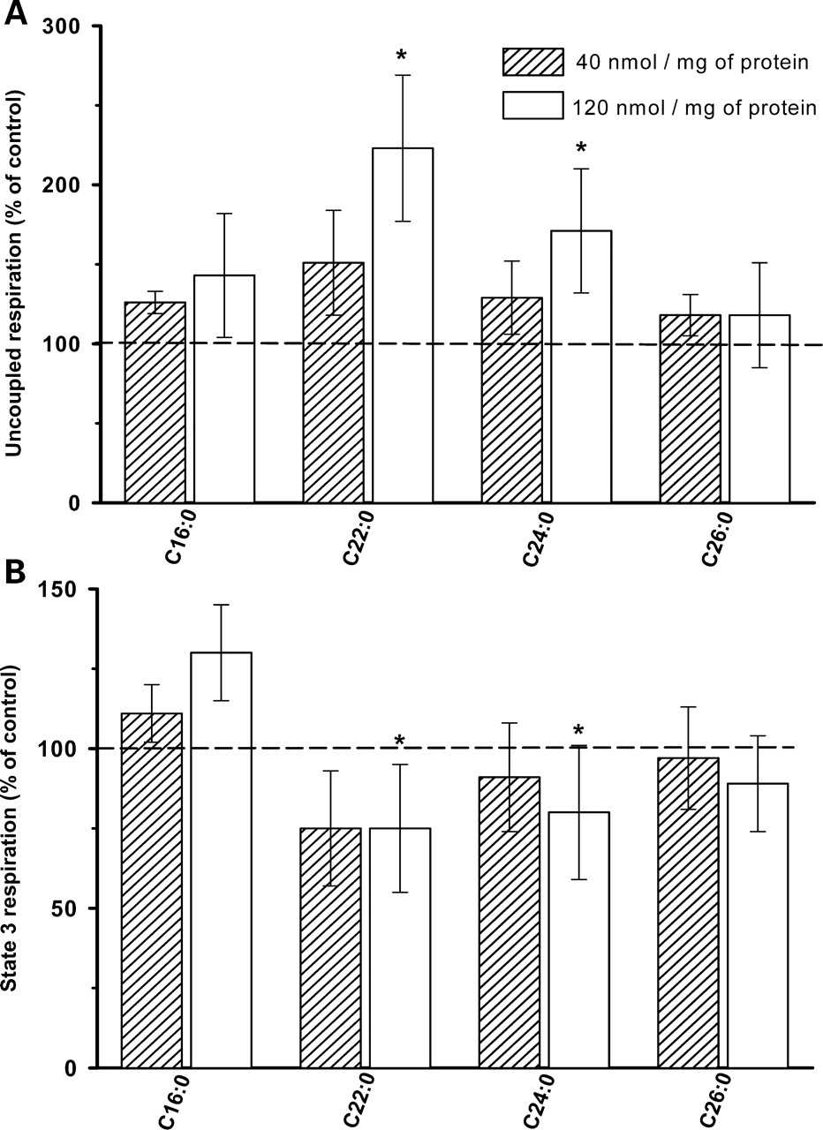
Figure 6. Effect of VLCFA on oxygen uptake (respiration) of resting (A) and phosphorylating (B) RBM. Effects of Palm ...
Notes:
Figure 6. Effect of VLCFA on oxygen uptake (respiration) of resting (A) and phosphorylating (B) RBM. Effects of Palm (C16:0) and VLCFA (C22:0, C24:0, C26:0) on the basal respiration (A) and phosphorylating respiration (B). RBM (1 mg of protein) were suspended in 1 ml incubation medium (37°C) supplemented with the substrates pyruvate (5 mm) plus malate (5 mm). VLCFAs were applied at two concentrations 20 and 60 µm, corresponding to 40 and 120 nmol/mg protein (dashed and white columns). Vehicle (α-cyclodextrin) solution of 20 and 60 µl was added as control. Phosphorylating respiration (State 3 respiration) was adjusted by addition of 0.5 mm of ADP. Rates of respiration are referred to controls (presence of vehicle) (A) without ADP (15.2±1.8 and 15.7±1 nmol O2/min/mg of protein) and (B) with ADP (104±11 and 96±9). Data were obtained from four mitochondrial preparations. *P < 0.05 compared with control (corresponding to 100%).
Unless provided in the caption above, the following copyright applies to the content of this slide: © The Author 2008. Published by Oxford University Press. All rights reserved. For Permissions, please email: journals.permissions@oxfordjournals.org

Slide 7
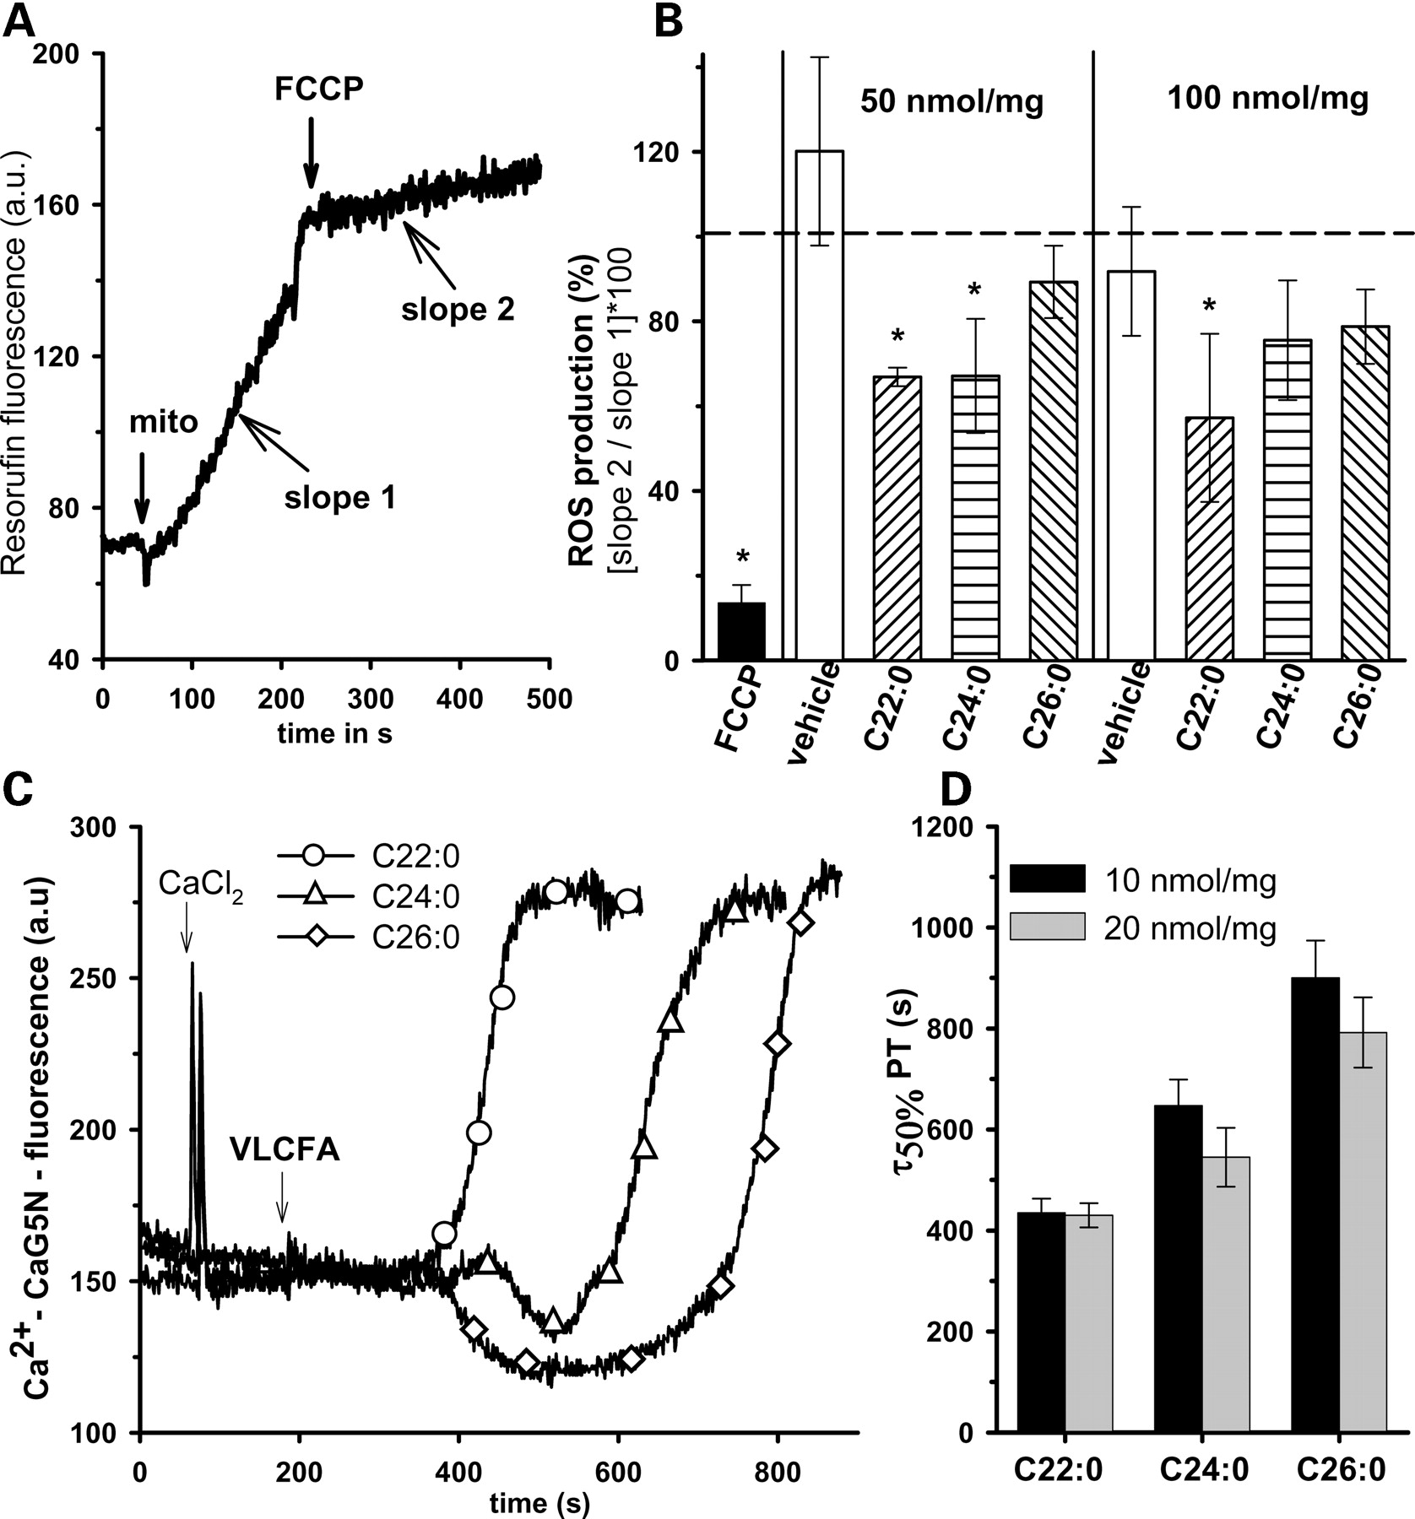
Figure 7. The influence of VLCFA on membrane potential and PT of isolated mitochondria. (A and B) Membrane potential, ...
Notes:
Figure 7. The influence of VLCFA on membrane potential and PT of isolated mitochondria. (A and B) Membrane potential, determined by the decrease in reverse electron transport-associated ROS production of isolated RBM. (A) Example trace demonstrating the method. Release of H2O2 by RBM was measured using the oxidation of the non-fluorescent Amplex Red to the fluorescent resorufin. Resorufin formation is measured by RBM oxidizing 10 mm succinate. Addition of mitochondria (mito; 0.2 mg of protein) to the incubation medium (1 ml) initiates the rapid increase of resorufin (slope 1). FCCP (0.5 µm) decreases the ROS production almost completely (slope 2). (B) VLCFA-induced inhibition of ROS production in isolated RBM indicates a decrease in membrane potential. Fatty acids were used 50 and 100 nmol/mg of mitochondria protein, corresponding to 10 and 20 µm. Data were calculated as percent (slope 2 of slope 1) for each experiment. The vehicle α-cyclodextrin (control) was used at 0.25 and 0.5 mg/ml, respectively. FCCP was used as a positive control. (C and D) VLCFA-triggered PT in isolated mitochondria. Measurement of sudden Ca2+ release by isolated rat liver mitochondria after addition of VLCFA. Mitochondria (1 mg of protein) were suspended in 1 ml incubation medium supplemented with glutamate/malate (5 mm/5 mm) and 0.05 µm CaG5N. (C) Fluorescence traces of CaG5N showing the uptake of Ca2+ from the medium after the pulse of 50 nmol CaCl2. Afterwards, VLCFAs (C22:0, C24:0, C26:0) were added (10 nmol/mg of protein). VLCFAs initiate a subsequent sudden release of accumulated Ca2+ from mitochondria. This indicates the onset of PTP opening. (D) The time to reach 50% of the maximal Ca2+ release (τ50% PT) was calculated from traces exemplified in (C) and was depicted as a function of the concentration of VLCFA used (10 and 20 nmol/mg = 10 and 20 µm). Data were obtained from three individual mitochondrial preparations. *P < 0.05 compared with control.
Unless provided in the caption above, the following copyright applies to the content of this slide: © The Author 2008. Published by Oxford University Press. All rights reserved. For Permissions, please email: journals.permissions@oxfordjournals.org

