Slide 1
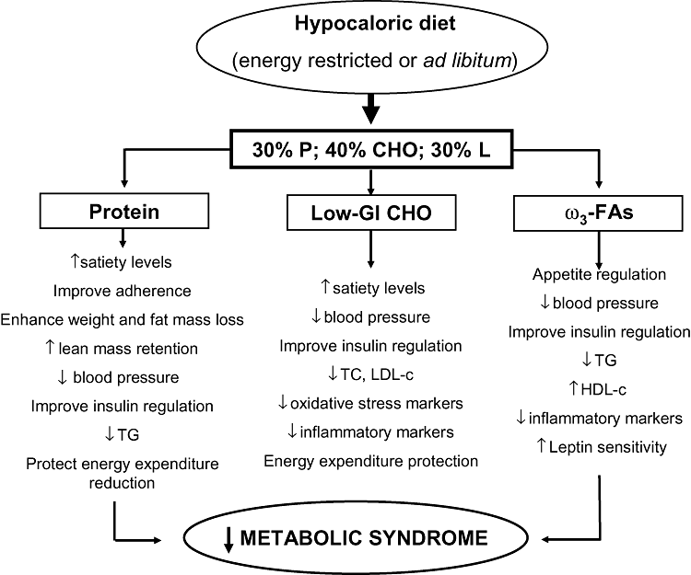
Figure 1 Metabolic changes that could be achieved with an energy-restricted or ad libitum diet combining moderate ...
Notes:
Figure 1 Metabolic changes that could be achieved with an energy-restricted or ad libitum diet combining moderate protein content with low glycemic index carbohydrates and high omega-3 fatty acids intake.
Unless provided in the caption above, the following copyright applies to the content of this slide: © 2010 International Life Sciences Institute

