Slide 1
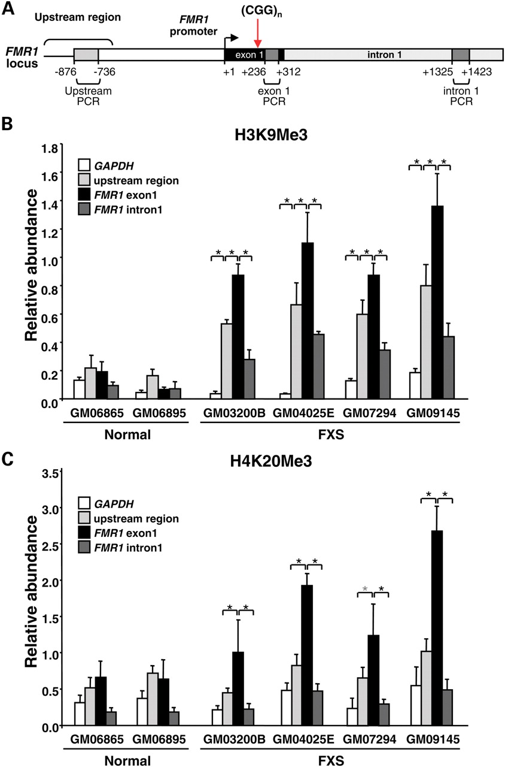
Figure 1. The distribution of H3K9Me3 and H4K20Me3 on normal and FX alleles. (A) Diagrammatic representation of the ...
Notes:
Figure 1. The distribution of H3K9Me3 and H4K20Me3 on normal and FX alleles. (A) Diagrammatic representation of the FMR1 5′ end showing location of the amplified regions used in these experiments. All the numbering is relative to the 3′ most transcription start site (Site I). (B) and (C) ChIP analysis of the abundance of H3K9Me3 (B) and H4K20Me3 (C) in normal and FX cells. The Y-axis in each case shows the abundance relative to Sat2 which is set to 1. The data in each panel are an average of at least three independent ChIP experiments. The black asterisks indicate that regions that are significantly different (P < 0.04). The gray asterisks indicate differences that approach statistical significance (P = 0.06).
Unless provided in the caption above, the following copyright applies to the content of this slide: Published by Oxford University Press 2010

Slide 2
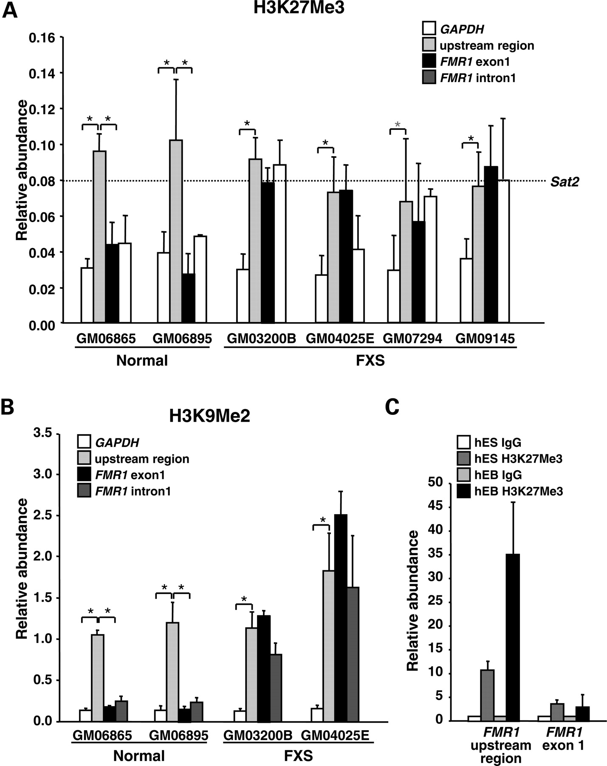
Figure 2. The distribution of H3K27Me3 and H3K9Me2 on the FMR1 locus. ChIP analysis of the abundance of H3K27Me3 (A) ...
Notes:
Figure 2. The distribution of H3K27Me3 and H3K9Me2 on the FMR1 locus. ChIP analysis of the abundance of H3K27Me3 (A) and H3K9Me2 (B) on normal and FX alleles. The Y-axis shows the abundance relative to either MYOD (A), a positive control for H3K27Me3 enrichment or Sat2 (B). The data shown are an average of at least three independent experiments. In (A), the dotted line shows the average abundance of H3K27Me3 on Sat2. The black asterisks indicate those regions that are significantly different (P < 0.04). The gray asterisks indicate regions whose differences approach statistical significance (P = 0.06). (C) ChIP analysis of H3K27Me3 on the upstream region and exon 1 of the FMR1 gene in normal hESCs and hEBs. The Y-axis shows the abundance of H3K27Me3 relative to IgG.
Unless provided in the caption above, the following copyright applies to the content of this slide: Published by Oxford University Press 2010

Slide 3
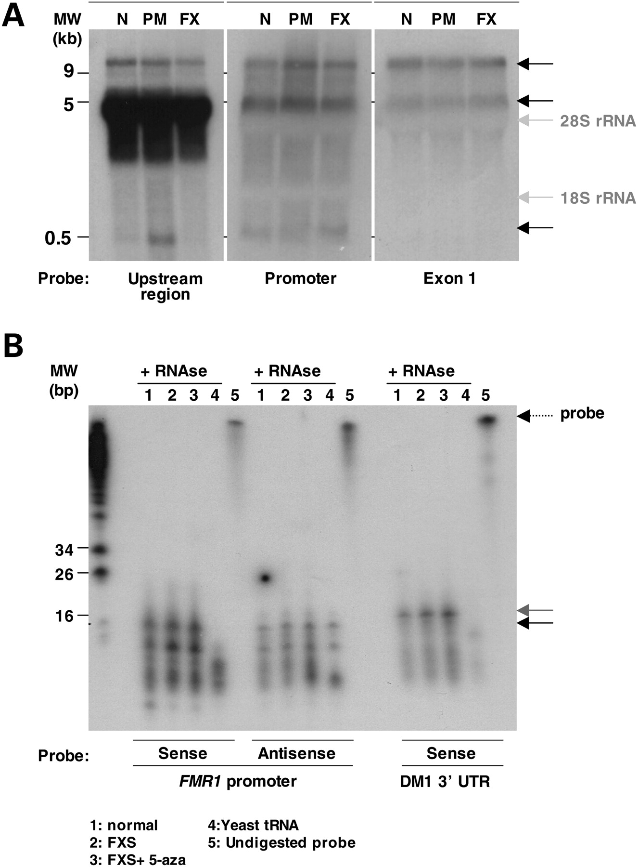
Figure 3. Transcripts produced from the FMR1 locus. (A) Northern analysis of total RNA from normal (N), PM and FX cells ...
Notes:
Figure 3. Transcripts produced from the FMR1 locus. (A) Northern analysis of total RNA from normal (N), PM and FX cells using the UHZ, promoter and exon 1 PCR products indicated in Figure 1A as probes. The black arrows on the right-hand side of the autoradiographs mark the positions of the three major products seen with all three probes. (B) RNase protection assays to detect small RNAs produced from the FMR1 promoter in normal alleles and in both silenced FM alleles and FM alleles reactivated by treatment with 5-aza. The molecular weight marker is MspI-digested pBR322. The gray arrow indicates the small antisense RNA produced from the DMPK allele. The black arrow indicates the small antisense RNA produced from the FMR1 allele.
Unless provided in the caption above, the following copyright applies to the content of this slide: Published by Oxford University Press 2010

Slide 4
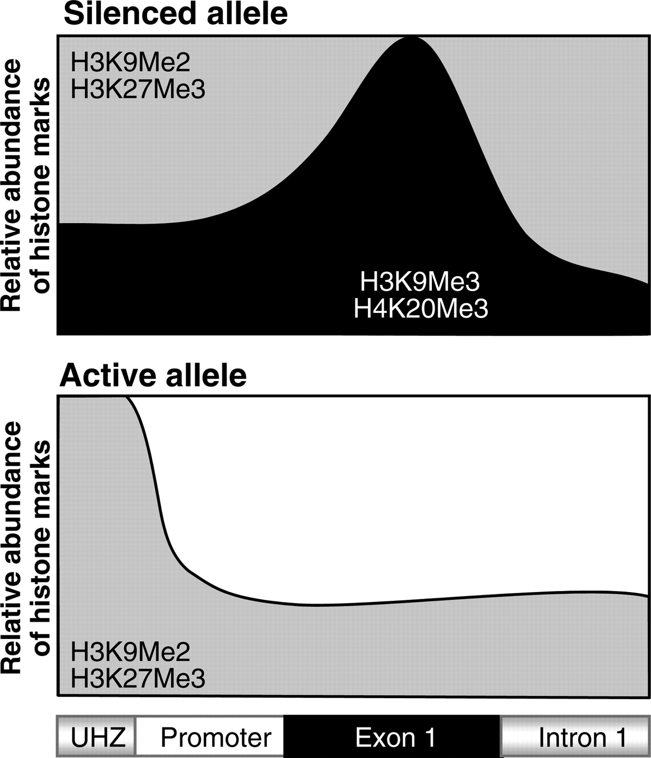
Figure 4. Diagrammatic representation of distribution of the two categories of repressive histone modifications ...
Notes:
Figure 4. Diagrammatic representation of distribution of the two categories of repressive histone modifications associated with FX alleles. The distribution of H3K9Me2 and H3K27Me3 is shown in gray and the distribution of H3K9Me3 and H4K20Me3 is shown in black.
Unless provided in the caption above, the following copyright applies to the content of this slide: Published by Oxford University Press 2010

