Slide 1
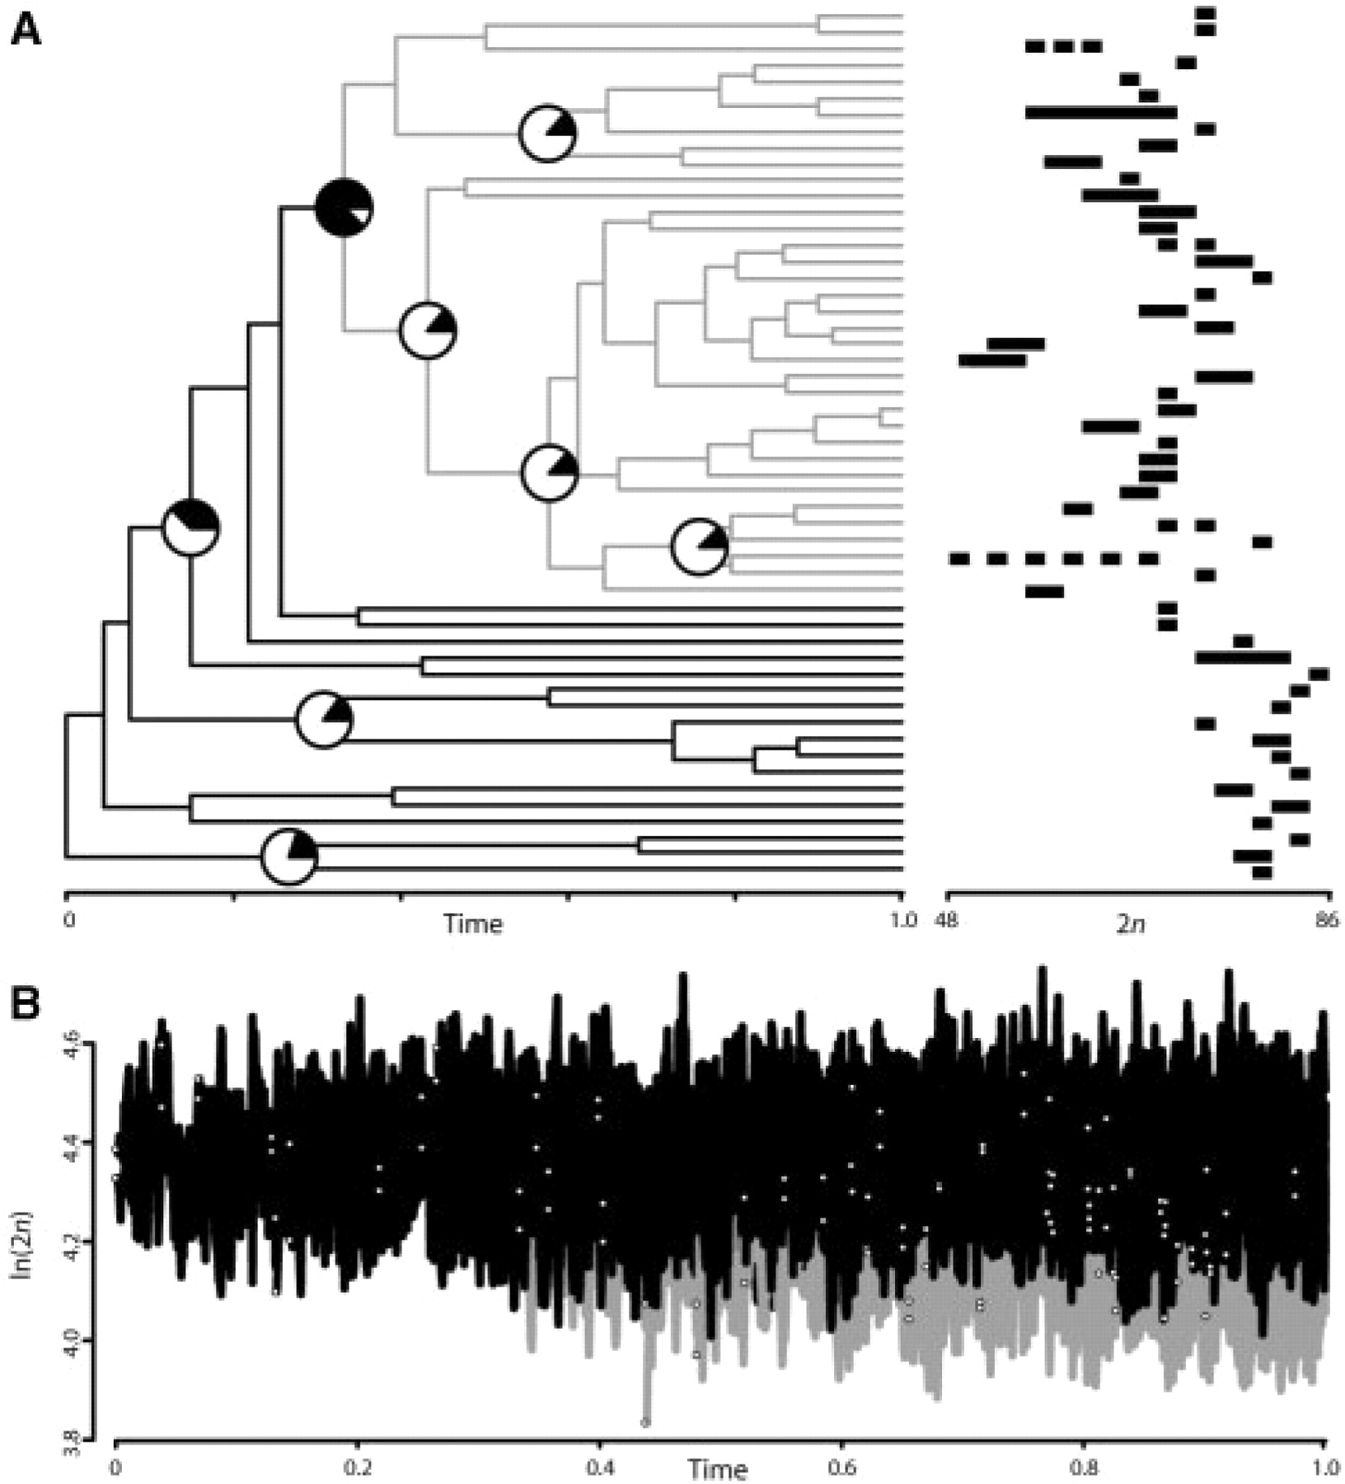
Fig. 1. (Carex: Cyperaceae) based on Bayesian analysis of nuclear ribosomal DNA data, with diploid chromosome numbers ...
Notes:
Fig. 1. (Carex: Cyperaceae) based on Bayesian analysis of nuclear ribosomal DNA data, with diploid chromosome numbers (2n) for each tip (Hipp, 2007). Mean 2n was log-transformed for analysis. Analysis of 256 models over 100 trees sampled in a Bayesian phylogenetic analysis took 1 h 55 min on an Intel Core 2 Duo at 3.00 GHz. Shaded portions of the pie charts at the nodes indicate relative support for a shift in distribution of ln(2n) at that node, based on BIC weights. Gray branches indicate one clade at which there is support for a shift in character distribution (cumulative BIC weight=0.876). (B) Character evolution on the same phylogeny in MATICCE; clear circles denote nodes, vertical scale indicates simulated ln(2n). Simulation parameters (θ=4.22 for gray branches; θ=4.37 for black branches; σ2=6.3 and α=380 for the entire tree) were estimated from the data, using the model averages over 28=256 models evaluated. Gray branches correspond to the gray clade in (A).
Unless provided in the caption above, the following copyright applies to the content of this slide: © The Author 2009. Published by Oxford University Press. All rights reserved. For Permissions, please email: journals.permissions@oxfordjournals.

