Slide 1
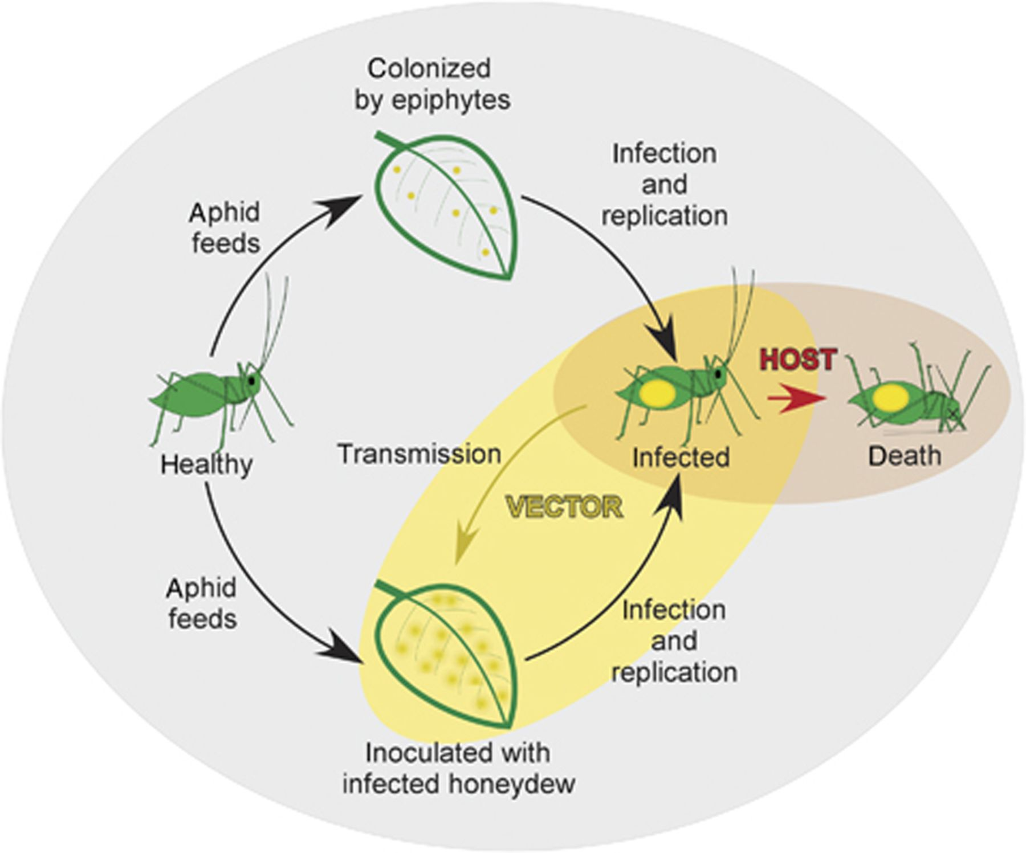
Figure 1 The role of the aphid as both vector and alternative primary host for the plant pathogen Pseudomonas syringae ...
Notes:
Figure 1 The role of the aphid as both vector and alternative primary host for the plant pathogen Pseudomonas syringae pv. syringae B728a (B728a). The acquisition of B728a by aphids occurs through feeding on plants colonized epiphytically by bacteria (yellow dots). The plant pathogenic bacteria replicate within infected aphids, and are excreted in globules of honeydew, which fall onto the plant surface. Infected aphids may wander to other plant hosts, vectoring the bacteria in the process. Shortly after infection with B728a, the host aphid, which has been used as a mass replication vessel by the bacteria, succumbs to sepsis. Adapted from Stavrinides et al. (2009).
Unless provided in the caption above, the following copyright applies to the content of this slide: © 2011 Federation of European Microbiological Societies.

Slide 2
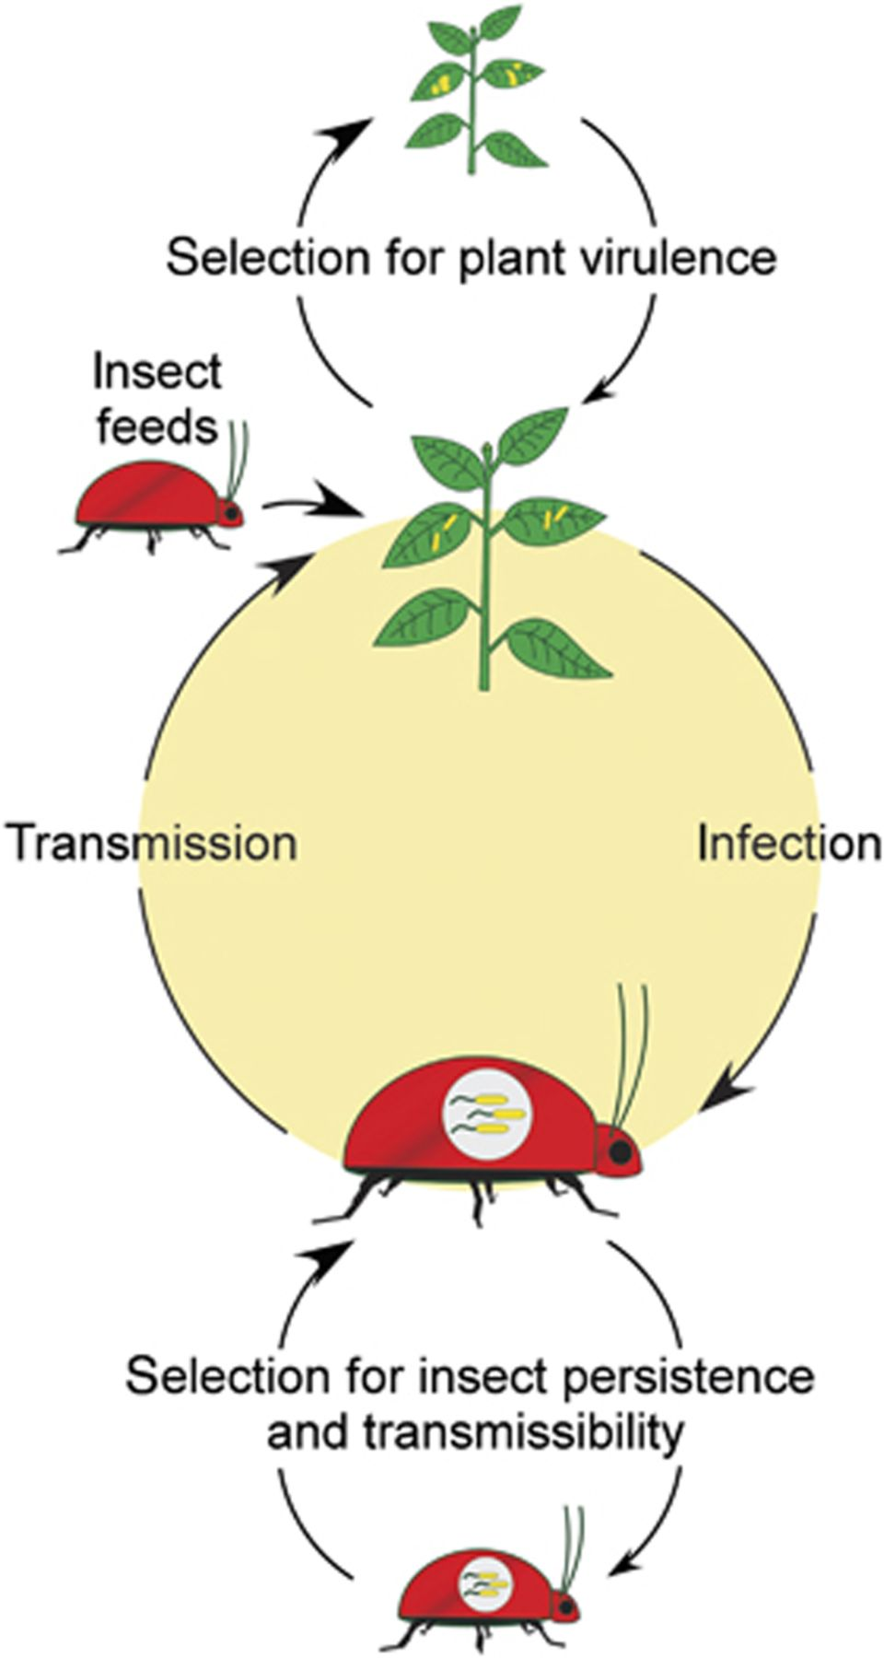
Figure 2 A bacterium having multiple hosts must achieve a balance with both its hosts to achieve optimal fitness. The ...
Notes:
Figure 2 A bacterium having multiple hosts must achieve a balance with both its hosts to achieve optimal fitness. The lifecycles of some phytopathogens include insect vectors, which function to transmit the bacteria to new plant hosts (middle circle). During their association with the plant (top), phytopathogens utilize plant-specific strategies for colonizing and causing disease in plant tissues, eventually reaching a virulence optimum that maximizes their fitness. This optimum, however, may conflict with the strategies used for colonizing, persisting, and being transmitted from the insect vector, necessitating a balance that maximizes the fitness of the pathogen with both hosts.
Unless provided in the caption above, the following copyright applies to the content of this slide: © 2011 Federation of European Microbiological Societies.

Slide 3
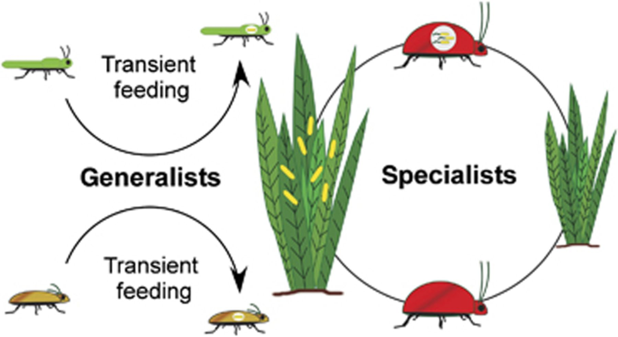
Figure 3 The plant-first model. Phytopathogenic bacteria (yellow) may have evolved alternative associations with ...
Notes:
Figure 3 The plant-first model. Phytopathogenic bacteria (yellow) may have evolved alternative associations with insects following either transient interactions with generalists (left), which may move to an unsuitable plant host for the pathogen, or through interactions with specialized insects (right) that feed on a limited set or subset of plants that overlap with the preferred hosts of the pathogen.
Unless provided in the caption above, the following copyright applies to the content of this slide: © 2011 Federation of European Microbiological Societies.

Slide 4
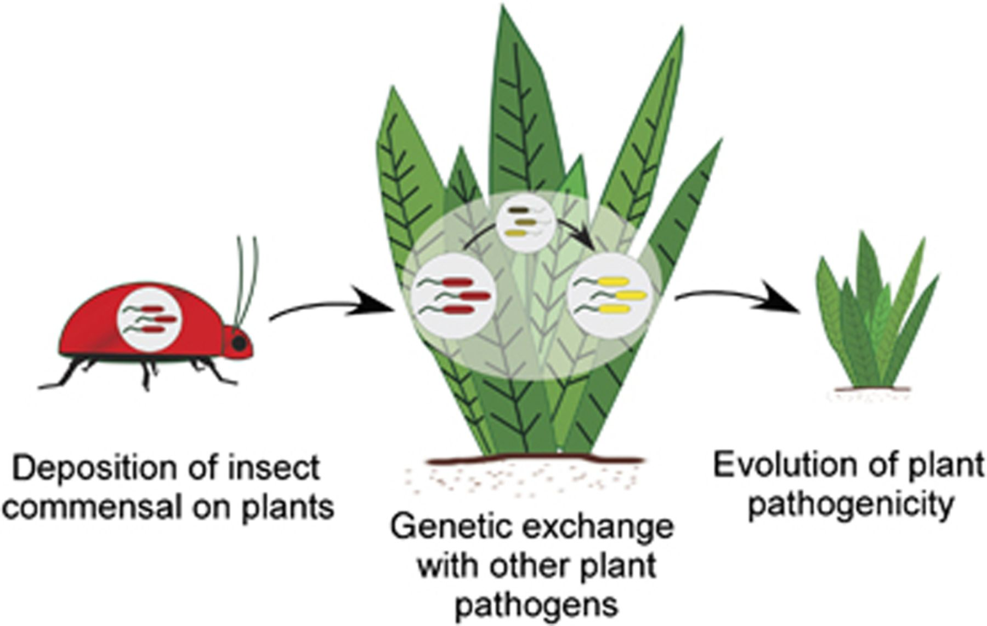
Figure 4 The insect-first model. Present-day phytopathogens that associate with insects may have had ancestral ...
Notes:
Figure 4 The insect-first model. Present-day phytopathogens that associate with insects may have had ancestral associations with insects. Following deposition onto plant hosts via their plant-associating insect hosts, genetic exchange with other plant pathogens found within the phyllosphere or rhizosphere may have led to the evolution of phytopathogenicity.
Unless provided in the caption above, the following copyright applies to the content of this slide: © 2011 Federation of European Microbiological Societies.

