Slide 1
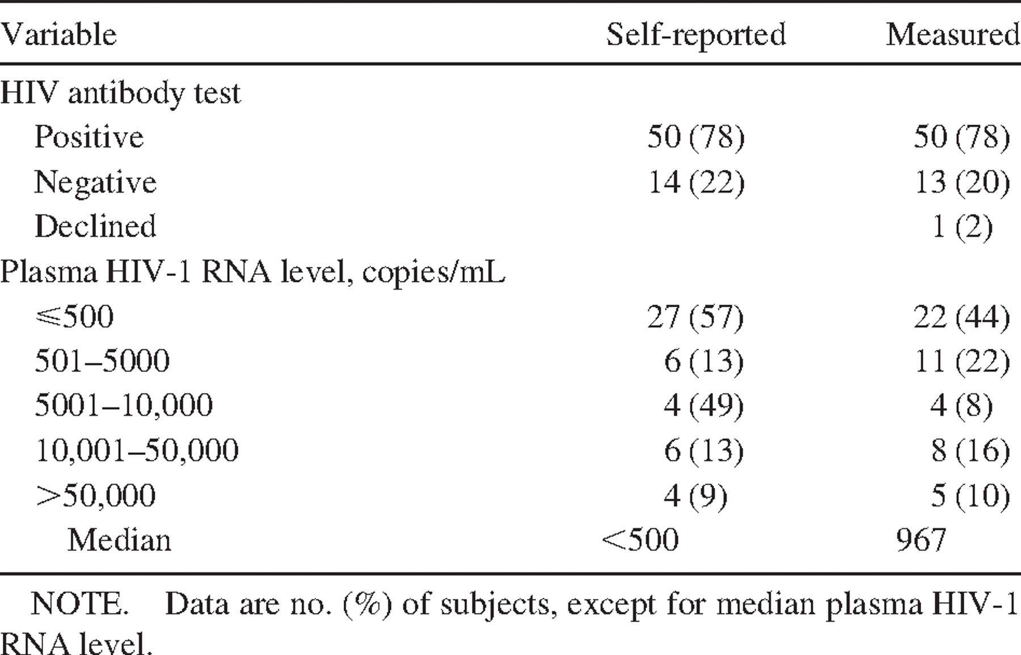
Table 1 Source subject human immunodeficiency virus (HIV) infection status.
Notes:
Table 1 Source subject human immunodeficiency virus (HIV) infection status.
Unless provided in the caption above, the following copyright applies to the content of this slide: © 2001 by the Infectious Diseases Society of America

Slide 2
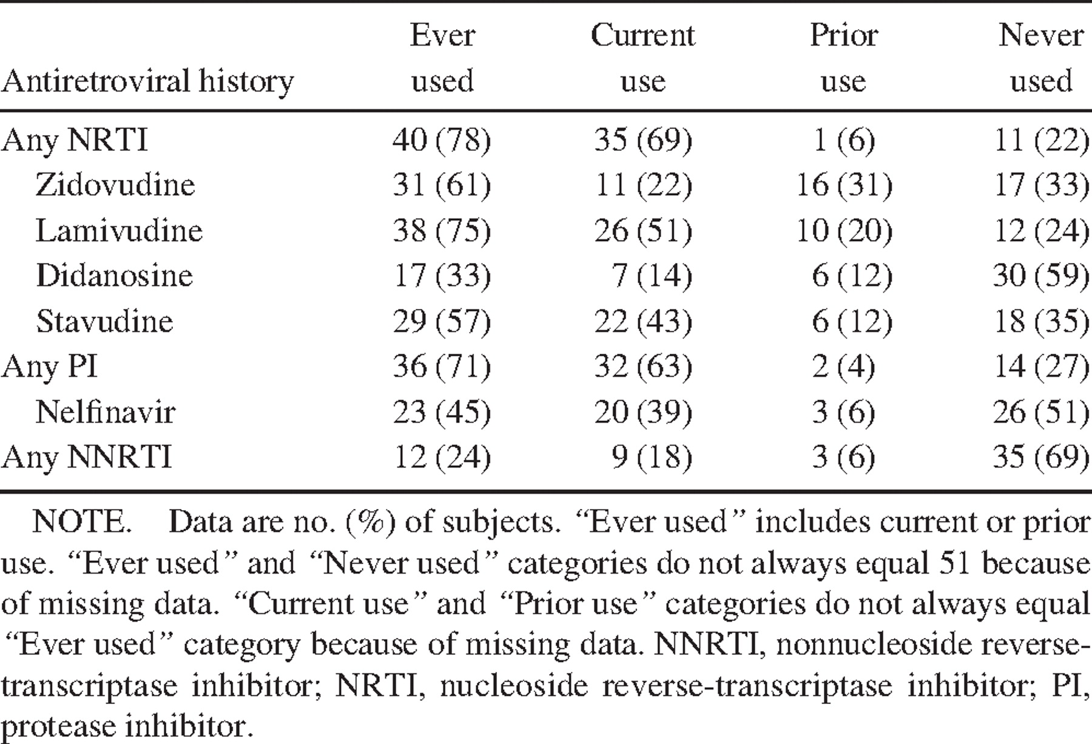
Table 2 Source subject antiretroviral history.
Notes:
Table 2 Source subject antiretroviral history.
Unless provided in the caption above, the following copyright applies to the content of this slide: © 2001 by the Infectious Diseases Society of America

Slide 3
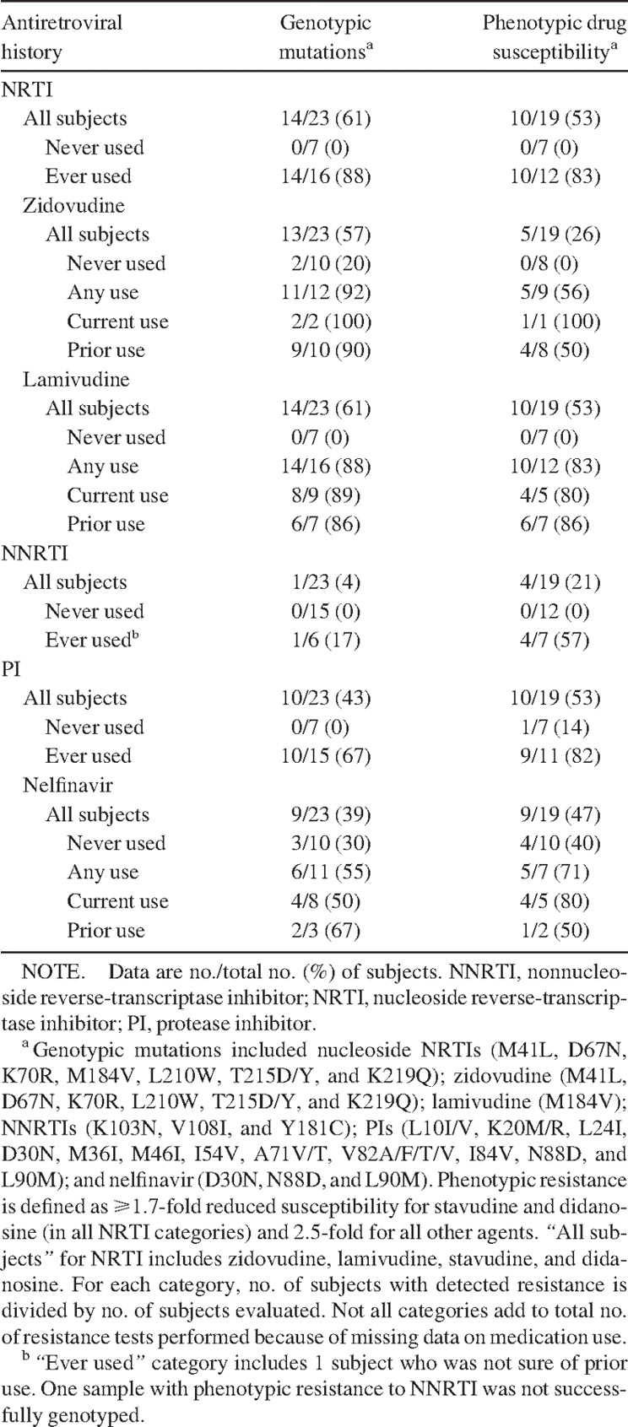
Table 3 Genotypic and phenotypic antiretroviral drug resistance and relationship to antiretroviral drug use.
Notes:
Table 3 Genotypic and phenotypic antiretroviral drug resistance and relationship to antiretroviral drug use.
Unless provided in the caption above, the following copyright applies to the content of this slide: © 2001 by the Infectious Diseases Society of America

