Slide 1
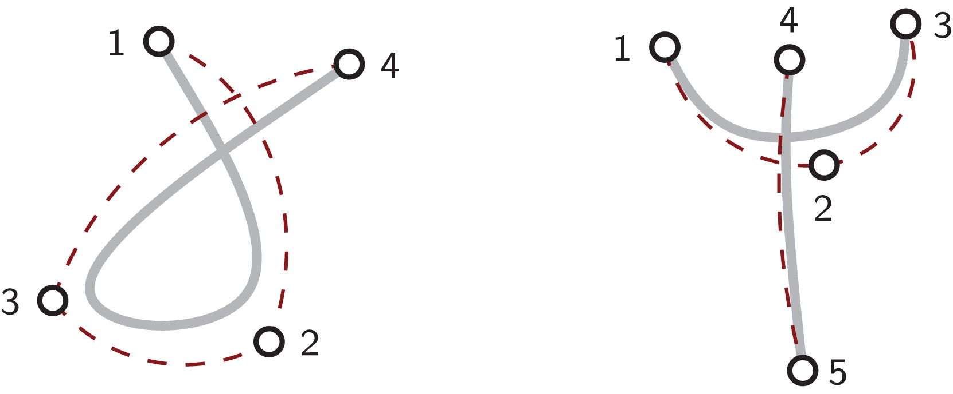
Figure 1. A gesture stroke (solid lines) is described by the temporal overlap of a series of primitives (dashed arcs) ...
Notes:
Figure 1. A gesture stroke (solid lines) is described by the temporal overlap of a series of primitives (dashed arcs) connecting a sequence of virtual targets (numbered circles). Each primitive is described by a lognormal velocity profile.
Unless provided in the caption above, the following copyright applies to the content of this slide: © The Author 2017. Published by Oxford University Press on behalf of The British Computer Society. All rights reserved. For Permissions, please email: journals.permissions@oup.com

Slide 2
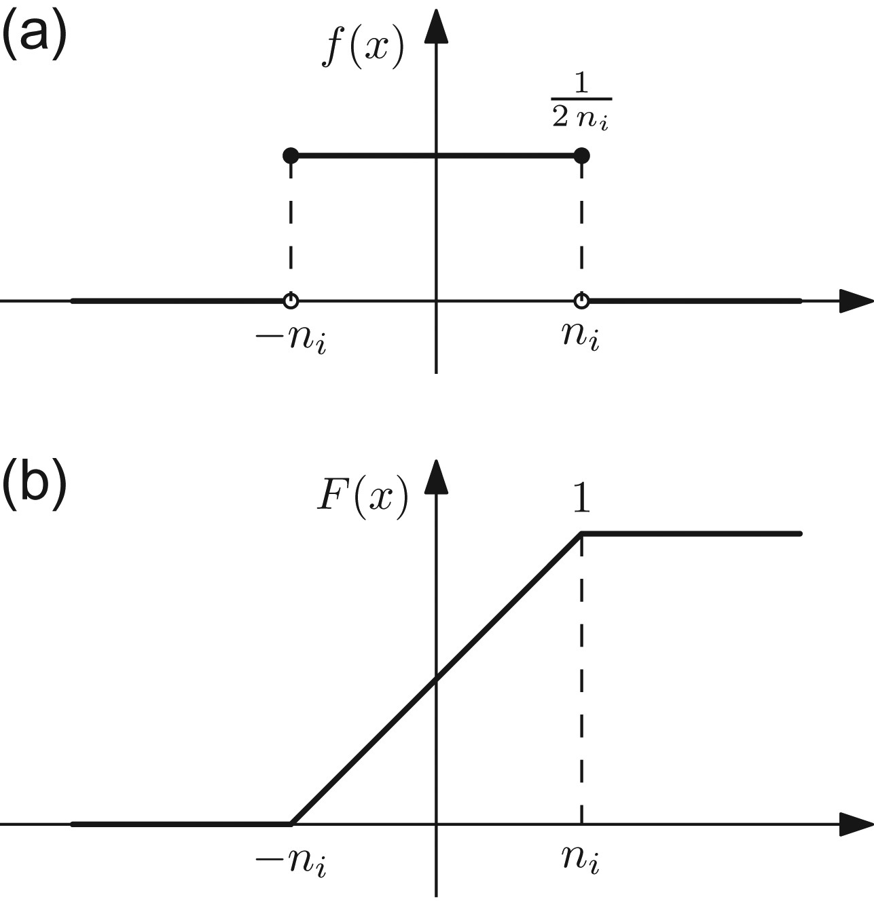
Figure 2. Probability density function (a) and cumulative distribution function (b) of the noise levels applied to each ...
Notes:
Figure 2. Probability density function (a) and cumulative distribution function (b) of the noise levels applied to each primitive's parameter.
Unless provided in the caption above, the following copyright applies to the content of this slide: © The Author 2017. Published by Oxford University Press on behalf of The British Computer Society. All rights reserved. For Permissions, please email: journals.permissions@oup.com

Slide 3
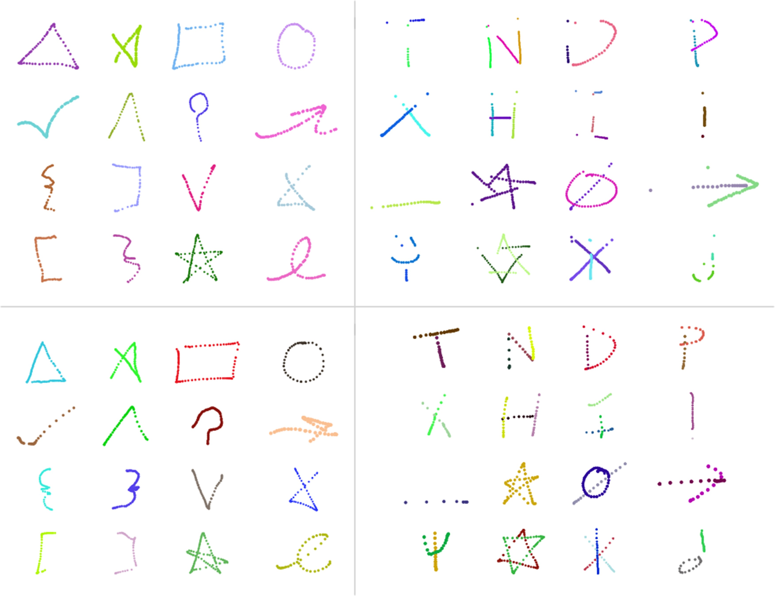
Figure 3. Examples of human (top row) and synthetic (bottom) stroke gestures from the GDS (left column) and MMG (right) ...
Notes:
Figure 3. Examples of human (top row) and synthetic (bottom) stroke gestures from the GDS (left column) and MMG (right) data sets.
Unless provided in the caption above, the following copyright applies to the content of this slide: © The Author 2017. Published by Oxford University Press on behalf of The British Computer Society. All rights reserved. For Permissions, please email: journals.permissions@oup.com

Slide 4
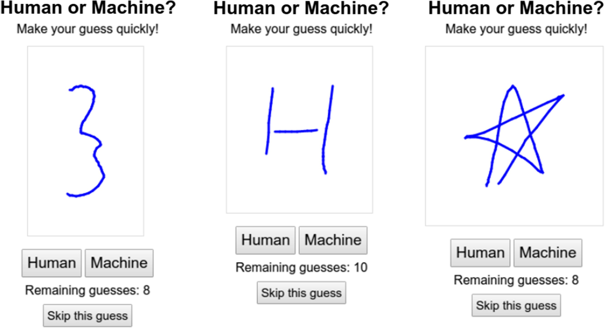
Figure 4. Screenshots of the application to conduct the visual appearance study. Can you guess which ones are synthetic ...
Notes:
Figure 4. Screenshots of the application to conduct the visual appearance study. Can you guess which ones are synthetic and which ones are human-generated?
Unless provided in the caption above, the following copyright applies to the content of this slide: © The Author 2017. Published by Oxford University Press on behalf of The British Computer Society. All rights reserved. For Permissions, please email: journals.permissions@oup.com

Slide 5
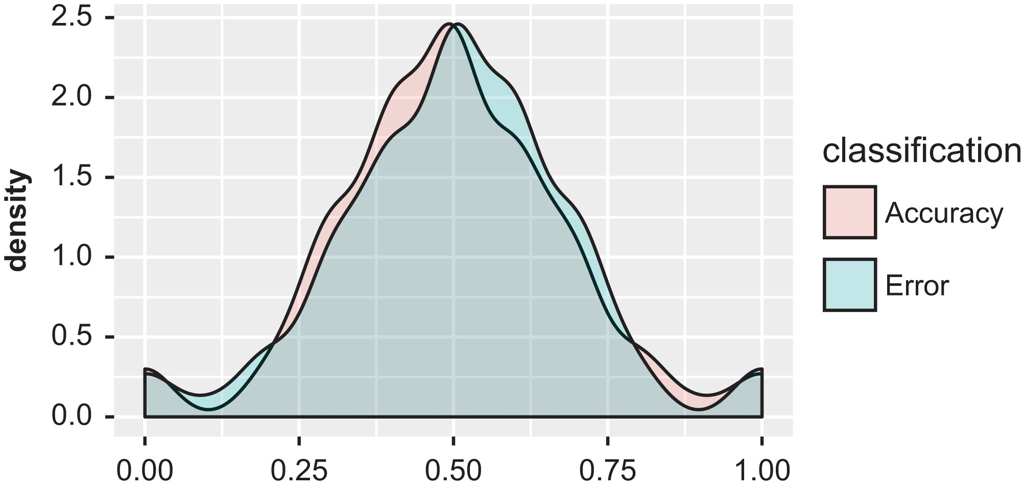
Figure 5. Distributions of classified and misclassified samples in the visual appearance study.
Notes:
Figure 5. Distributions of classified and misclassified samples in the visual appearance study.
Unless provided in the caption above, the following copyright applies to the content of this slide: © The Author 2017. Published by Oxford University Press on behalf of The British Computer Society. All rights reserved. For Permissions, please email: journals.permissions@oup.com

Slide 6
Figure 6. Different task axes (thick lines) computed for all samples (thin lines) of a multistroke gesture from the MMG ...
Notes:
Figure 6. Different task axes (thick lines) computed for all samples (thin lines) of a multistroke gesture from the MMG data set. Being more robust to noise and outliers, the k-medoid (d) was chosen to compute all relative measures.
Unless provided in the caption above, the following copyright applies to the content of this slide: © The Author 2017. Published by Oxford University Press on behalf of The British Computer Society. All rights reserved. For Permissions, please email: journals.permissions@oup.com

Slide 7
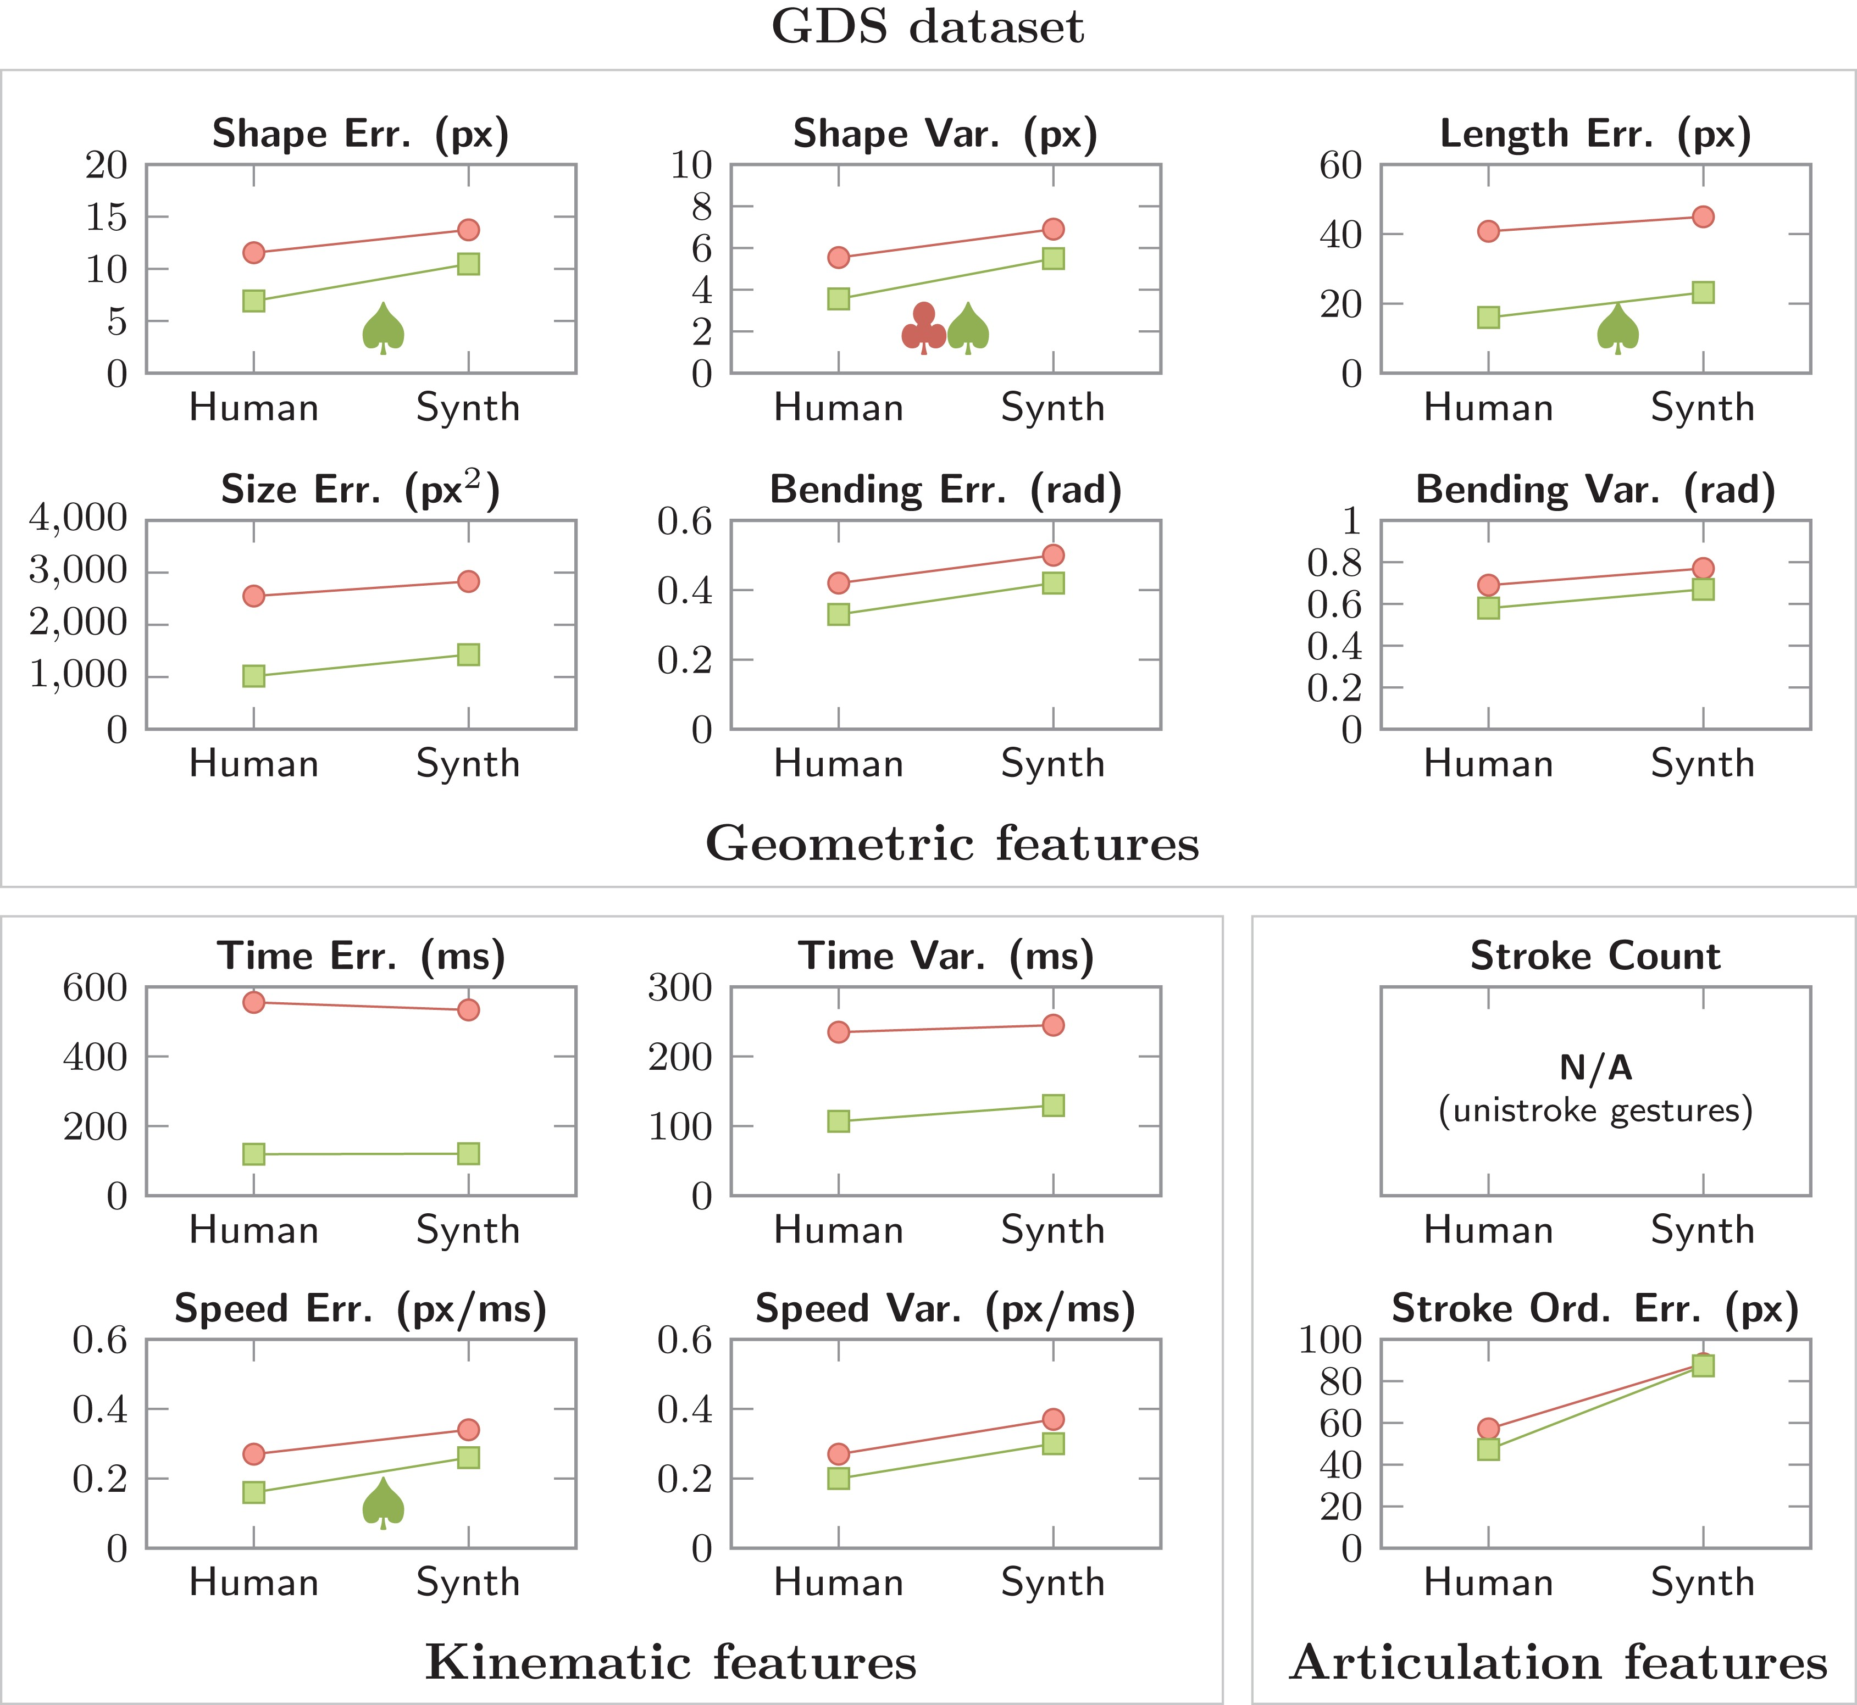
Figure 7. Overall results with human and synthesized gestures over the GDS data set. Circles () denote user-independent ...
Notes:
Figure 7. Overall results with human and synthesized gestures over the GDS data set. Circles () denote user-independent tests and squares () denote user-dependent tests. Of the note, 95% confidence intervals are all below 1%, so they are omitted. A statistically significant difference between populations (P<0.05/12) is denoted with clubs () for user-independent tests and spades () for user-dependent tests. Effects sizes (M = 0.13, SD = 0.1) suggest low practical significance.
Unless provided in the caption above, the following copyright applies to the content of this slide: © The Author 2017. Published by Oxford University Press on behalf of The British Computer Society. All rights reserved. For Permissions, please email: journals.permissions@oup.com

Slide 8
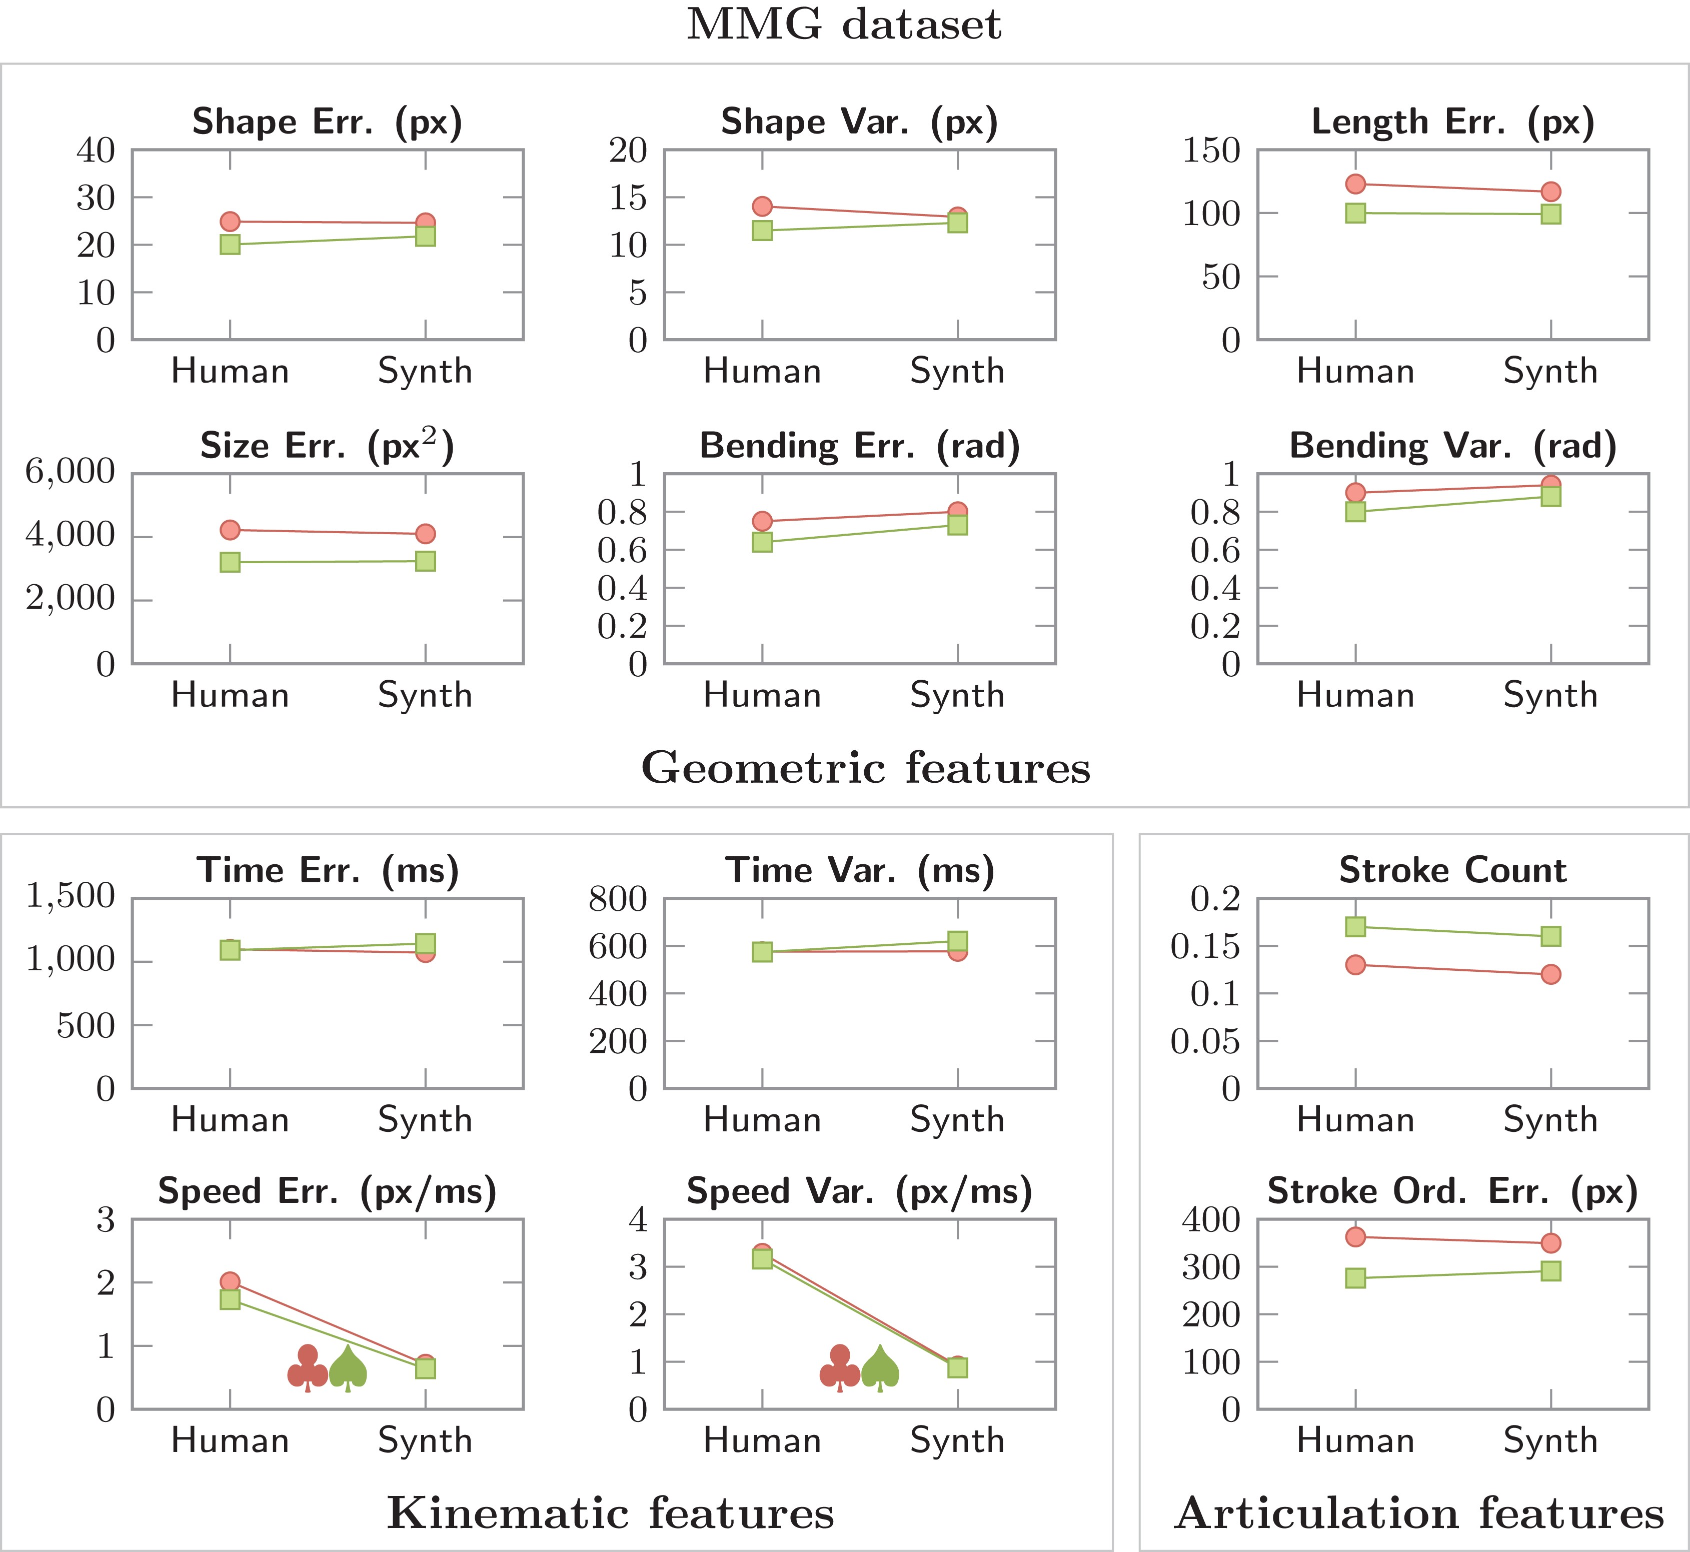
Figure 8. Overall results with human and synthesized gestures over the MMG data set. Circles () denote user-independent ...
Notes:
Figure 8. Overall results with human and synthesized gestures over the MMG data set. Circles () denote user-independent tests and squares () denote user-dependent tests. Of the note, 95% confidence intervals are all below 1%, so they are omitted. A statistically significant difference between populations (P<0.05/12) is denoted with clubs () for user-independent tests and spades () for user-dependent tests. Effects sizes (M = 0.13, SD = 0.1) suggest low practical significance.
Unless provided in the caption above, the following copyright applies to the content of this slide: © The Author 2017. Published by Oxford University Press on behalf of The British Computer Society. All rights reserved. For Permissions, please email: journals.permissions@oup.com

