Slide 1
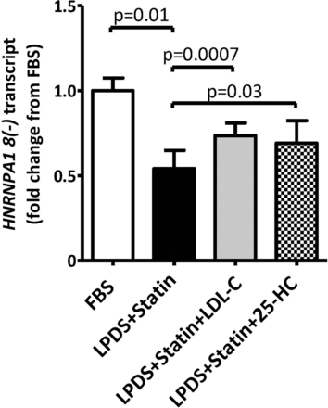
Figure 1. Sterol depletion down-regulates HNRNPA1 expression. HepG2 cells (n = 10) were incubated under one of the four ...
Notes:
Figure 1. Sterol depletion down-regulates HNRNPA1 expression. HepG2 cells (n = 10) were incubated under one of the four conditions: 48-h incubation in media supplemented with 10% FBS, 48-h incubation in media supplemented with 2 µm activated simvastatin and 10% LPDS, 24-h incubation in media supplemented with 2 µm statin and 10% LPDS followed by a 24-h incubation with 50 µg/ml LDL-C add-back, or 24-h incubation in media supplemented with 2 µM statin and 10% LPDS followed by a 24-h incubation with 1 µg/ml 25-HC. Transcript levels of HNRNPA1 lacking exon 8, HNRNPA1 8(−), the predominant variant of HNRNPA1, were quantified using qPCR. Results are shown as mean ± standard error. *P < 0.05 for FBS versus Statins (Student's t-test). See also Supplementary Material, Figure S1.
Unless provided in the caption above, the following copyright applies to the content of this slide: © The Author 2013. Published by Oxford University Press. All rights reserved. For Permissions, please email: journals.permissions@oup.com

Slide 2
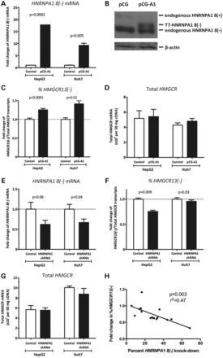
Figure 2. HNRNPA1 overexpression and knock-down modulate the relative ratio of HMGCR13(−) to total HMGCR transcripts. ...
Notes:
Figure 2. HNRNPA1 overexpression and knock-down modulate the relative ratio of HMGCR13(−) to total HMGCR transcripts. HepG2 and Huh7 cells were transfected with either the pCG-A1 HNRNPA1 8(−) overexpression or pCG control plasmid for 48 h. (A)HNRNPA1 8(−), (C) HMGCR13(−), and (D) total HMGCR transcripts from pCG-A1 and pCG transfected cells were quantified by qPCR (n = 12 for HepG2 cells; n = 3 for Huh7 cells). (B) After transfection, HepG2 cells were lysed, and 15 µg of total cell lysate was used for western blotting with either anti-HNRNPA1 or anti-β-actin antibodies. HepG2 and Huh7 cells were transfected with either the pLKO.1 HNRNPA1 shRNA or pLKO.1 scramble shRNA plasmid. After 48 h of transfection, (E) HNRNPA1 8(−), (F) HMGCR13(−) and (G) total HMGCR transcripts were quantified using qPCR (n = 6 in HepG2 cells; n = 5 in Huh7 cells). Data are shown as mean ± standard error. (H) HepG2 cells were transfected with either a Silence Select siRNA specific for HNRNPA1, or non-targeting negative control under 16 different experimental conditions created by varying the transfection agent: siRNA complex ratio and length of transfection time between 18–24 h. HMGCR13(−), HMGCR13(+) and HNRNPA1 8(−) transcripts were quantified by qPCR.
Unless provided in the caption above, the following copyright applies to the content of this slide: © The Author 2013. Published by Oxford University Press. All rights reserved. For Permissions, please email: journals.permissions@oup.com

Slide 3
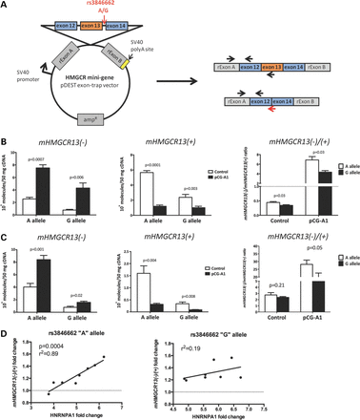
Figure 3. HNRNPA1 overexpression increases the efficiency of HMGCR exon 13 skipping in an allele-related manner. (A) ...
Notes:
Figure 3. HNRNPA1 overexpression increases the efficiency of HMGCR exon 13 skipping in an allele-related manner. (A) Scheme of the HMGCR mini-gene construct containing the genomic fragment of HMGCR introns 11 through 14. Arrows on exons indicate the locations of qPCR primers designed to specifically quantify mini-gene-derived HMGCR transcripts. (B) Huh7 (n = 6), (C) Hep3B (n = 6) and (D) HepG2 (n = 8) cell lines were co-transfected with either the rs3846662 ‘A’ allele or ‘G’ allele HMGCR mini-gene construct as well as either the pCG-A1 HNRNPA1 8(−) overexpression or pCG control plasmid. After 48 h, mHMGCR transcripts were quantified by qPCR. The relative ratio of mHMGCR13(−) to mHMGCR13(+) transcripts are shown for co-transfected Huh7 and Hep3B cell lines (n = 6 per cell line). Values shown are expressed as mean ± standard error. The correlation between HNRNPA1 overexpression levels and the ratio of mHMGCR13(−) to mHMGCR13(+) transcripts is shown for co-transfected HepG2 cells.
Unless provided in the caption above, the following copyright applies to the content of this slide: © The Author 2013. Published by Oxford University Press. All rights reserved. For Permissions, please email: journals.permissions@oup.com

Slide 4
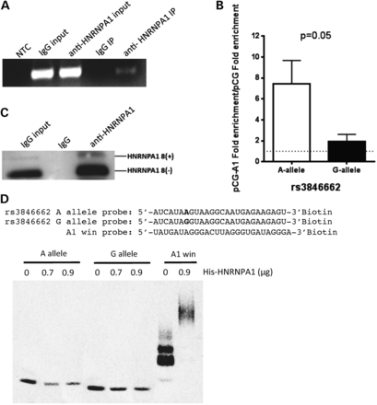
Figure 4. HNRNPA1 directly interacts with HMGCR intron 13. (A) HepG2 cell lysates were subject to RIP using an ...
Notes:
Figure 4. HNRNPA1 directly interacts with HMGCR intron 13. (A) HepG2 cell lysates were subject to RIP using an anti-HNRNPA1 antibody or normal mouse IgG as control. HMGCR intron 13 containing transcripts in the input and immunprecipitated (IP) RNA was detected by RT-PCR, and visualized on a 2% agarose gel along with PCR negative control (NTC). (B) HepG2 cells (n = 3) were co-transfected with either the rs3846662 ‘A’ allele or ‘G’ allele HMGCR mini-gene construct as well as either the pCG-A1 HNRNPA1 8(−) overexpression or pCG control plasmid. After 48 h, an RIP assay was performed, and the pull-down mHMGCR pre-mRNA was analyzed by qPCR. The fold enrichment of binding was calculated as the amount of mini-gene HMGCR obtained from the anti-HNRNPA1 antibody-immunoprecipitates compared with the quantity of mini-gene HMGCR isolated from the normal mouse IgG complexes (negative control). Values shown are mean ± standard error. (C) Cell lysates from the RIP assays were subject to western blot analysis with anti-human HNRNPA1 antibody to confirm HNRNPA1 protein pull-down. (D) RNA gel shift assay was performed to test whether rs3846662 modulates the direct interaction between HNRNPA1 protein (His-HNRNPA1) and HMGCR intron 13. The upper panel shows the sequences of 3′ biotin-labeled rs3846662 RNA probes containing either ‘A’ or ‘G’ allele. The A1 win probe is a positive control probe containing three repeats of a known HNRNPA1-binding motif (15). Each of the three RNA probes was incubated with varying concentrations of His-HNRNPA1 protein, with reactions separated onto a 4–20% gel, transferred to a membrane, cross-linked and band intensity quantified. Although no shift was observed with the HMGCR probes, complex formation was inferred by the decrease in free RNA probe as RNA–protein complexes may have been trapped in the gel wells. The experiment was performed in triplicate, with a representative gel shown. See also Supplementary Material, Figure S2.
Unless provided in the caption above, the following copyright applies to the content of this slide: © The Author 2013. Published by Oxford University Press. All rights reserved. For Permissions, please email: journals.permissions@oup.com

Slide 5
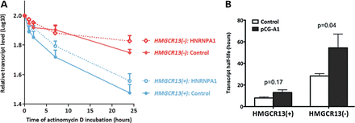
Figure 5. HNRNPA1 preferentially stabilizes HMGCR13(−) transcripts. HepG2 cells were transfected with either the pCG-A1 ...
Notes:
Figure 5. HNRNPA1 preferentially stabilizes HMGCR13(−) transcripts. HepG2 cells were transfected with either the pCG-A1 HNRNPA1 8(−) overexpression or pCG control plasmid for 48 h, after which 1 µg/ml actinomycin D was added (n = 9). Cells were harvested after 0, 0.5, 1, 2, 7 and 24 h of actinomycin D treatment. HMGCR13(−) and 13(+) transcripts were quantified by qPCR. Transcript half-life was calculated using only time points congruous with first-order decay kinetics (17). (A) Transcript levels per time point were log transformed, averaged and plotted versus actinomycin D incubation time. (B) Transcript half-life was calculated from the slope of the log-transformed mRNA quantities of the 0–24-h time points with the following formula: t1/2 (h) = ln2/(−2.303 × slope). Values shown are expressed as mean ± standard error. See also Supplementary Material, Figures S3 and S4.
Unless provided in the caption above, the following copyright applies to the content of this slide: © The Author 2013. Published by Oxford University Press. All rights reserved. For Permissions, please email: journals.permissions@oup.com

Slide 6
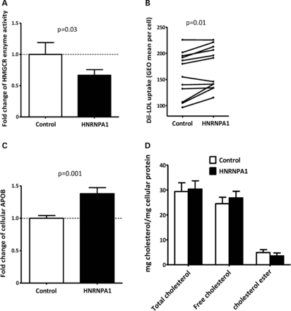
Figure 6. HNRNPA1 overexpression effects on cellular cholesterol metabolism. HepG2 cells (n = 6–12) were transfected ...
Notes:
Figure 6. HNRNPA1 overexpression effects on cellular cholesterol metabolism. HepG2 cells (n = 6–12) were transfected with a control plasmid (pCG) or an HNRNPA1 8(−) expression plasmid (pCG-A1) for 24 h. (A) HMGCR enzyme activity was quantified by incubating lysed cells with 14C-HMG-CoA (precursor) to directly assess incorporation rates into 14C-mevalonate (substrate). Radiolabeled HMG-CoA and mevalonate were separated by ion affinity in an AG-1X column, with 3H-mevalonate spiked in to assess recovery rates. Total cellular protein was quantified by the Bradford assay, and pmol of mevalonate formed was normalized to total protein. (B) LDL-C uptake was assayed by FACS following 4-h incubation with 10 µg/ml Dil-LDL. (C) Cellular APOB amount was determined by ELISA. (D) Intracellular cholesterol content was quantified by an Amplex® Red cholesterol assay kit. Values shown are expressed as mean ± standard error.
Unless provided in the caption above, the following copyright applies to the content of this slide: © The Author 2013. Published by Oxford University Press. All rights reserved. For Permissions, please email: journals.permissions@oup.com

Slide 7
Figure 7. rs1920045 influences HNRNPA1 8(+) transcript expression levels and statin-induced cholesterol-lowering. (A) ...
Notes:
Figure 7. rs1920045 influences HNRNPA1 8(+) transcript expression levels and statin-induced cholesterol-lowering. (A) 480 CAP LCLs were incubated with either sham buffer or 2 µm simvastatin for 24 h after which HNRNPA1 8(+) expression levels were quantified by expression array. Statistically significant differences in statin-induced change in HNRNPA1 8(+) transcript levels between rs1920045 genotype classes were calculated post hoc by Student's t-test. (B) Hep3B, HepG2 and Huh7 cell lines were grown under standard conditions, and cytoplasmic versus nuclear fractions were isolated. HNRNPA1 protein was identified by immunoblot to determine the subcellular localization of the two HNRNPA1 isoforms. (C) Statin-induced plasma cholesterol-lowering was compared across rs1920045 genotype classes in two independent statin clinical trials [CC + CT versus. TT one-tailed t-test P = 0.006, 0.0304 and 0.0362 for CAP + PRINCE, PRINCE (n = 1123 CC + CT and n = 188 TT), and CAP (n = 496 CC + CT and n = 90 TT), respectively]. Graphs depict mean ± standard error, and P-values are uncorrected for multiple testing. See also Supplementary Material, Figures S5–S8.
Unless provided in the caption above, the following copyright applies to the content of this slide: © The Author 2013. Published by Oxford University Press. All rights reserved. For Permissions, please email: journals.permissions@oup.com

Slide 8
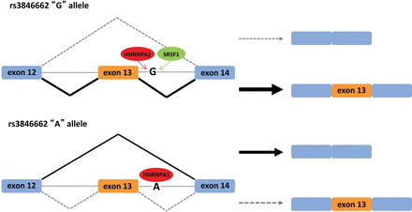
Figure 8. Hypothetic model of rs3846662 regulation of HMGCR exon 13 alternative splicing. Putative HNRNPA1 and ...
Notes:
Figure 8. Hypothetic model of rs3846662 regulation of HMGCR exon 13 alternative splicing. Putative HNRNPA1 and SRSF1-binding motifs within the HMGCR intron 13 sequence containing either the rs3846662 ‘G’ or ‘A’ allele were identified using the Human Splicing Finder (11) with the default threshold values. SRSF1 and HNRNPA1 have similar binding motifs and are known antagonists. SRSF1 promotes utilization of the proximal 5′ splice donor resulting in exon retention, while HNRNPA1 promotes utilization of the distal 5′ splice donor to cause exon skipping (14). Although both HNRNPA1 and SRSF1 are predicted to compete for a binding motif containing the rs3846662 ‘G’ allele, only HNRNPA1 is predicted to bind the rs3846662 ‘A’ allele, and thus is expected to promote exon 13 skipping.
Unless provided in the caption above, the following copyright applies to the content of this slide: © The Author 2013. Published by Oxford University Press. All rights reserved. For Permissions, please email: journals.permissions@oup.com

