Slide 1
A colour version of this photograph is on The Computer Journal website.
Notes:
A colour version of this photograph is on The Computer Journal website.
Unless provided in the caption above, the following copyright applies to the content of this slide: © The Author 2006. Published by Oxford University Press on behalf of The British Computer Society. All rights reserved. For Permissions, please email: journals.permissions@oxfordjournals.org

Slide 2
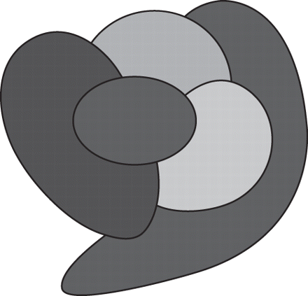
FIGURE 1 The Four Colour Theorem. This map is coloured with just four colours, so that no two adjacent countries share ...
Notes:
FIGURE 1 The Four Colour Theorem. This map is coloured with just four colours, so that no two adjacent countries share a colour. Will four colours always suffice? The colour version of this figure is on The Computer Journal website.
Unless provided in the caption above, the following copyright applies to the content of this slide: © The Author 2006. Published by Oxford University Press on behalf of The British Computer Society. All rights reserved. For Permissions, please email: journals.permissions@oxfordjournals.org

Slide 3
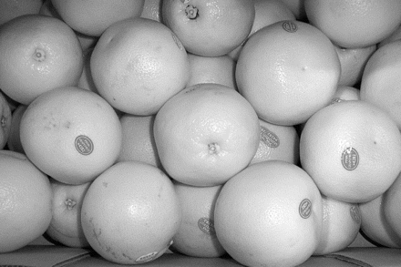
FIGURE 2 Kepler's Conjecture. The grapefruit are packed tightly together. Could they be packed more tightly? The ...
Notes:
FIGURE 2 Kepler's Conjecture. The grapefruit are packed tightly together. Could they be packed more tightly? The colour version of this figure is on The Computer Journal website.
Unless provided in the caption above, the following copyright applies to the content of this slide: © The Author 2006. Published by Oxford University Press on behalf of The British Computer Society. All rights reserved. For Permissions, please email: journals.permissions@oxfordjournals.org

Slide 4
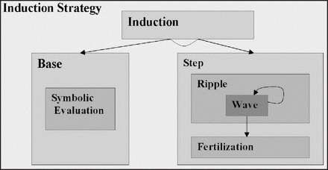
FIGURE 3 A hiproof for the induction strategy. The whole induction strategy is represented by the outer box. It ...
Notes:
FIGURE 3 A hiproof for the induction strategy. The whole induction strategy is represented by the outer box. It consists of three tactics: an application of an induction rule, followed by a base case and a step case. The base case consists of symbolic evaluation and a step case consists of ripple followed by fertilization. Ripple consists of repeated applications of the wave tactic. The colour version of this figure is on The Computer Journal website.
Unless provided in the caption above, the following copyright applies to the content of this slide: © The Author 2006. Published by Oxford University Press on behalf of The British Computer Society. All rights reserved. For Permissions, please email: journals.permissions@oxfordjournals.org

Slide 5
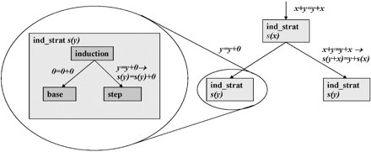
FIGURE 4 An exploded view of one of the tactics. The proof of the commutativity of addition consists of three ...
Notes:
FIGURE 4 An exploded view of one of the tactics. The proof of the commutativity of addition consists of three applications of the induction strategy. One of these applications has been exploded to show its inner structure, which consists of an induction tactic followed by a base and step case. The colour version of this figure is on The Computer Journal website.
Unless provided in the caption above, the following copyright applies to the content of this slide: © The Author 2006. Published by Oxford University Press on behalf of The British Computer Society. All rights reserved. For Permissions, please email: journals.permissions@oxfordjournals.org

Slide 6
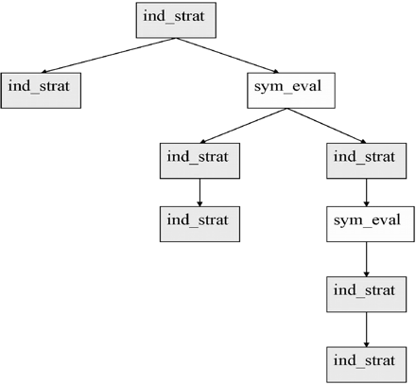
FIGURE 5 The overall view of a proof. The depicted proof plan is from the verification of an electronic circuit for ...
Notes:
FIGURE 5 The overall view of a proof. The depicted proof plan is from the verification of an electronic circuit for multiplication. The hiproof shows the top-level tactics involved in the proof. It consists of seven applications of the induction strategy interleaved with two applications of symbolic evaluation. The colour version of this figure is on The Computer Journal website.
Unless provided in the caption above, the following copyright applies to the content of this slide: © The Author 2006. Published by Oxford University Press on behalf of The British Computer Society. All rights reserved. For Permissions, please email: journals.permissions@oxfordjournals.org

