Slide 1
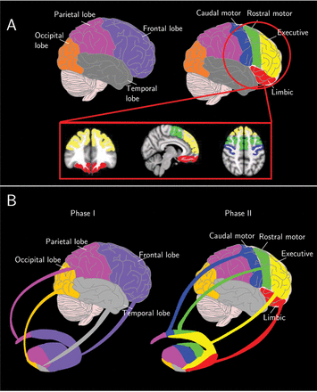
Figure 1. (A) Cortical subdivisions. Purple corresponds to the frontal lobe, magenta to the parietal lobe, gray to the ...
Notes:
Figure 1. (A) Cortical subdivisions. Purple corresponds to the frontal lobe, magenta to the parietal lobe, gray to the temporal lobe, and orange to the occipital lobe. Yellow corresponds to the executive, red to the limbic, green to the rostral-motor, and blue to the caudal-motor. (B) Methods overview. To obtain the CB functional regions in each subject, a 2-step procedure was applied: (Phase I) the projections from the 4 brain lobes (frontal, parietal, occipital, and temporal) to the striatum were calculated, and the striatal areas associated with each lobe were established. (Phase II) The frontal lobe was subdivided into 4 anatomical ROIs, each associated with a particular functional specialization (limbic, executive, rostral-motor, and caudal-motor), and projections between these anatomical ROIs and the striatal area associated with the frontal lobe were estimated
Unless provided in the caption above, the following copyright applies to the content of this slide: © The Author 2013. Published by Oxford University Press. All rights reserved. For Permissions, please e-mail: journals.permissions@oup.com

Slide 2
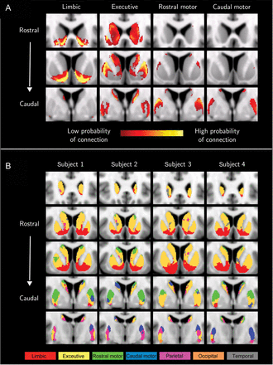
Figure 2. (A) Group average projections from the 4 frontal lobe target to the striatum. Each anatomical target is ...
Notes:
Figure 2. (A) Group average projections from the 4 frontal lobe target to the striatum. Each anatomical target is associated with a specific function; limbic (first column), executive (second), rostral-motor (third), and caudal-motor (fourth) functions. The rows correspond to different coronal planes (top row corresponds to rostral striatum and bottom row to caudal striatum). A threshold of 50 samples was applied to the image in order to discard noise and voxels with low connection probabilities. (B) Individual functional subdivisions in 4 randomly selected subjects (MNI space—coronal planes). Each column corresponds to a subject starting from rostral (top row) to caudal (bottom row). To obtain the functional subdivision for each subject, a 2-step procedure was applied. First, the projections from the 4 brain lobes (frontal, parietal, occipital, and temporal) were calculated and each lobe's dominant area was established. Subsequently, the frontal lobe was subdivided into 4 anatomical ROIs, each associated with a specific function (limbic, executive, rostral-motor, and caudal-motor), and the projection of each target to the frontal lobe dominant area was estimated. Each voxel was assigned to the target that gave the highest connection probability.
Unless provided in the caption above, the following copyright applies to the content of this slide: © The Author 2013. Published by Oxford University Press. All rights reserved. For Permissions, please e-mail: journals.permissions@oup.com

Slide 3
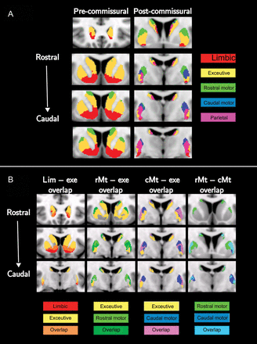
Figure 3. (A) Group averaged functional subdivision of the striatum (MNI space—coronal planes). First column ...
Notes:
Figure 3. (A) Group averaged functional subdivision of the striatum (MNI space—coronal planes). First column corresponds to the precommissural and second column to the postcommissural striatum. (B) Overlapping projections in the striatum (MNI space—coronal planes). The columns correspond to overlaps between: 1) limbic and executive (first column); 2) executive and rostral-motor (second column); 3) executive and caudal-motor (third column); and 4) rostral-motor and caudal-motor (fourth column). A threshold of 50 samples was applied to the projections and, subsequently, the overlapping areas were determined
Unless provided in the caption above, the following copyright applies to the content of this slide: © The Author 2013. Published by Oxford University Press. All rights reserved. For Permissions, please e-mail: journals.permissions@oup.com

Slide 4
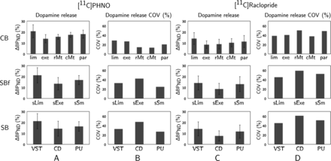
Figure 4. Dopamine release measured as the percentage change of [¹¹C]PHNO BP_{ND} (column A) and ...
Notes:
Figure 4. Dopamine release measured as the percentage change of [11C]PHNO BPND (column A) and [11C]Raclopride BPND (column C) within the exclusive CB functional ROIs (CB, top row), the structural-derived functional ROIs (SBf, middle row), and the structural subdivisions of the striatum (SB, bottom row). Columns B and D correspond to the dopamine release %COV for each region for [11C]PHNO and [11C]Raclopride, respectively. Abbreviations correspond to: lim = limbic, exe = executive, rMt = rostral-motor, cMt = caudal-motor, par = parietal, sLim = structural-limbic, sExe = structural-executive, sSm = structural-sensorimotor, VST = ventral striatum, CD = caudate, PU = putamen.
Unless provided in the caption above, the following copyright applies to the content of this slide: © The Author 2013. Published by Oxford University Press. All rights reserved. For Permissions, please e-mail: journals.permissions@oup.com

