Slide 1
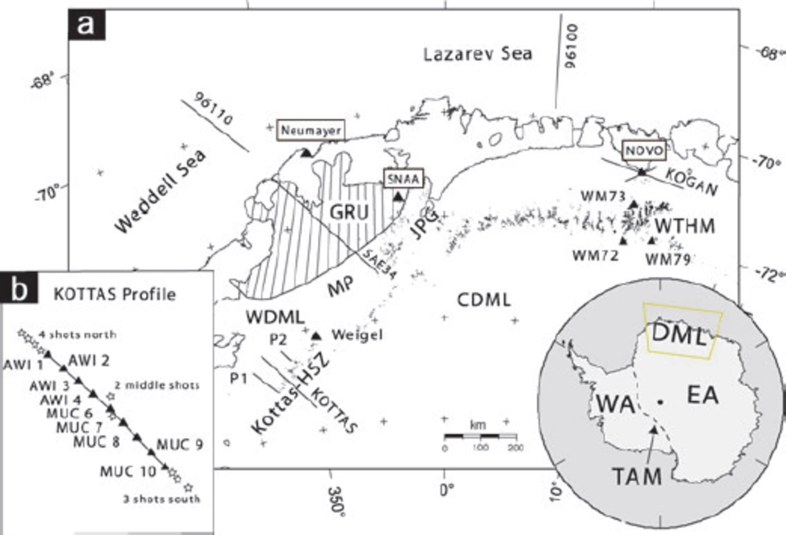
Figure 1. (a) Sketch of Dronning Maud Land with the seismic stations (black triangles), the refraction profiles (96110, ...
Notes:
Figure 1. (a) Sketch of Dronning Maud Land with the seismic stations (black triangles), the refraction profiles (96110, 96100, KOGAN, KOTTAS, SAE34, P1, P2 as black lines) and the main geological units. Outcrops are marked with black dots. Abbreviations mentioned in the text are: HSZ, Heimefront shear zone; Kottas, Kottas Mountains; JPG, Jutul-Penck-Graben covered by the Jutulstraumen glacier; GRU, Grunehogna Craton (dashed area); WTHM, Wohlthat Massif; MP, Maudheim Province; Weigel, station deployed on Weigel nunatak (an outcrop at Kottas); Novo, Russian station Novolazarevskaya; SNAA, South African station Sanae IV; CDML, Central Dronning Maud Land; WDML, Western Dronning Maud Land; WA, West Antarctica; EA, East Antarctica; TAM, Transantarctic Mountains. Inset (b) shows the refraction profile that was performed in 1989/1990 across the Heimefront shear zone in Kottas Mountains. Nine stations, named with AWI and MUC, were deployed along the 200-km-long profile. Four shots were fired at the northern side, two at the middle and three at the southern end of the profile.
Unless provided in the caption above, the following copyright applies to the content of this slide: © 2009 The Authors Journal compilation © 2009 RAS

Slide 2
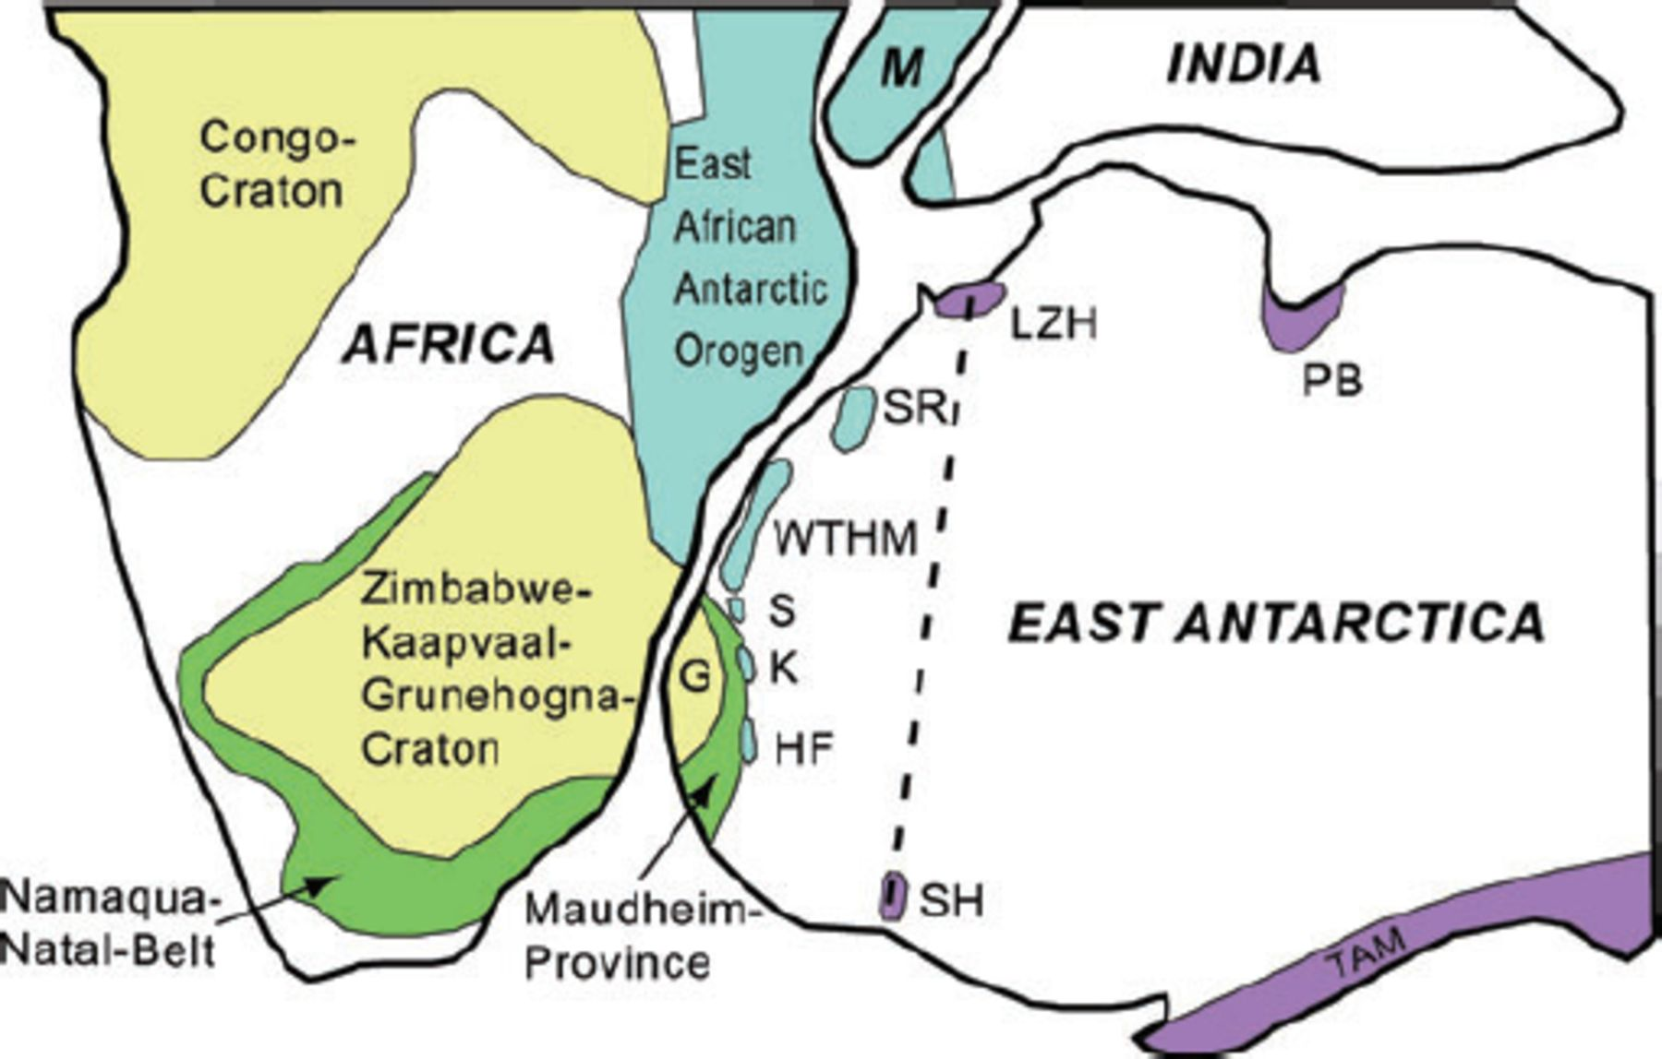
Figure 2. Sketch of the Gondwana reconstruction adapted from Jacobs et al. (2003b). Blue areas represent areas which ...
Notes:
Figure 2. Sketch of the Gondwana reconstruction adapted from Jacobs et al. (2003b). Blue areas represent areas which were affected by the Pan-African (ca. 550 Ma) orogeny named the East African Antarctic Orogen. Green areas show the Mesoproterozoic (ca. 1.1 Ga) African Namaqua-Natal mobile belt and the Antarctic Maudheim Province. Yellow units are major African cratons. Purple areas mark ∼700–500 Ma mobile belts. Thick dashed line indicates a proposed Pan-African suture in Antarctica. Abbreviations mentioned in the text are: G, Grunehogna Craton; HF, Heimefrontfjella with Kottas Mountains; K, Kirvanveggen; LZH, Lützow Holm Bay; M, Madagascar; PB, Brydz Bay; S, Sverdrupfjella; SR, Sor Rodane; SH, Shackleton Range; TAM, Transantarctic Mountains and WTHM, Wohlthat Massif.
Unless provided in the caption above, the following copyright applies to the content of this slide: © 2009 The Authors Journal compilation © 2009 RAS

Slide 3
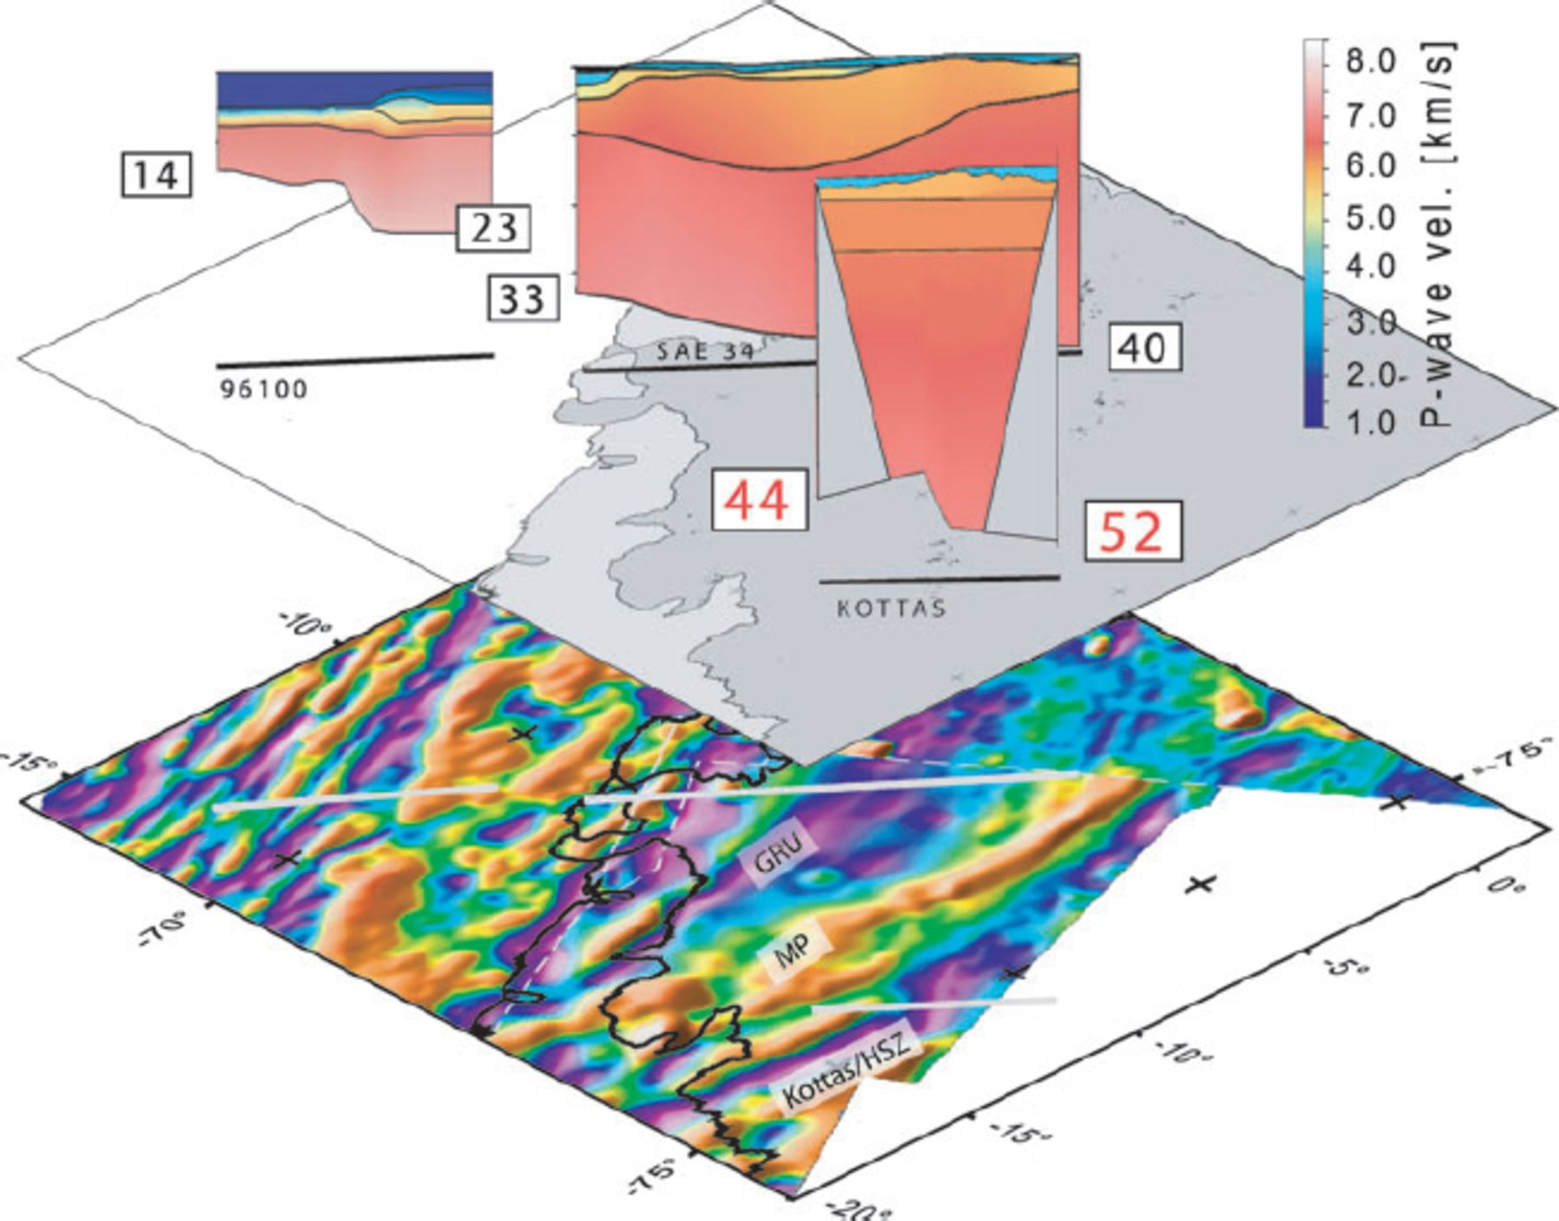
Figure 3. Transect of some existing refraction profiles within the area of investigation. Lower map shows the available ...
Notes:
Figure 3. Transect of some existing refraction profiles within the area of investigation. Lower map shows the available high resolution aero-magnetic anomaly grids of DML (EMAGE grid (Jokat et al. 2003) and ADMAP grid (Golynsky et al. 2001)). The magnetic signature of the Kottas Mountains with Heimefront shear zone (HSZ) is detectable as an elongated purple coloured region. The seismic profile KOTTAS runs directly across the Heimefront shear zone. Juxtaposed to the north is the Maudheim Province (MP), juxtaposed to MP is the Archean Grunehogna Craton (GRU).
Unless provided in the caption above, the following copyright applies to the content of this slide: © 2009 The Authors Journal compilation © 2009 RAS

Slide 4
Table 1. Parameter of the stations.
Notes:
Table 1. Parameter of the stations.
Unless provided in the caption above, the following copyright applies to the content of this slide: © 2009 The Authors Journal compilation © 2009 RAS

Slide 5
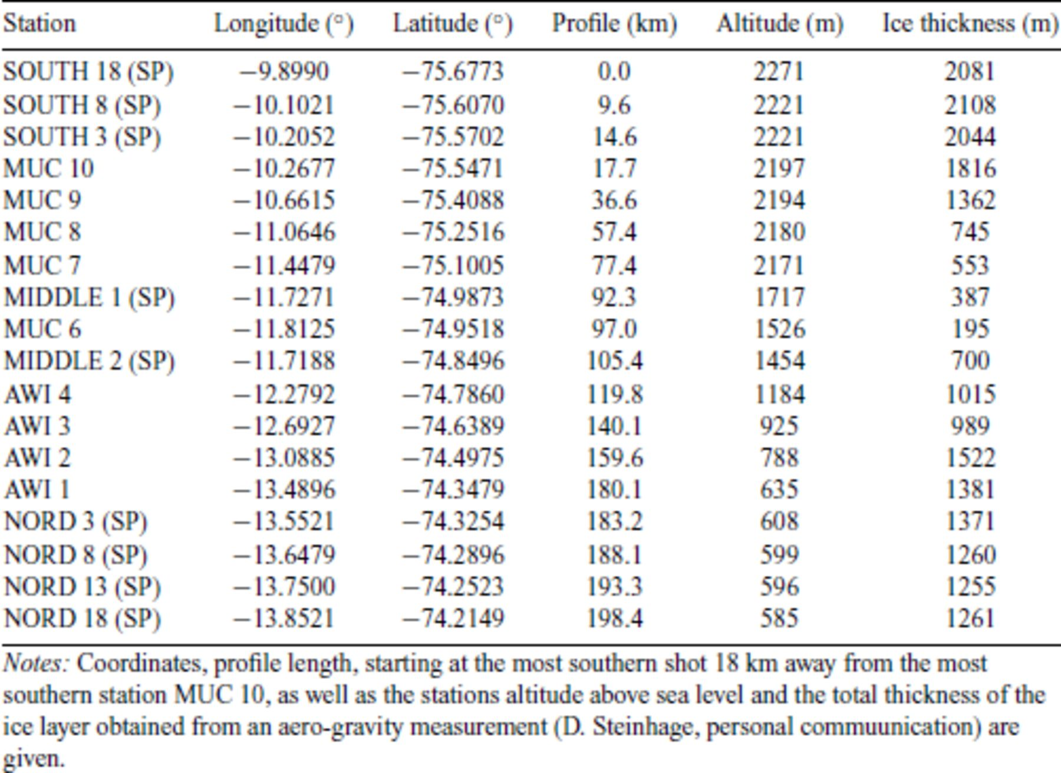
Table 2. Stations and shot points (SP) of the refractions profile KOTTAS.
Notes:
Table 2. Stations and shot points (SP) of the refractions profile KOTTAS.
Unless provided in the caption above, the following copyright applies to the content of this slide: © 2009 The Authors Journal compilation © 2009 RAS

Slide 6
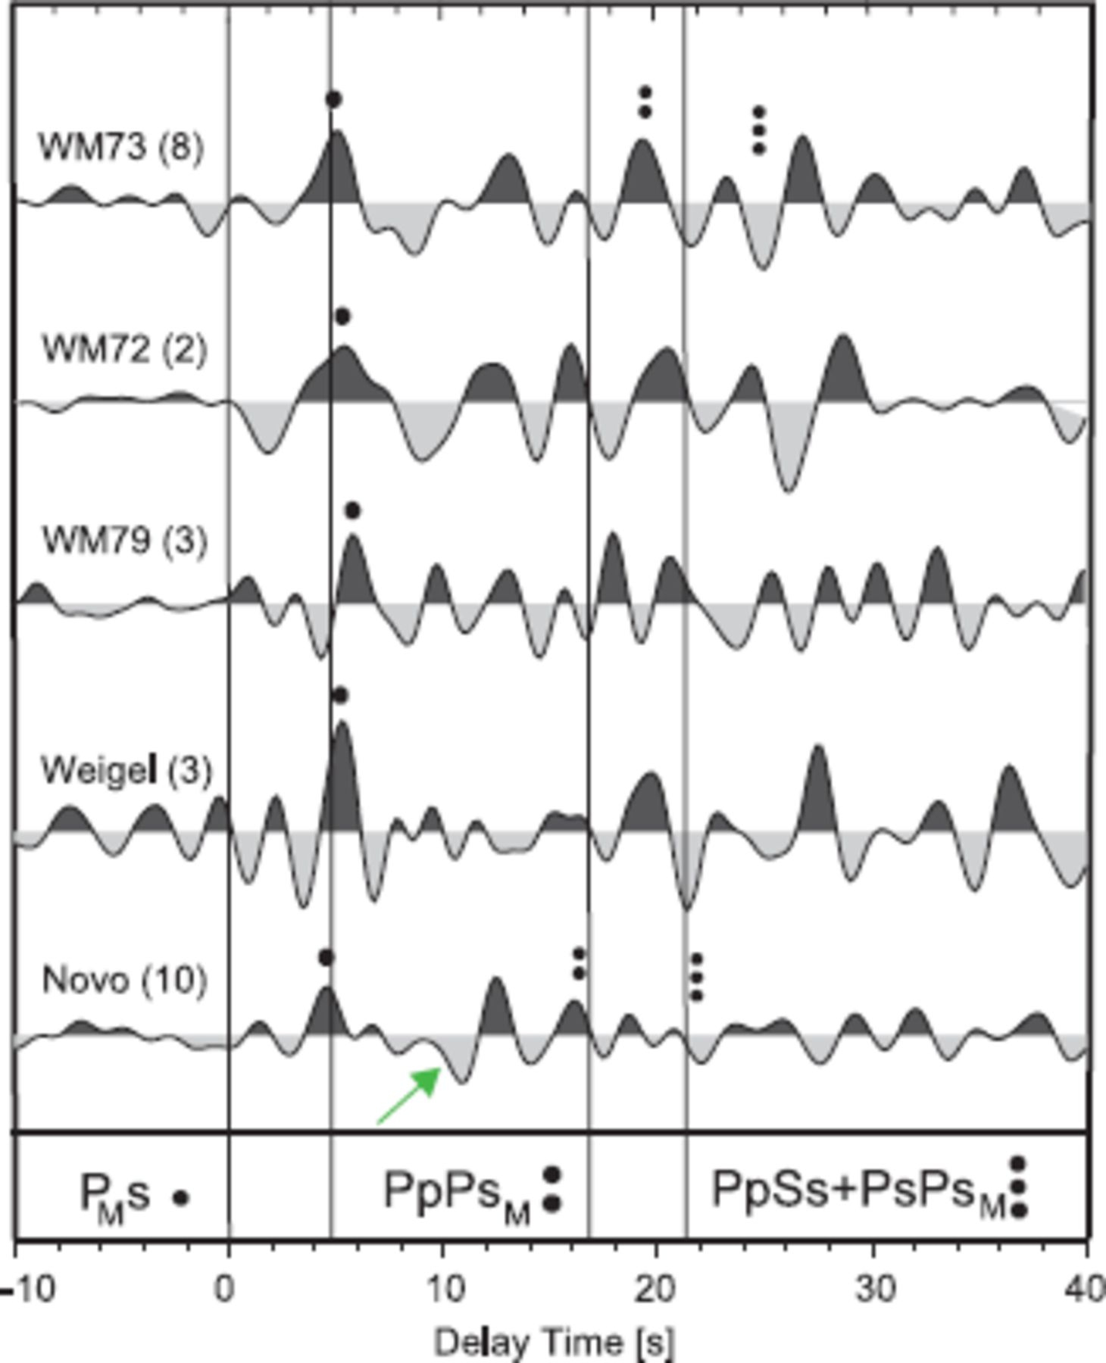
Figure 4. Sum traces of RF for all stations deployed at the Wohlthat Massif (WM), Weigel and Novo. Direct converted ...
Notes:
Figure 4. Sum traces of RF for all stations deployed at the Wohlthat Massif (WM), Weigel and Novo. Direct converted phase at the Moho PMs (taken directly from the data) is marked with one black dot. The possible crustal multiples of the Moho PpPsM and PpSs + PsPsM are marked with two and three black dots, respectively. Vertical lines mark the theoretical phases based on a IASP91-model with adapted Moho depth of 40 km. Green arrow at Novo trace signs a possible negative signal.
Unless provided in the caption above, the following copyright applies to the content of this slide: © 2009 The Authors Journal compilation © 2009 RAS

Slide 7
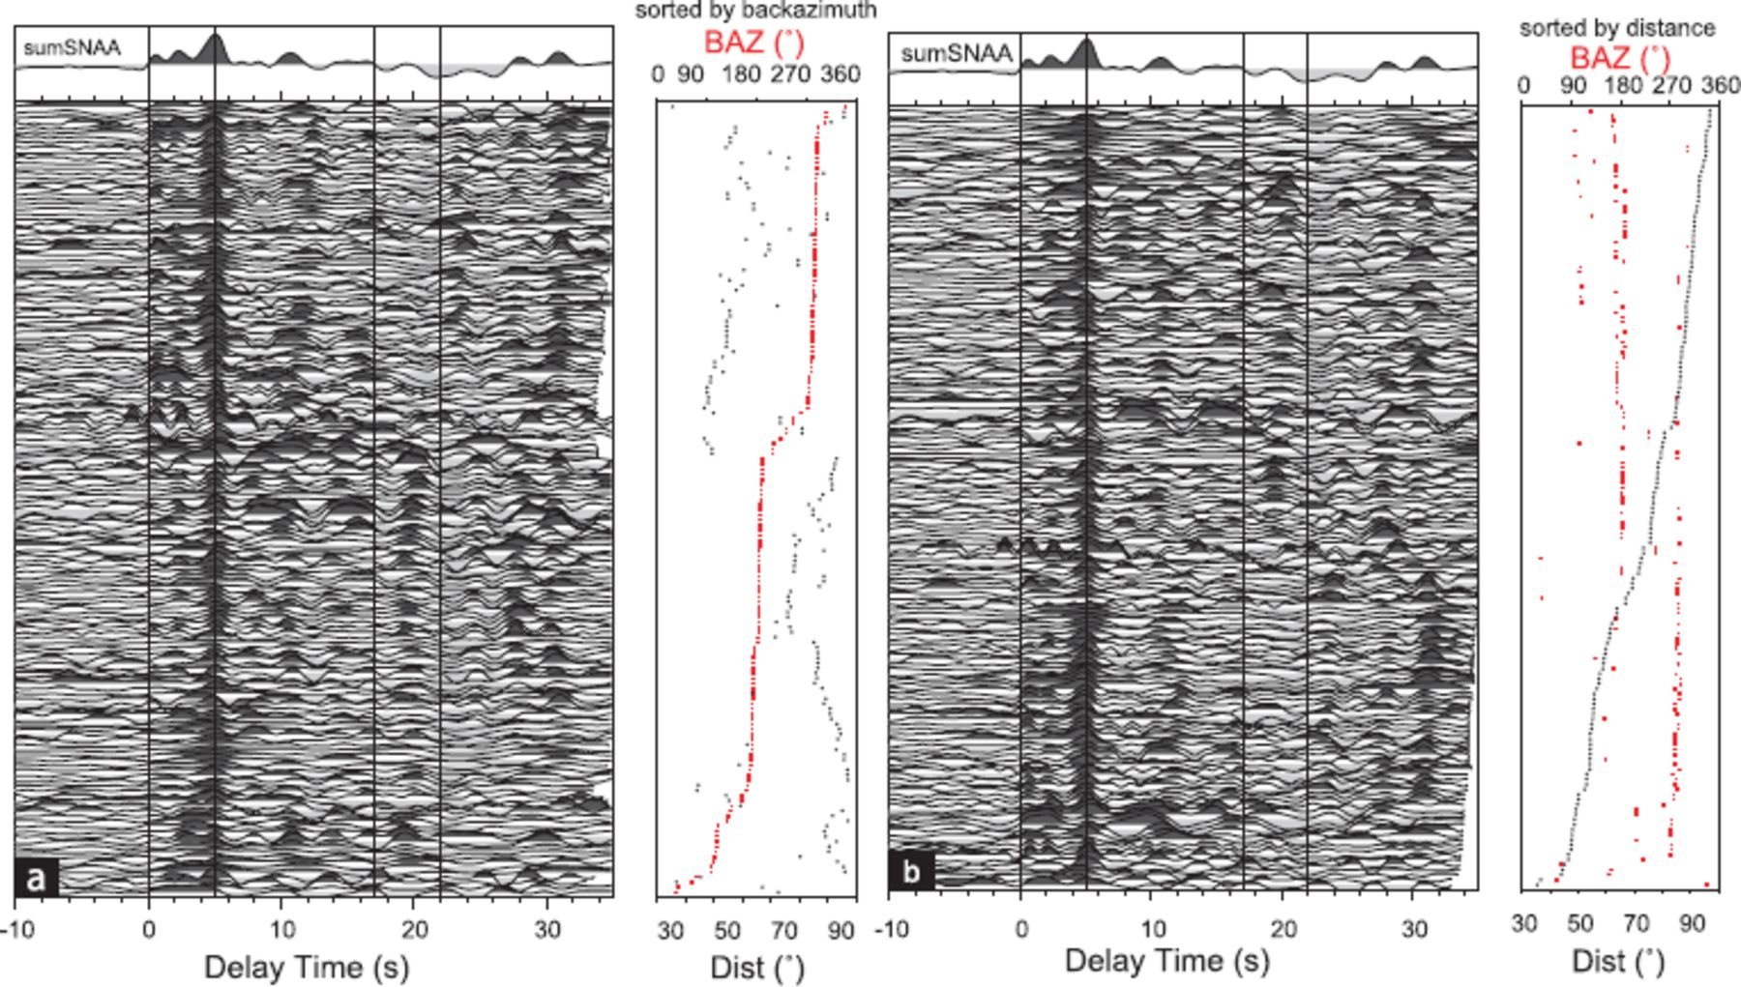
Figure 5. Receiver functions for station SNAA sorted by backazimuth (a) and distance (b). Vertical black lines at about ...
Notes:
Figure 5. Receiver functions for station SNAA sorted by backazimuth (a) and distance (b). Vertical black lines at about 5, 17 and 22 s mark the theoretical arrival times of the Ps and multiples using a ISAP91 model with an adapted Moho depth of 40 km. The sum trace on the top was build by summing the shown 173 single RFs.
Unless provided in the caption above, the following copyright applies to the content of this slide: © 2009 The Authors Journal compilation © 2009 RAS

Slide 8
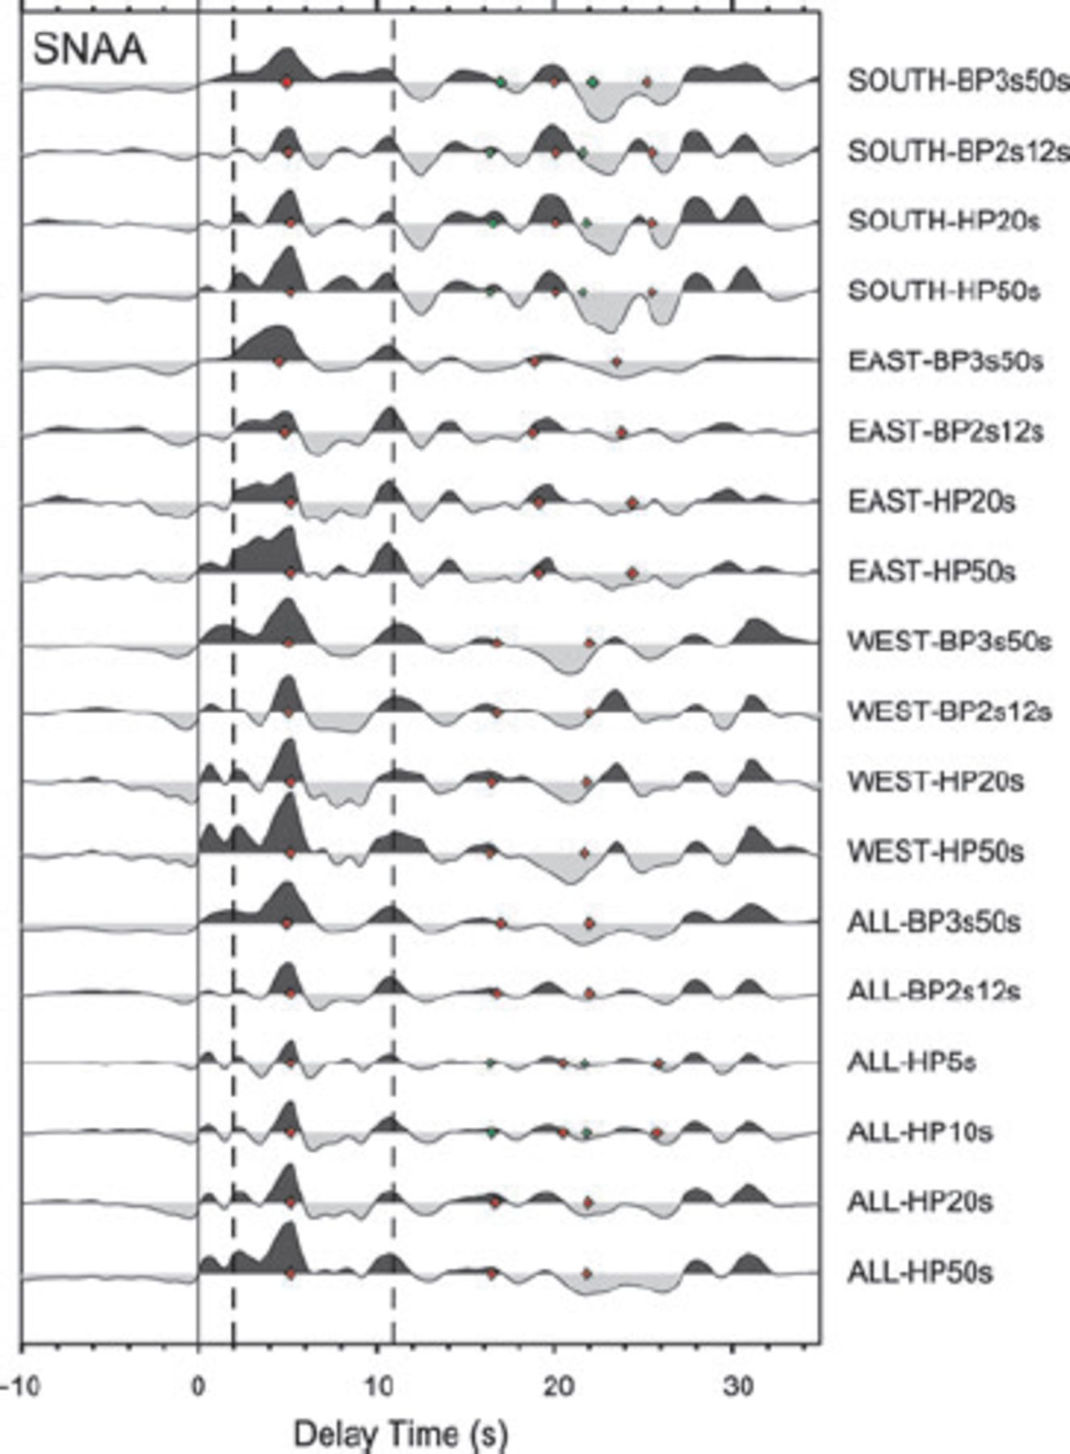
Figure 6. Sum traces of RFs for station SNAA coming from different backazimuthal segments (south, east, west and all). ...
Notes:
Figure 6. Sum traces of RFs for station SNAA coming from different backazimuthal segments (south, east, west and all). Prior to summation the traces were filtered with different filter characteristica listed on the left (e.g. SOUTH-BP3s50s: bandpass filter with filter corners of 3 and 50 s, HP: highpass). Red diamonds are the calculated delay times for the primary and multiple conversions based on the parameters of ZK analyses. Green dots represent delay times for alternative solution, which are closer to the results from all traces and only the western backazimuths. Dotted line at about 2 s sign a possible inner-crustal structure with a multiple at about 11 s.
Unless provided in the caption above, the following copyright applies to the content of this slide: © 2009 The Authors Journal compilation © 2009 RAS

Slide 9
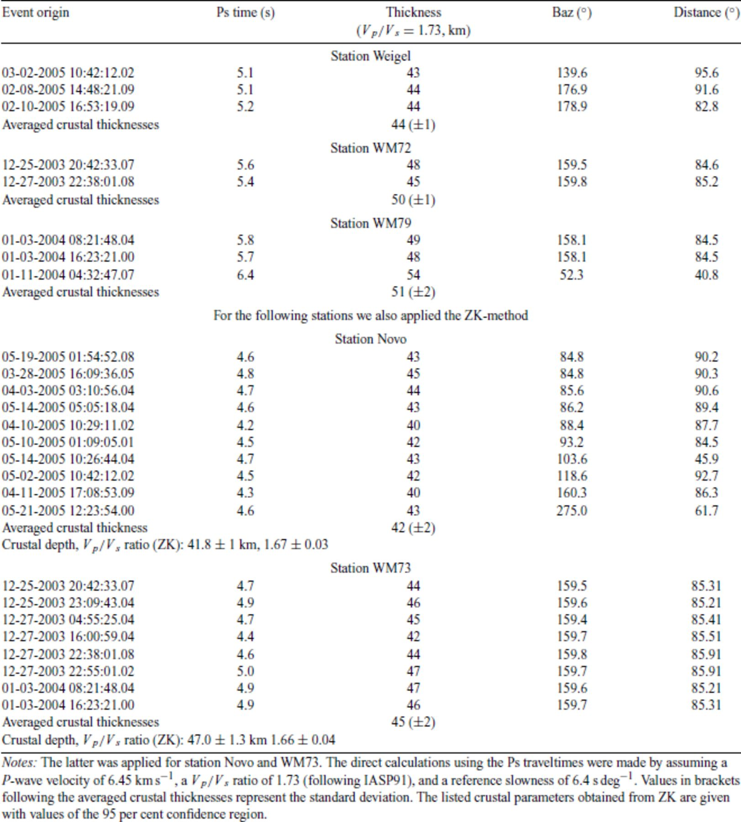
Table 3. Crustal depths for station Weigel, WM72, WM73 and WM79, and Novo based on the onsets of Moho Ps conversion ...
Notes:
Table 3. Crustal depths for station Weigel, WM72, WM73 and WM79, and Novo based on the onsets of Moho Ps conversion and the Zhu & Kanamori (2000) technique (ZK).
Unless provided in the caption above, the following copyright applies to the content of this slide: © 2009 The Authors Journal compilation © 2009 RAS

Slide 10
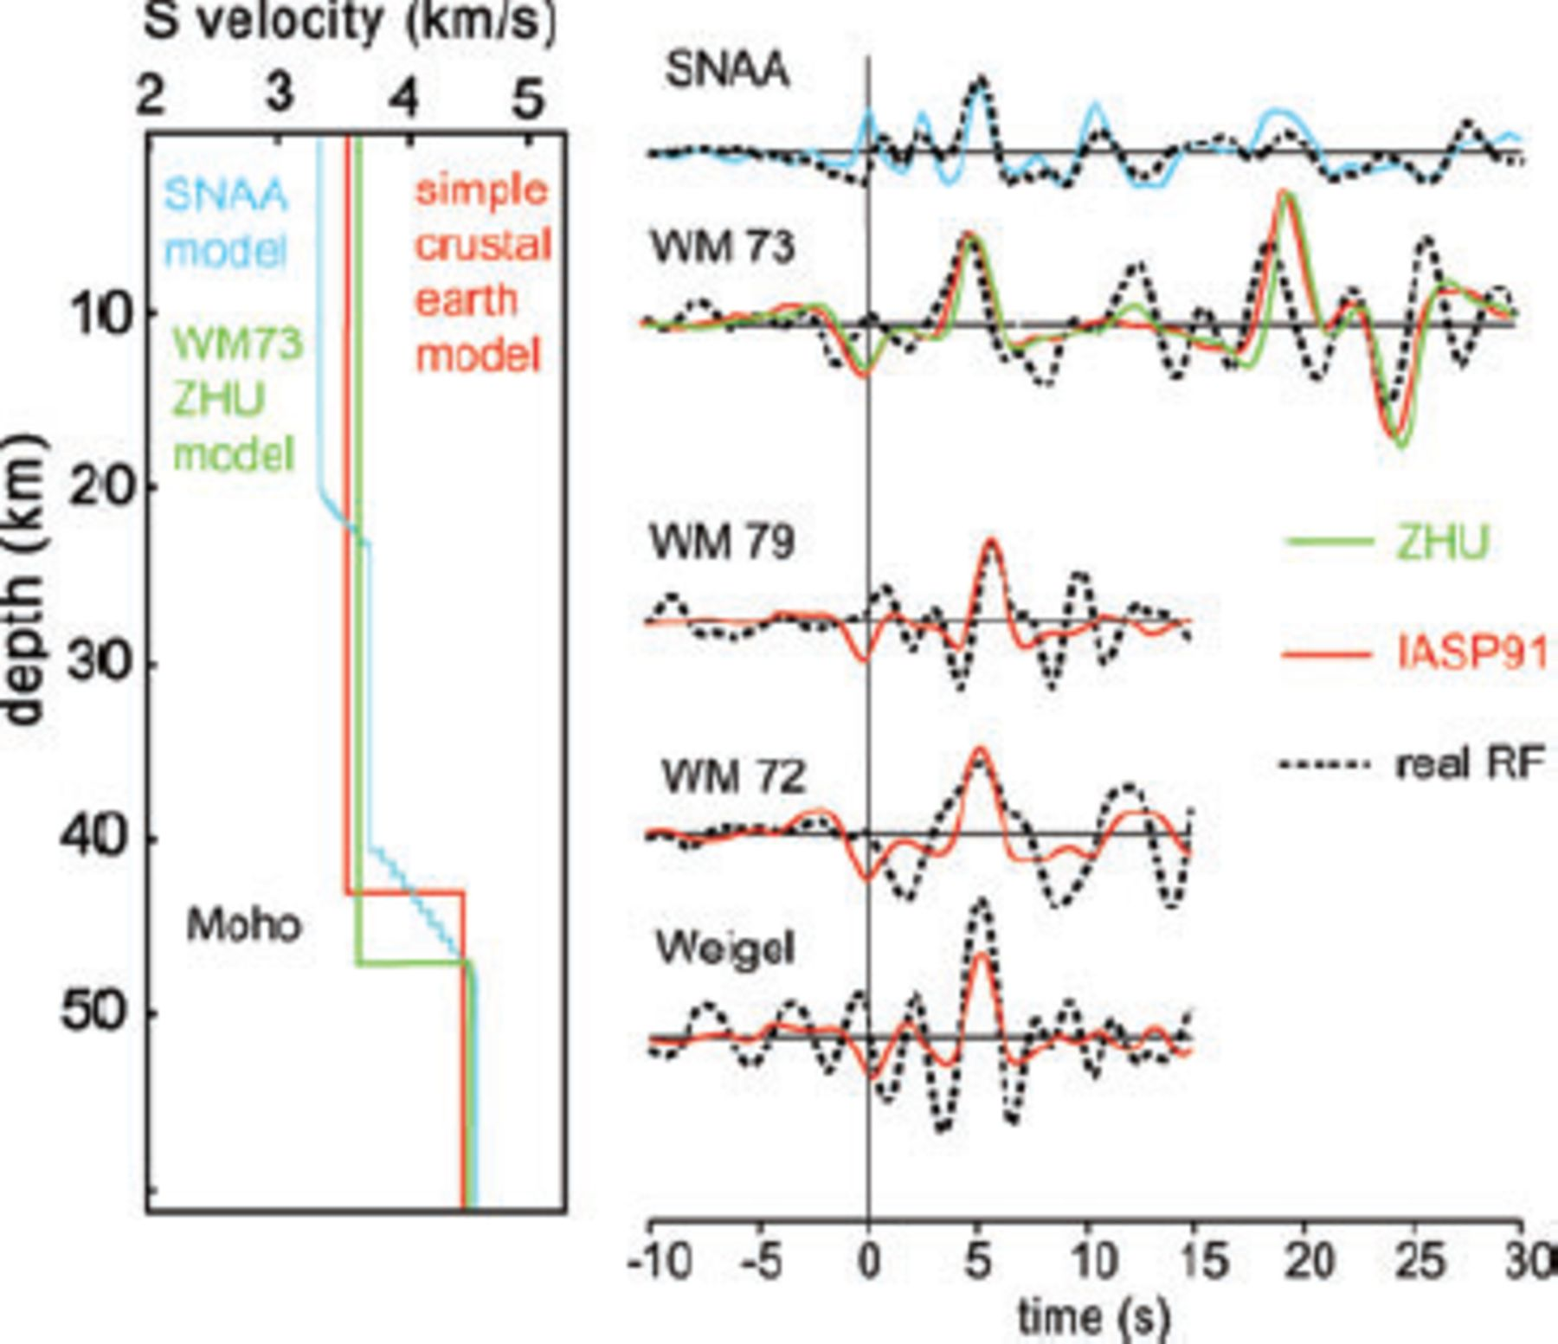
Figure 7. Synthetic RF obtained by forward modelling (slowness of 6.4 s deg⁻¹) with the plane wave ...
Notes:
Figure 7. Synthetic RF obtained by forward modelling (slowness of 6.4 s deg−1) with the plane wave approximation (Kind et al. 1995) in comparison with observed RF (black dashed lines). Solid red waveforms are the synthetics based on a very simple crustal model shown on the left-hand side (also in red) with a sharp Moho transition zone. For stations WM72, WM73, WM79 and Weigel we assumed a Vp/Vs ratio of 1.73 (according to IASP91 earth model) and a crustal thickness deduced from the delay time of the direct crustal converted phase Ps. Green waveform for station WM73 corresponds to a crustal model with values for crustal thickness and Vp/Vs we obtained by applying ZK technique (left-hand green model). For SNAA we implemented a simple model with gradient zones instead of sharp transition between crustal discontinuities (blue). The inversion was done for the stack of all SNAA traces filtered with a highpass of 20 s.
Unless provided in the caption above, the following copyright applies to the content of this slide: © 2009 The Authors Journal compilation © 2009 RAS

Slide 11
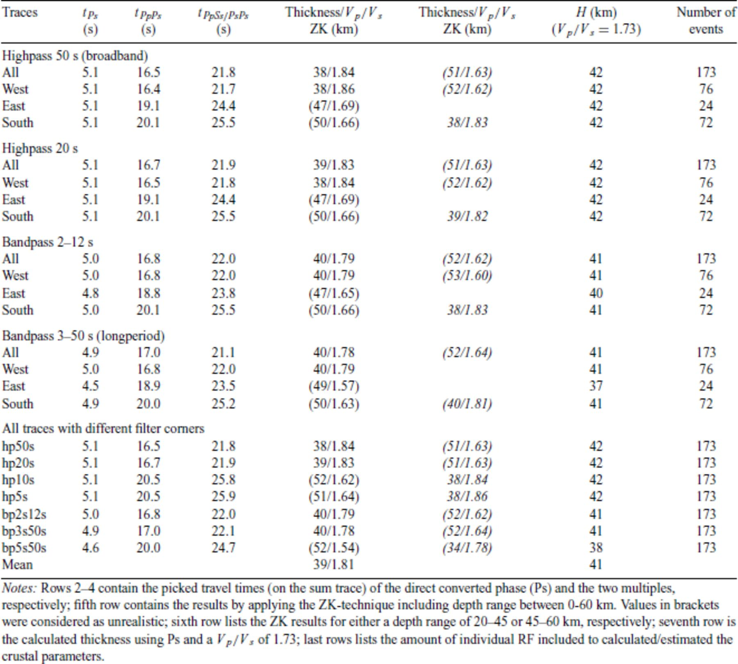
Table 4. Crustal parameters for station SNAA from the backazimuthal investigation (all, segments west, east and ...
Notes:
Table 4. Crustal parameters for station SNAA from the backazimuthal investigation (all, segments west, east and south).
Unless provided in the caption above, the following copyright applies to the content of this slide: © 2009 The Authors Journal compilation © 2009 RAS

Slide 12
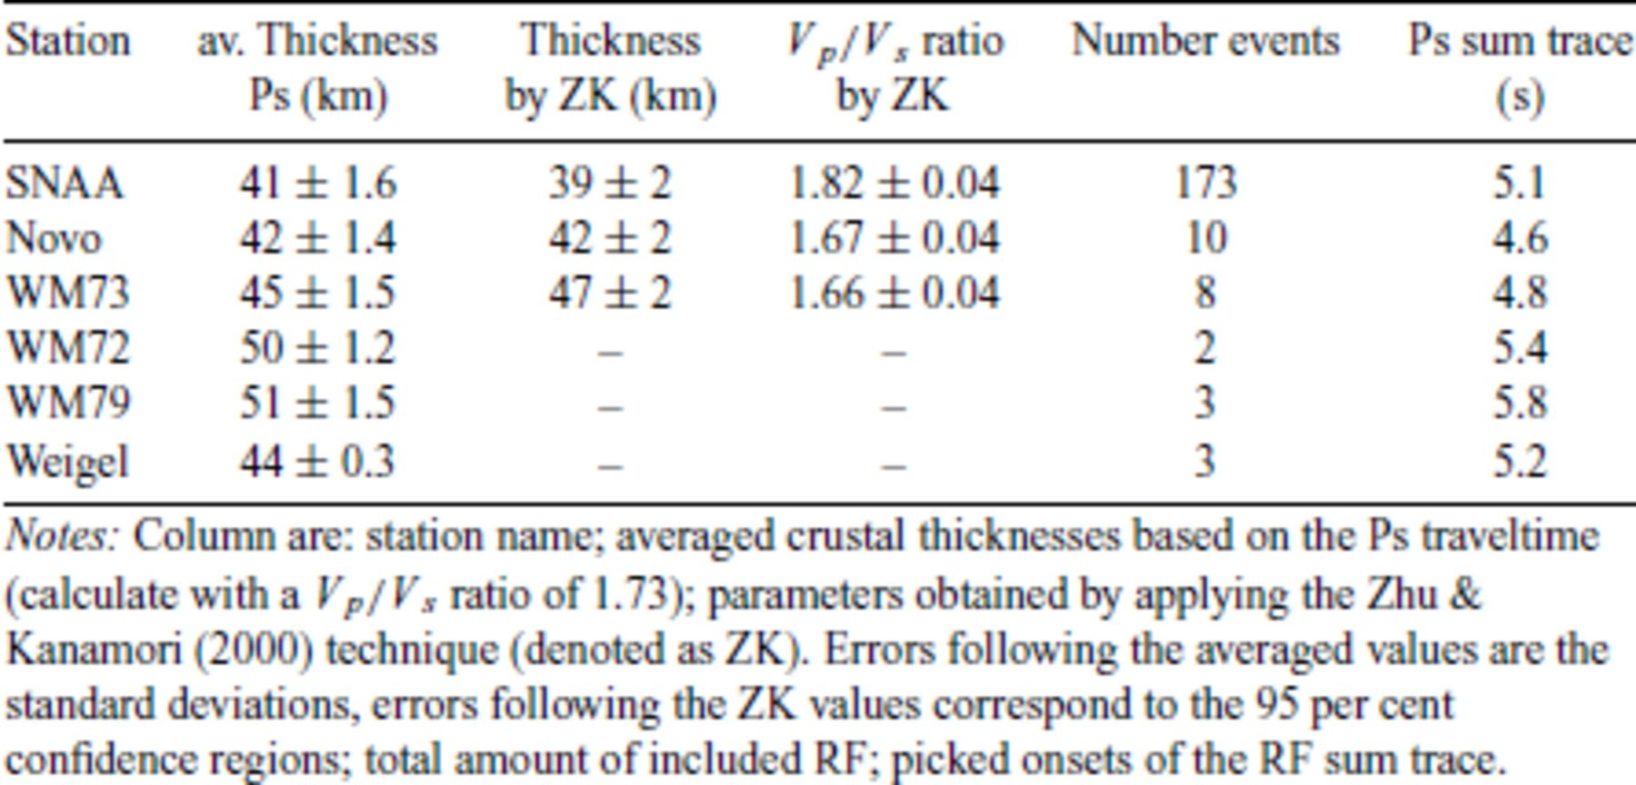
Table 5. Overview over the determined crustal parameters.
Notes:
Table 5. Overview over the determined crustal parameters.
Unless provided in the caption above, the following copyright applies to the content of this slide: © 2009 The Authors Journal compilation © 2009 RAS

Slide 13
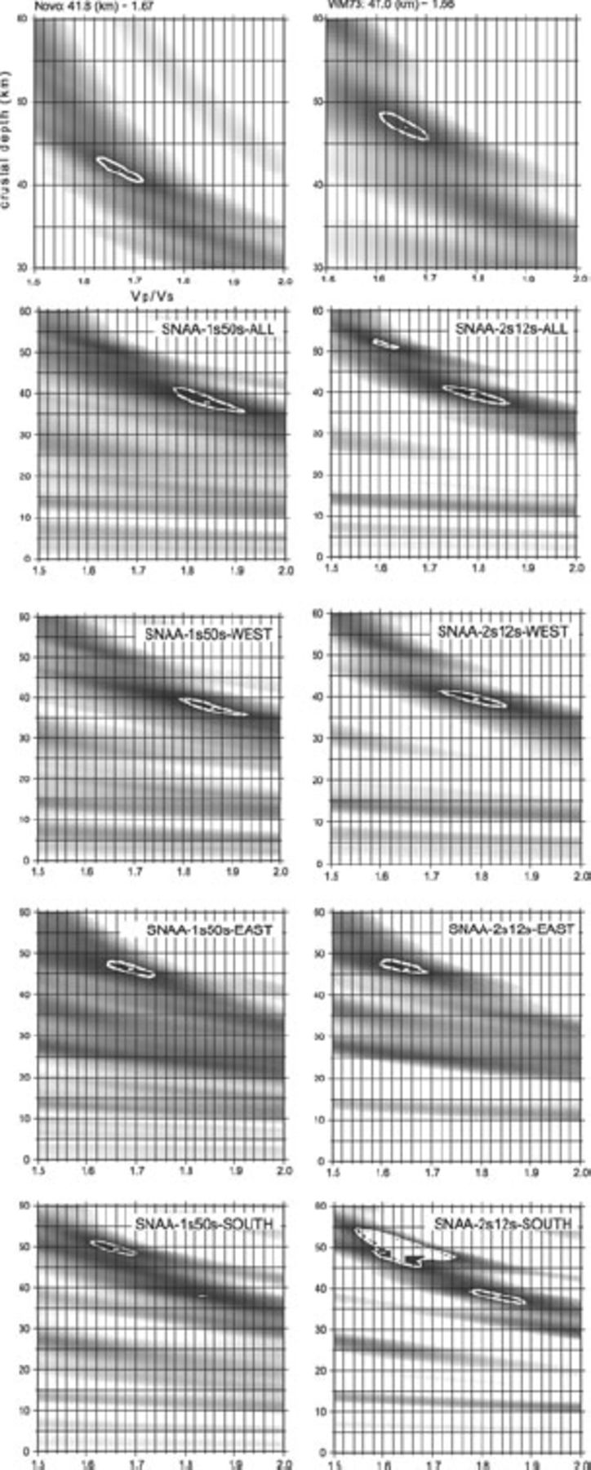
Figure 8. Crustal thicknesses and correspondent V_{p}/V_{s} ratios obtained by applying the algorithm ...
Notes:
Figure 8. Crustal thicknesses and correspondent Vp/Vs ratios obtained by applying the algorithm of Zhu & Kanamori (2000). We used a P-velocity of 6.45 km s−1. The contour lines represent the 95 per cent confidence regions. For station SNAA different values were retrieved depending on the backazimuthal distribution.
Unless provided in the caption above, the following copyright applies to the content of this slide: © 2009 The Authors Journal compilation © 2009 RAS

Slide 14
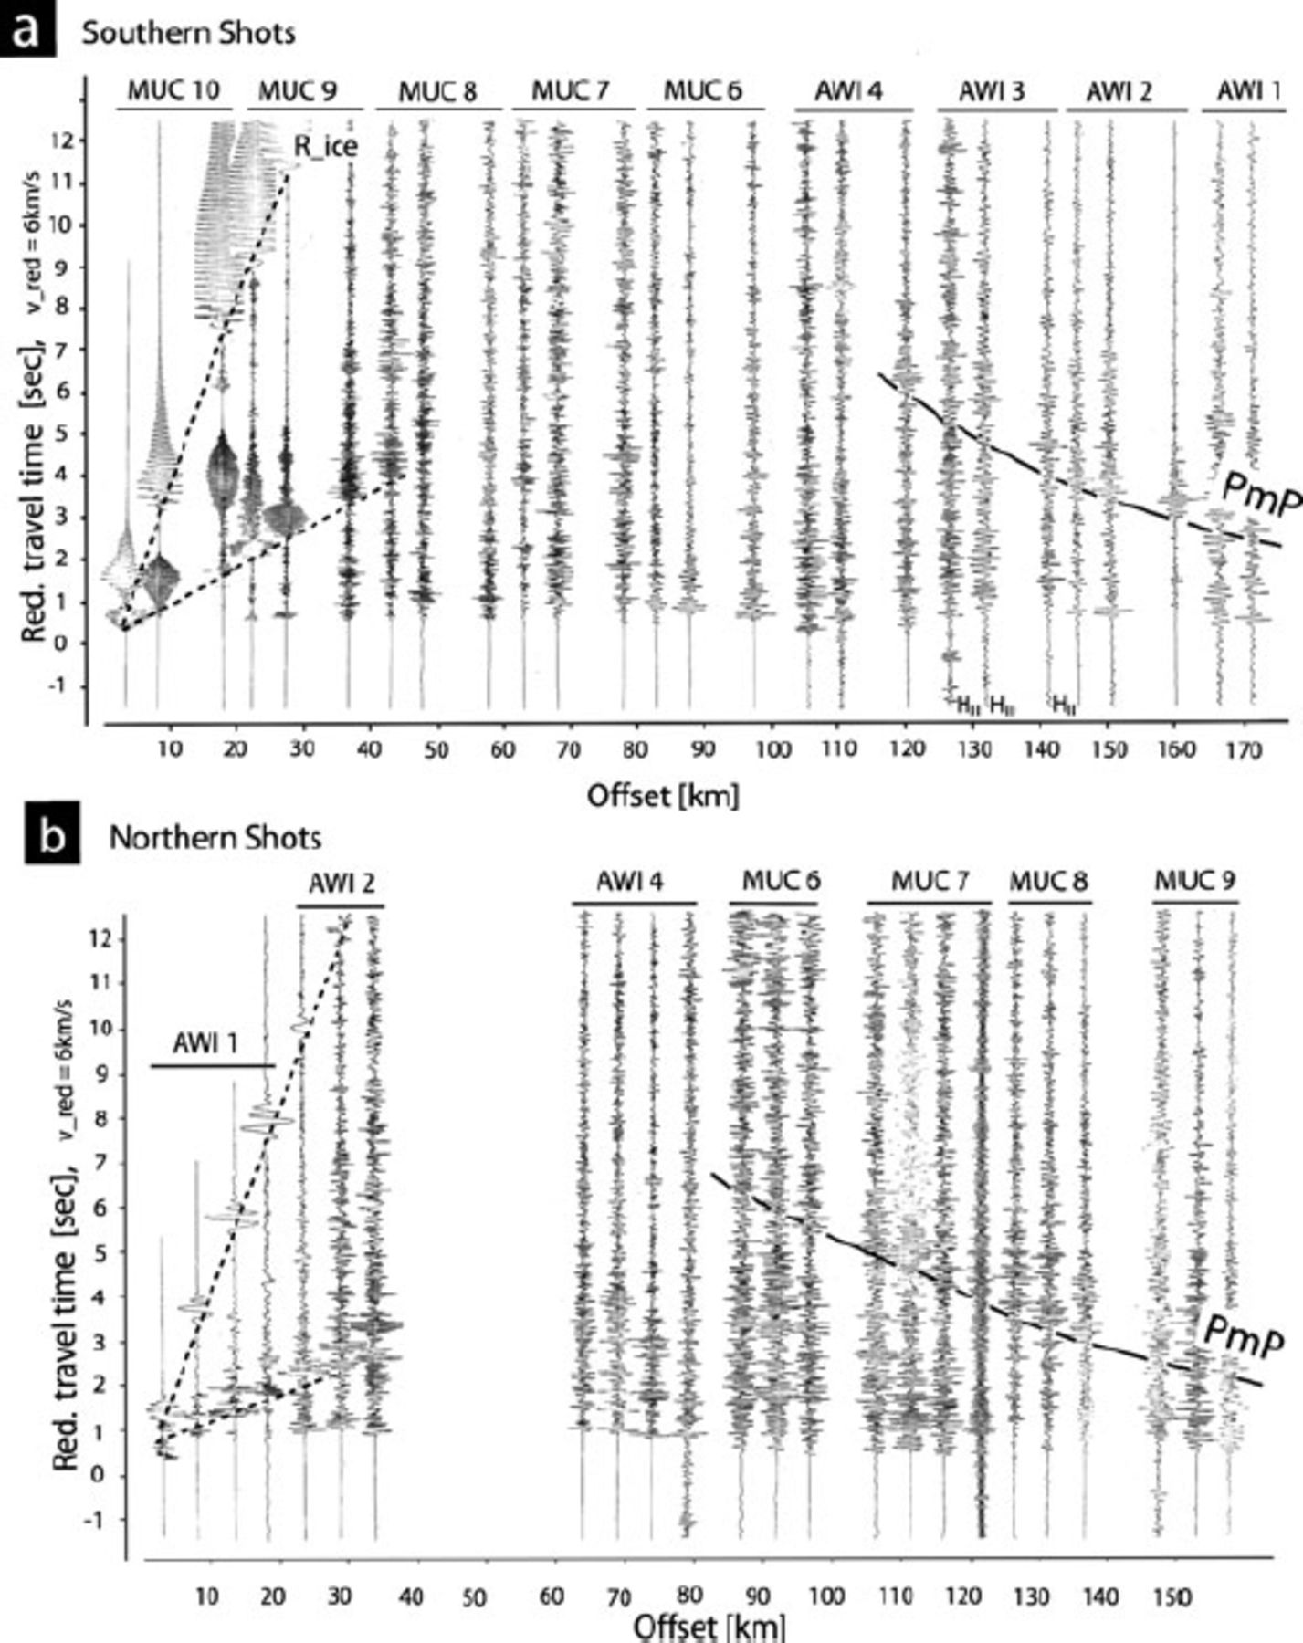
Figure 9. Reduced record sections for the three and four shots performed at the southern and northern end of the ...
Notes:
Figure 9. Reduced record sections for the three and four shots performed at the southern and northern end of the profile, respectively (modified after Miller & Oerter 1991). All other traces shows the vertical ground motion. In panel (a) one can recognize the more or less distinct PmP onsets for the southern shots at a distance of about km 120. The PmP onsets for the northern shots in panel (b) can be observed at a distance of about km 95. The first arrivals of the direct P-waves are observable over the entire profile. There are only a few later onsets, if any, in the distance range up to km 80, which can be grouped to some (ambiguous?) traveltime branches. The excitation of Rayleigh waves within the ice with large amplitudes is remarkable (two dotted lines). The dispersive character of these waves are distinctly observed up to km 50. Enlarged record sections are provided as supplementary material.
Unless provided in the caption above, the following copyright applies to the content of this slide: © 2009 The Authors Journal compilation © 2009 RAS

Slide 15
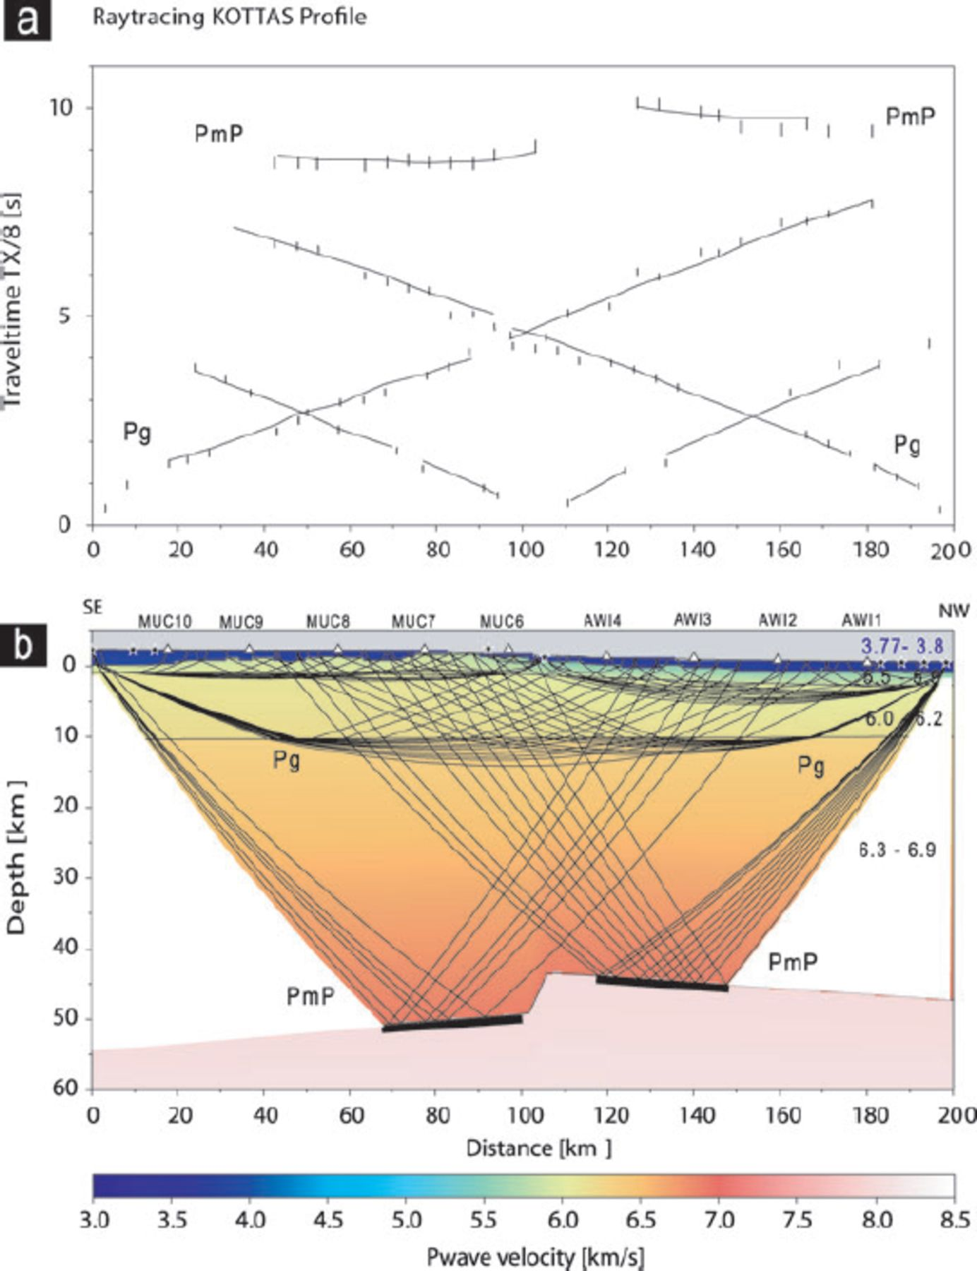
Figure 10. Crustal model of Kottas retrieved by ray tracing of P-waves. Panel (a) shows the traveltime curves (solid ...
Notes:
Figure 10. Crustal model of Kottas retrieved by ray tracing of P-waves. Panel (a) shows the traveltime curves (solid lines) of the model below, whereas the vertical lines denote the pick times including an error of ±100 ms for the Pg phases and ±150 ms for the PmP phases. The uppermost two branches correspond to the phases, which were reflected on the Moho (signed with PmP). The calculated traveltime branches fit the observed picks more or less in the error bars. Panel (b) for each layer, the coverage with reflected and refracted rays traced to the observed picks is shown. Thick black lines denote the Moho for which a thickness can be determined. The velocities with positive gradients of each layer are given in km s−1 on the right-hand side.
Unless provided in the caption above, the following copyright applies to the content of this slide: © 2009 The Authors Journal compilation © 2009 RAS

Slide 16
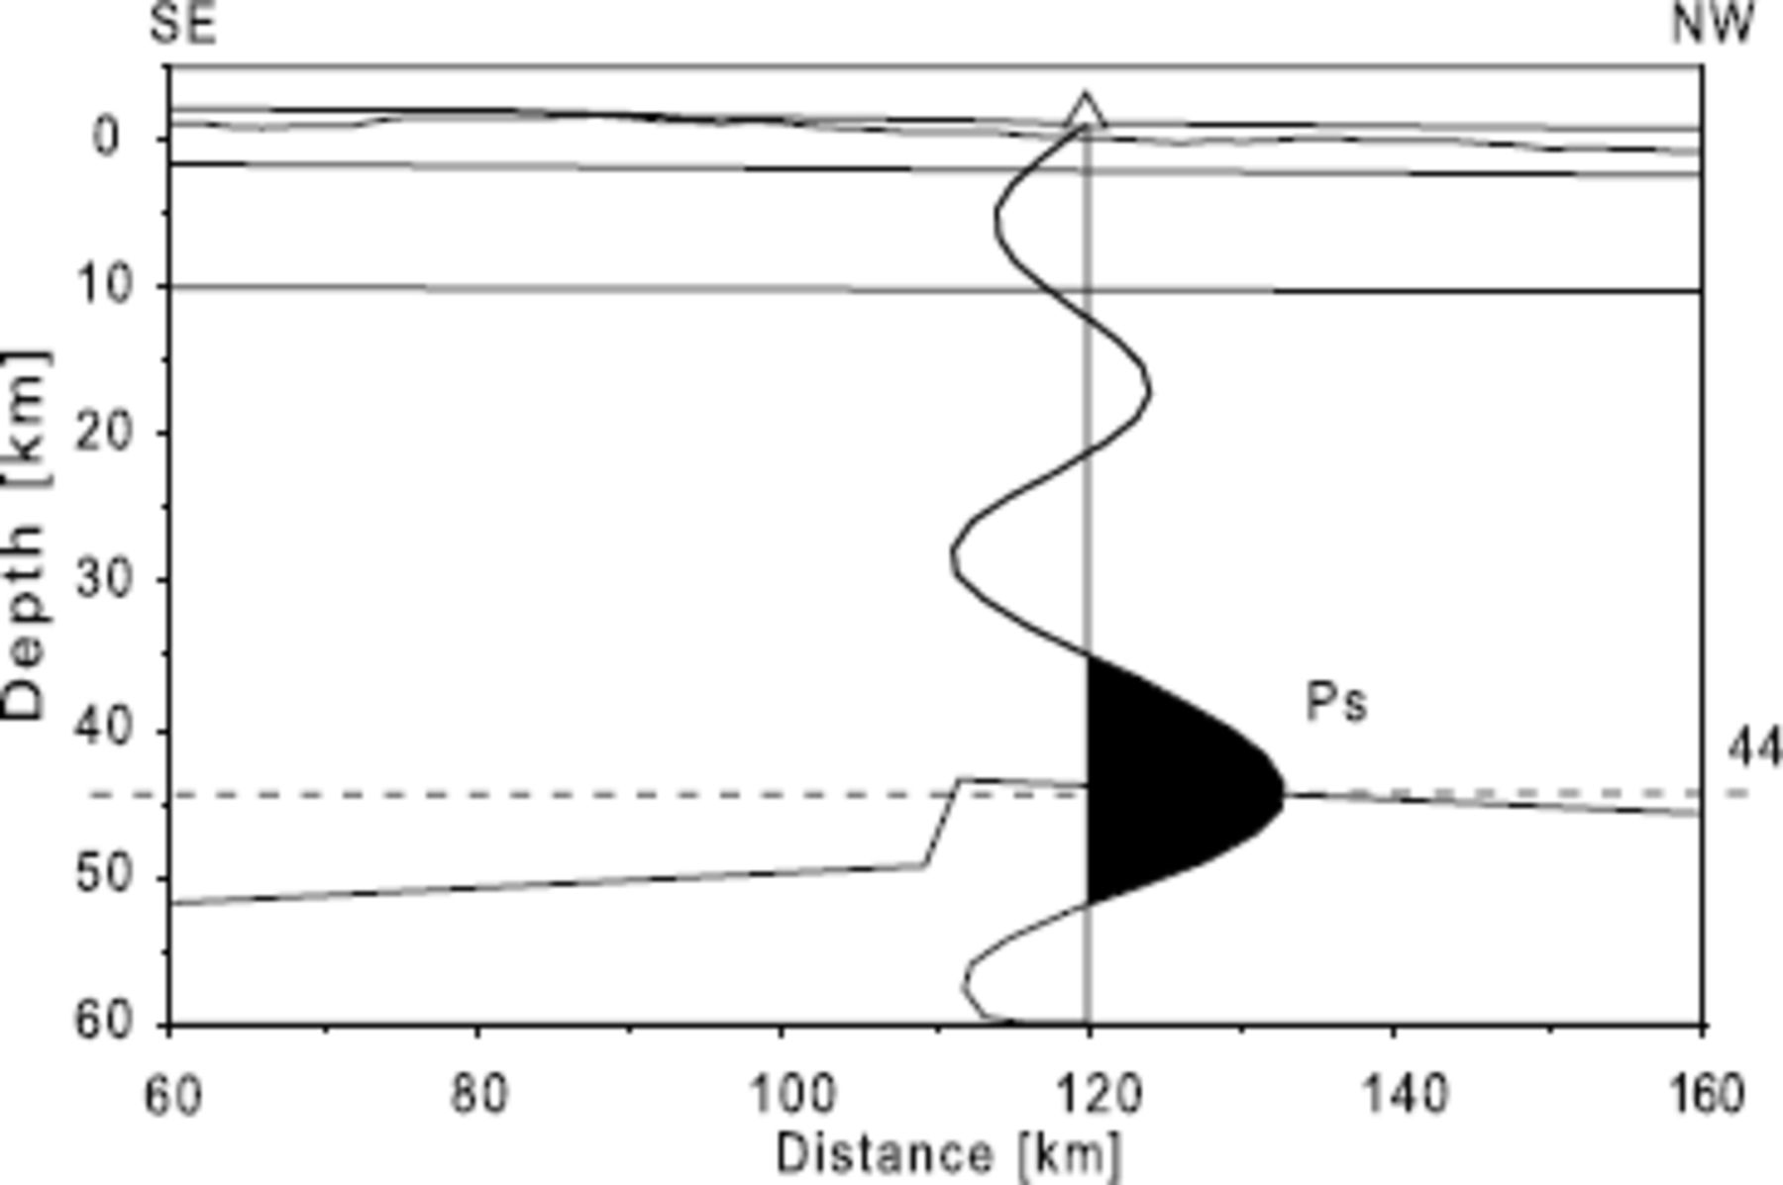
Figure 11. Sketch of the refraction profile KOTTAS, and the receiver function of the seismic station Weigel nunatak ...
Notes:
Figure 11. Sketch of the refraction profile KOTTAS, and the receiver function of the seismic station Weigel nunatak displayed on the projection point. Weigel nunatak is located ca. 150 km off the profile. Within the uncertainties of both methods, the crustal thicknesses match well. Other signals than the Ps phase cannot be attributed to inner-crustal structure since these signals are more likely caused by noise.
Unless provided in the caption above, the following copyright applies to the content of this slide: © 2009 The Authors Journal compilation © 2009 RAS

Slide 17
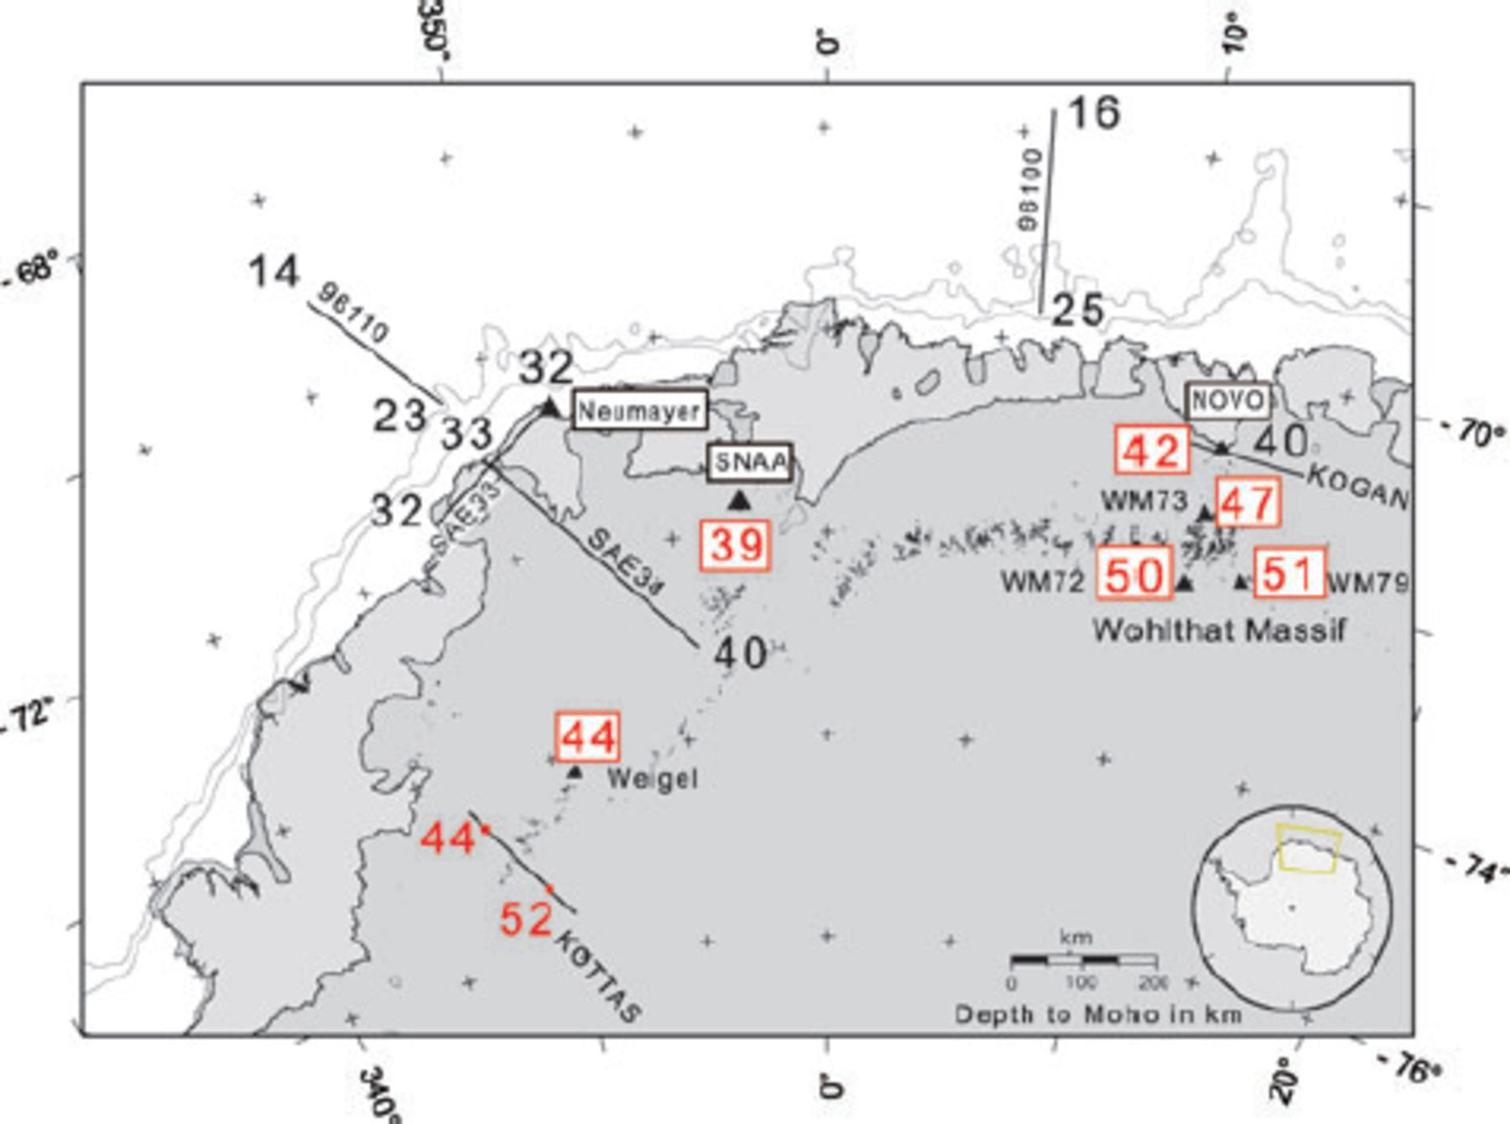
Figure 12. Crustal thicknesses within Dronning Maud Land. An increasing crustal thickness from coast to inland are ...
Notes:
Figure 12. Crustal thicknesses within Dronning Maud Land. An increasing crustal thickness from coast to inland are observable with thickened crust underneath the orogens of Wohlthat Massif and Kottas. New determined crustal thicknesses retrieved from receiver functions are red and surrounded by a red box. Some new Moho depths of the KOTTAS profile are signed in red. Black values are crustal thicknesses from previous refraction studies of Kogan (1992) (denoted as KOGAN), Kudryavtzek et al. (1991) (profiles SAE34, SAE33) and Jokat et al. (2004) (profiles 96110, 96100).
Unless provided in the caption above, the following copyright applies to the content of this slide: © 2009 The Authors Journal compilation © 2009 RAS

Slide 18
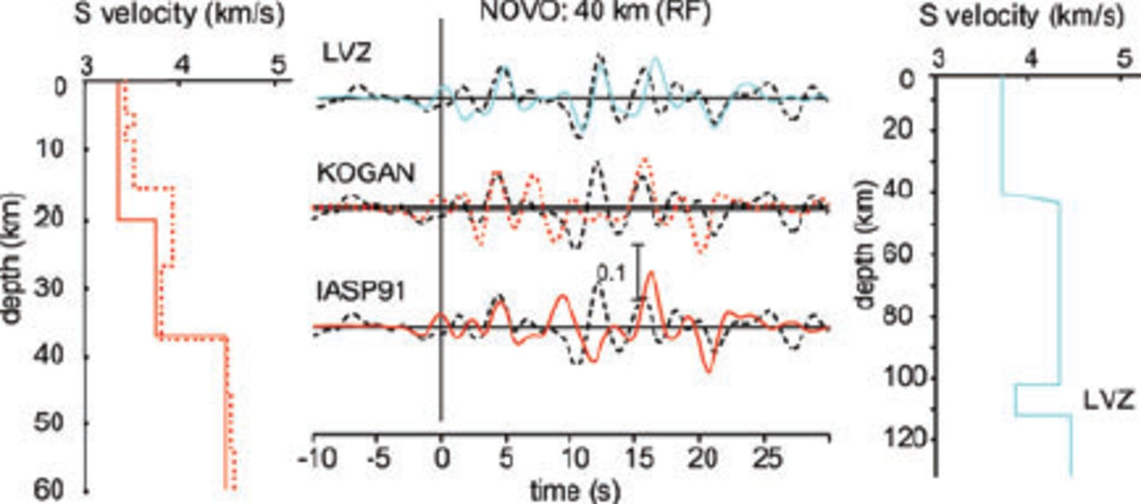
Figure 13. Synthetic RF for station Novo obtained by forward modelling (Kind et al. 1995) with a slowness of 6.4 s ...
Notes:
Figure 13. Synthetic RF for station Novo obtained by forward modelling (Kind et al. 1995) with a slowness of 6.4 s deg−1. We took the velocity depth model retrieved from a seismic experiment (Kogan 1992), which is denoted with KOGAN and a red dotted line. As a second model we took the IASP91 Earth model (red solid line). The model with the abbreviation LVZ on the right side (blue line) contains a low-velocity zone (LVZ) within the upper mantle. The black dashed lines are the sum trace of 10 single RF.
Unless provided in the caption above, the following copyright applies to the content of this slide: © 2009 The Authors Journal compilation © 2009 RAS

Slide 19
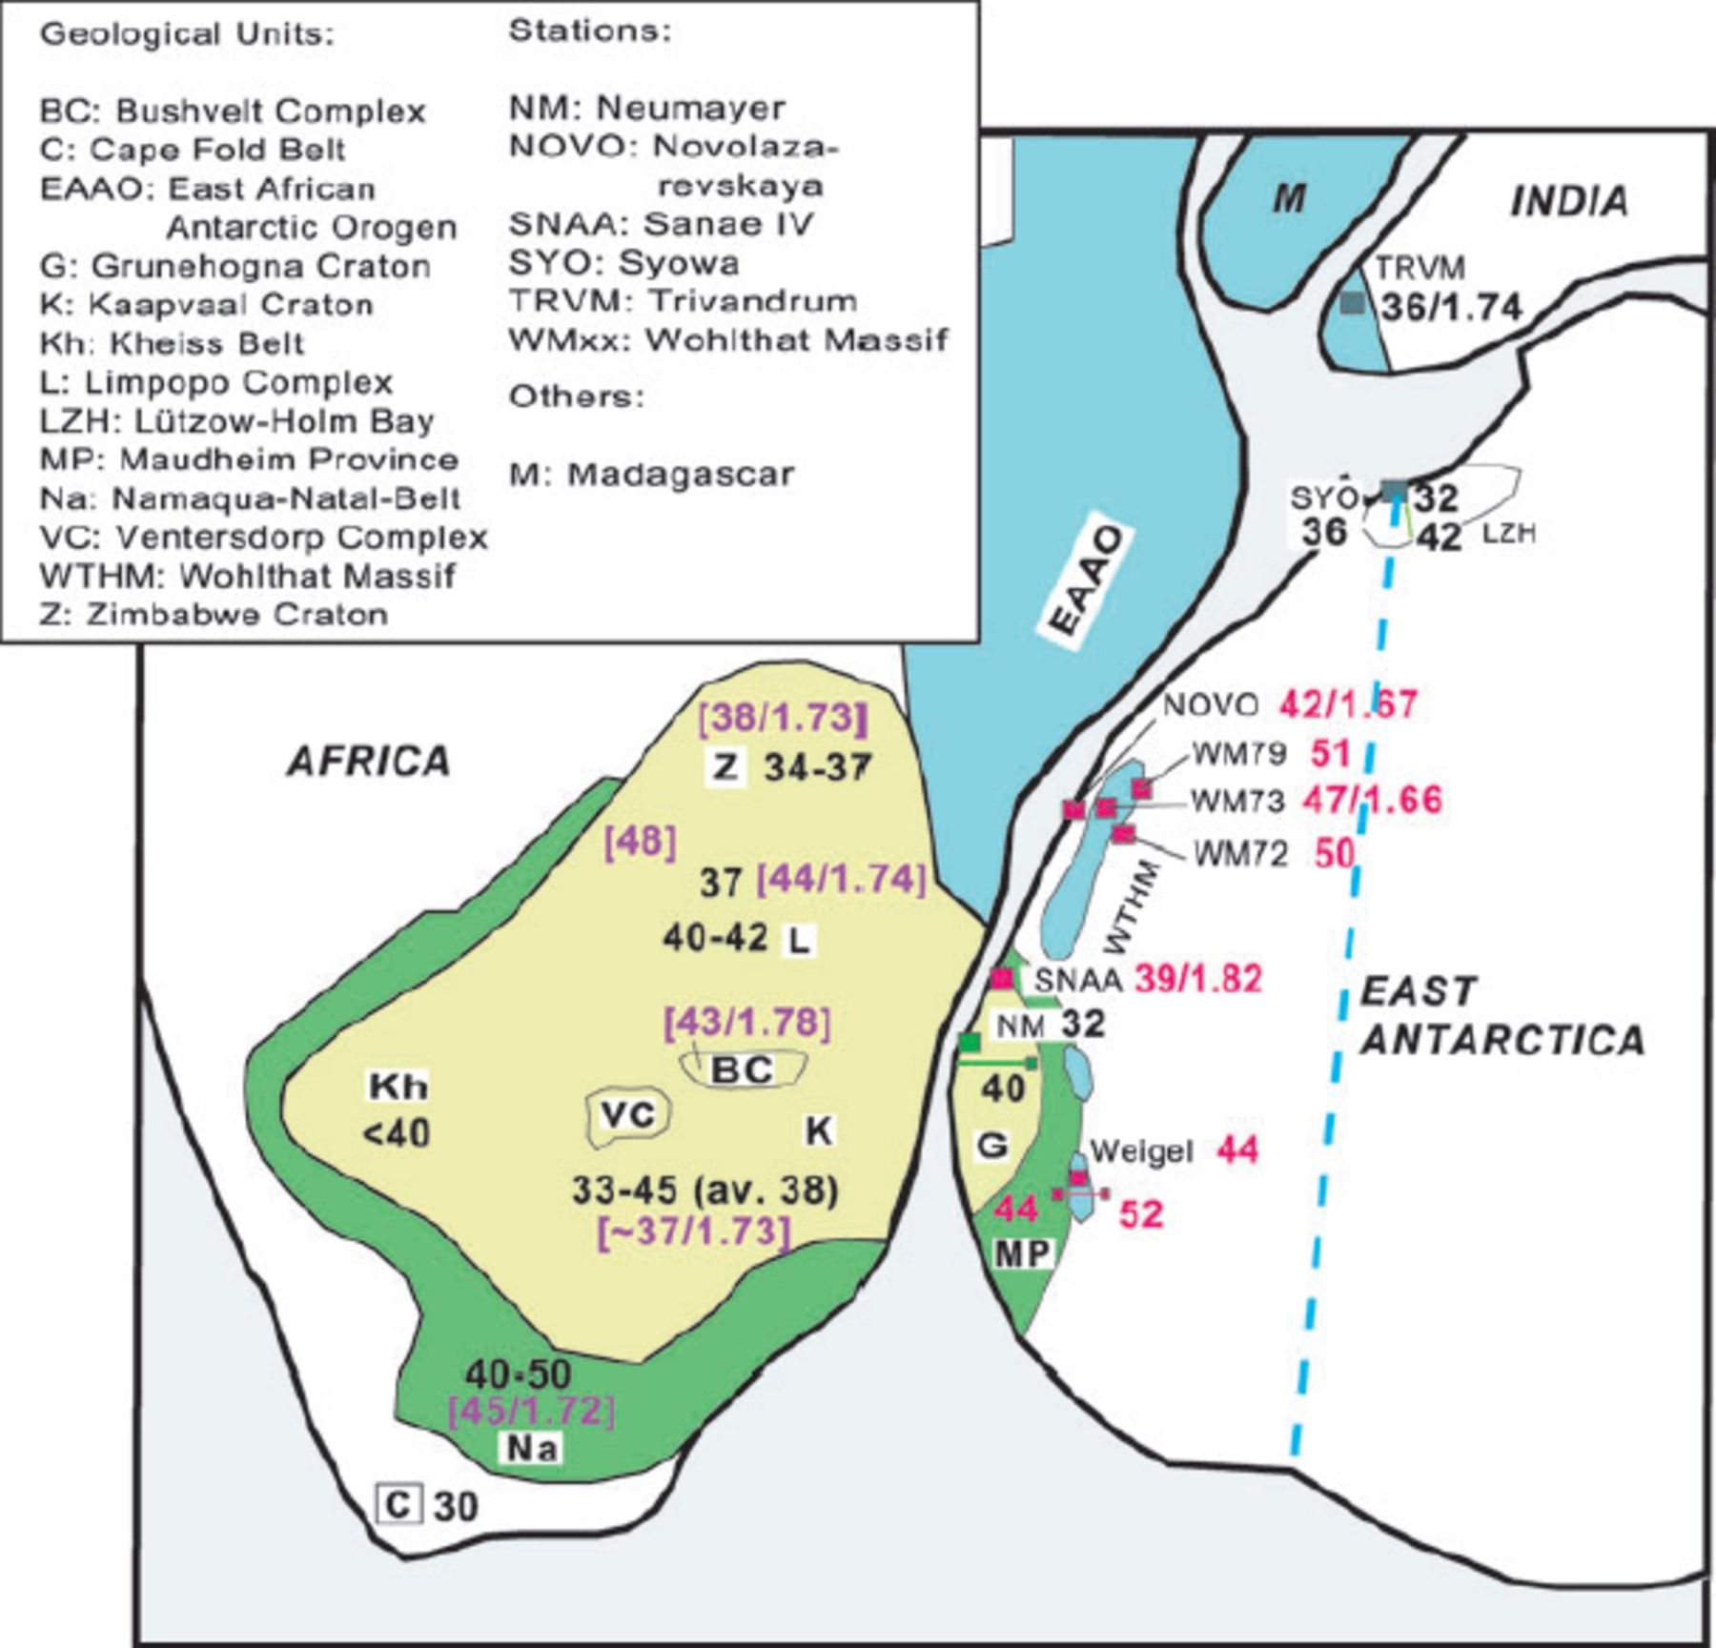
Figure 14. Comparison between crustal thicknesses of a Gondwana reconstruction (Jacobs et al. 2003b, and references ...
Notes:
Figure 14. Comparison between crustal thicknesses of a Gondwana reconstruction (Jacobs et al. 2003b, and references therein). New crustal thicknesses and Vp/Vs ratios of this study are signed in red. Black depths within the African continent are published values from Nguuri et al. (2001), purple values in brackets refer to Nair et al. (2006). Crustal depth for station TRVM in India accords to a study of Kumar et al. (2001), values for station SYO, East Antarctica, refer to an investigation of RF (Kanao et al. 2002) and a seismic experiment (Tsutsiu et al. 2001). The blue dashed line represents a proposed suture of the Pan-African orogeny (Jacobs et al. 2003b). Coloured main geological features are described in more detail in Fig. 2.
Unless provided in the caption above, the following copyright applies to the content of this slide: © 2009 The Authors Journal compilation © 2009 RAS

