Slide 1
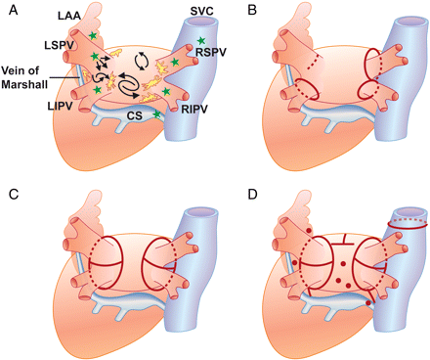
Figure 1 Schematic of the anatomo-functional arrhythmic mechanism and common ablation strategies in paroxysmal and ...
Notes:
Figure 1 Schematic of the anatomo-functional arrhythmic mechanism and common ablation strategies in paroxysmal and long-standing/persistent AF. (A) Active triggers arising from the atrial myocardium within the PVs and other thoracic veins (CS, vein/ligament of Marshall, and the SVC) are shown in green. Autonomic ganglia and nerves are shown in yellow. Abrupt changes of fibre orientation along the PV antrum and posterior LA wall favouring anatomic re-entry or high frequency rotors are also shown. (B) The two most common approaches for paroxysmal AF: segmental PV isolation for electric disconnection of triggers within the veins; and circumferential ostial PV isolation (one-by-one linear ablation of the PVs). (C) Simultaneous isolation of the ipsilateral PVs, encircling the antrum and additional linear lesions between the superior and inferior PVs. (D) Combinations of more than two techniques are usually necessary for a successful outcome in long-standing or persistent AF. These approaches include (i) PV isolation; (ii) isolation of the thoracic veins and non-PV triggers; (iii) additional linear lesions such as the ‘mitral isthmus’ line connecting the mitral valve and the lesion encircling the LIPV, a ‘roof’ line connecting the lesions encircling the left and right PVs, a ‘right atrial isthmus’ line, and an ‘anterior’ line connecting the roof line to the mitral annulus anteriorly; (iv) ablation of complex fractionated activity; and (v) ablation of autonomic plexuses. CS, coronary sinus; LAA, left atrial appendage; LIPV, left inferior PV; LSPV, left superior PV; RIPV, right inferior PV; RSPV, right superior PV; SVC, superior vena cava.
Unless provided in the caption above, the following copyright applies to the content of this slide: Published on behalf of the European Society of Cardiology. All rights reserved. © The Author 2010. For permissions please email: journals.permissions@oxfordjournals.org

Slide 2
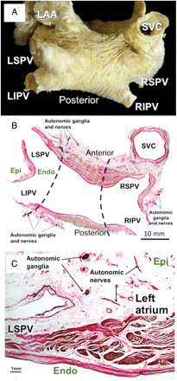
Figure 2 (A) Dissection showing the subepicardial myocardial fibres viewed from the superior–posterior aspect. The ...
Notes:
Figure 2 (A) Dissection showing the subepicardial myocardial fibres viewed from the superior–posterior aspect. The myocardial tissue encircles the veno-atrial junction. (B) Cross-section in a specimen of a 65-year-old subject stained with the van Gieson technique to show the myoarchitecture along the entire thickness of the PVs and LA walls. The LA musculature lies external to the venous wall between the adventitia and the venous media in a fine matrix composed of collagen, elastic fibres, and blood vessels. Note the abrupt changes in muscular thickness and fibre orientation transmurally along the PV antrum and posterior atrial wall. Surgical antral isolation of the PVs may partially involve the autonomic ganglia and nerves (dotted line). (C) Cross-section along the left superior PV to show the mixed arrangement of myocardial fibres making up the wall of the LA and the vein. Note the presence of collagenous septa between the myocardial fibres and the autonomic nervous system elements mainly located in the fat pads on the epicardium. Epi and Endo mark the orientation for epicardial and endocardial surfaces, respectively. LAA, LA appendage; SVC, superior vena cava.
Unless provided in the caption above, the following copyright applies to the content of this slide: Published on behalf of the European Society of Cardiology. All rights reserved. © The Author 2010. For permissions please email: journals.permissions@oxfordjournals.org

