Slide 1
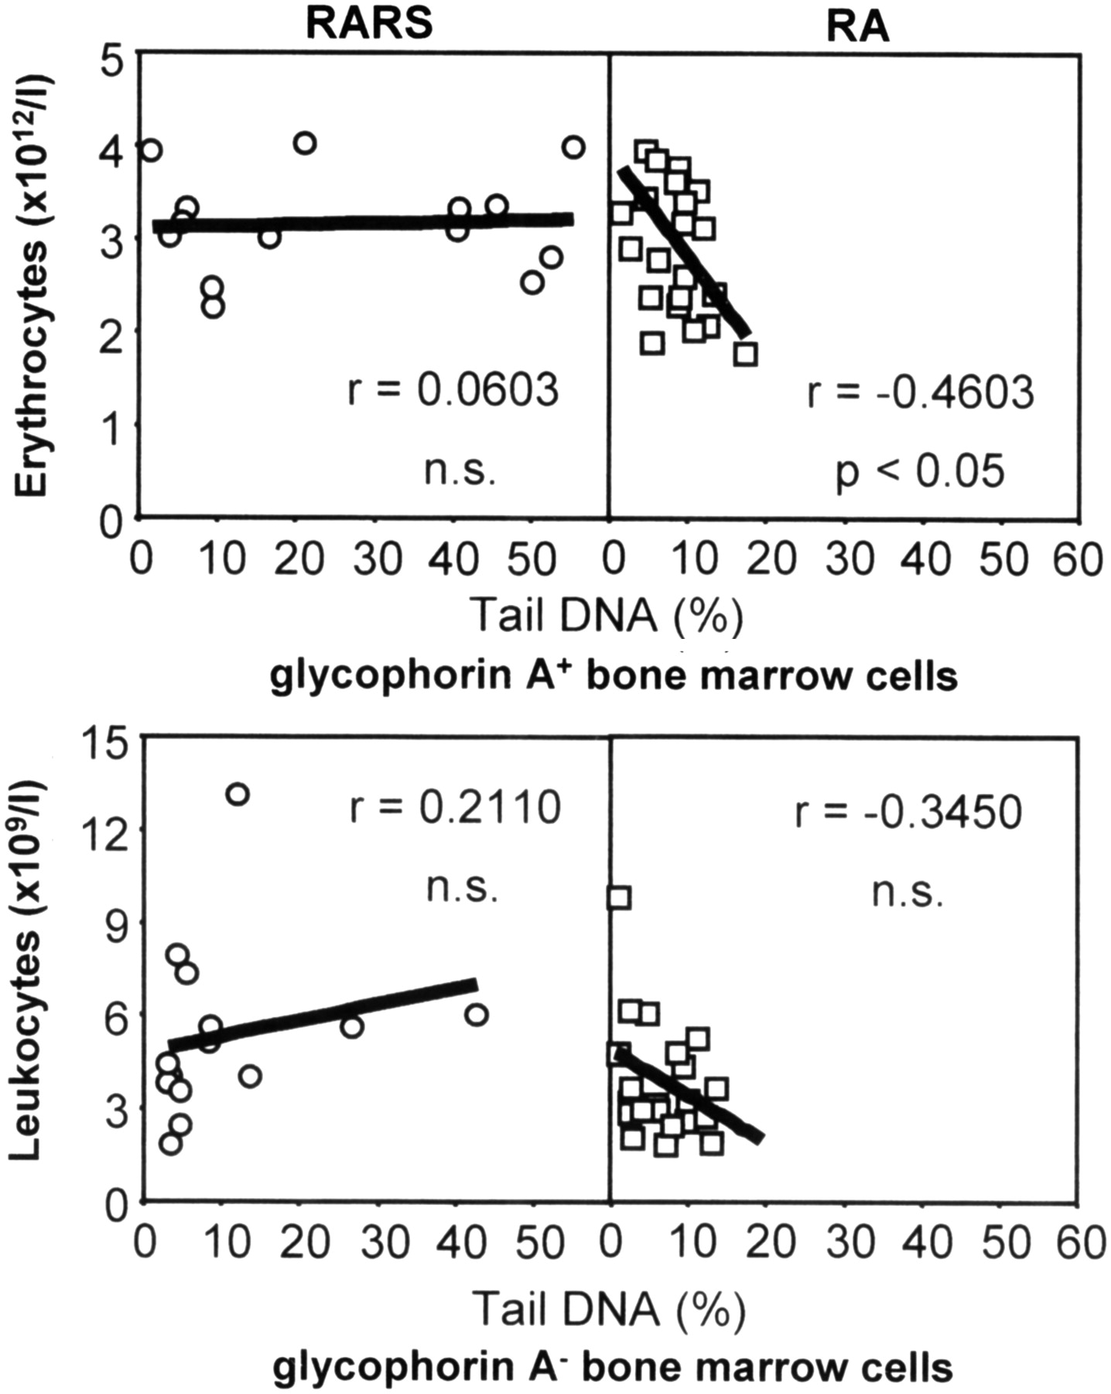
Figure 2. Relationship between the number of erythrocytes (leukocytes) and DNA migration in glycophorin A⁺ ...
Notes:
Figure 2. Relationship between the number of erythrocytes (leukocytes) and DNA migration in glycophorin A+ (glycophorin A−) bone marrow cells of MDS patients. RA, refractory anemia; RARS, refractory anemia with ring sideroblasts, continuous line represent the join of the trend; r, Pearson correlation coefficient; n.s., not significant.
Unless provided in the caption above, the following copyright applies to the content of this slide: © The Author 2008. Published by Oxford University Press. All rights reserved. For Permissions, please email: journals.permissions@oxfordjournals.org

Slide 2
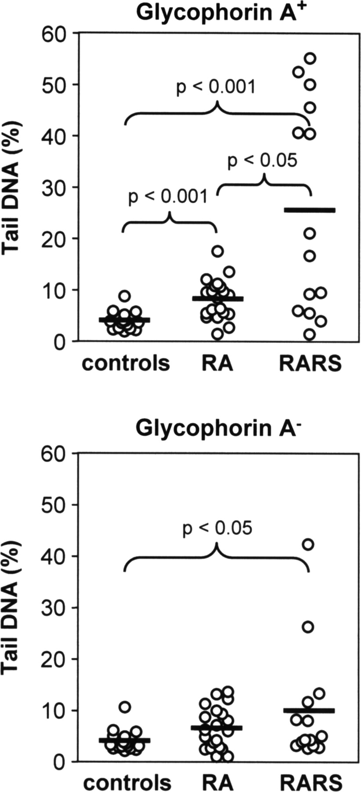
Figure 1. The extent of DNA migration in bone marrow cells: comparison of analyzed groups. RA, refractory anemia; RARS, ...
Notes:
Figure 1. The extent of DNA migration in bone marrow cells: comparison of analyzed groups. RA, refractory anemia; RARS, refractory anemia with ring sideroblasts. The circles represent medians obtained from 200 cells per individual and bone marrow fraction. The horizontal lines depict an arithmetic mean from individual medians characterizing persons within a given group.
Unless provided in the caption above, the following copyright applies to the content of this slide: © The Author 2008. Published by Oxford University Press. All rights reserved. For Permissions, please email: journals.permissions@oxfordjournals.org

