Slide 1
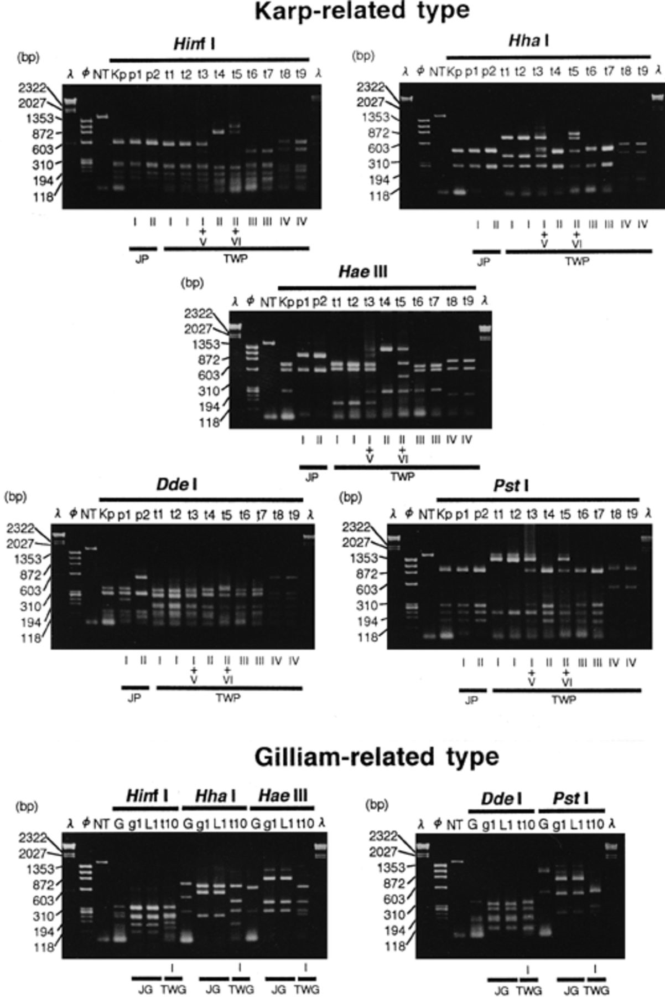
1 PCR-RFLP profiles of 56-kDa protein genes of isolates after digestion with endonucleases Hinf I, Hha I, Hae ...
Notes:
1 PCR-RFLP profiles of 56-kDa protein genes of isolates after digestion with endonucleases Hinf I, Hha I, Hae III, Dde I, and Pst I. The digests were electrophoresed in agarose gels and the bands were stained with ethidium bromide. λ and φ: DNA size markers. NT: PCR product of Gilliam strain (1,568 bp) without digestion with endonucleases. The other letters above each column indicate the strains of O. tsutsugamushi. Kp: Karp strain; p1: Matsuzawa; p2: 402I; t1–t10: isolates in Taiwan; G: Gilliam strain; g1: 436T; and L1: LP-2. The characters and Roman numerals at the bottom of each column indicate type of each strain as described in the text. JP and JG: Karp and Gilliam subtypes, respectively, isolated in Japan, TWP and TWG: type designation of isolates in Taiwan (see text). The numbers at the left side show the sizes in bp.
Unless provided in the caption above, the following copyright applies to the content of this slide: © 1997 Federation of European Microbiological Societies. Published by Elsevier Science B.V.

Slide 2
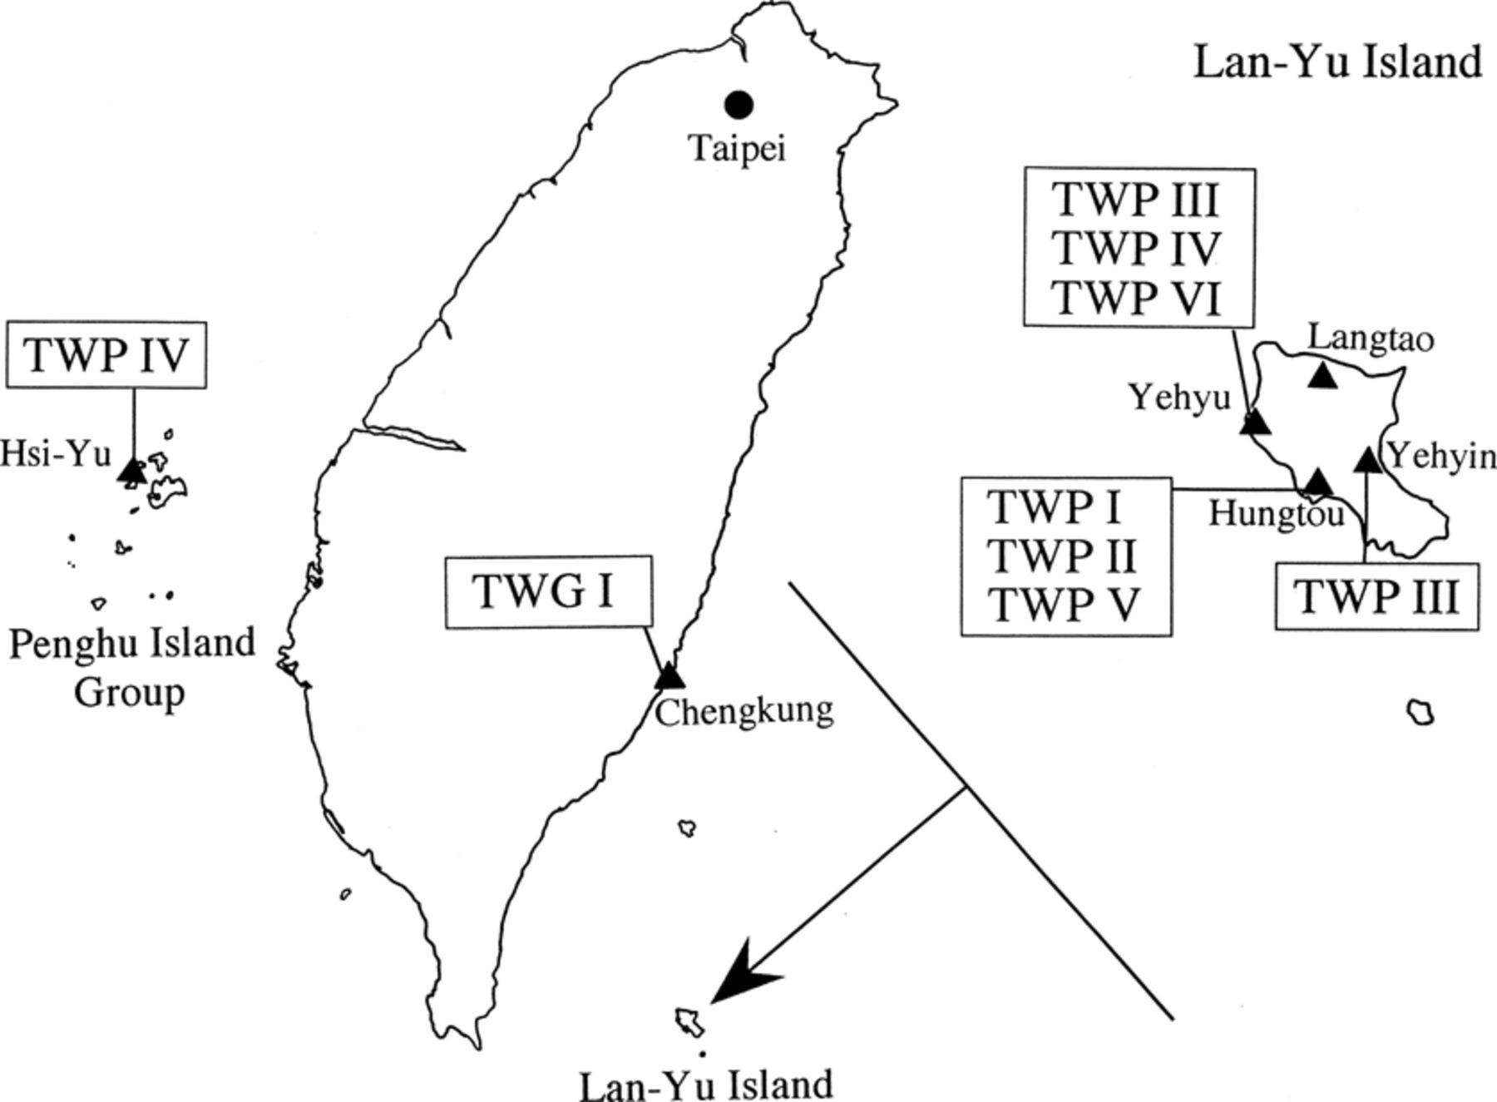
2 Geographical areas in Taiwan from which types of O. tsutsugamushi were isolated.
Notes:
2 Geographical areas in Taiwan from which types of O. tsutsugamushi were isolated.
Unless provided in the caption above, the following copyright applies to the content of this slide: © 1997 Federation of European Microbiological Societies. Published by Elsevier Science B.V.

