Slide 1
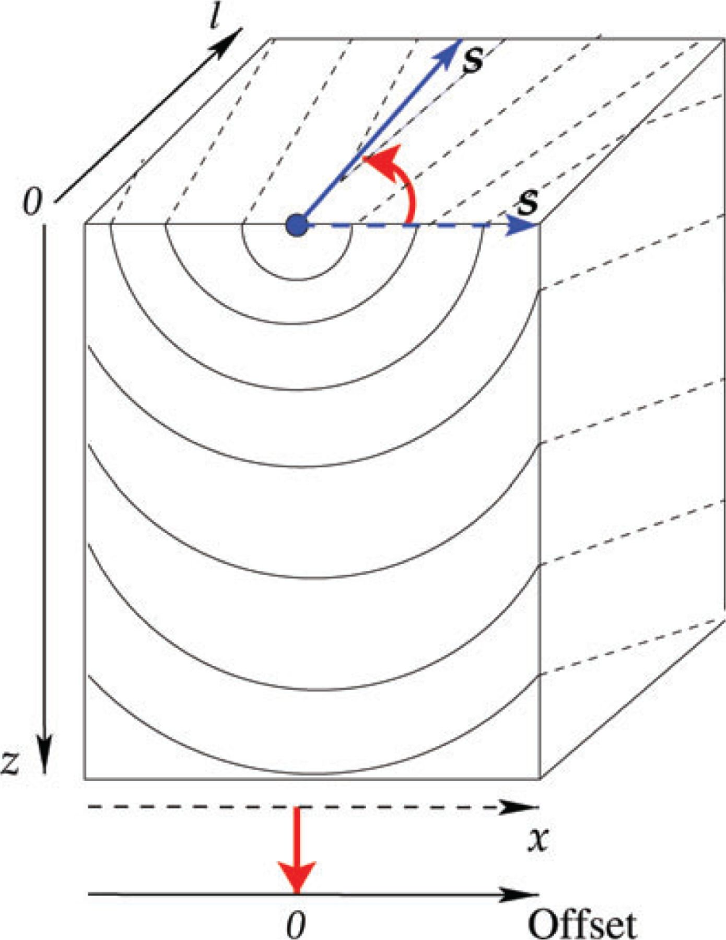
Figure 1 Illustration of the evolution of the 2-D wavefield given by distance, x, and depth, z, as a function of the ...
Notes:
Figure 1 Illustration of the evolution of the 2-D wavefield given by distance, x, and depth, z, as a function of the shift in the source location, l. The actual source shift is transformed to a new 3rd axis, where the x axis now describes the offset from the source. The dot in the middle on the surface represents the source location.
Unless provided in the caption above, the following copyright applies to the content of this slide: © 2010 The Authors Geophysical Journal International © 2010 RAS

Slide 2
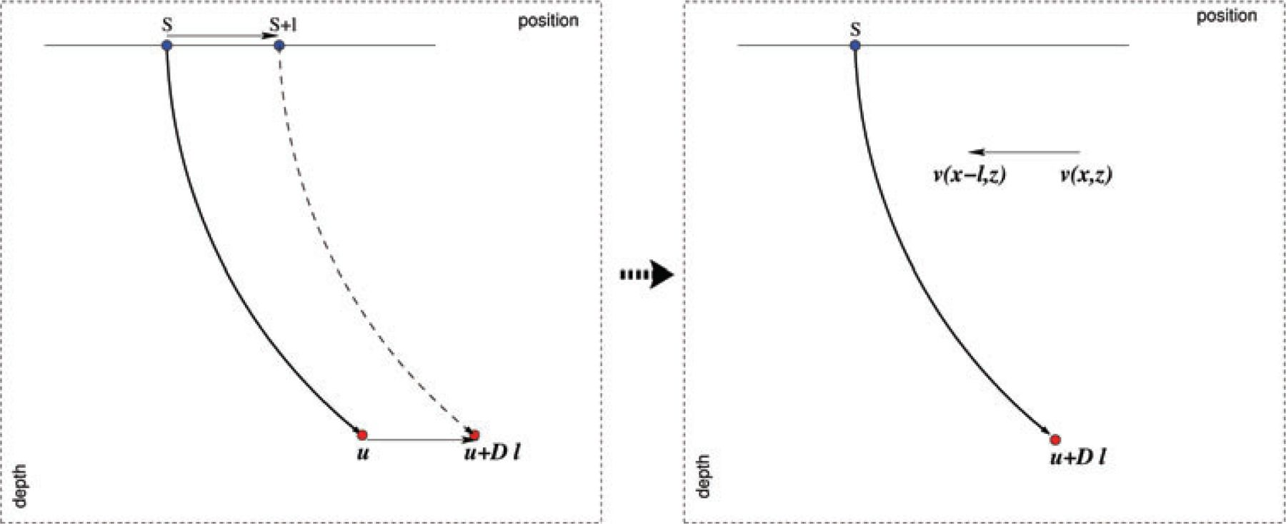
Figure 2 Illustration of the relation between the initial source location and a perturbed version given by a single ...
Notes:
Figure 2 Illustration of the relation between the initial source location and a perturbed version given by a single source and image point locations. This is equivalent to a shift in the velocity field laterally by l.
Unless provided in the caption above, the following copyright applies to the content of this slide: © 2010 The Authors Geophysical Journal International © 2010 RAS

Slide 3
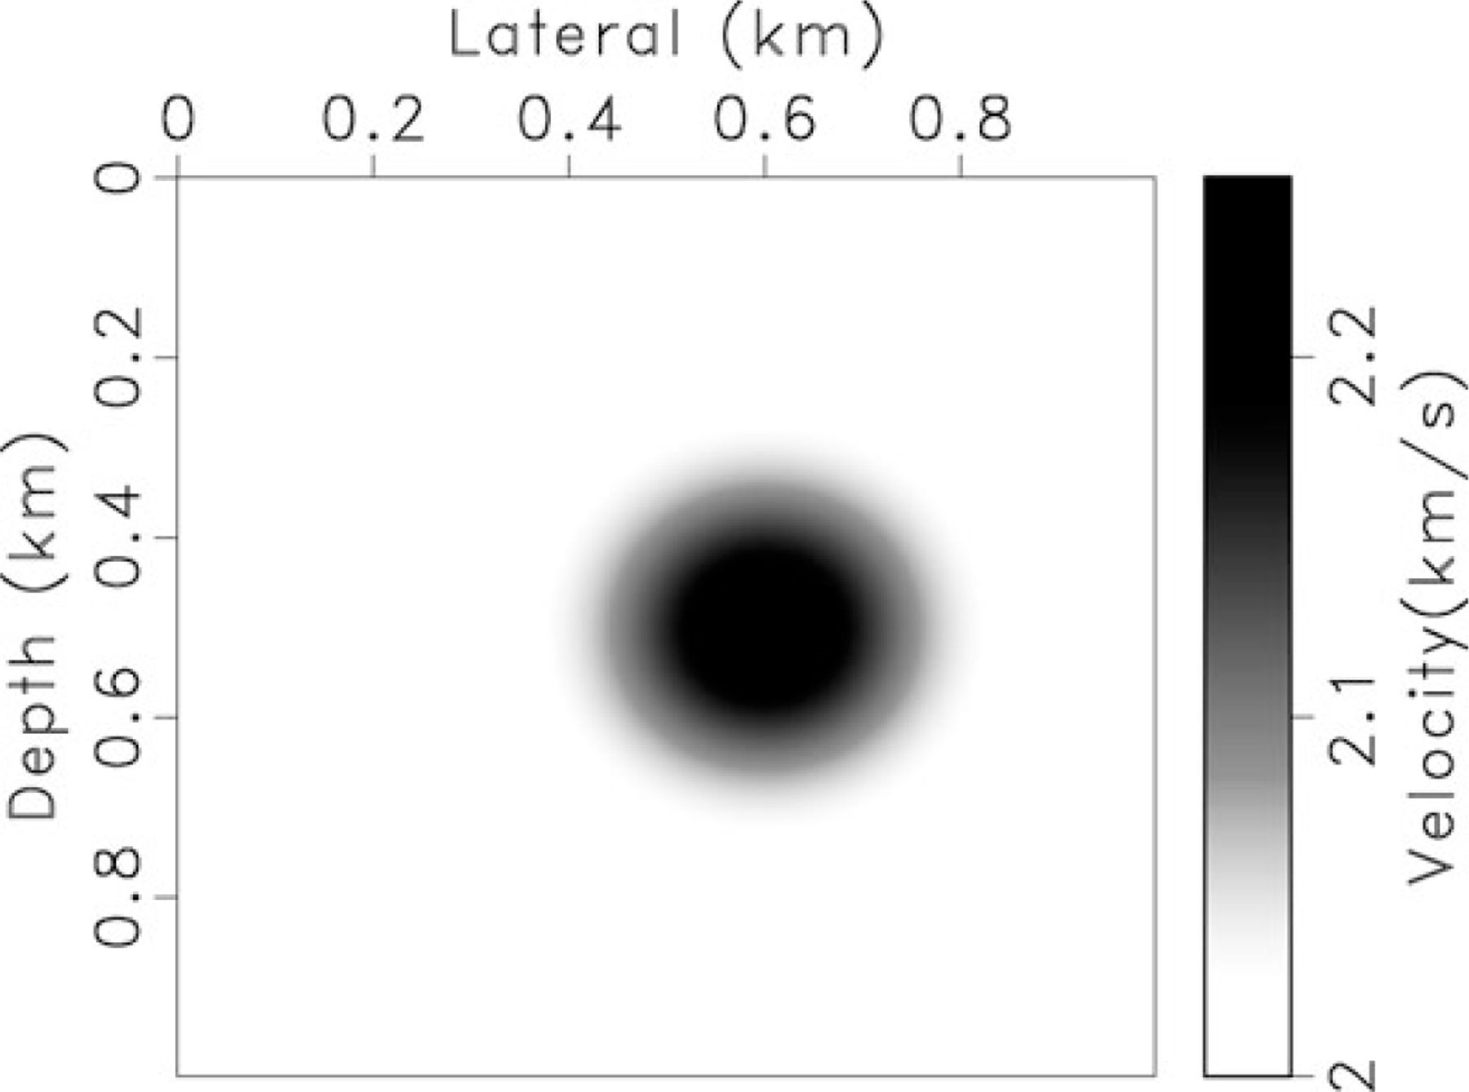
Figure 3 A velocity model containing a lens in an otherwise homogeneous background with a velocity of 2 km ...
Notes:
Figure 3 A velocity model containing a lens in an otherwise homogeneous background with a velocity of 2 km s−1.
Unless provided in the caption above, the following copyright applies to the content of this slide: © 2010 The Authors Geophysical Journal International © 2010 RAS

Slide 4
Figure 4 A snap shot at time 0.5 s of the wavefield obtained from solving the conventional wave equation using the ...
Notes:
Figure 4 A snap shot at time 0.5 s of the wavefield obtained from solving the conventional wave equation using the velocity model in Fig. 3 for a source located at surface at 0.35 km (left), a snap shot of the wavefield by perturbing the 0.3 km source wavefield to approximate the 0.35 km one using the first order approximation (middle), and using the second order approximation (right).
Unless provided in the caption above, the following copyright applies to the content of this slide: © 2010 The Authors Geophysical Journal International © 2010 RAS

Slide 5
Figure 5 A snap shot at time 0.3 s of the difference between the 0.35 km source wavefield and the 0.3 km source ...
Notes:
Figure 5 A snap shot at time 0.3 s of the difference between the 0.35 km source wavefield and the 0.3 km source wavefield after superimposing the sources (left), the difference after using the first order perturbation on the 0.3 km source wavefield (middle), and after using the second-order perturbation on it (right). All three plots are displayed using the same range, for comparison purposes, and this range is maintained in all Figures corresponding to this lens example.
Unless provided in the caption above, the following copyright applies to the content of this slide: © 2010 The Authors Geophysical Journal International © 2010 RAS

Slide 6
Figure 6 A snap shot at time 0.5 s of the difference between the 0.35 km source wavefield and the 0.3 km source ...
Notes:
Figure 6 A snap shot at time 0.5 s of the difference between the 0.35 km source wavefield and the 0.3 km source wavefield after superposing the sources (left), the difference after using the first order perturbation on the 0.3 km source wavefield (middle), and after using the second-order perturbation on it (right).
Unless provided in the caption above, the following copyright applies to the content of this slide: © 2010 The Authors Geophysical Journal International © 2010 RAS

Slide 7
Figure 7 The Marmousi velocity model (left) and a smoothed version of it (right).
Notes:
Figure 7 The Marmousi velocity model (left) and a smoothed version of it (right).
Unless provided in the caption above, the following copyright applies to the content of this slide: © 2010 The Authors Geophysical Journal International © 2010 RAS

Slide 8
Figure 8 A snap shot of the wavefield obtained from solving the conventional wave equation in the smoothed Marmousi ...
Notes:
Figure 8 A snap shot of the wavefield obtained from solving the conventional wave equation in the smoothed Marmousi model for a source located at surface at 5 km (left) and at 5.025 km (middle). The difference between the two wavefields when we shift one of them to make the sources coincide is shown on the right. All three plots are displayed using the same range and this range is maintained in all Figures corresponding to Marmousi example.
Unless provided in the caption above, the following copyright applies to the content of this slide: © 2010 The Authors Geophysical Journal International © 2010 RAS

Slide 9
Figure 9 A snap shot of the wavefield obtained from solving the conventional wave equation in the smoothed Marmousi ...
Notes:
Figure 9 A snap shot of the wavefield obtained from solving the conventional wave equation in the smoothed Marmousi model for a source located at surface at 5.025 km (left), and the snap shot by perturbing the 5 km source wavefield to approximate the 5.025 km one using the first-order equation (middle). The difference between the two wavefields is shown on the right.
Unless provided in the caption above, the following copyright applies to the content of this slide: © 2010 The Authors Geophysical Journal International © 2010 RAS

Slide 10
Figure 10 A snap shot of the difference between the 5 km source wavefield and the 5.025 km source wavefield (left), the ...
Notes:
Figure 10 A snap shot of the difference between the 5 km source wavefield and the 5.025 km source wavefield (left), the difference after using the first order perturbation (middle), and after using the second-order perturbation (right).
Unless provided in the caption above, the following copyright applies to the content of this slide: © 2010 The Authors Geophysical Journal International © 2010 RAS

Slide 11
Figure 11 The difference between a shot gather for a source located at surface at 5.025 km and one located at 5 km ...
Notes:
Figure 11 The difference between a shot gather for a source located at surface at 5.025 km and one located at 5 km after superimposing the sources (left), the difference between a shot gather for a source located at surface at 5.025 km and one extracted from the expansion of the 5 km source location using the first-order perturbation approximation (middle), and using the second-order perturbation approximation (right) for the smoothed Marmousi model.
Unless provided in the caption above, the following copyright applies to the content of this slide: © 2010 The Authors Geophysical Journal International © 2010 RAS

Slide 12
Figure 12 A snap shot of the difference between the 5 km source wavefield and the 5.05 km source wavefield (left), and ...
Notes:
Figure 12 A snap shot of the difference between the 5 km source wavefield and the 5.05 km source wavefield (left), and the 5.075 km source wavefield (middle), and the 5.1 km source wavefield (right) after using the modified second-order expansion for 50, 75 and 100 meters perturbations, respectively. The velocity model is the original smoothed Marmousi model.
Unless provided in the caption above, the following copyright applies to the content of this slide: © 2010 The Authors Geophysical Journal International © 2010 RAS

