Slide 1
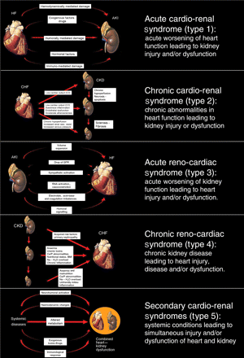
Figure 1 Pathophysiology and definitions of the five subtypes of cardio-renal syndrome (modified by Ronco et ...
Notes:
Figure 1 Pathophysiology and definitions of the five subtypes of cardio-renal syndrome (modified by Ronco et al.105).
Unless provided in the caption above, the following copyright applies to the content of this slide: Published on behalf of the European Society of Cardiology. All rights reserved. © The Author 2009. For permissions please email: journals.permissions@oxfordjournals.orgThe online version of this article has been published under an open access model. Users are entitled to use, reproduce, disseminate, or display the open access version of this article for non-commercial purposes provided that the original authorship is properly and fully attributed; the Journal, Learned Society and Oxford University Press are attributed as the original place of publication with correct citation details given; if an article is subsequently reproduced or disseminated not in its entirety but only in part or as a derivative work this must be clearly indicated. For commercial re-use, please contact journals.permissions@oxfordjournals.org

Slide 2
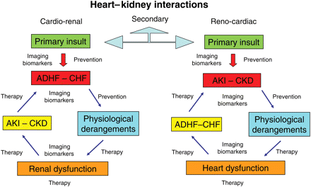
Figure 2 In cardio-renal syndromes, there are two important aspects: the first is the sequence of organ involvement ...
Notes:
Figure 2 In cardio-renal syndromes, there are two important aspects: the first is the sequence of organ involvement and the second is the bi-directionality of signalling leading to a vicious cycle. Another important aspect is the time frame in which the derangements occur (chronic or acute). In all cases, there are moments in which prevention is possible, in others mitigation of the insult is potentially feasible, in others, therapeutic strategies must be implemented. At different times, a crucial role is played by imaging techniques and biomarkers enabling the clinician to make an early diagnosis, establish illness severity, and to potentially predict outcomes. This flowchart describes a series of conditions indicating that patients may move from one type to another of cardio-renal syndromes.
Unless provided in the caption above, the following copyright applies to the content of this slide: Published on behalf of the European Society of Cardiology. All rights reserved. © The Author 2009. For permissions please email: journals.permissions@oxfordjournals.orgThe online version of this article has been published under an open access model. Users are entitled to use, reproduce, disseminate, or display the open access version of this article for non-commercial purposes provided that the original authorship is properly and fully attributed; the Journal, Learned Society and Oxford University Press are attributed as the original place of publication with correct citation details given; if an article is subsequently reproduced or disseminated not in its entirety but only in part or as a derivative work this must be clearly indicated. For commercial re-use, please contact journals.permissions@oxfordjournals.org

