Slide 1
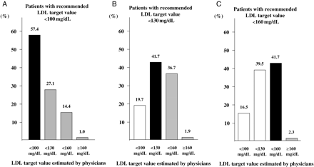
Figure 1 (A–C) Low-density lipoprotein target values estimated by the managing physicians for patients with objective ...
Notes:
Figure 1 (A–C) Low-density lipoprotein target values estimated by the managing physicians for patients with objective low-density lipoprotein target values <100 mg/dL (A), <130 mg/dL (B), and <160 mg/dL (C) as assigned by the NCEP ATP-III guideline criteria, respectively. Patients that were assigned correctly to their low-density lipoprotein target values are shown in black, grey symbols show too high and white too low low-density lipoprotein estimates by physicians.
Unless provided in the caption above, the following copyright applies to the content of this slide: Published on behalf of the European Society of Cardiology. All rights reserved. © The Author 2010. For permissions please email: journals.permissions@oxfordjournals.org

Slide 2
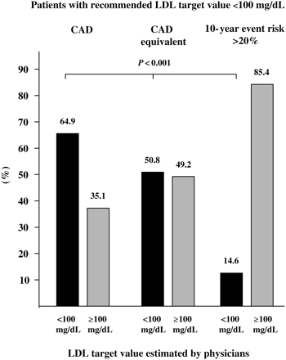
Figure 2 Percentage of high-risk patients (and therefore the recommended low-density lipoprotein target value <100 ...
Notes:
Figure 2 Percentage of high-risk patients (and therefore the recommended low-density lipoprotein target value 20% based on the Framingham risk score.
Unless provided in the caption above, the following copyright applies to the content of this slide: Published on behalf of the European Society of Cardiology. All rights reserved. © The Author 2010. For permissions please email: journals.permissions@oxfordjournals.org

Slide 3
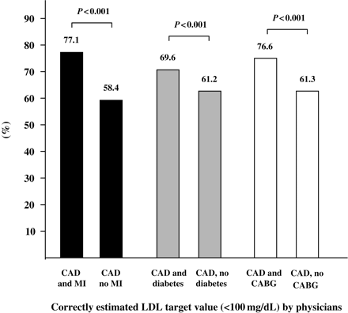
Figure 3 Proportion of patients with correctly estimated low-density lipoprotein target values of <100 mg/dL in groups ...
Notes:
Figure 3 Proportion of patients with correctly estimated low-density lipoprotein target values of <100 mg/dL in groups with coronary artery disease with and without myocardial infarction (black), coronary artery disease with and without diabetes mellitus (grey), and coronary artery disease with and without a history of coronary artery bypass grafting (CABG) (white).
Unless provided in the caption above, the following copyright applies to the content of this slide: Published on behalf of the European Society of Cardiology. All rights reserved. © The Author 2010. For permissions please email: journals.permissions@oxfordjournals.org

Slide 4
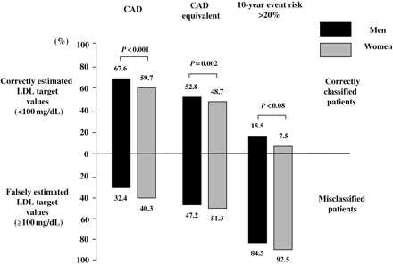
Figure 4 The analysis shows data of patients with a recommended low-density lipoprotein target value <100 mg/dL by ...
Notes:
Figure 4 The analysis shows data of patients with a recommended low-density lipoprotein target value <100 mg/dL by NCEP ATP-III guideline criteria. The proportion of men (black) and women (grey) with correctly (20% based on the Framingham risk score.
Unless provided in the caption above, the following copyright applies to the content of this slide: Published on behalf of the European Society of Cardiology. All rights reserved. © The Author 2010. For permissions please email: journals.permissions@oxfordjournals.org

Slide 5
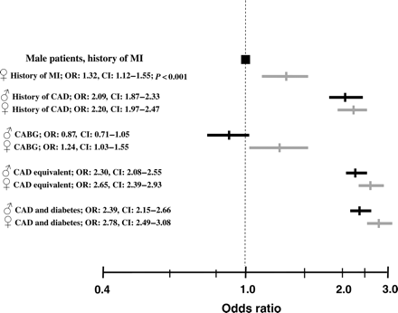
Figure 5 Odds ratio (square) and corresponding confidence intervals (lines) for incorrectly estimated low-density ...
Notes:
Figure 5 Odds ratio (square) and corresponding confidence intervals (lines) for incorrectly estimated low-density lipoprotein values in different subgroups of patients with recommended low-density lipoprotein target values of <100 mg/dL. Results are demonstrated in comparison with male patients with a history of myocardial infarction (MI). The results for male patients are marked in black; results for female patients are marked in grey. (CAD, coronary artery disease).
Unless provided in the caption above, the following copyright applies to the content of this slide: Published on behalf of the European Society of Cardiology. All rights reserved. © The Author 2010. For permissions please email: journals.permissions@oxfordjournals.org

Slide 6
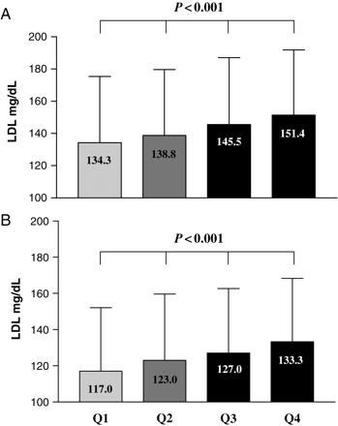
Figure 6 (A and B) Patients' low-density lipoprotein profile (mean ± SD) within quartiles of physicians (Q1–4) at the ...
Notes:
Figure 6 (A and B) Patients' low-density lipoprotein profile (mean ± SD) within quartiles of physicians (Q1–4) at the time of initial data and blood sampling (A) and 3 months after optimizing therapy (B).
Unless provided in the caption above, the following copyright applies to the content of this slide: Published on behalf of the European Society of Cardiology. All rights reserved. © The Author 2010. For permissions please email: journals.permissions@oxfordjournals.org

