Slide 1
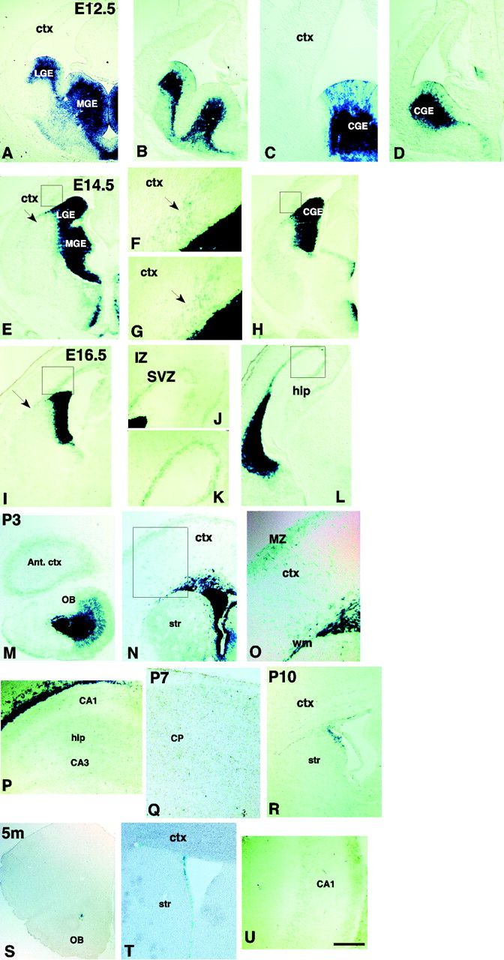
Figure 1. Expression of Dlx2-LacZ within the telencephalon: in situ hybridization and X-Gal stained coronal sections at ...
Notes:
Figure 1. Expression of Dlx2-LacZ within the telencephalon: in situ hybridization and X-Gal stained coronal sections at different embryonic and postnatal ages. At E12.5, Dlx2 is expressed in the ventral telencephalon and was visualized either by in situ hybridization (A) or X-gal staining (B–D). At this age, no Dlx2 cells were observed migrating to the cortex. At E14.5 (E–H), streams of cells are seen emanating from the basal ganglia into the cortex (arrowheads) and toward the ventrolateral telencephalon (arrow in E). F and G are high power views of the boxed areas shown in E and H, respectively. At E16.5 (I–L) and P3 (M–P) more cells are observed directed towards and within the cortical SVZ, hippocampus, ventrolateral telencephalon (arrow in I), as well as in the MZ and white matter. J and K are high power views of the boxed areas shown in I and L, respectively. Cells are also seen in the olfactory bulb (M). O shows a high power view of the boxed area shown in N. At P7 (Q) Dlx2-expressing cells are seen in the cortical plate but not in the MZ. From P10 (R) and onwards through to adulthood (5 months S–T), Dlx2-expressing cells are only detected in the SVZ, white matter and RMS. Some weakly expressing Dlx2 cells are also detected in the hippocampus at both P3 (P) and in the adult (U), this is especially true in the CA1 region. Ant. Ctx, anterior cortex; CGE, caudal ganglionic eminence; CP, cortical plate; Ctx, cortex; Hip, hippocampus; IZ, intermediate zone; LGE, lateral ganglionic eminence; MGE, medial ganglionic eminence; MZ, marginal zone; OB, olfactory bulb; Str, striatum; SVZ, subventricular zone; WM, white matter. Scale bar in U represents 300 μm in A, B, D, E, I, M, R and S; 200 μm in H and L; 150 μm in N, P, Q, T and U; 100 μm in C, F, G, J, K and O.
Unless provided in the caption above, the following copyright applies to the content of this slide: © Oxford University Press

Slide 2
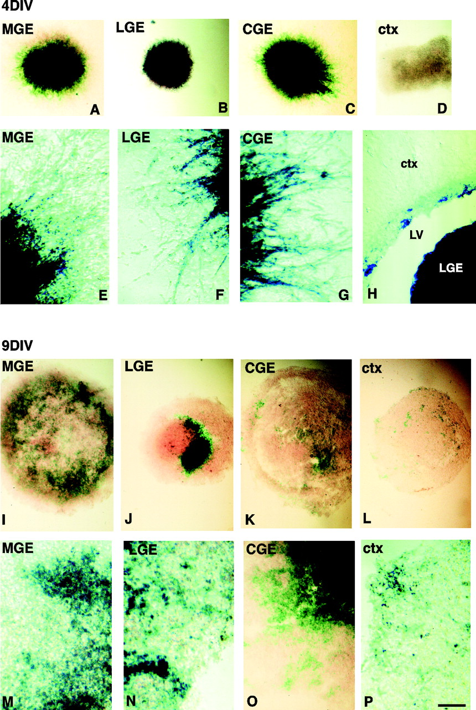
Figure 2. Dlx2-expressing cells are highly migratory at E13.5 in vitro and are a subpopulation of migrating cells. ...
Notes:
Figure 2. Dlx2-expressing cells are highly migratory at E13.5 in vitro and are a subpopulation of migrating cells. (A–G) In vitro explants cultured in matrigel for 4 days reveals cells from the MGE (A, E) and CGE (C, G) migrate extensively out of explants. In contrast, LGE (B, F) explants exhibit less migration, and cortical cells do not migrate away from the explant (D). X-gal staining of the explants reveals that Dlx2-expressing cells are migratory in vitro and represent a subpopulation of the cells that have migratory ability. After 9 days, the core of the MGE (I, M), LGE (J, N) and CGE (K, O) explants downregulated Dlx2 expression. On the other hand, cortical (L, P) explants contain βgal positive cells after long term culture. After prolonged X-gal histochemical staining, Dlx2 positive cells are also observed in the cortical ventricular zone as shown in an E15.5 coronal section (H). LV, lateral ventricle. Scale bar in P represents 300 μm in A–D; 200 μm in I–L; 150 μm in E–H; 100 μm in M–N.
Unless provided in the caption above, the following copyright applies to the content of this slide: © Oxford University Press

Slide 3
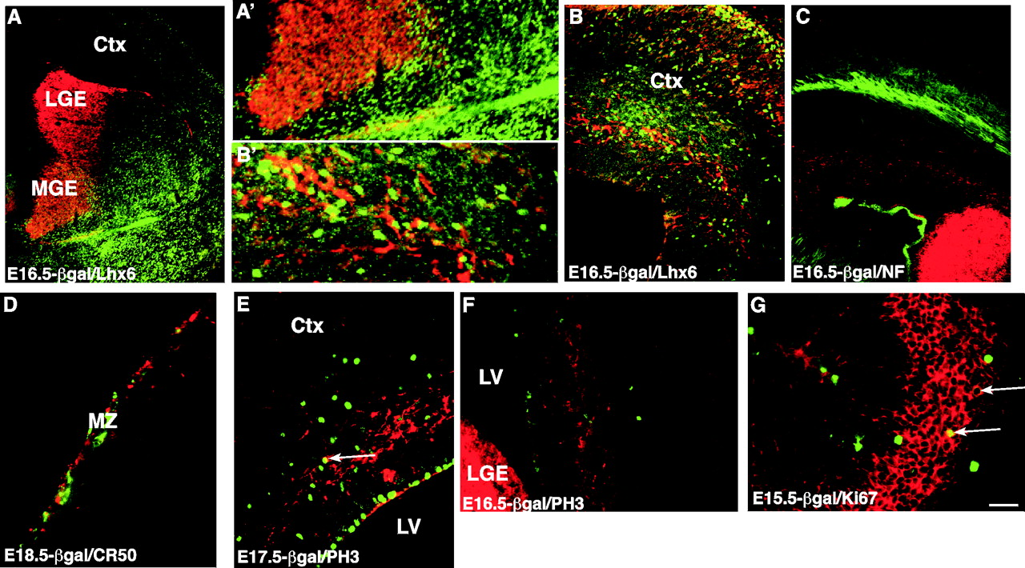
Figure 3. Dlx2-expressing cells are a subpopulation of the cells that migrate to the cortex. Immunostaining of coronal ...
Notes:
Figure 3. Dlx2-expressing cells are a subpopulation of the cells that migrate to the cortex. Immunostaining of coronal sections at E16.5 reveals that Lhx6 (green) and Dlx2 (red) expressing cells do not overlap in regions outside of the MGE (A, B, boxed areas in A, B are shown at higher power in A′ and B′). At E16.5, Dlx2-expressing cells (red) do not migrate via the intermediate zone, as visualized by neurofilament-145 antibody staining (green) (C). At E18.5, cells in the cortical MZ do not co-express βgal (red) and CR50 (green) (D). At E17.5, Dlx2-expressing cells are not mitotically active as they do not overlap with PH3 (green) (E, F). In contrast, a few Dlx2 positive cells (red) in the termination of the RMS in the olfactory bulb are dividing at E15.5, as indicated by double labeling with Ki67 (green) (G). Scale bar in G represents 300 μm in A; 150 μm in B, C and F; 100 μm in D and E; 50 μm in G.
Unless provided in the caption above, the following copyright applies to the content of this slide: © Oxford University Press

Slide 4
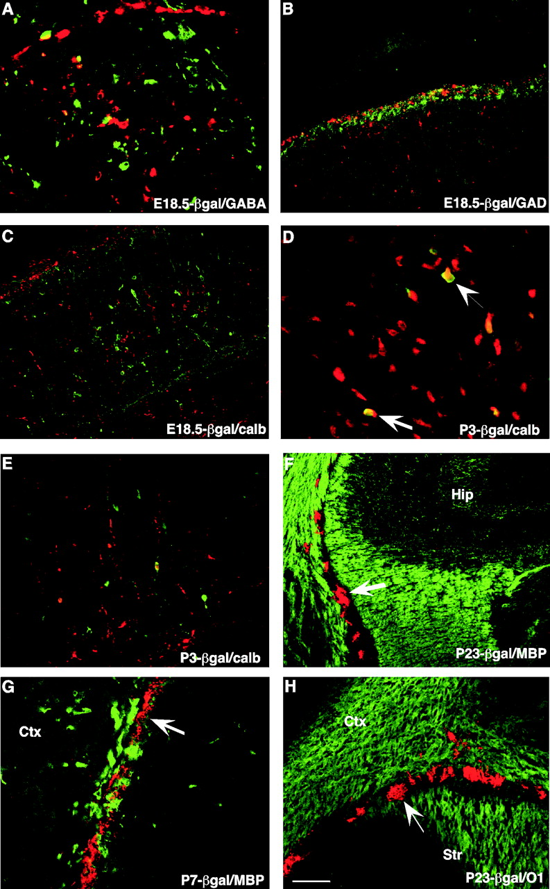
Figure 4. βgal positive cells are in close association with interneurons and oligodendrocytes. Immunostainings of ...
Notes:
Figure 4. βgal positive cells are in close association with interneurons and oligodendrocytes. Immunostainings of E18.5, P3, P7 and P23 coronal sections from Dlx2–tauLacZ KI mice. At E18.5, while we observe Dlx2 positive cells throughout the cortex (red), they do not overlap with the interneuronal markers (green) GABA (A), GAD67 (B) or calbindin (C, E). The only exception is the existence of cells that co-express βgal and calbindin in the piriform cortex at P3 (arrowheads) (D). Both at P7 and P23 we observe Dlx2 positive cells in the white matter, but double immunostaining for βgal (red) and MBP (green) (F, G) or O1 (green) (H) reveal that, although Dlx2 positive cells (arrowheads) are in close association with oligodendrocytes, the two markers do not overlap. Scale bar in H represents 100 μm in B, C, F and H; 70 μm in E; 50 μm in A and G; 30 μm in D.
Unless provided in the caption above, the following copyright applies to the content of this slide: © Oxford University Press

Slide 5
Figure 5. The mutant MGE exhibits early but not late defects in tangentially migrating Dlx2 populations. The early ...
Notes:
Figure 5. The mutant MGE exhibits early but not late defects in tangentially migrating Dlx2 populations. The early migratory defects in Nkx2.1 mutant mice appear to recover by perinatal times, as assessed by X-gal staining of E13.5, E15.5 and E18.5 coronal sections of Dlx-tauLacZ control and Nkx2.1 null embryos. Arrowheads show ventral to dorsal migrating streams of Dlx2 positive cells. At E13.5, there is a stream of Dlx2 positive cells that migrating from the ventral telencephalon to the cortex (A, B). This stream of Dlx2 positive cells is not observed in Nkx2.1 null embryos at this age (C, D). At E15.5, Dlx2 positive cells begin to be observed in the cortex of the Nkx2.1 null animals (G, H) but in a lower number than control brains (E, F). By E18.5, cortical Dlx2 staining has a similar distribution in control (I, J) and Nkx2.1 null mutants (K, L), although the absolute numbers of Dlx2 positive cells appears to be diminished in mutant animals. Scale bar in J represents 500 μm in A and C; 300 μm E and G; 200 μm in I and K; 100 μm in B, D, F, H, J and L.
Unless provided in the caption above, the following copyright applies to the content of this slide: © Oxford University Press

