Slide 1
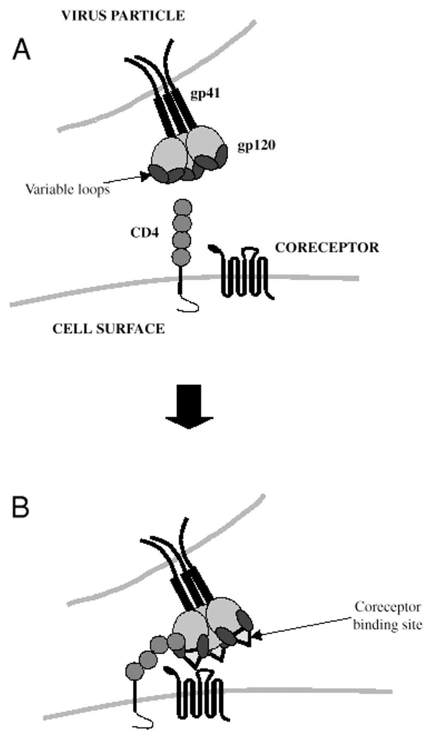
Fig. 1 Receptor interactions involved in HIV entry. (A) HIV virion binds CD4. (B) CD4 binding induces conformation ...
Notes:
Fig. 1 Receptor interactions involved in HIV entry. (A) HIV virion binds CD4. (B) CD4 binding induces conformation changes in gp120 that result in the movement of the variable loops and exposure of the co-receptor binding site. Flexible regions in CD4 between domains 2 and 3 as well as between domain 4 and the membrane allow orientation of the co-receptor binding site for co-receptor binding.
Unless provided in the caption above, the following copyright applies to the content of this slide:

