Slide 1
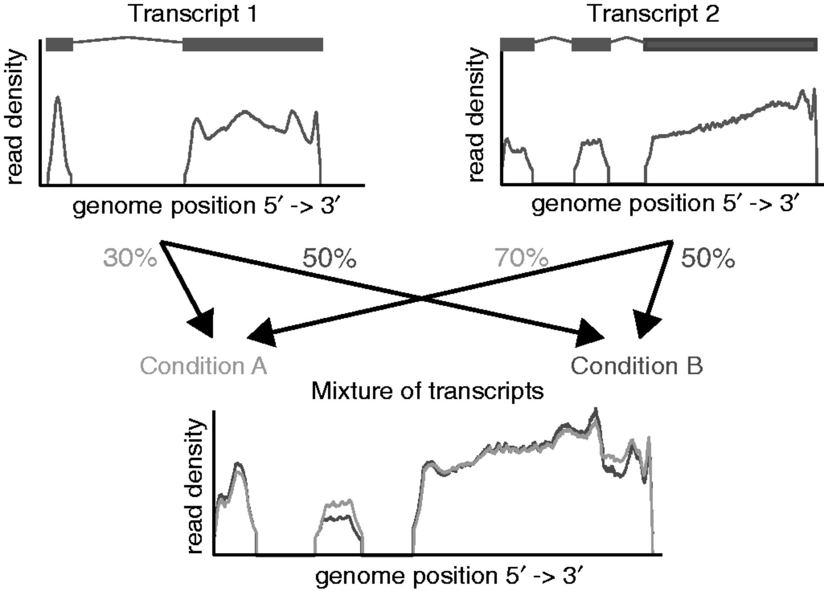
Figure 1. On the top, two transcripts are shown together with the read density one would observe if they were present ...
Notes:
Figure 1. On the top, two transcripts are shown together with the read density one would observe if they were present isolated from each other. On the bottom, the read densities for two mixtures of the transcripts are shown. The mixture for the conditions A (light gray) and B (dark gray) is different, which is reflected by the difference of the read densities.
Unless provided in the caption above, the following copyright applies to the content of this slide: © The Author(s) 2013. Published by Oxford University Press.This is an Open Access article distributed under the terms of the Creative Commons Attribution Non-Commercial License (http://creativecommons.org/licenses/by-nc/3.0/), which permits non-commercial re-use, distribution, and reproduction in any medium, provided the original work is properly cited. For commercial re-use, please contact journals.permissions@oup.com

Slide 2
Figure 2. (a) The alternative regions used by rDiff.parametric. Alternative regions are defined as regions in the ...
Notes:
Figure 2. (a) The alternative regions used by rDiff.parametric. Alternative regions are defined as regions in the genome that are not contained in all transcripts of a gene but at least one, according to the gene structure. In a second step, all regions are merged, which are in the same subgroups of transcripts, to obtain the so-called alternative regions. (b) Test statistic used by rDiff.nonparametric. Shown are the two read densities in the two conditions A and B and their difference in gray and the underlying gene structure in light green.
Unless provided in the caption above, the following copyright applies to the content of this slide: © The Author(s) 2013. Published by Oxford University Press.This is an Open Access article distributed under the terms of the Creative Commons Attribution Non-Commercial License (http://creativecommons.org/licenses/by-nc/3.0/), which permits non-commercial re-use, distribution, and reproduction in any medium, provided the original work is properly cited. For commercial re-use, please contact journals.permissions@oup.com

Slide 3
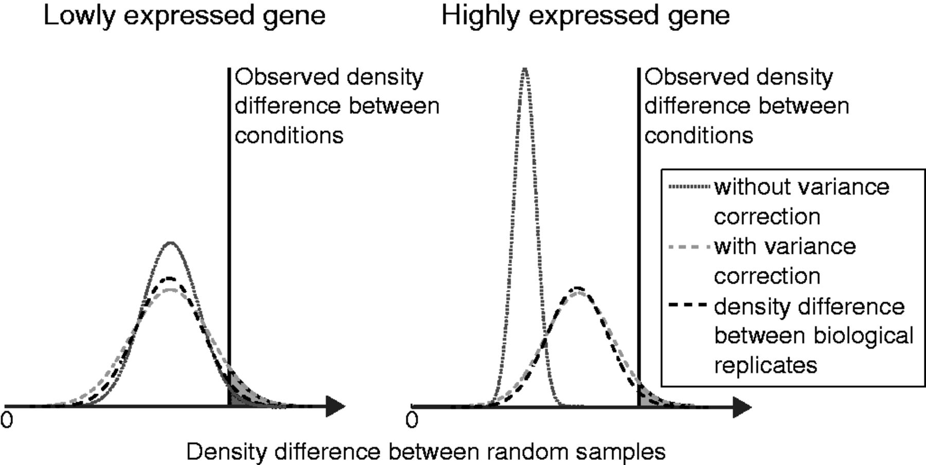
Figure 3. Illustration of variance of the read density difference (see gray area in Figure 2b) between random samples ...
Notes:
Figure 3. Illustration of variance of the read density difference (see gray area in Figure 2b) between random samples from the null distribution. The distribution difference between two biological samples is shown as a dashed black curve, the one between two random samples when not correcting for biological variance in dark gray dashed and when correcting for biological variance in light gray dashed. The resulting P-value for rDiff.nonparametric corresponds to the gray area of surface, which is the fraction of random samples that have a bigger difference than the difference observed between the two conditions. For highly expressed genes, when not correcting for biological variance, the density difference between random samples converges to zero, thus leading to an unrealistically small P-value.
Unless provided in the caption above, the following copyright applies to the content of this slide: © The Author(s) 2013. Published by Oxford University Press.This is an Open Access article distributed under the terms of the Creative Commons Attribution Non-Commercial License (http://creativecommons.org/licenses/by-nc/3.0/), which permits non-commercial re-use, distribution, and reproduction in any medium, provided the original work is properly cited. For commercial re-use, please contact journals.permissions@oup.com

Slide 4
Figure 4. Comparison of rDiff with MISO and CuffDiff. (a) ROC curve for rDiff, MISO and CuffDiff. (b) Comparison of the ...
Notes:
Figure 4. Comparison of rDiff with MISO and CuffDiff. (a) ROC curve for rDiff, MISO and CuffDiff. (b) Comparison of the empirical false discovery rate (empFDR) and the FDR based on P-values provided by the methods, for rDiff and CuffDiff. This was not possible for MISO, as it did not provide P-values. (c) Number of detected genes as a function of the FDR cut-off.
Unless provided in the caption above, the following copyright applies to the content of this slide: © The Author(s) 2013. Published by Oxford University Press.This is an Open Access article distributed under the terms of the Creative Commons Attribution Non-Commercial License (http://creativecommons.org/licenses/by-nc/3.0/), which permits non-commercial re-use, distribution, and reproduction in any medium, provided the original work is properly cited. For commercial re-use, please contact journals.permissions@oup.com

Slide 5
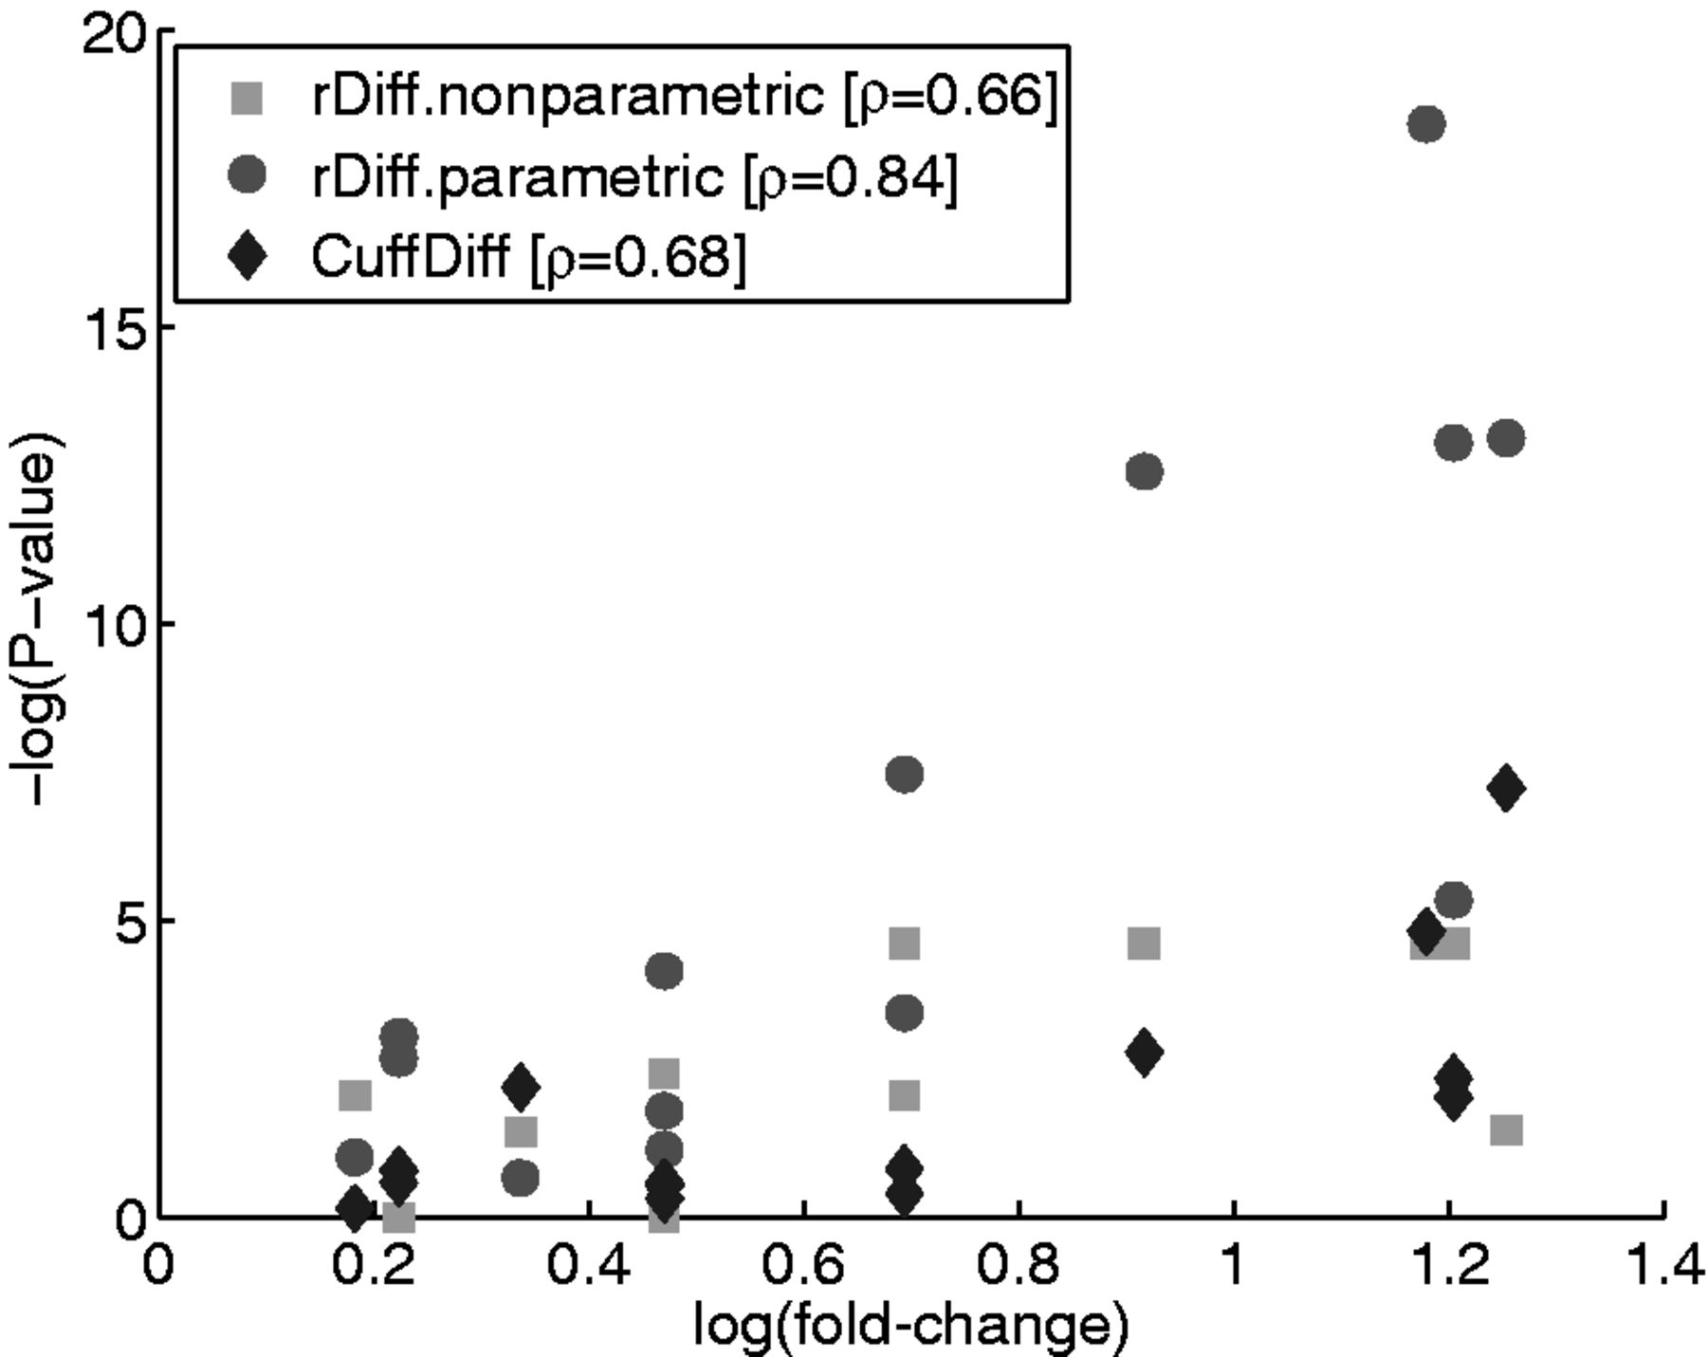
Figure 5. Plot of the −log(P-value) against the log(fold-change) measured by RT-qPCR. The P-values for ...
Notes:
Figure 5. Plot of the −log(P-value) against the log(fold-change) measured by RT-qPCR. The P-values for rDiff.nonparametric are shown in light gray, for rDiff.parametric in dark gray and for CuffDiff in black. Spearman’s correlation coefficient ρ for the two methods is given in the legend.
Unless provided in the caption above, the following copyright applies to the content of this slide: © The Author(s) 2013. Published by Oxford University Press.This is an Open Access article distributed under the terms of the Creative Commons Attribution Non-Commercial License (http://creativecommons.org/licenses/by-nc/3.0/), which permits non-commercial re-use, distribution, and reproduction in any medium, provided the original work is properly cited. For commercial re-use, please contact journals.permissions@oup.com

Slide 6
Figure 6. Examples of two genes detected by rDiff.nonparametric with a minimal P-value of 0.01. Shown is the read ...
Notes:
Figure 6. Examples of two genes detected by rDiff.nonparametric with a minimal P-value of 0.01. Shown is the read density on top. The gray area indicates the region in which the change was detected, and the black bar in the upper part of the plot shows the 100-bp region which showed the biggest difference. Below the read densities is the splice graph in dark gray and the transcripts in black. The light gray indicates the UTRs.
Unless provided in the caption above, the following copyright applies to the content of this slide: © The Author(s) 2013. Published by Oxford University Press.This is an Open Access article distributed under the terms of the Creative Commons Attribution Non-Commercial License (http://creativecommons.org/licenses/by-nc/3.0/), which permits non-commercial re-use, distribution, and reproduction in any medium, provided the original work is properly cited. For commercial re-use, please contact journals.permissions@oup.com

Slide 7
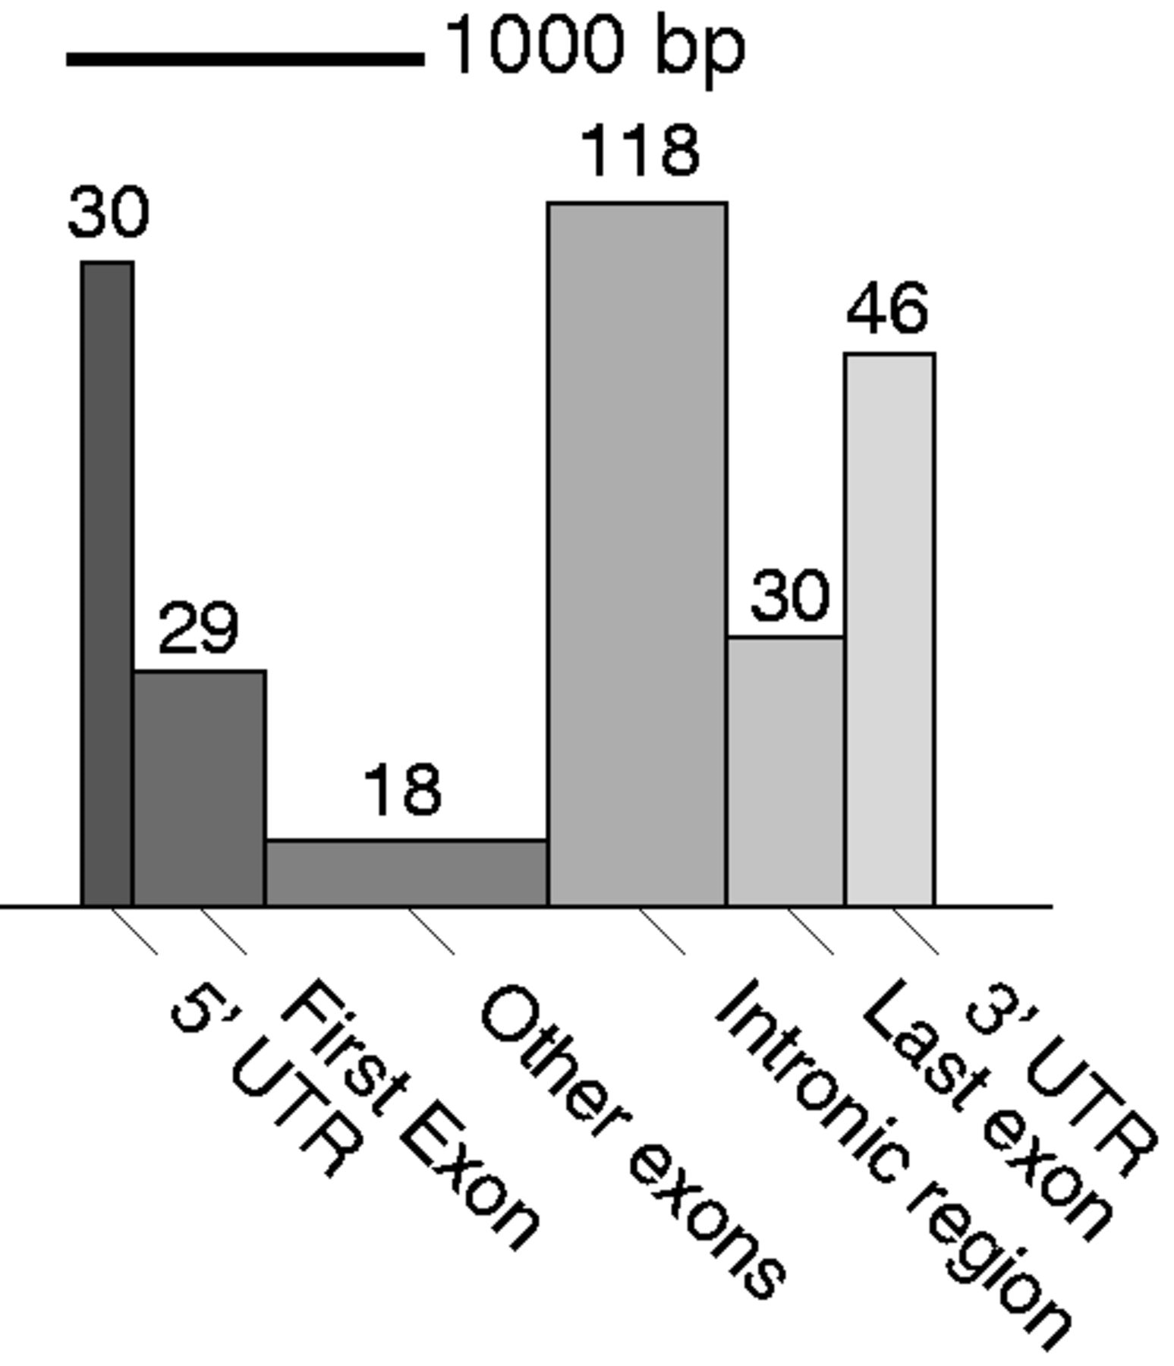
Figure 7. Categorization of the most differential 100 bp between the time points 0 h and 1 h according to the gene ...
Notes:
Figure 7. Categorization of the most differential 100 bp between the time points 0 h and 1 h according to the gene structure, in genes detected by rDiff.nonparametric with an FDR smaller than 10%. The width of the boxes is the average length of those regions, and the area equals the total number of detected differential cases.
Unless provided in the caption above, the following copyright applies to the content of this slide: © The Author(s) 2013. Published by Oxford University Press.This is an Open Access article distributed under the terms of the Creative Commons Attribution Non-Commercial License (http://creativecommons.org/licenses/by-nc/3.0/), which permits non-commercial re-use, distribution, and reproduction in any medium, provided the original work is properly cited. For commercial re-use, please contact journals.permissions@oup.com

