Slide 1
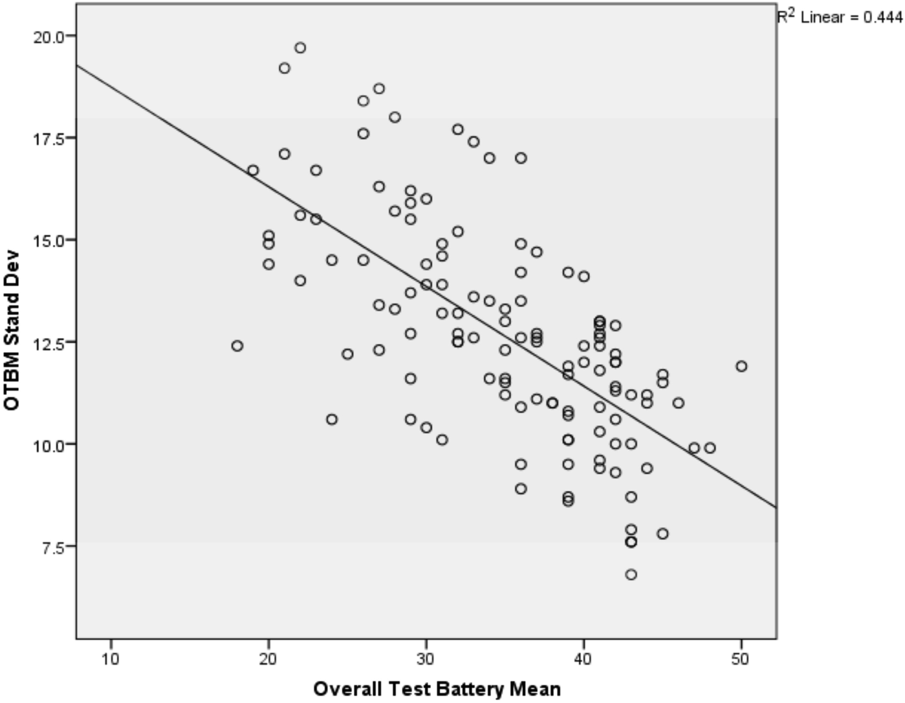
Fig. 2. Scatterplot of OTBM SD predicting OTBM for invalid performers.
Notes:
Fig. 2. Scatterplot of OTBM SD predicting OTBM for invalid performers.
Unless provided in the caption above, the following copyright applies to the content of this slide: © The Author 2013. Published by Oxford University Press. All rights reserved. For permissions, please e-mail: journals.permissions@oup.com.

Slide 2
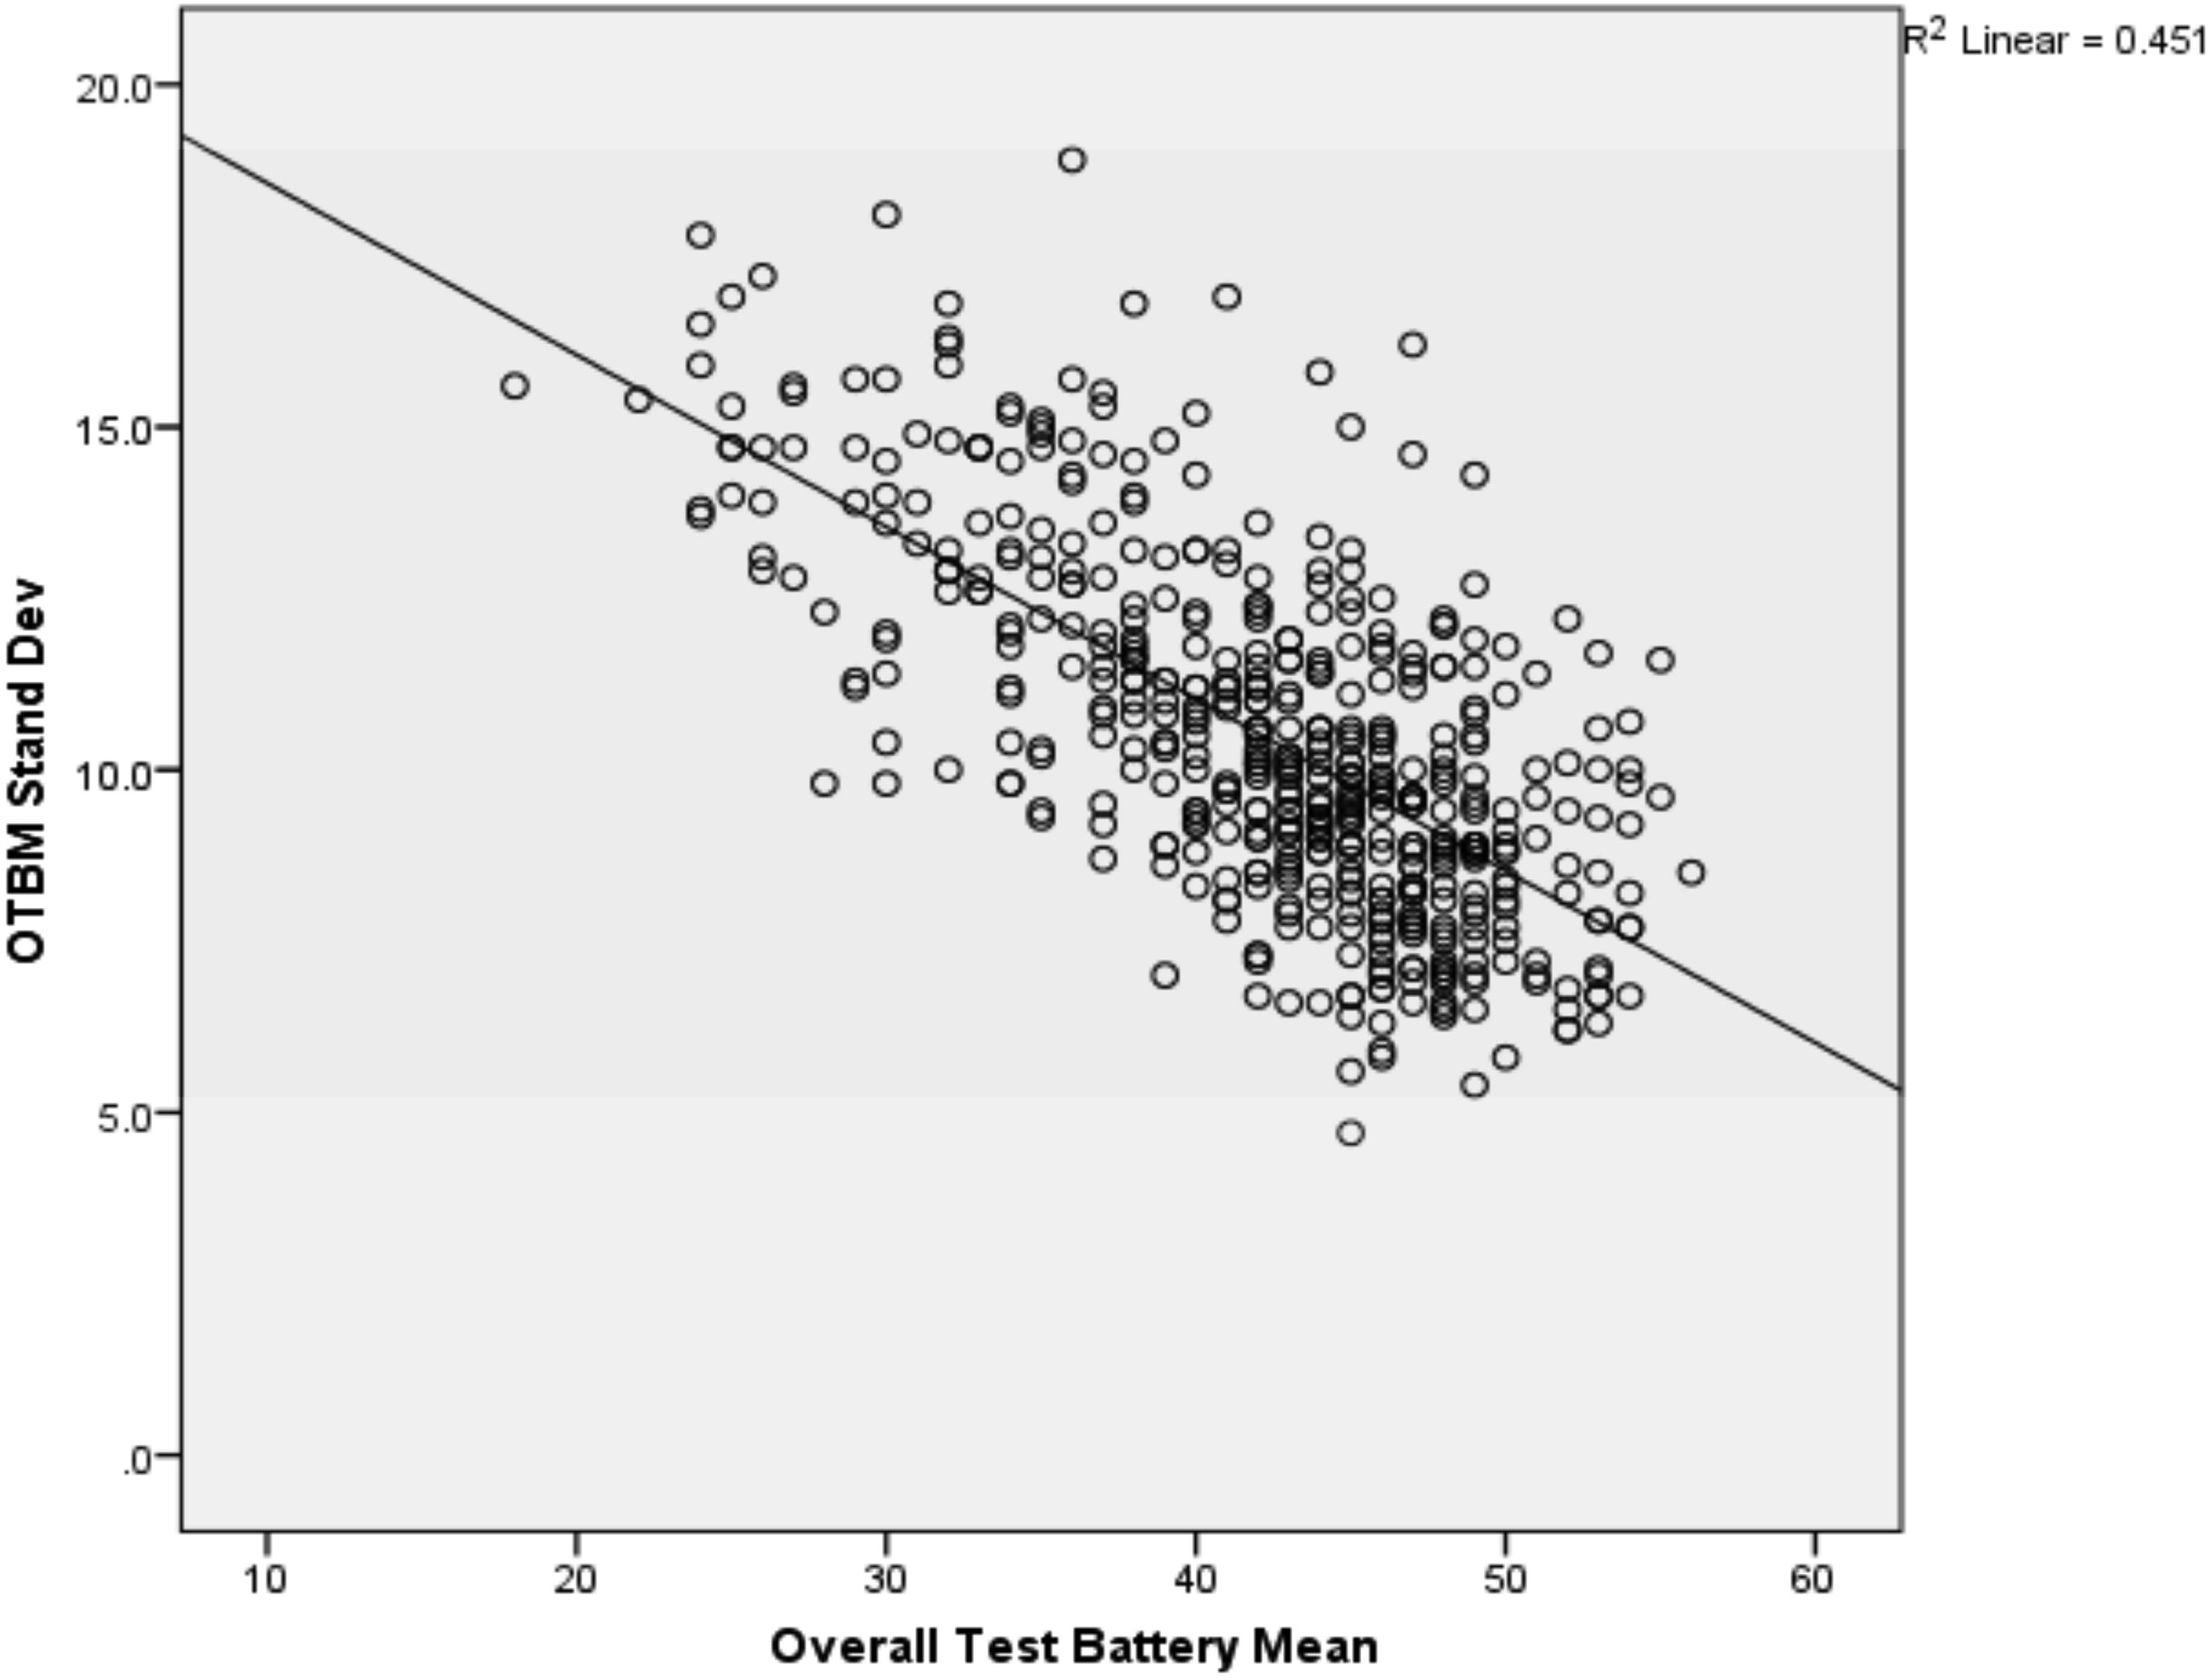
Fig. 1. Scatterplot of OTBM SD predicting OTBM for valid performers.
Notes:
Fig. 1. Scatterplot of OTBM SD predicting OTBM for valid performers.
Unless provided in the caption above, the following copyright applies to the content of this slide: © The Author 2013. Published by Oxford University Press. All rights reserved. For permissions, please e-mail: journals.permissions@oup.com.

