Slide 1
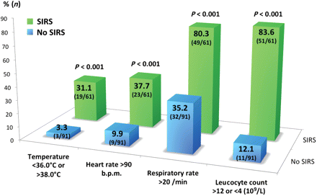
Figure 1 Parameters of systemic inflammatory response syndrome (SIRS) in patients after transcatheter aortic valve ...
Notes:
Figure 1 Parameters of systemic inflammatory response syndrome (SIRS) in patients after transcatheter aortic valve implantation. Systemic inflammatory response syndrome patients (green bars) fulfilled at least two of the following criteria during the first 48 h after TAVI as assessed on ICU: fever or hypothermia (temperature 38.0°C), tachycardia (heart rate >90 beats/min), hyperventilation (respiratory rate >20 breaths/min or PaCO2 12 or <4 × 109/L). Non-systemic inflammatory response syndrome patients (blue bars) did not fulfil more than one criterion.
Unless provided in the caption above, the following copyright applies to the content of this slide: Published on behalf of the European Society of Cardiology. All rights reserved. © The Author 2012. For permissions please email: journals.permissions@oup.com

Slide 2
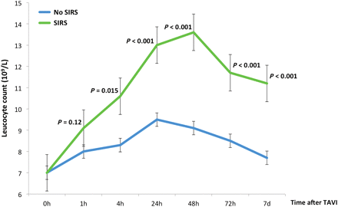
Figure 2 Leucocyte count according to the occurrence of systemic inflammatory response syndrome (SIRS) after ...
Notes:
Figure 2 Leucocyte count according to the occurrence of systemic inflammatory response syndrome (SIRS) after transcatheter aortic valve implantation (TAVI). Mean leucocyte count (109/L) before and at 1, 4, 24, 48, 72 h, and 7 days after transcatheter aortic valve implantation according to the occurrence of systemic inflammatory response syndrome.
Unless provided in the caption above, the following copyright applies to the content of this slide: Published on behalf of the European Society of Cardiology. All rights reserved. © The Author 2012. For permissions please email: journals.permissions@oup.com

Slide 3
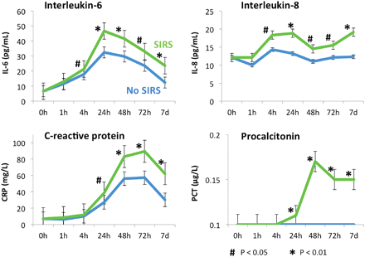
Figure 3 Inflammatory biomarker increases after transcatheter aortic valve implantation. Median interleukin-6 (IL-6), ...
Notes:
Figure 3 Inflammatory biomarker increases after transcatheter aortic valve implantation. Median interleukin-6 (IL-6), interleukin-8 (IL-8), C-reactive protein (CRP), and procalcitonin (PCT) levels in patients after transcatheter aortic valve implantation according to the occurrence of systemic inflammatory response syndrome (SIRS).
Unless provided in the caption above, the following copyright applies to the content of this slide: Published on behalf of the European Society of Cardiology. All rights reserved. © The Author 2012. For permissions please email: journals.permissions@oup.com

Slide 4
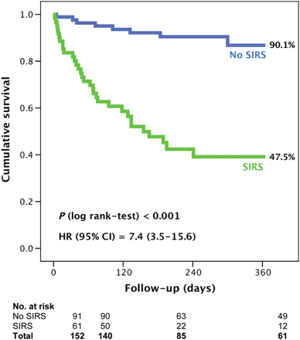
Figure 4 One-year mortality according to the development of systemic inflammatory response syndrome I (SIRS).
Notes:
Figure 4 One-year mortality according to the development of systemic inflammatory response syndrome I (SIRS).
Unless provided in the caption above, the following copyright applies to the content of this slide: Published on behalf of the European Society of Cardiology. All rights reserved. © The Author 2012. For permissions please email: journals.permissions@oup.com

Slide 5
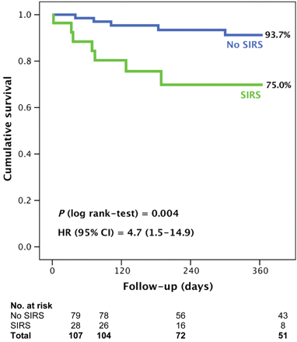
Figure 5 One-year mortality according to the development of systemic inflammatory response syndrome (SIRS) after ...
Notes:
Figure 5 One-year mortality according to the development of systemic inflammatory response syndrome (SIRS) after exclusion from patients (n = 45) suffering from periprocedural complications (major vascular complications, major bleeding events, and acute kidney injury).
Unless provided in the caption above, the following copyright applies to the content of this slide: Published on behalf of the European Society of Cardiology. All rights reserved. © The Author 2012. For permissions please email: journals.permissions@oup.com

