Slide 1
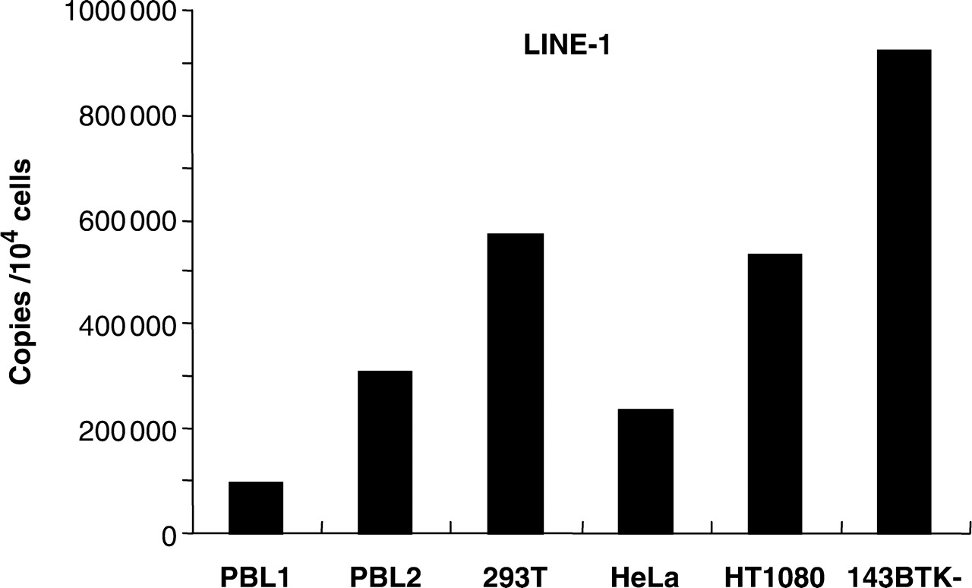
Figure 1. Endogenous expression of LINE-1 in primary and established cells. LINE-1 mRNA copy numbers in PBL (two ...
Notes:
Figure 1. Endogenous expression of LINE-1 in primary and established cells. LINE-1 mRNA copy numbers in PBL (two different donors), 293T, HeLa, HT1080 and 143BTK- cells were determined by real-time RT-PCR using total RNAs isolated from those cells. L1 mRNA levels were normalized with GAPDH mRNA levels, and are presented as copies per 10 4 cells.
Unless provided in the caption above, the following copyright applies to the content of this slide: © 2007 The Author(s)This is an Open Access article distributed under the terms of the Creative Commons Attribution Non-Commercial License (http://creativecommons.org/licenses/by-nc/2.0/uk/) which permits unrestricted non-commercial use, distribution, and reproduction in any medium, provided the original work is properly cited.

Slide 2
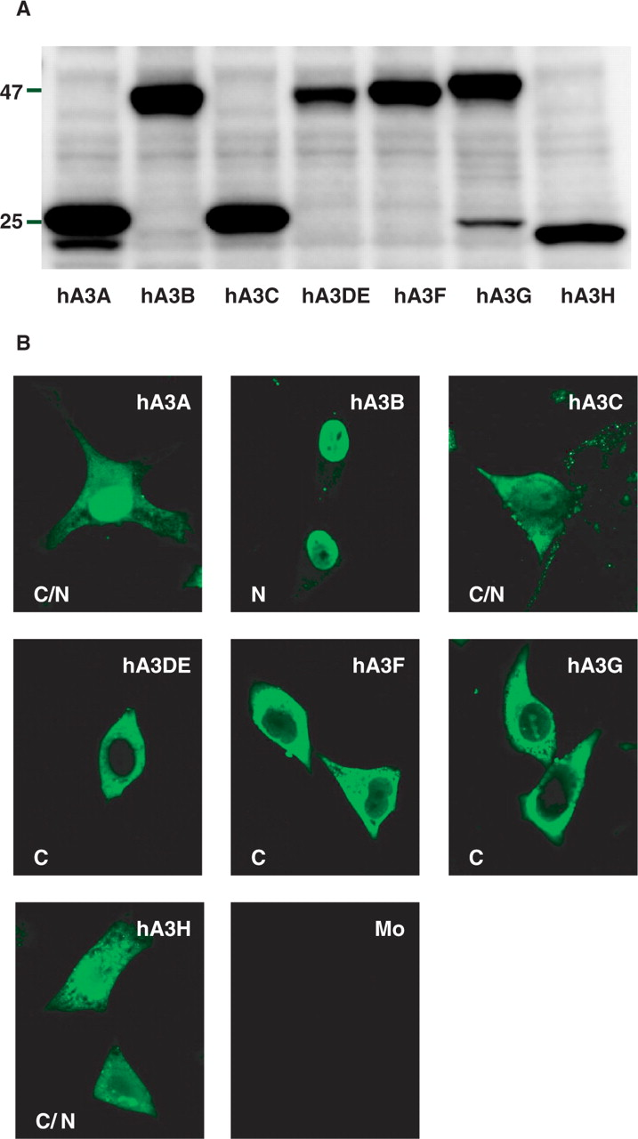
Figure 2. Western analysis and subcellular localization of the hA3 family proteins. ( A ) Western blot analysis was ...
Notes:
Figure 2. Western analysis and subcellular localization of the hA3 family proteins. ( A ) Western blot analysis was performed by using extracts from 293T cells transfected with HA-tagged hA3 expression plasmids. Antibodies specific for HA were used. ( B ) To analyze subcellular localization of hA3 proteins, immunofluorescence microscopy was performed by using HeLa cells transfected with the HA-tagged hA3 expression plasmids. An anti-HA monoclonal antibody and Alexa 488 conjugating anti-mouse IgG were used for the first antibody and for the second antibody, respectively. C, N or C/N in the pictures indicates cytoplasmic, nuclear or both localizations, respectively.
Unless provided in the caption above, the following copyright applies to the content of this slide: © 2007 The Author(s)This is an Open Access article distributed under the terms of the Creative Commons Attribution Non-Commercial License (http://creativecommons.org/licenses/by-nc/2.0/uk/) which permits unrestricted non-commercial use, distribution, and reproduction in any medium, provided the original work is properly cited.

Slide 3
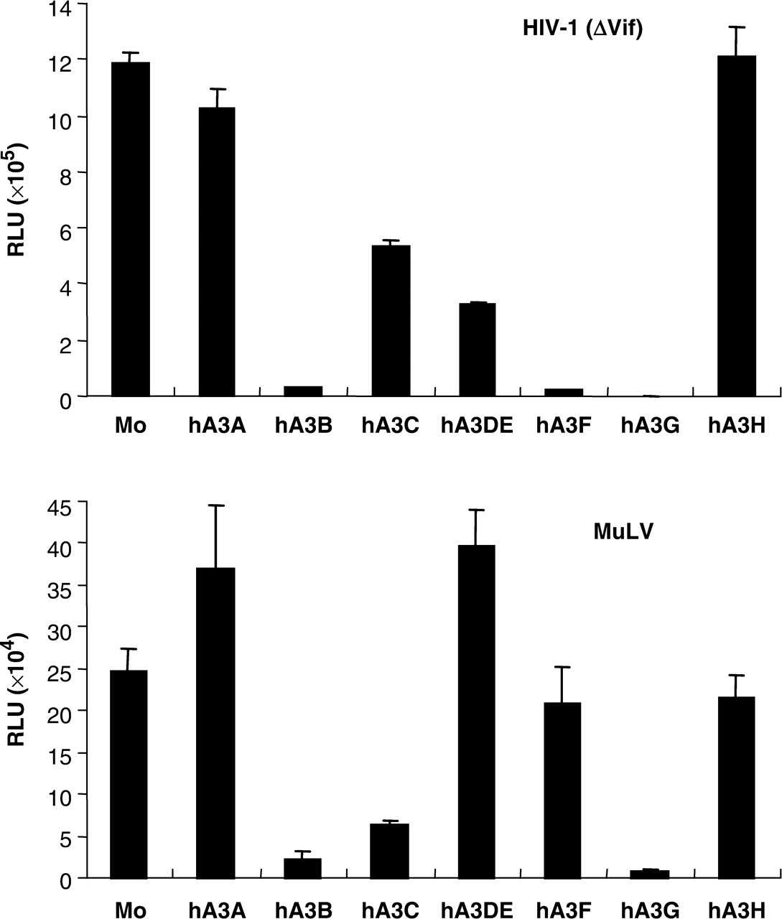
Figure 3. Inhibitory effect of hA3 family proteins on retroviruses. 293T cells were cotransfected with VSV-G and hA3 ...
Notes:
Figure 3. Inhibitory effect of hA3 family proteins on retroviruses. 293T cells were cotransfected with VSV-G and hA3 expression plasmids, together with a luciferase-based HIV-1 or MuLV construct. After 48 h, each viral supernatant was harvested. Normalized supernatants were incubated with 293T cells for additional 48 h. Cells were then lysed and subjected to luciferase assay. Data shown are mean ± SD. RLU: relative light units.
Unless provided in the caption above, the following copyright applies to the content of this slide: © 2007 The Author(s)This is an Open Access article distributed under the terms of the Creative Commons Attribution Non-Commercial License (http://creativecommons.org/licenses/by-nc/2.0/uk/) which permits unrestricted non-commercial use, distribution, and reproduction in any medium, provided the original work is properly cited.

Slide 4
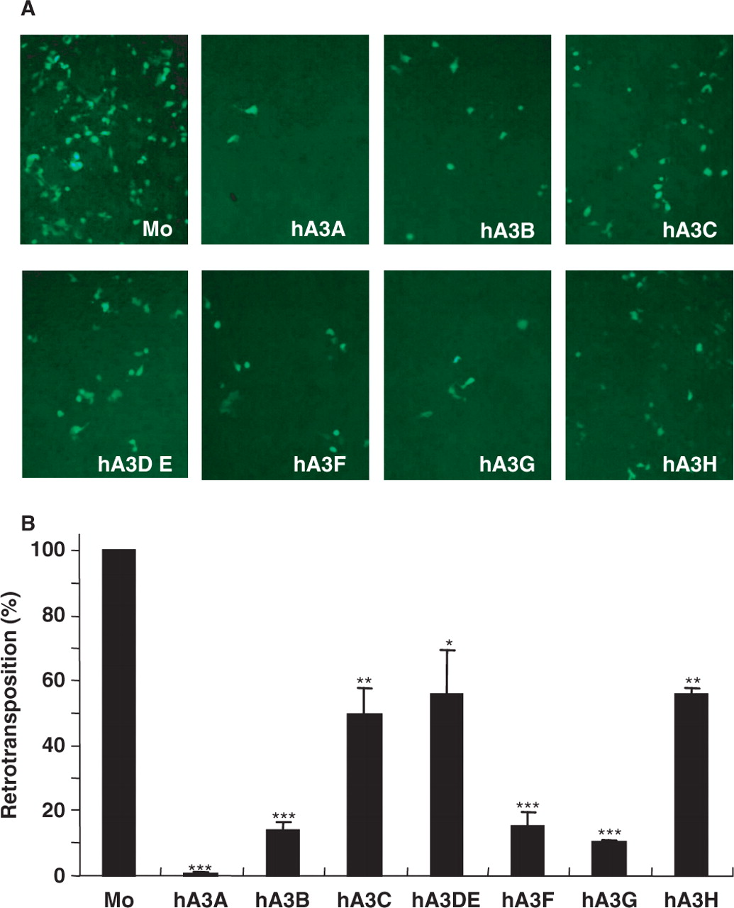
Figure 4. EGFP-based retrotransposition assay. 293T cells were cotransfected with the EGFP-based L1 retrotransposon ...
Notes:
Figure 4. EGFP-based retrotransposition assay. 293T cells were cotransfected with the EGFP-based L1 retrotransposon indicator construct pL1 RP -EGFP and hA3 expression plasmids. After 48 h, cells were subjected to puromycin (0.5 μg/ml) selection. After 8 days of puromycin selection, cells were observed by fluorescence microscopy ( A ) and subjected to flow cytometry analysis ( B ). Retrotransposition level in the absence of hA3 proteins was set as 100%. Data shown are mean ± SD; * P < 0.05, **P < 0.01, ***P < 0.001, t -test.
Unless provided in the caption above, the following copyright applies to the content of this slide: © 2007 The Author(s)This is an Open Access article distributed under the terms of the Creative Commons Attribution Non-Commercial License (http://creativecommons.org/licenses/by-nc/2.0/uk/) which permits unrestricted non-commercial use, distribution, and reproduction in any medium, provided the original work is properly cited.

Slide 5
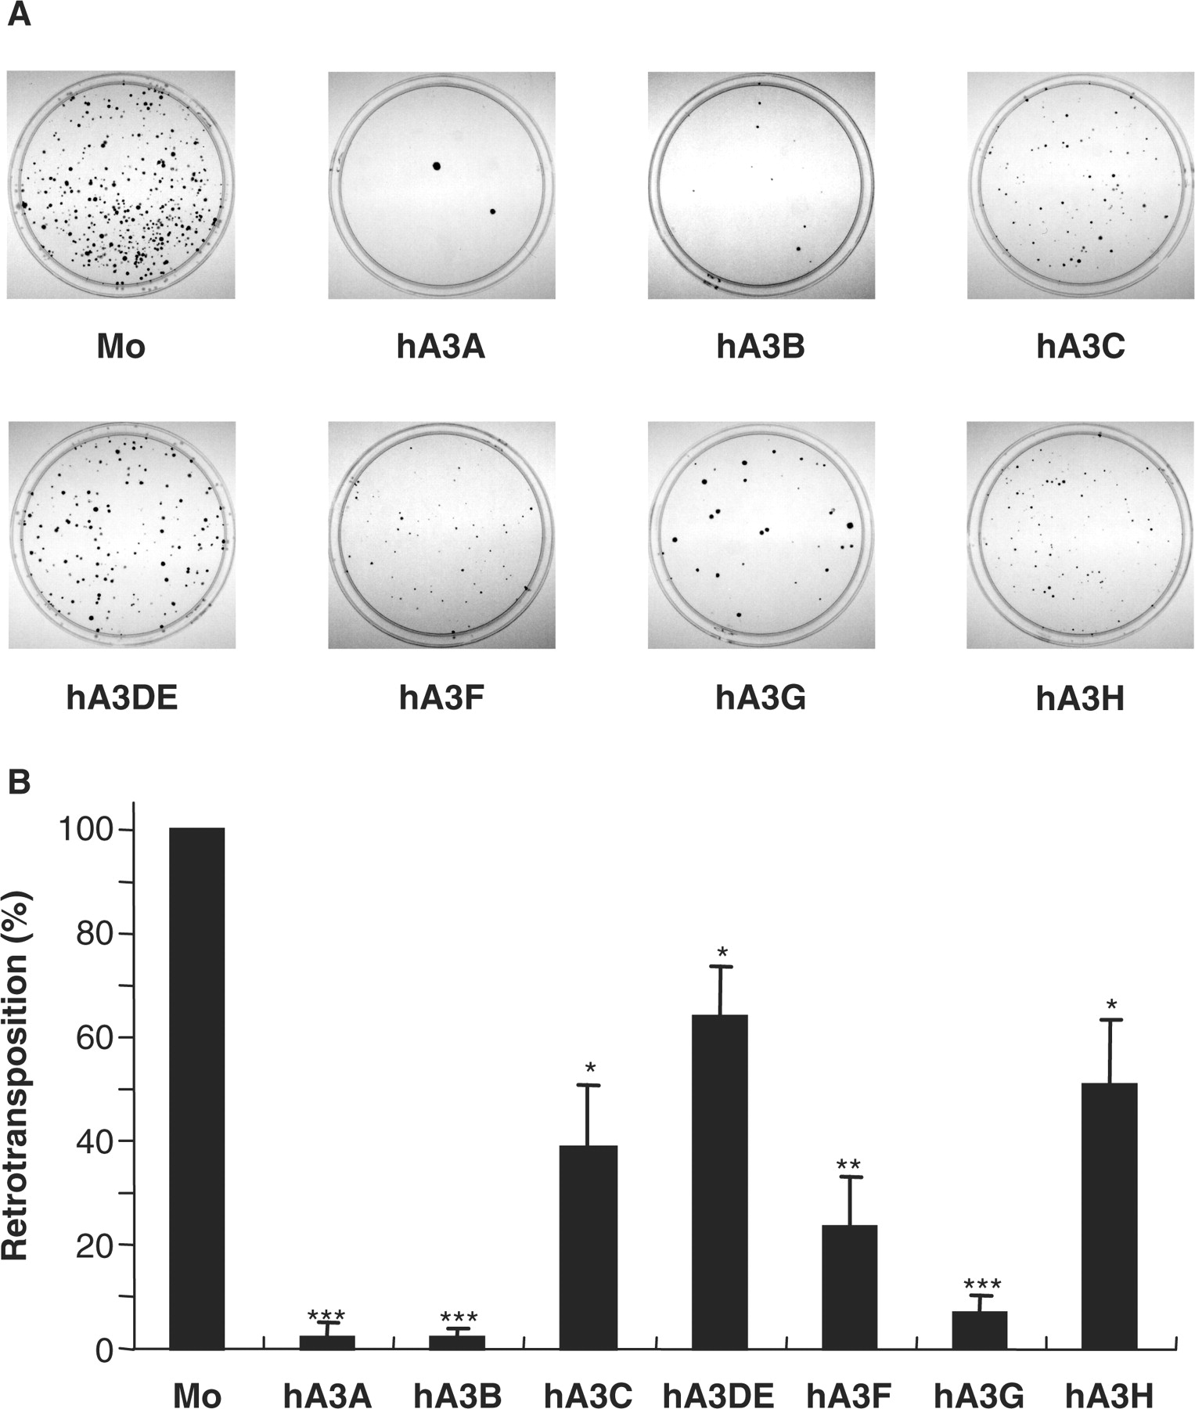
Figure 5. neo ^{r} -based retrotransposition assay. HeLa cells were cotransfected with pCEP4/L1mneoI/ColE1 and ...
Notes:
Figure 5. neo r -based retrotransposition assay. HeLa cells were cotransfected with pCEP4/L1mneoI/ColE1 and the respective hA3 expression plasmids. Seventy-two hours later, cells were trypsinized, re-seeded onto 100 mm dishes, and subjected to G418 (1 mg/ml) selection. Fourteen days after selection, resultant G418 R colonies fixed, stained with crystal violet ( A ), and counted to determine the level of L1 retrotransposition ( B ). Transposition level in the absence of hA3 proteins was set as 100%. Data shown are mean ± SD; * P < 0.05, **P < 0.01, ***P < 0.001, t -test.
Unless provided in the caption above, the following copyright applies to the content of this slide: © 2007 The Author(s)This is an Open Access article distributed under the terms of the Creative Commons Attribution Non-Commercial License (http://creativecommons.org/licenses/by-nc/2.0/uk/) which permits unrestricted non-commercial use, distribution, and reproduction in any medium, provided the original work is properly cited.

Slide 6
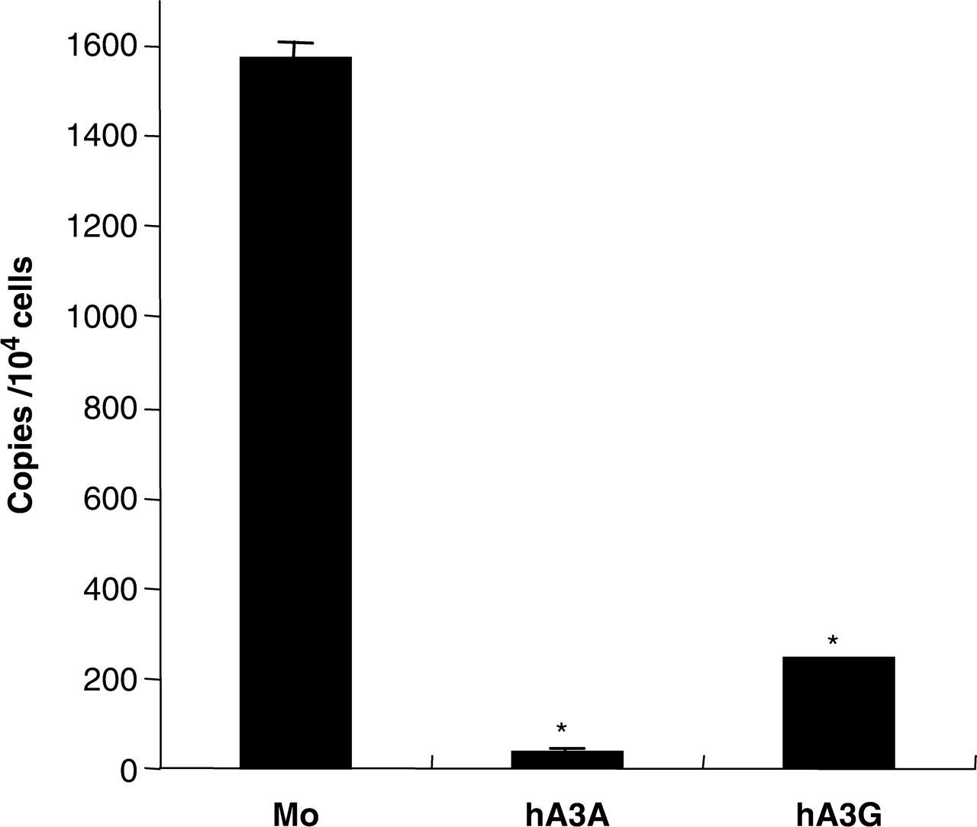
Figure 6. Real-time PCR targeting spliced EGFP genes. Total cellular DNA was extracted from the cells used in Figure 4 ...
Notes:
Figure 6. Real-time PCR targeting spliced EGFP genes. Total cellular DNA was extracted from the cells used in Figure 4 and subjected to real-time PCR analysis. Dual labeled probe was designed for the detection of spliced EGFP. Mock, hA3A and hA3G were shown as representatives. Data shown are mean ± SD; * P < 0.001, t -test.
Unless provided in the caption above, the following copyright applies to the content of this slide: © 2007 The Author(s)This is an Open Access article distributed under the terms of the Creative Commons Attribution Non-Commercial License (http://creativecommons.org/licenses/by-nc/2.0/uk/) which permits unrestricted non-commercial use, distribution, and reproduction in any medium, provided the original work is properly cited.

Slide 7
Figure 7. Sequence analysis of L1 reverse transcripts. Total DNA was extracted from 293T cells cotransfected with pL1 ...
Notes:
Figure 7. Sequence analysis of L1 reverse transcripts. Total DNA was extracted from 293T cells cotransfected with pL1 RP -EGFP and hA3 expression plasmid, at 2 and 6 days after transfection. Reverse transcribed EGFP genes were PCR-amplified and inserted into the cloning vector. Alignment of partial sequences of EGFP genes in hA3G-cotransfected cells is shown.
Unless provided in the caption above, the following copyright applies to the content of this slide: © 2007 The Author(s)This is an Open Access article distributed under the terms of the Creative Commons Attribution Non-Commercial License (http://creativecommons.org/licenses/by-nc/2.0/uk/) which permits unrestricted non-commercial use, distribution, and reproduction in any medium, provided the original work is properly cited.

Slide 8
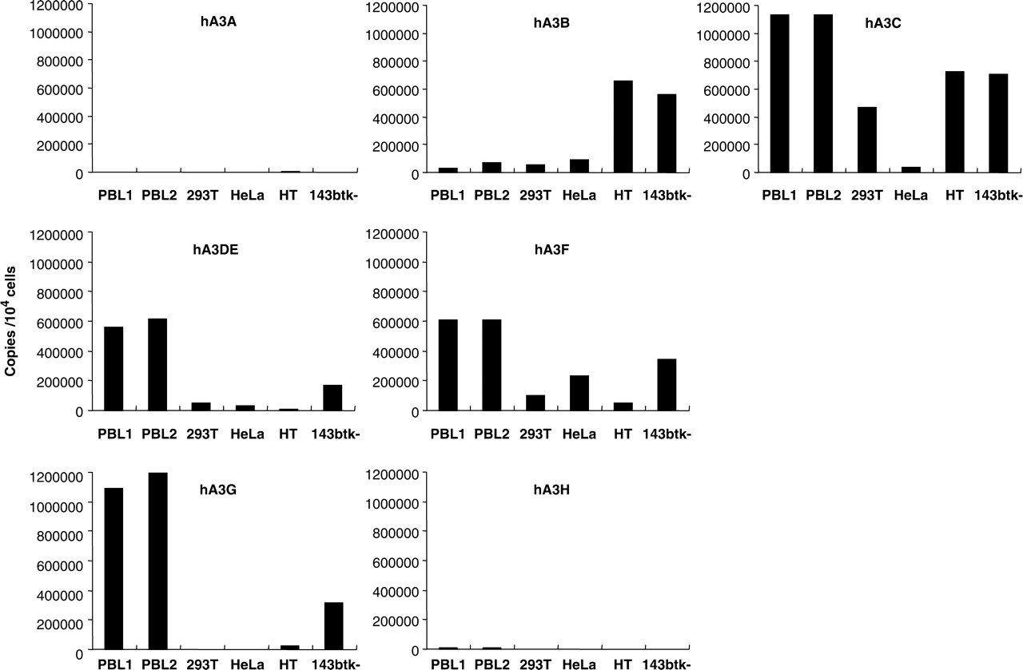
Figure 8. Endogenous expressions of hA3 family members in primary and established cells. Total RNAs were extracted ...
Notes:
Figure 8. Endogenous expressions of hA3 family members in primary and established cells. Total RNAs were extracted from PBL (from two different donors), 293T, HeLa, HT1080 (HT) and 143BTK- cells, and subjected to real-time RT-PCR to determine the copy numbers of the respective hA3 mRNAs. Levels of hA3 mRNA were normalized with GAPDH mRNA levels, and are presented as copies per 10 4 cells.
Unless provided in the caption above, the following copyright applies to the content of this slide: © 2007 The Author(s)This is an Open Access article distributed under the terms of the Creative Commons Attribution Non-Commercial License (http://creativecommons.org/licenses/by-nc/2.0/uk/) which permits unrestricted non-commercial use, distribution, and reproduction in any medium, provided the original work is properly cited.

