Slide 1
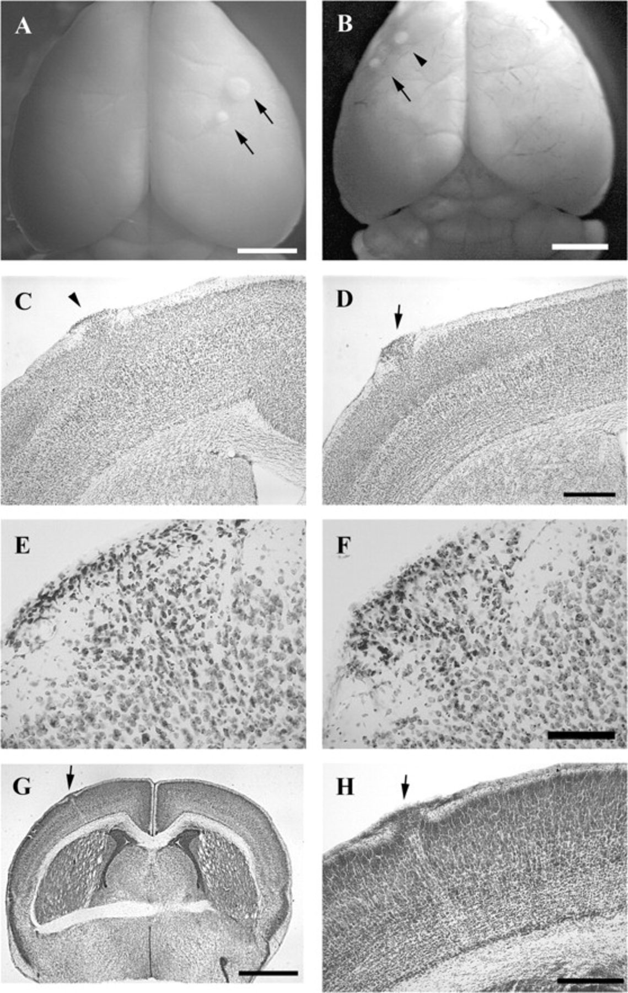
Figure 1. Dorsal neocortical molecular layer heterotopia. (A, B) Representative photomicrographs of heterotopia from ...
Notes:
Figure 1. Dorsal neocortical molecular layer heterotopia. (A, B) Representative photomicrographs of heterotopia from adult C57BL/10J mice where 2 heterotopia can be seen on the cortical surface of each brain (arrows and arrowhead). (C, D) Coronal sections from same brain as in (B) stained for Nissl. Cells can be seen invading the molecular layer. Heterotopia in (C) corresponds to rostral heterotopion in (B) (arrowhead). Heterotopia in (D) corresponds to caudal ectopia in (B) (arrow). (E, F) High-magnification micrographs of heterotopia shown in (C) and (D), respectively. (G, H) Representative micrographs of a P2 C57BL/10J mouse brain with a molecular layer heterotopia (arrow). Calibration in μm: (A, B) 2000; (C, D), 500; (E, F), 250; (G) 1000; (H) 250.
Unless provided in the caption above, the following copyright applies to the content of this slide: © The Author 2008. Published by Oxford University Press. All rights reserved. For permissions, please e-mail: journals.permissions@oxfordjournals.org

Slide 2
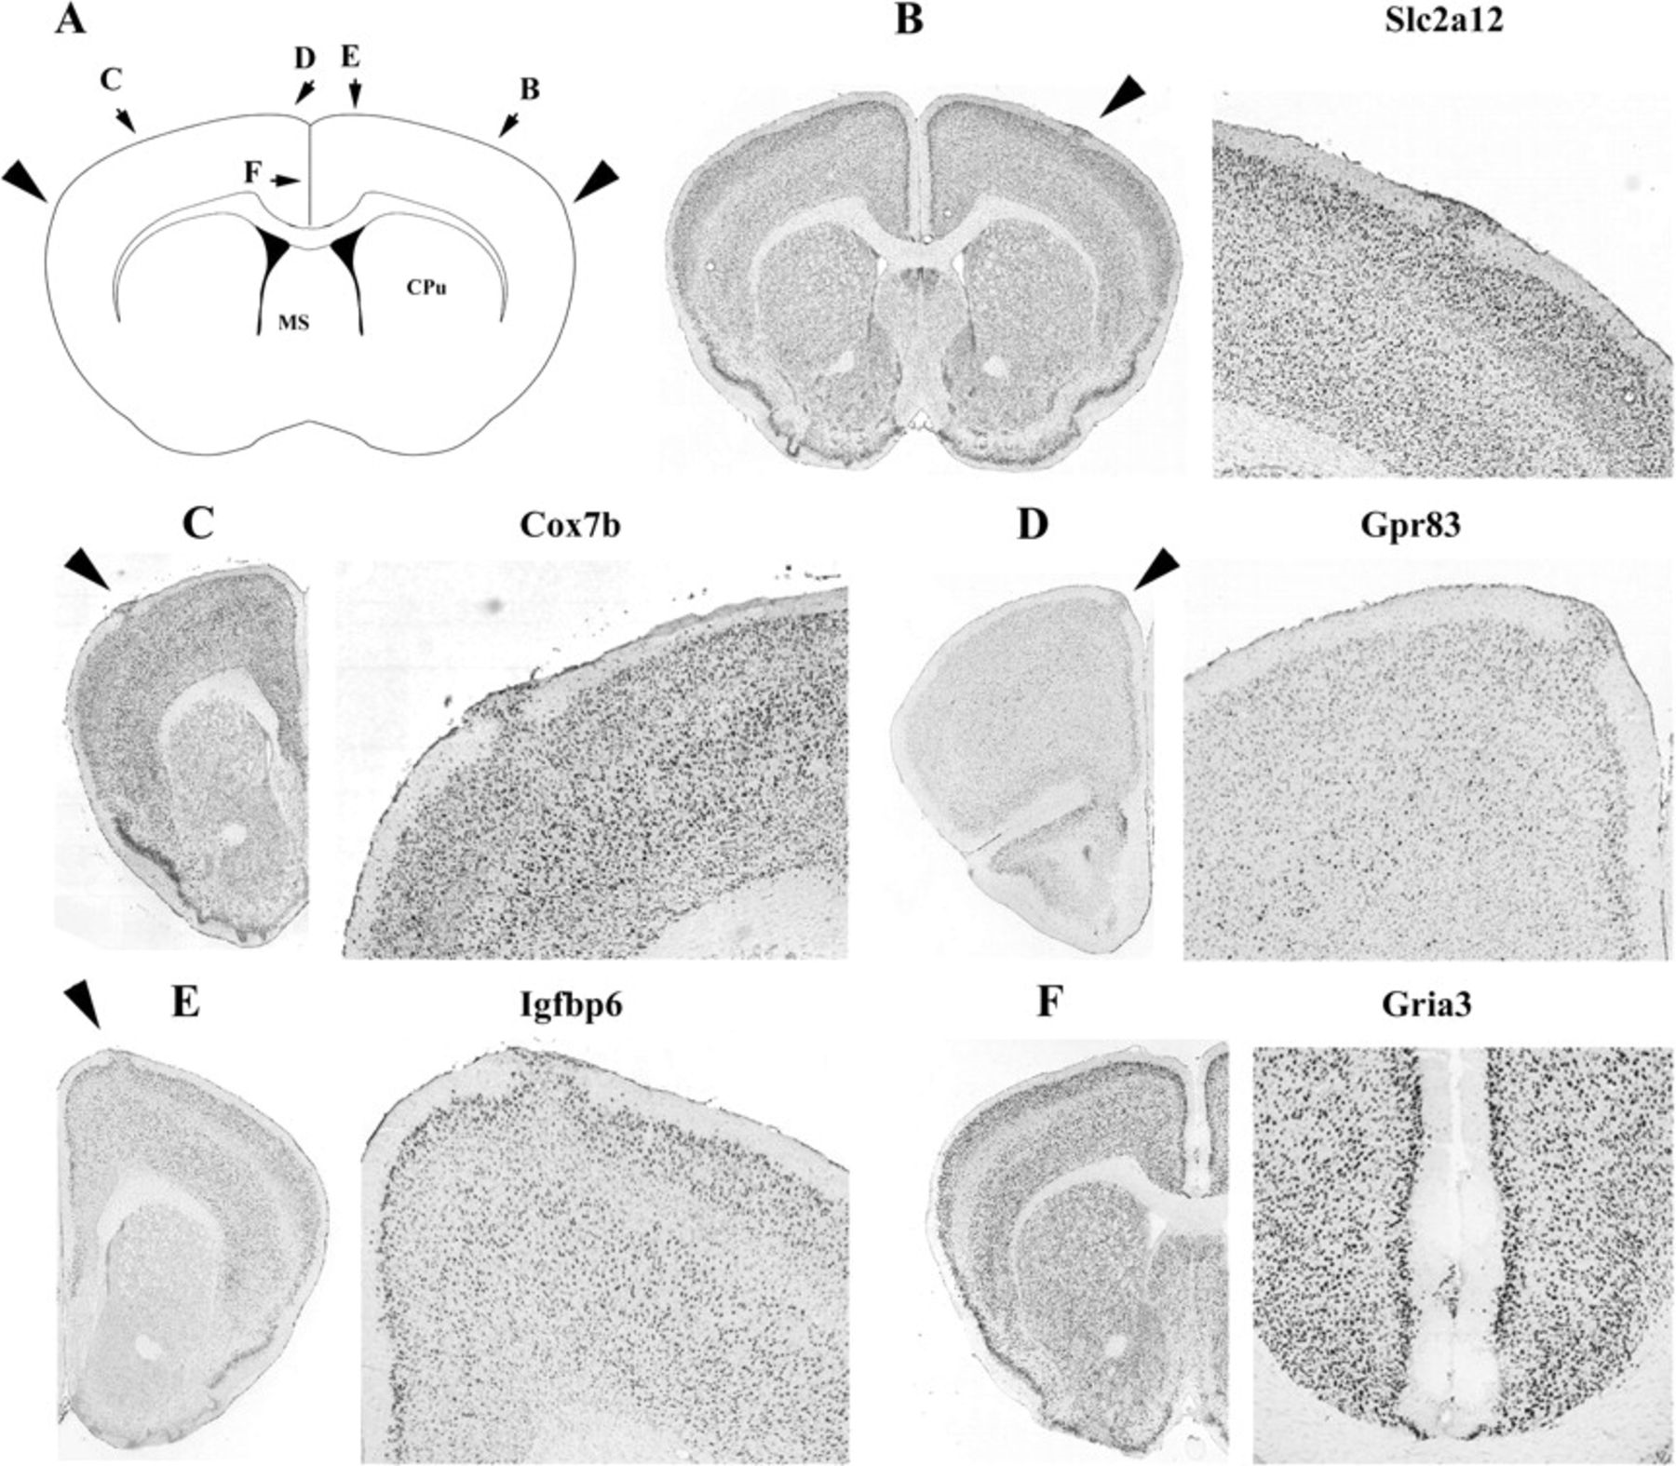
Figure 2. Medio-lateral extent of observed molecular layer heterotopia. (A) Illustration of a coronal mouse section. ...
Notes:
Figure 2. Medio-lateral extent of observed molecular layer heterotopia. (A) Illustration of a coronal mouse section. Arrowheads point to the aerial extent to which heterotopia was observed. Small-labeled arrows in (A) refer to other panels with heterotopia found at different positions. (B–F) Representative examples of heterotopia observed in the ABA. Hybridized gene listed next to each micrograph taken from ABA.
Unless provided in the caption above, the following copyright applies to the content of this slide: © The Author 2008. Published by Oxford University Press. All rights reserved. For permissions, please e-mail: journals.permissions@oxfordjournals.org

Slide 3
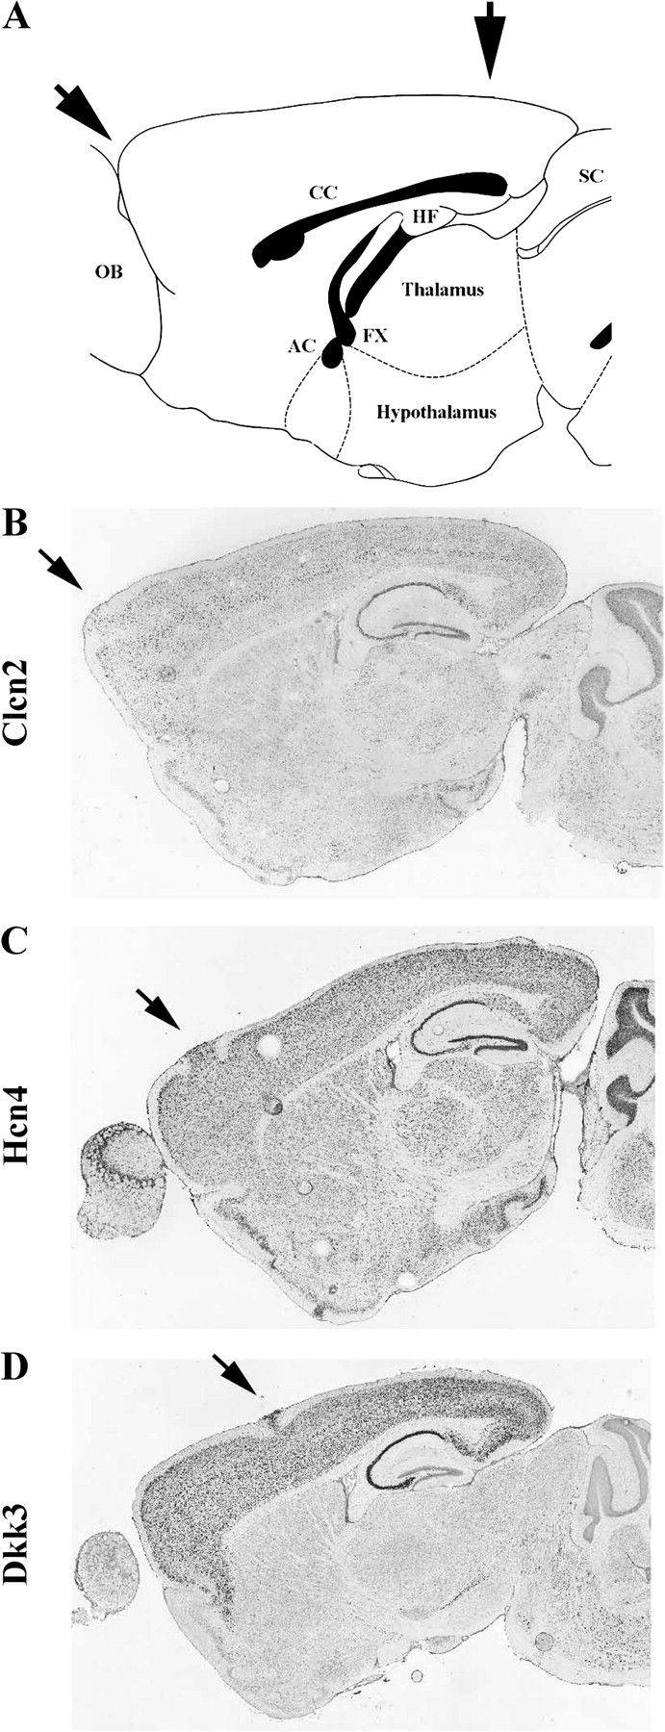
Figure 3. Rostro-caudal extent of observed dorsal cortical heterotopia. (A) Illustration of a mid-sagittal mouse ...
Notes:
Figure 3. Rostro-caudal extent of observed dorsal cortical heterotopia. (A) Illustration of a mid-sagittal mouse section. Arrows point to the aerial extent to which heterotopia was observed. (B–D) Representative examples of heterotopia observed in the ABA. Hybridized gene listed next to each micrograph taken from ABA.
Unless provided in the caption above, the following copyright applies to the content of this slide: © The Author 2008. Published by Oxford University Press. All rights reserved. For permissions, please e-mail: journals.permissions@oxfordjournals.org

Slide 4
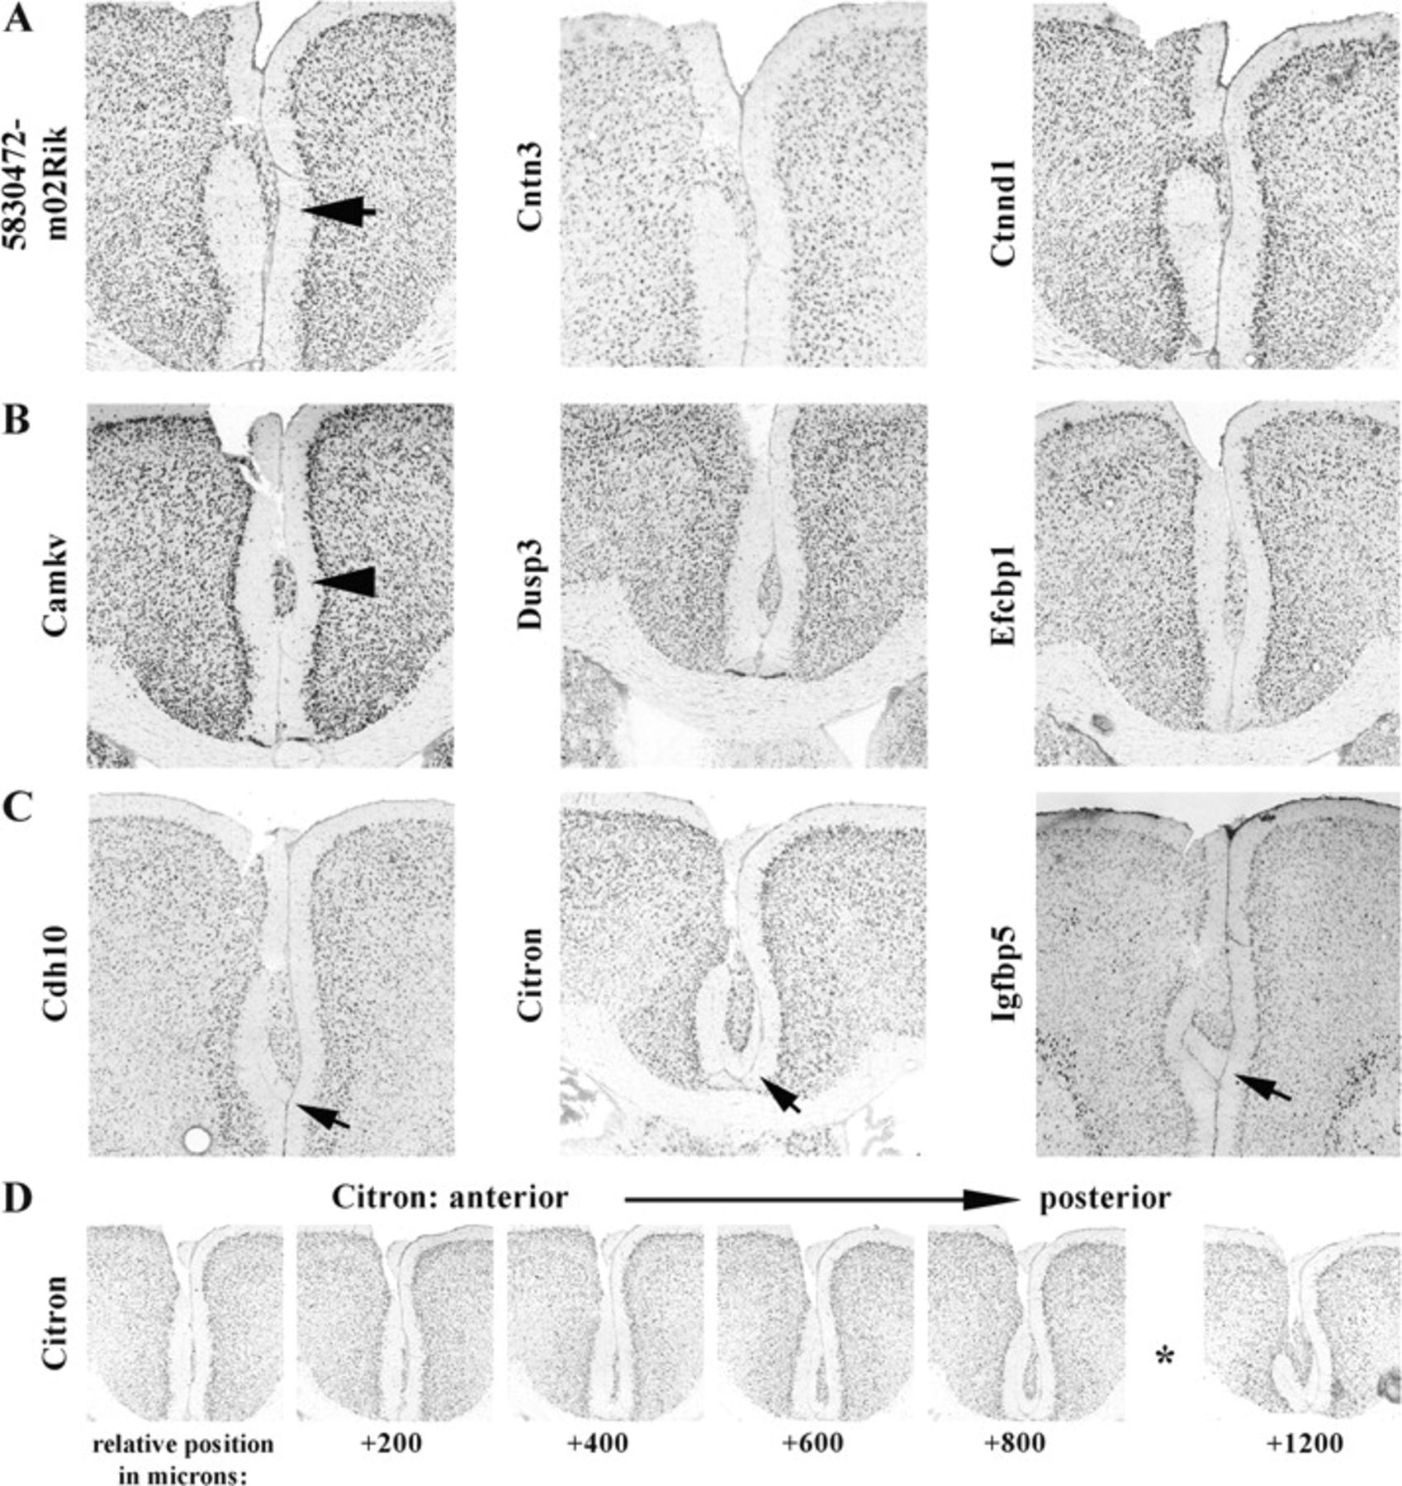
Figure 4. Midline molecular layer heterotopia. (A) Representative examples of heterotopia observed in the ABA with ...
Notes:
Figure 4. Midline molecular layer heterotopia. (A) Representative examples of heterotopia observed in the ABA with cells found in the molecular layer as well as in between the molecular layers of the 2 cortical hemispheres (arrow). (B) Representative examples of heterotopia observed in the ABA with cells in between the molecular layers of the 2 cortical hemispheres but without any apparent cells in the molecular (arrowhead). (C) Representative examples of heterotopia observed in the ABA with cells in between the molecular layers with additional alterations in white matter (arrows). (D) Serial sections from brain hybridized for Citron (same as in middle panel C) demonstrating cytoarchitecture and rostro-caudal extent of heterotopia. Asterisk denotes position corresponding to micrograph found in panel (C). Hybridized gene listed next to each micrograph taken from ABA.
Unless provided in the caption above, the following copyright applies to the content of this slide: © The Author 2008. Published by Oxford University Press. All rights reserved. For permissions, please e-mail: journals.permissions@oxfordjournals.org

Slide 5
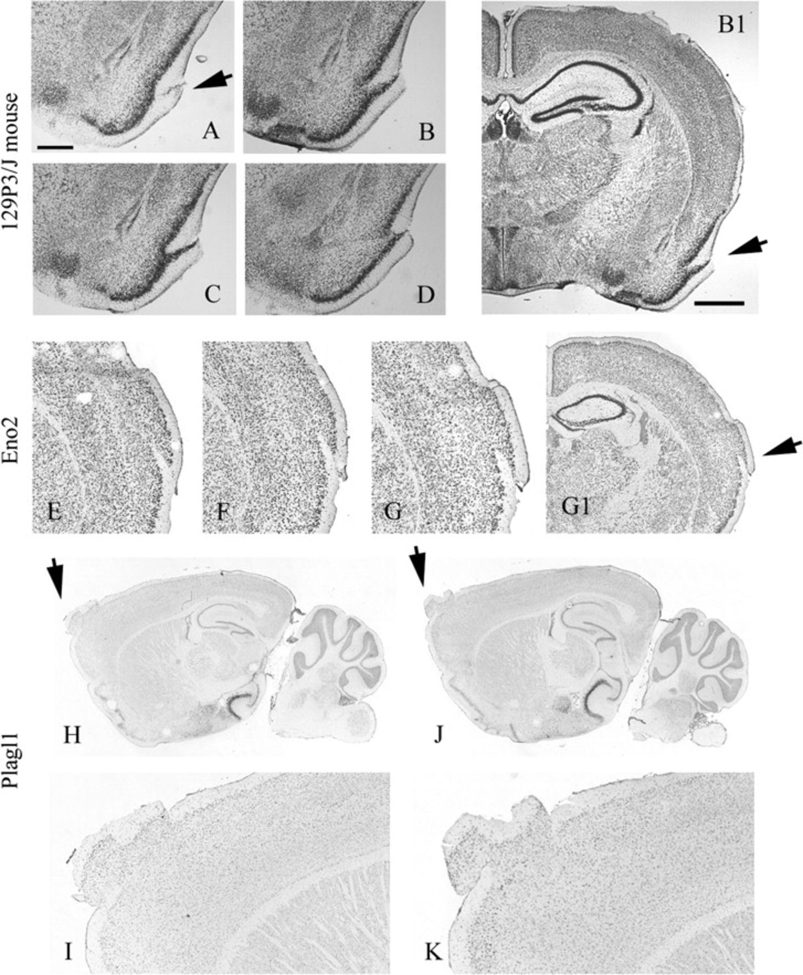
Figure 5. Other observed malformations with complex cytoarchitecture. (A–D) Micrographs from a 129P3/J mouse with a ...
Notes:
Figure 5. Other observed malformations with complex cytoarchitecture. (A–D) Micrographs from a 129P3/J mouse with a complex malformation. Rostral–caudal, serial sections (100-μm intervals) shown in (A–D). Low magnification of (B) shown in (B1). (E–K) Data from the ABA. (E–G1) Rostro-caudal, serial sections (200-μm intervals) of mouse brain hybridized for Eno2. Low magnification of (G) shown in (G1). (H–K) Rostro-caudal, serial sections (200-μm intervals) of mouse brain hybridized for Plagl1. High magnification of (H) and (J) shown in (I) and (K), respectively. Hybridized gene listed next to each micrograph taken from ABA.
Unless provided in the caption above, the following copyright applies to the content of this slide: © The Author 2008. Published by Oxford University Press. All rights reserved. For permissions, please e-mail: journals.permissions@oxfordjournals.org

Slide 6
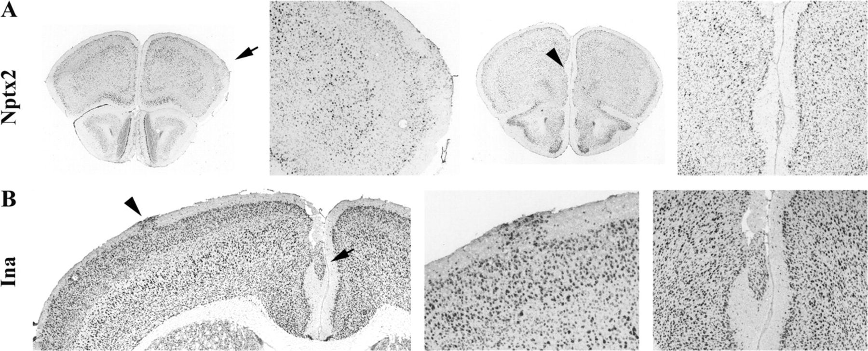
Figure 6. Multiple heterotopia found in individual brains. Representative photomicrographs taken from hybridized tissue ...
Notes:
Figure 6. Multiple heterotopia found in individual brains. Representative photomicrographs taken from hybridized tissue found in the ABA (A, B). Midline and dorsal cortical heterotopia indicated by arrows and arrowheads, respectively. Hybridized gene listed next to each micrograph taken from ABA.
Unless provided in the caption above, the following copyright applies to the content of this slide: © The Author 2008. Published by Oxford University Press. All rights reserved. For permissions, please e-mail: journals.permissions@oxfordjournals.org

Slide 7
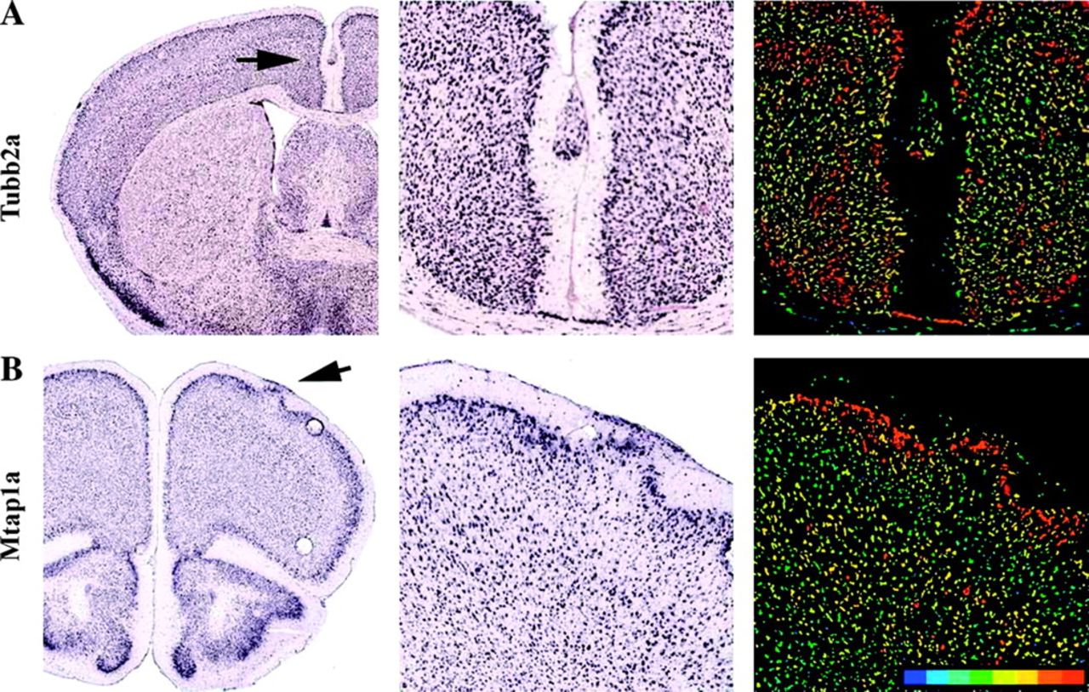
Figure 7. Cellular constituents of malformations include neurons. Representative photomicrographs taken from the ABA ...
Notes:
Figure 7. Cellular constituents of malformations include neurons. Representative photomicrographs taken from the ABA containing a dorsal (A) and midline (B) heterotopia and hybridized for genes enriched in neurons. Magnified images found in middle (ISH) and right (colorimetric) panels. Hybridized gene listed next to each micrograph taken from ABA.
Unless provided in the caption above, the following copyright applies to the content of this slide: © The Author 2008. Published by Oxford University Press. All rights reserved. For permissions, please e-mail: journals.permissions@oxfordjournals.org

Slide 8
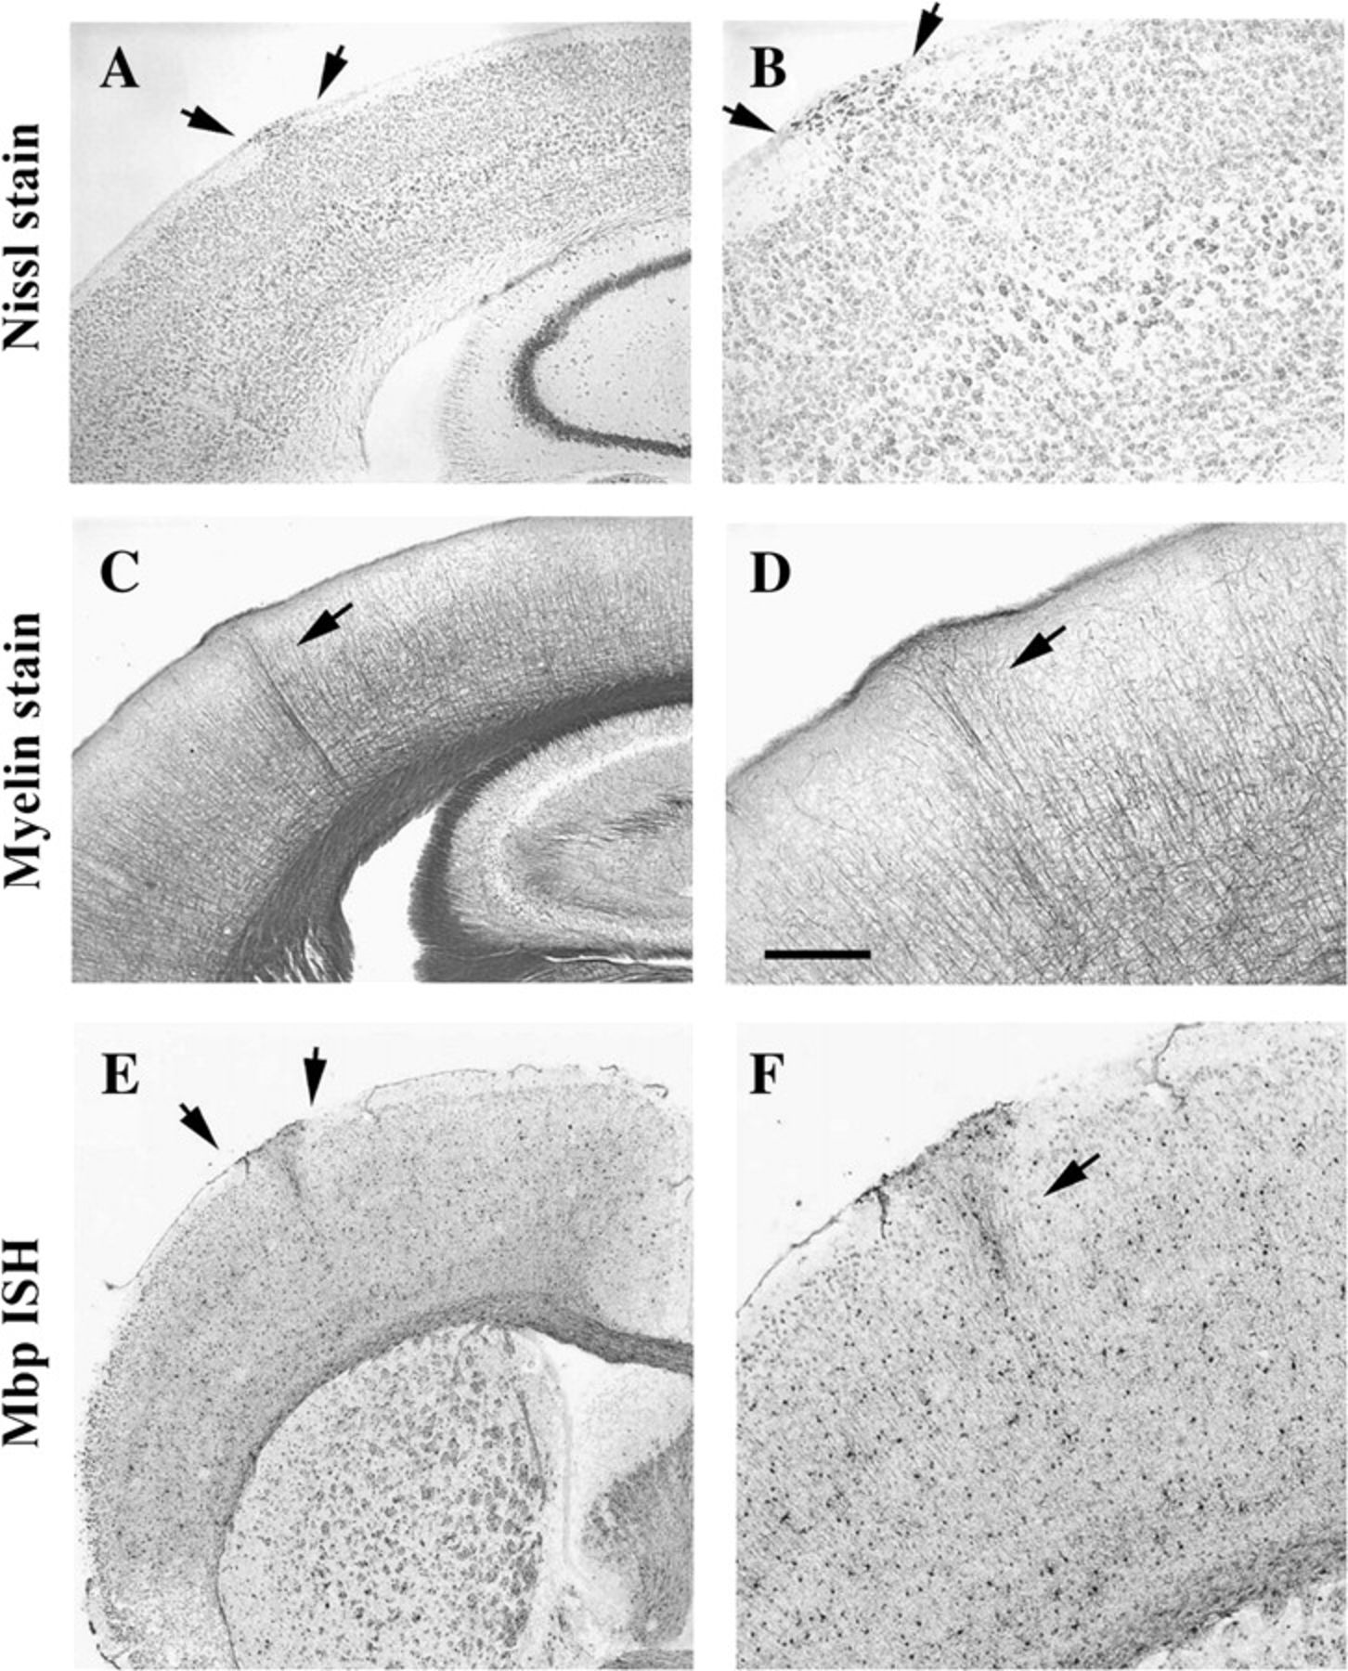
Figure 8. Changes in myelinated axons and oligodendrocytes found in dorsal heterotopia. Representative photomicrographs ...
Notes:
Figure 8. Changes in myelinated axons and oligodendrocytes found in dorsal heterotopia. Representative photomicrographs of Nissl (A, B) and myelin-stained (C, D) sections. Structural changes in myelinated axons found within a column extending from the white matter up to the pial surface. (E–F) Images from ABA for case hybridized for Mbp demonstrating labeled cells in a heterotopion.
Unless provided in the caption above, the following copyright applies to the content of this slide: © The Author 2008. Published by Oxford University Press. All rights reserved. For permissions, please e-mail: journals.permissions@oxfordjournals.org

Slide 9
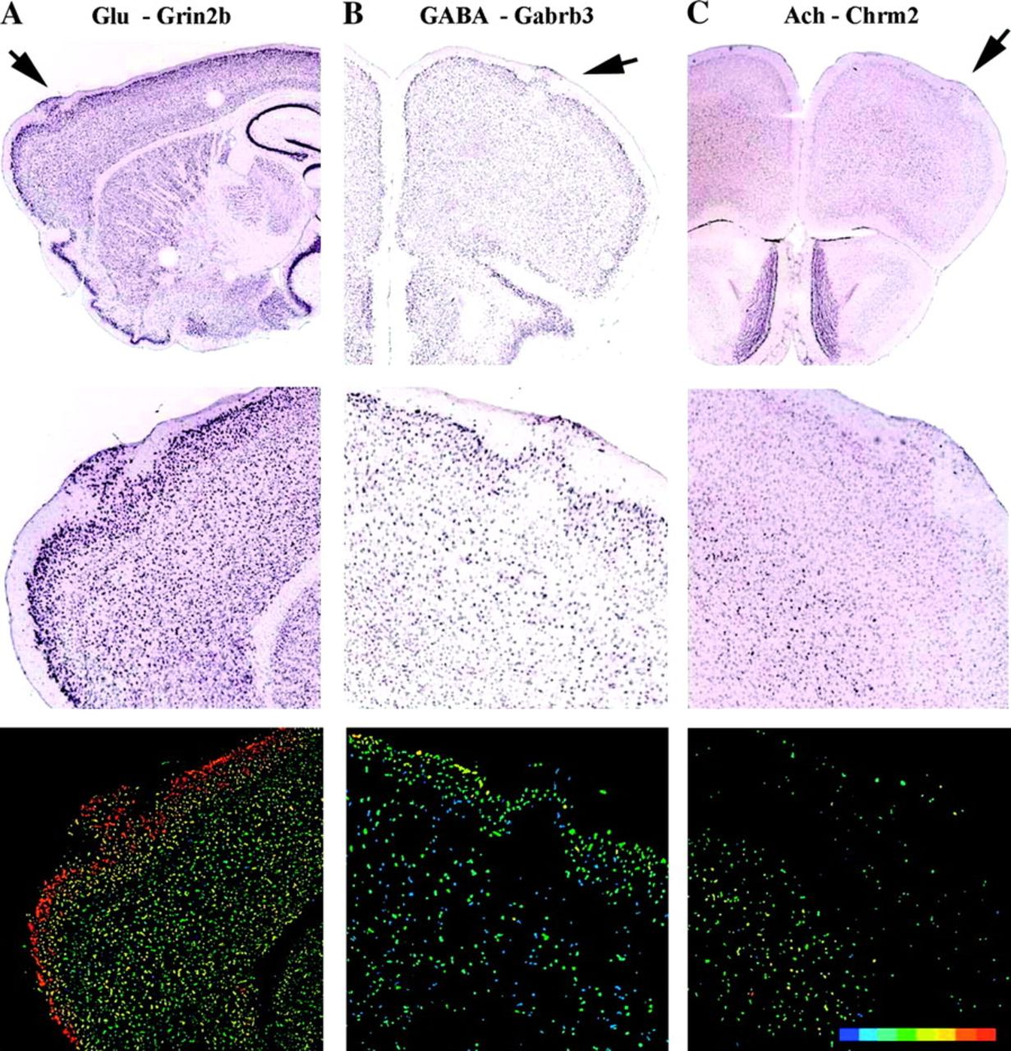
Figure 9. Neurotransmitter receptor expression in heterotopia. Images from ABA for tissue hybridized for Glu (A), GABA ...
Notes:
Figure 9. Neurotransmitter receptor expression in heterotopia. Images from ABA for tissue hybridized for Glu (A), GABA (B), and Ach (C) receptors. Magnified images found in middle (ISH) and bottom (colorimetric) panels.
Unless provided in the caption above, the following copyright applies to the content of this slide: © The Author 2008. Published by Oxford University Press. All rights reserved. For permissions, please e-mail: journals.permissions@oxfordjournals.org

Slide 10
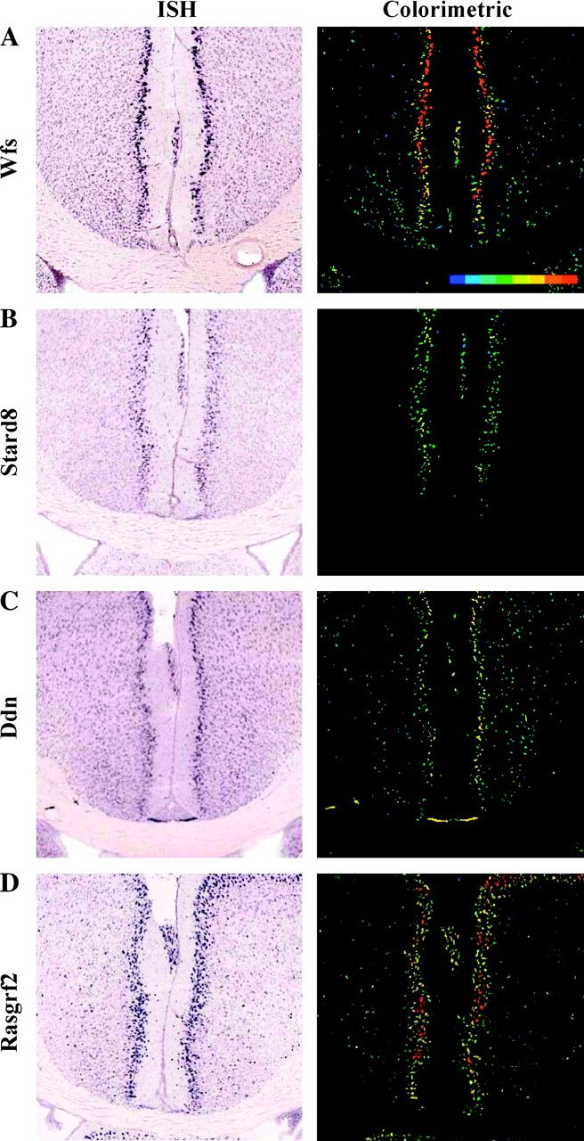
Figure 10. Cellular constituents of midline heterotopia. (A–D) Representative photomicrographs taken from the ABA ...
Notes:
Figure 10. Cellular constituents of midline heterotopia. (A–D) Representative photomicrographs taken from the ABA containing midline heterotopia and hybridized for genes enriched in layer II cells. Hybridization data shown on left and quantitative colorimetric scale shown on right. Hybridized gene listed next to each micrograph taken from ABA.
Unless provided in the caption above, the following copyright applies to the content of this slide: © The Author 2008. Published by Oxford University Press. All rights reserved. For permissions, please e-mail: journals.permissions@oxfordjournals.org

Slide 11
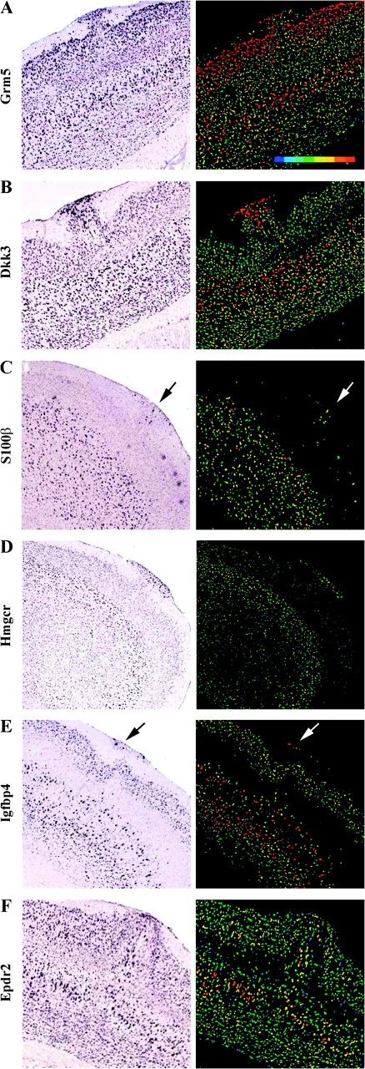
Figure 11. Cellular constituents of dorsal cortical heterotopia. (A–F) Representative photomicrographs taken from the ...
Notes:
Figure 11. Cellular constituents of dorsal cortical heterotopia. (A–F) Representative photomicrographs taken from the ABA containing dorsal cortical heterotopia and hybridized for genes enriched in upper or deep-layer cells. Hybridization data shown on left and quantitative colorimetric scale shown on right. Hybridized gene listed next to each micrograph taken from ABA.
Unless provided in the caption above, the following copyright applies to the content of this slide: © The Author 2008. Published by Oxford University Press. All rights reserved. For permissions, please e-mail: journals.permissions@oxfordjournals.org

Slide 12
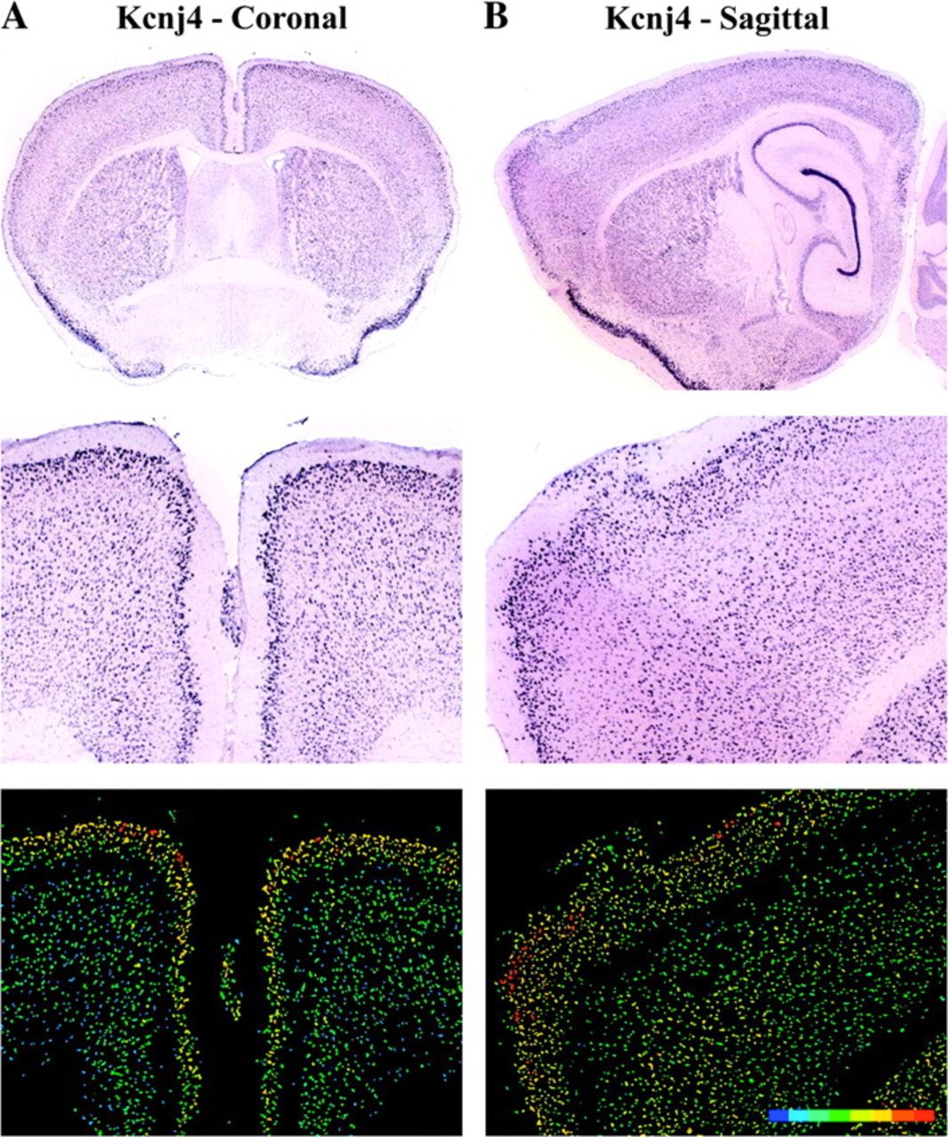
Figure 12. No change in expression density in cells found in heterotopia. Data from ABA where multiple brains, each ...
Notes:
Figure 12. No change in expression density in cells found in heterotopia. Data from ABA where multiple brains, each containing a heterotopia, were hybrid for the same gene, Kcnj4. Left panels (A) from brain cut along coronal plane containing a midline heterotopia. Right panels (B) from brain cut along sagittal plane containing a dorsal cortical heterotopia. Magnified images found in middle (ISH) and bottom (colorimetric) panels.
Unless provided in the caption above, the following copyright applies to the content of this slide: © The Author 2008. Published by Oxford University Press. All rights reserved. For permissions, please e-mail: journals.permissions@oxfordjournals.org

