Slide 1
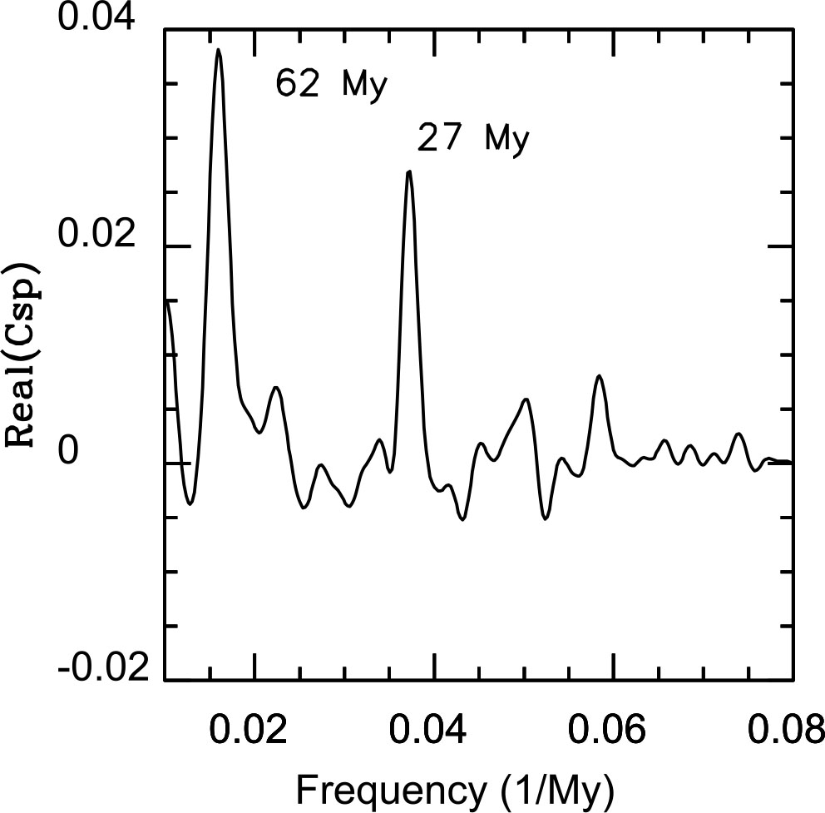
Figure 1 The real part of the cross-spectrum of fluctuations of extinction intensity against frequency in ...
Notes:
Figure 1 The real part of the cross-spectrum of fluctuations of extinction intensity against frequency in Myr−1 for the two data sets used here. The large peak on the left corresponds to a period of 62 Myr in total biodiversity, studied elsewhere. The narrow peak on the right corresponds to a period of 27 Myr in phase with the original Raup & Sepkoski (1984) extinction periodicity which led to the suggestion of Nemesis. Negative values are indicative of random error, and positive values phase agreement between the independent data sets.
Unless provided in the caption above, the following copyright applies to the content of this slide: © 2010 The Authors. Journal compilation © 2010 RAS

Slide 2
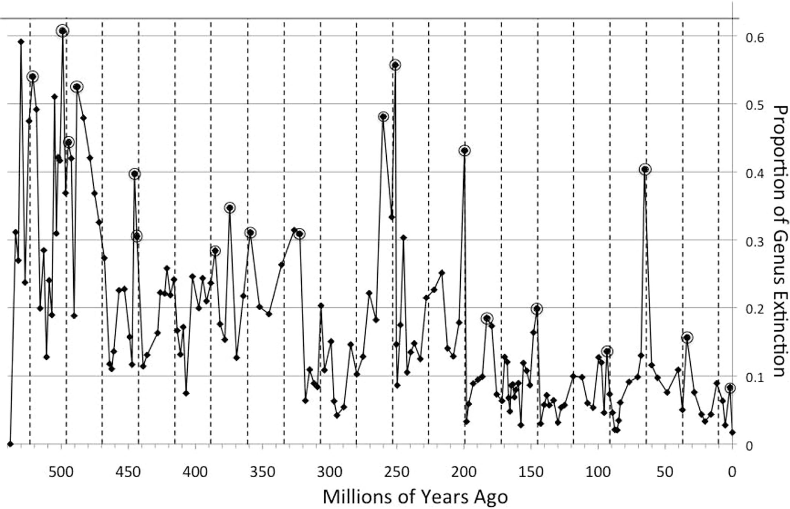
Figure 2 A plot of extinction intensity (genera going extinct divided by total extant genera) at the substage level ...
Notes:
Figure 2 A plot of extinction intensity (genera going extinct divided by total extant genera) at the substage level from the Sepkoski data. Extinction dates are taken as end dates of intervals as described in the text. Events meeting the criteria for ‘mass extinctions’ in the review of Bambach (2006) are circled. It is visually apparent that a large proportion of the circled points lie near the vertical lines which mark off a 27-Myr interval. In the text we show a probability of p≤ 0.01 that this can be a random alignment.
Unless provided in the caption above, the following copyright applies to the content of this slide: © 2010 The Authors. Journal compilation © 2010 RAS

