Slide 1
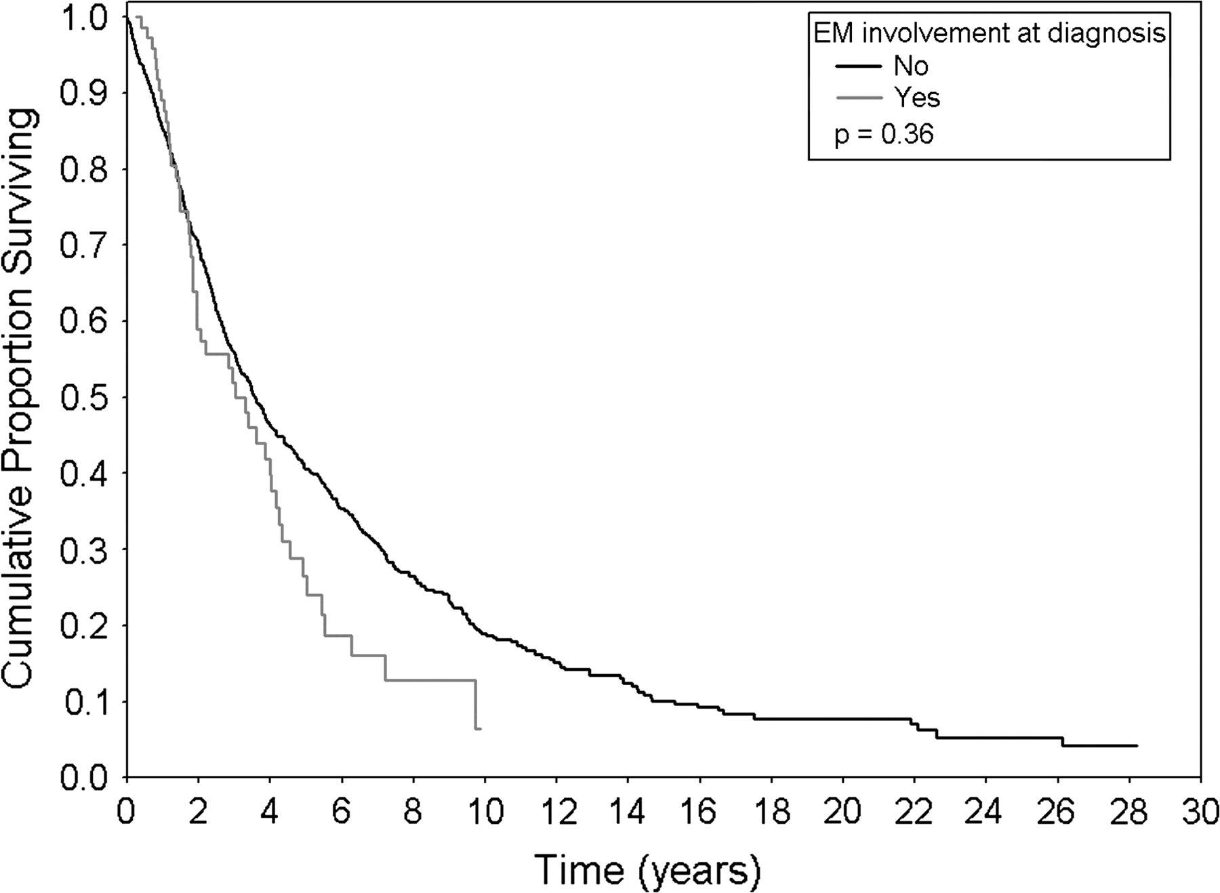
Figure 2. Overall survival according to the presence of extramedullary (EM) involvement at diagnosis.
Notes:
Figure 2. Overall survival according to the presence of extramedullary (EM) involvement at diagnosis.
Unless provided in the caption above, the following copyright applies to the content of this slide: © The Author 2009. Published by Oxford University Press on behalf of the European Society for Medical Oncology. All rights reserved. For permissions, please email: journals.permissions@oxfordjournals.org

Slide 2
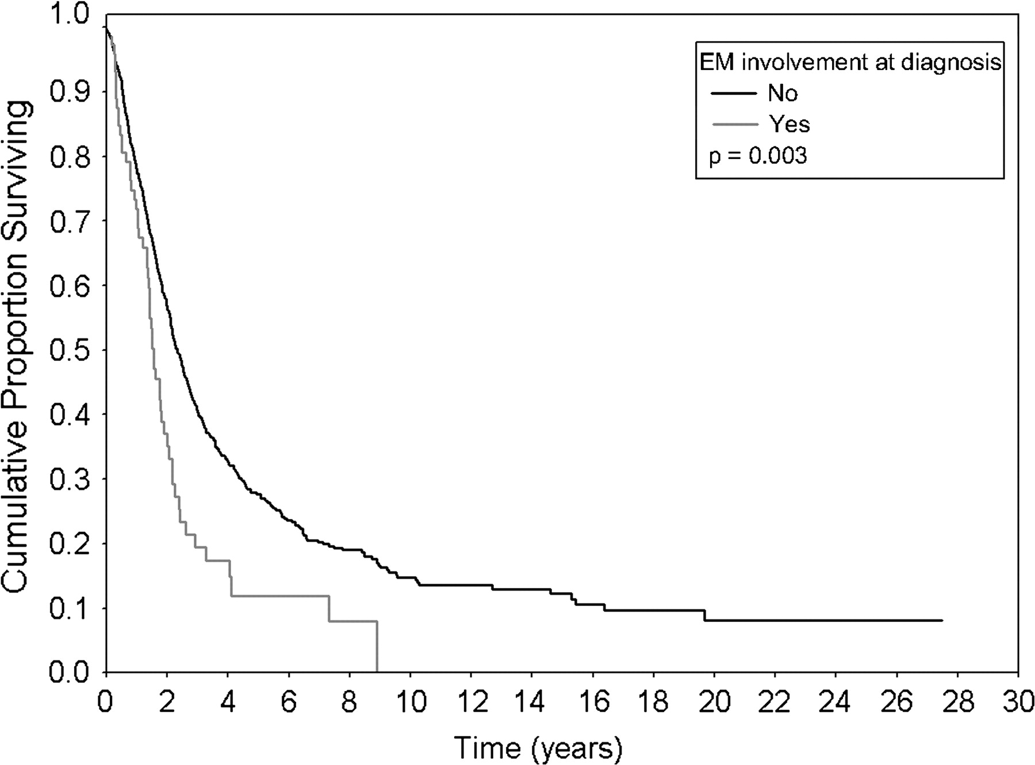
Figure 1. Progression-free survival according to the presence of extramedullary (EM) involvement at diagnosis.
Notes:
Figure 1. Progression-free survival according to the presence of extramedullary (EM) involvement at diagnosis.
Unless provided in the caption above, the following copyright applies to the content of this slide: © The Author 2009. Published by Oxford University Press on behalf of the European Society for Medical Oncology. All rights reserved. For permissions, please email: journals.permissions@oxfordjournals.org

