Slide 1
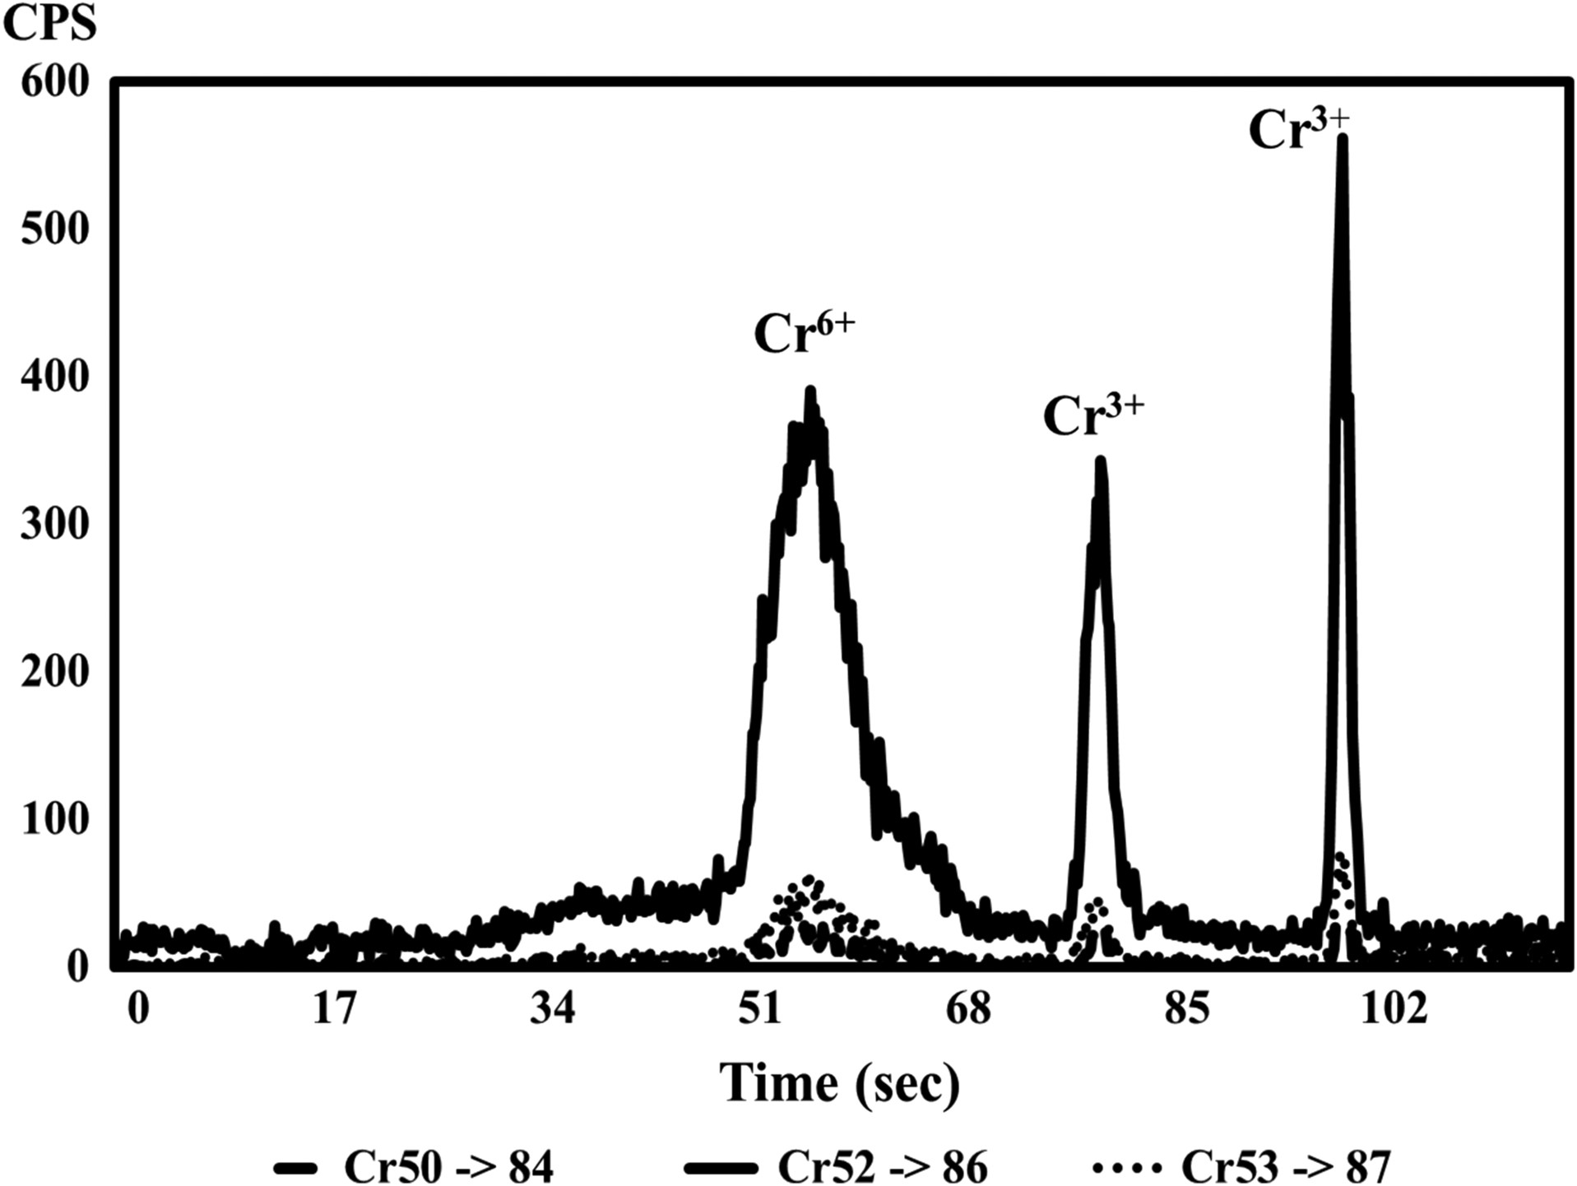
Figure 1. ETV-ICP-MS vaporizogram of unspiked chromium in diluted particulate matter from mainstream smoke of a CORESTA ...
Notes:
Figure 1. ETV-ICP-MS vaporizogram of unspiked chromium in diluted particulate matter from mainstream smoke of a CORESTA Monitor 7 cigarette.
Unless provided in the caption above, the following copyright applies to the content of this slide: Published by Oxford University Press 2017. This work is written by (a) US Government employee(s) and is in the public domain in the US.

Slide 2
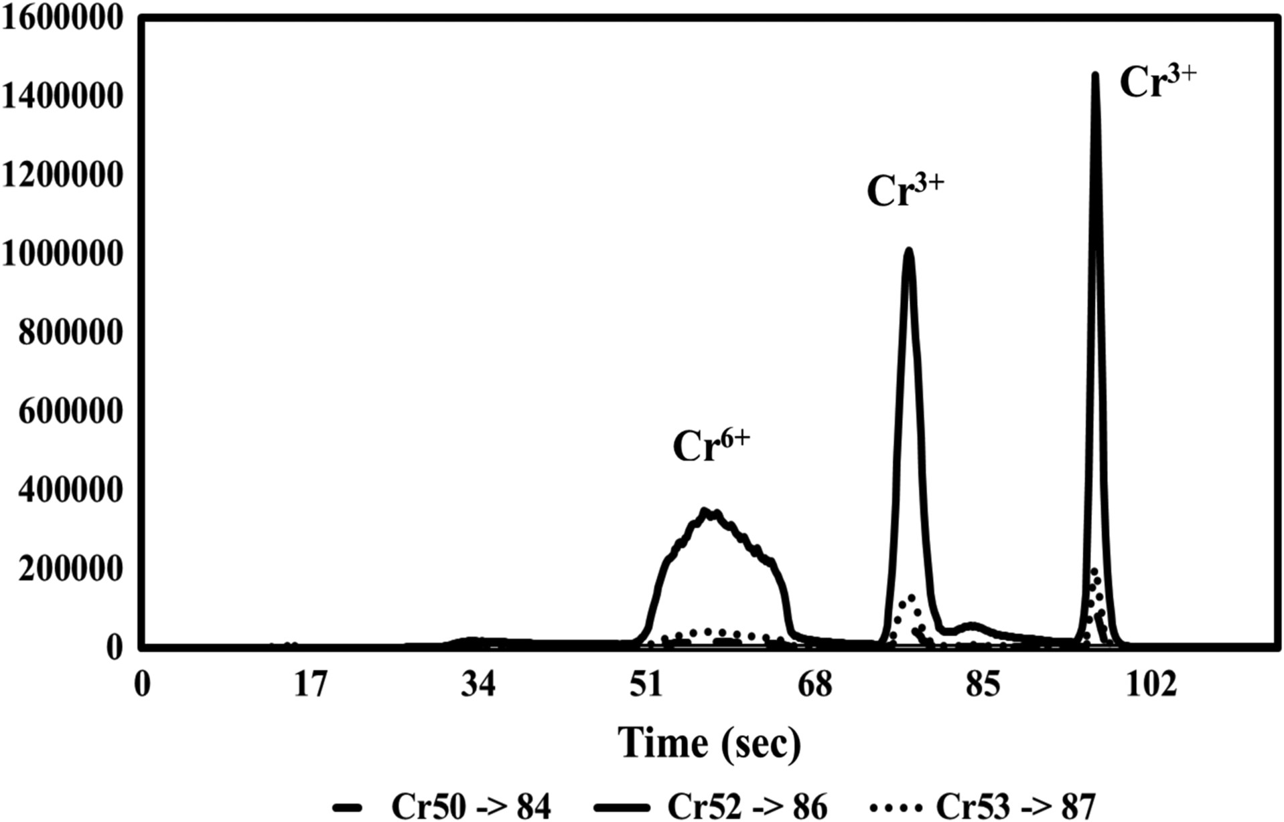
Figure 2. ETV-ICP-MS vaporizogram of chromium in diluted particulate matter from mainstream smoke of a CORESTA Monitor ...
Notes:
Figure 2. ETV-ICP-MS vaporizogram of chromium in diluted particulate matter from mainstream smoke of a CORESTA Monitor 7 cigarette spiked with 67 ng natural Cr3+.
Unless provided in the caption above, the following copyright applies to the content of this slide: Published by Oxford University Press 2017. This work is written by (a) US Government employee(s) and is in the public domain in the US.

Slide 3
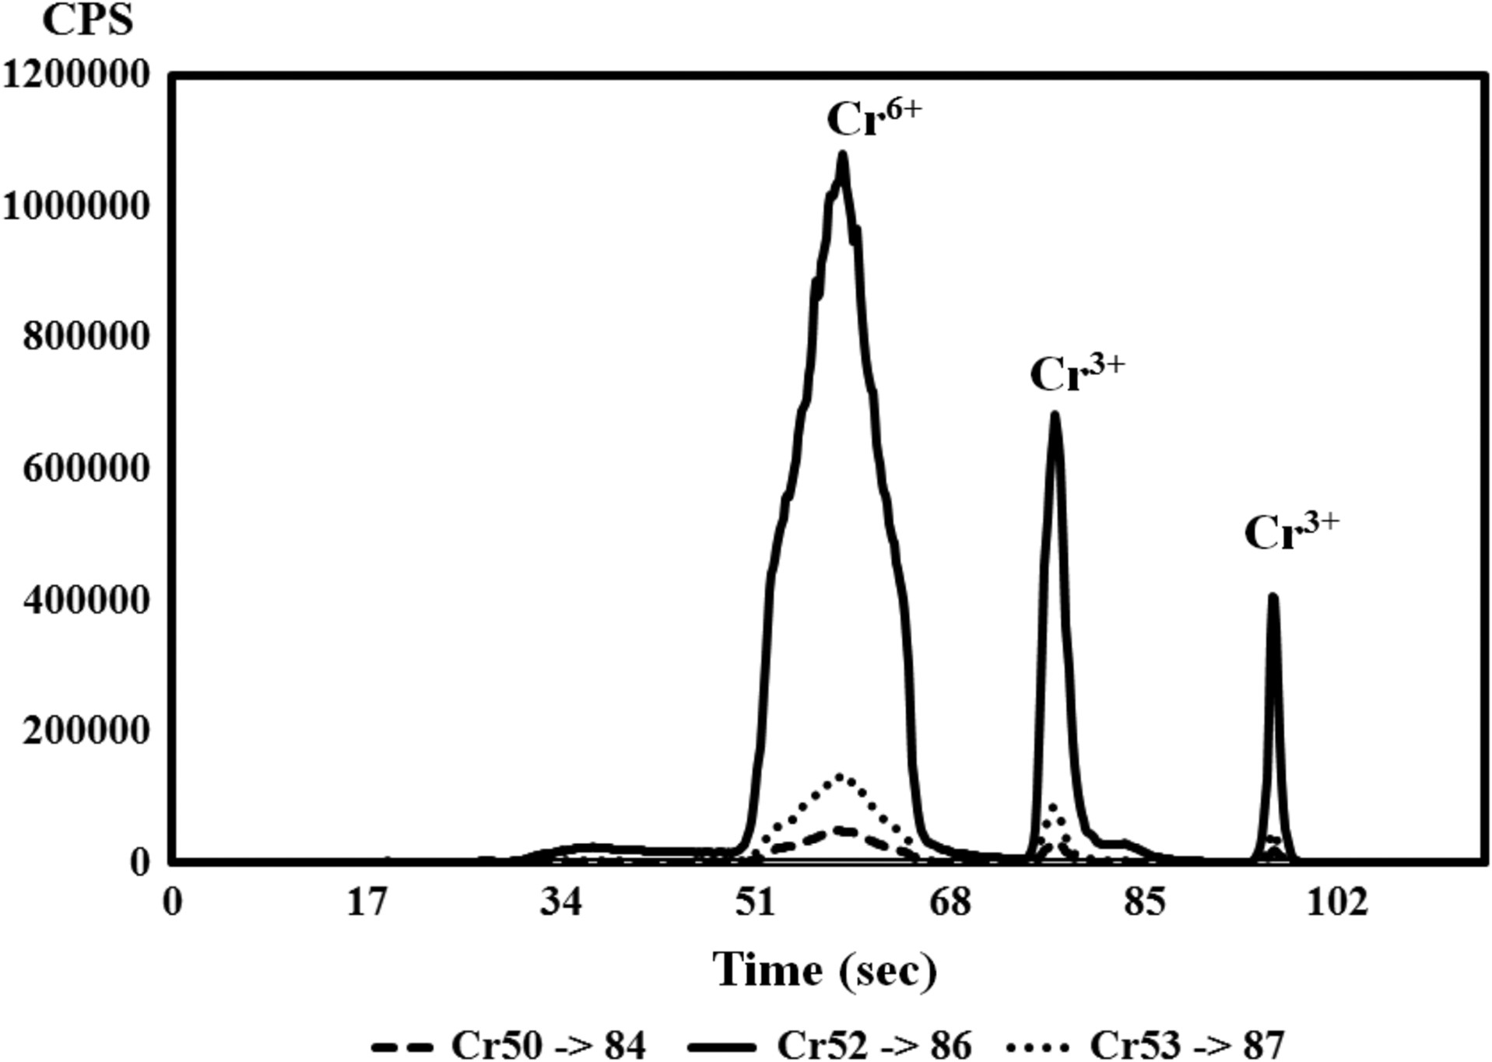
Figure 3. ETV-ICP-MS vaporizogram of chromium in diluted particulate matter from mainstream smoke of a CORESTA Monitor ...
Notes:
Figure 3. ETV-ICP-MS vaporizogram of chromium in diluted particulate matter from mainstream smoke of a CORESTA Monitor 7 cigarette spiked with 67 ng natural Cr6+.
Unless provided in the caption above, the following copyright applies to the content of this slide: Published by Oxford University Press 2017. This work is written by (a) US Government employee(s) and is in the public domain in the US.

