Slide 1
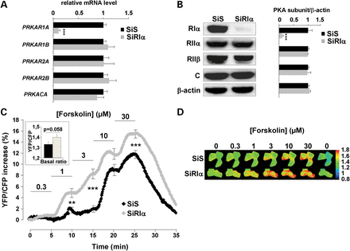
Figure 1. PRKAR1A silencing and real-time monitoring of global PKA activity with AKAR3 in HEK293 cells. (A) ...
Notes:
Figure 1. PRKAR1A silencing and real-time monitoring of global PKA activity with AKAR3 in HEK293 cells. (A) Quantitative PCR analysis and (B) western blot analysis of PKA regulatory subunits RIα, RIIα, RIIβ and catalytic C subunit in HEK293 cells 48 h after transfection with either scrambled (SiS) or RIα-specific (SiRIα) siRNA. PPIA (CYCLO) gene expression was used as reference in PCR. β-Actin was used as loading control in western blot. Data represent the average of four- and three-independent experiments for qPCR and western blot analysis, respectively. (C) HEK293 cells were cotransfected with AKAR3 and either SiS or SiRIα and FRET measurements were performed 48 h after. Average time course of the normalized YFP/CFP ratio upon challenge with increasing concentrations of forskolin (SiS, n = 61; SiRIα, n = 61). Each forskolin concentration was applied for 5 min, as indicated by the solid lines. Error bars at the end of each application indicate SEM. Bar graph in inset shows average basal YFP/CFP ratio value before forskolin application. Statistically significant differences between SiS and SiRIα are indicated as **P < 0.01; ***P < 0.001. (D) Pseudocolor images illustrate the variations of the YFP/CFP emission ratio elicited by forskolin in SiS- and SiRIα-transfected cells.
Unless provided in the caption above, the following copyright applies to the content of this slide: © The Author 2013. Published by Oxford University Press. All rights reserved. For Permissions, please email: journals.permissions@oup.com

Slide 2
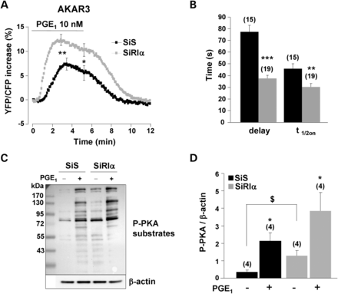
Figure 2. Upregulation of global PKA activity in RIα-deficient HEK293 cells. (A) Average time course of the normalized ...
Notes:
Figure 2. Upregulation of global PKA activity in RIα-deficient HEK293 cells. (A) Average time course of the normalized YFP/CFP ratio upon PGE1 (10 nm) stimulation in control cells (SiS, n = 15) and RIα-deficient cells (SiRIα, n = 19) expressing AKAR3. PGE1 application started at time zero and lasted 5min before washout. SEM is indicated at the peak and at the end of the PGE1 application. Statistically significant differences between SiS and SiRIα are indicated as *P < 0.05, **P < 0.01. (B) Kinetic parameters of the PGE1 response in the experiments depicted in (A). The delay between the application of PGE1 and the initial response (Delay) and the time required to reach half-maximal response (t1/2on) are indicated. Statistically significant differences between groups are indicated as **P < 0.01, ***P < 0.001. (C) Phosphorylation of PKA substrates as detected with a Phospho-PKA substrate antibody in total proteins (50 µg/lane) from HEK293 cells transfected with SiS or SiRIα and stimulated or not with 10 nm PGE1 for 3 min. (D) Quantification of four-independent experiments as in (C). In each experimental condition, the entire lane was quantified and normalized to β-actin. Statistically significant differences are indicated as *P < 0.05 between control and PGE1 and as $P < 0.05 between SiS and SiRIα.
Unless provided in the caption above, the following copyright applies to the content of this slide: © The Author 2013. Published by Oxford University Press. All rights reserved. For Permissions, please email: journals.permissions@oup.com

Slide 3
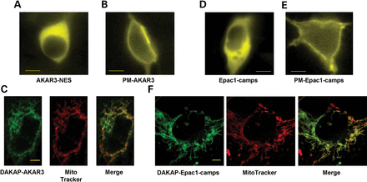
Figure 3. Subcellular localization of AKAR3 and Epac1-camps indicators in HEK293 cells. All images were taken 48 h ...
Notes:
Figure 3. Subcellular localization of AKAR3 and Epac1-camps indicators in HEK293 cells. All images were taken 48 h after transfection of the various FRET sensors. YFP images of representative cells transfected with AKAR3-NES (A), PM-AKAR3 (B), Epac1-camps (D) and PM-Epac1-camps (E) obtained with epifluorescent microscopy. Scale bars: 10 µm. (C)Confocal YFP images of DAKAP-AKAR3, MitoTracker® Red staining and colocalization (Pearson's coefficient: 0.87). (F) Confocal YFP images of DAKAP-Epac1-camps, MitoTracker® Red staining and colocalization (Pearson's coefficient: 0.78). In (C) and (F) scale bars represent 5 µm.
Unless provided in the caption above, the following copyright applies to the content of this slide: © The Author 2013. Published by Oxford University Press. All rights reserved. For Permissions, please email: journals.permissions@oup.com

Slide 4
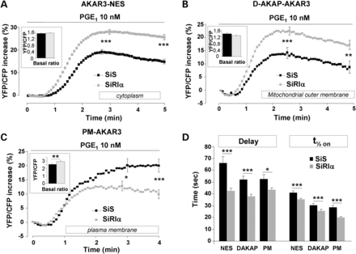
Figure 4. Comparative effects of PGE₁ on PKA activity in distinct subcellular compartments of control and ...
Notes:
Figure 4. Comparative effects of PGE1 on PKA activity in distinct subcellular compartments of control and RIα-deficient HEK293 cells. Average time course of PKA activation by 10 nm PGE1 in (A) the cytoplasm, as monitored with AKAR3-NES (SiS, n = 105; SiRIα, n = 121); (B) the outer mitochondrial membrane, as reported by DAKAP-AKAR3 (SiS, n = 65; SiRIα, n = 87) and (C) the plasma membrane, as reported by PM-AKAR3 (SiS, n = 50; SiRIα, n = 97). (A–C) PGE1 application started at time zero and was maintained throughout the experiment as indicated by the solid line. SEM is indicated at the peak and at the end of the stimulation. The bar graphs in inset indicate the values of the average basal YFP/CFP ratio before PGE1 application. (D) Kinetic parameters (delay and t1/2on values) of PKA activation in the experiments as in (A–C). Statistically significant differences are indicated as *P < 0.05; **P < 0.01; ***P < 0.001.
Unless provided in the caption above, the following copyright applies to the content of this slide: © The Author 2013. Published by Oxford University Press. All rights reserved. For Permissions, please email: journals.permissions@oup.com

Slide 5
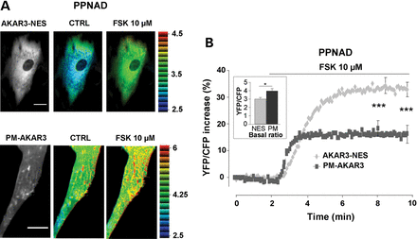
Figure 5. PKA activity gradients in human adrenal cells from patients with PPNAD disease. (A) Left: YFP images of PPNAD ...
Notes:
Figure 5. PKA activity gradients in human adrenal cells from patients with PPNAD disease. (A) Left: YFP images of PPNAD cells expressing AKAR3-NES and PM-AKAR3 (scale bar = 20 µm). Right: intensity modulated display pseudocolor images of the YFP/CFP emission ratio in control Ringer solution (CTRL) and upon forskolin application (FSK 10 µm) in the same cells. (B) Average PKA activation by forskolin (FSK 10 µm) in the cytoplasm (n = 23 cells from two patients) and at the plasma membrane (n = 16 cells from two patients). Bar graph in inset shows average basal YFP/CFP ratio values obtained with AKAR3-NES in the cytoplasm (NES) and with PM-AKAR3 at the plasma membrane (PM). Statistically significant differences are indicated as *P < 0.05; ***P < 0.001.
Unless provided in the caption above, the following copyright applies to the content of this slide: © The Author 2013. Published by Oxford University Press. All rights reserved. For Permissions, please email: journals.permissions@oup.com

Slide 6
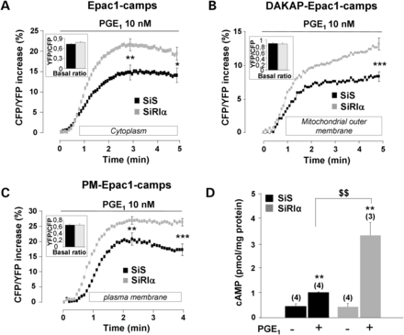
Figure 6. Upregulation of cAMP levels after PGE₁ stimulation in RIα-deficient HEK293 cells. Average time ...
Notes:
Figure 6. Upregulation of cAMP levels after PGE1 stimulation in RIα-deficient HEK293 cells. Average time course of cAMP elevation in response to 10 nm PGE1 in (A) the cytoplasm, as reported by the cAMP sensor Epac1-camps (SiS, n = 61; SiRIα, n = 76); (B) the outer mitochondrial membrane, as reported by DAKAP-Epac1-camps (SiS, n = 65; SiRIα, n = 60) and (C) the plasma membrane, as reported by PM-Epac1-camps (SiS, n = 66; SiRIα, n = 88). (A–C) PGE1 application started at time zero and was maintained throughout the experiment as indicated by the solid line. In (A) and (C), SEM is indicated at the peak and at the end of the stimulation, and in (B) at 5 min (corresponding to maximal value). (D) Total cAMP levels measured by enzyme immunoassay in SiS and SiRIα treated HEK293 cells challenged with 10 nm PGE1 for 5 min. Values are mean ± SEM. Statistically significant differences are indicated as **P < 0.05 between control and PGE1 and as $$P < 0.01 between SiS and SiRIα.
Unless provided in the caption above, the following copyright applies to the content of this slide: © The Author 2013. Published by Oxford University Press. All rights reserved. For Permissions, please email: journals.permissions@oup.com

