Slide 1
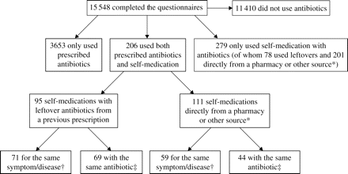
Figure 1 Flow chart describing antibiotic use in the past 12 months by the respondent. *Including antibiotics obtained ...
Notes:
Figure 1 Flow chart describing antibiotic use in the past 12 months by the respondent. *Including antibiotics obtained from relatives/friends, directly from a pharmacy/store from abroad or the Internet. †Prescribed use and self-medication for the same symptom/disease. ‡The same antibiotic for prescribed use and self-medication.
Unless provided in the caption above, the following copyright applies to the content of this slide: © The Author 2006. Published by Oxford University Press on behalf of the British Society for Antimicrobial Chemotherapy. All rights reserved. For Permissions, please e-mail: journals.permissions@oxfordjournals.org

