Slide 1
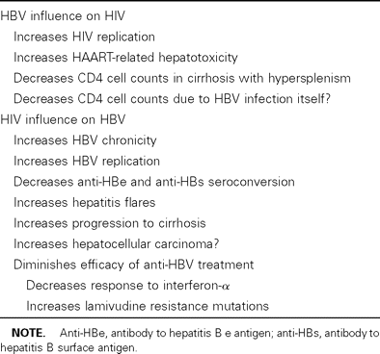
Table 1 Interferences between HIV and hepatitis B virus (HBV).
Notes:
Table 1 Interferences between HIV and hepatitis B virus (HBV).
Unless provided in the caption above, the following copyright applies to the content of this slide: © 2003 by the Infectious Diseases Society of America

Slide 2
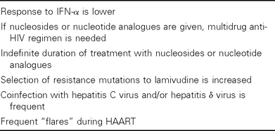
Table 2 Special considerations of anti–hepatitis B virus (HBV) treatment in patients with HIV infection.
Notes:
Table 2 Special considerations of anti–hepatitis B virus (HBV) treatment in patients with HIV infection.
Unless provided in the caption above, the following copyright applies to the content of this slide: © 2003 by the Infectious Diseases Society of America

Slide 3
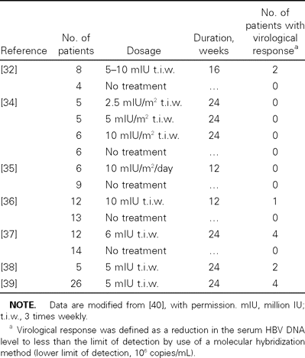
Table 3 Sustained response to IFN-α in hepatitis B virus (HBV)– and HIV-coinfected patients.
Notes:
Table 3 Sustained response to IFN-α in hepatitis B virus (HBV)– and HIV-coinfected patients.
Unless provided in the caption above, the following copyright applies to the content of this slide: © 2003 by the Infectious Diseases Society of America

Slide 4
Table 4 Efficacy of lamivudine against hepatitis B virus in HIV-coinfected patients.
Notes:
Table 4 Efficacy of lamivudine against hepatitis B virus in HIV-coinfected patients.
Unless provided in the caption above, the following copyright applies to the content of this slide: © 2003 by the Infectious Diseases Society of America

Slide 5
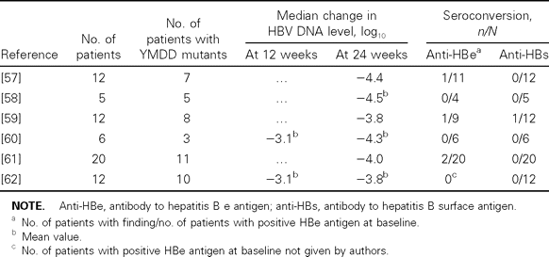
Table 5 Efficacy of tenofovir as anti-HBV treatment in HIV-coinfected subjects (results at 24 weeks).
Notes:
Table 5 Efficacy of tenofovir as anti-HBV treatment in HIV-coinfected subjects (results at 24 weeks).
Unless provided in the caption above, the following copyright applies to the content of this slide: © 2003 by the Infectious Diseases Society of America

Slide 6
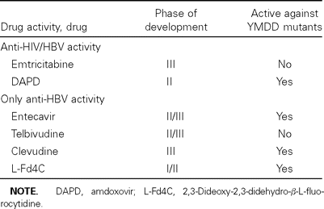
Table 6 New anti–hepatitis B virus (HBV) nucleoside analogues under development.
Notes:
Table 6 New anti–hepatitis B virus (HBV) nucleoside analogues under development.
Unless provided in the caption above, the following copyright applies to the content of this slide: © 2003 by the Infectious Diseases Society of America

