Slide 1
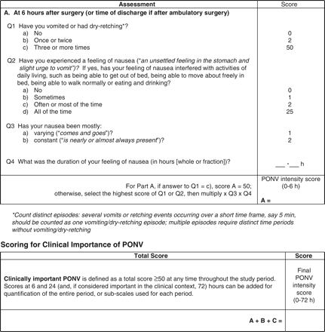
Fig 1 The Postoperative Nausea and Vomiting (PONV) Intensity Scale. The PONV Intensity Scale can be repeated at 24 ...
Notes:
Fig 1 The Postoperative Nausea and Vomiting (PONV) Intensity Scale. The PONV Intensity Scale can be repeated at 24 and 72 h to measure later onset PONV.
Unless provided in the caption above, the following copyright applies to the content of this slide: © The Author [2009]. Published by Oxford University Press on behalf of the British Journal of Anaesthesia. All rights reserved. For Permissions, please email: journals.permissions@oxfordjournal.org

Slide 2
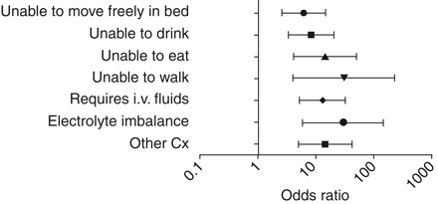
Fig 2 The risk (expressed as odds ratio) of having an adverse consequence of emesis in patients classified as ...
Notes:
Fig 2 The risk (expressed as odds ratio) of having an adverse consequence of emesis in patients classified as having clinically important PONV using the PONV Intensity Scale.
Unless provided in the caption above, the following copyright applies to the content of this slide: © The Author [2009]. Published by Oxford University Press on behalf of the British Journal of Anaesthesia. All rights reserved. For Permissions, please email: journals.permissions@oxfordjournal.org

