Slide 1
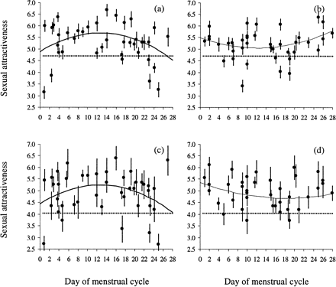
Figure 1 Sexual attractiveness of women's body odors with respect to day of menstrual cycle. The points represent the ...
Notes:
Figure 1 Sexual attractiveness of women's body odors with respect to day of menstrual cycle. The points represent the mean (± SE) attractiveness values of T-shirts scored by raters (31 men and 12 women). The dotted lines represent the mean ratings for clean T-shirts. The data is transformed by using the equation [(28/cycle length) × day of menstrual cycle]. (a) Normally ovulating women, rated by males. (b) Women using contraceptive pills, rated by males. (c) Normally ovulating women, rated by females. (d) Women using contraceptive pills, rated by females. For statistics, see Results
Unless provided in the caption above, the following copyright applies to the content of this slide: Behavioral Ecology vol. 15 no. 4 © International Society for Behavioral Ecology 2004; all rights reserved

