Slide 1
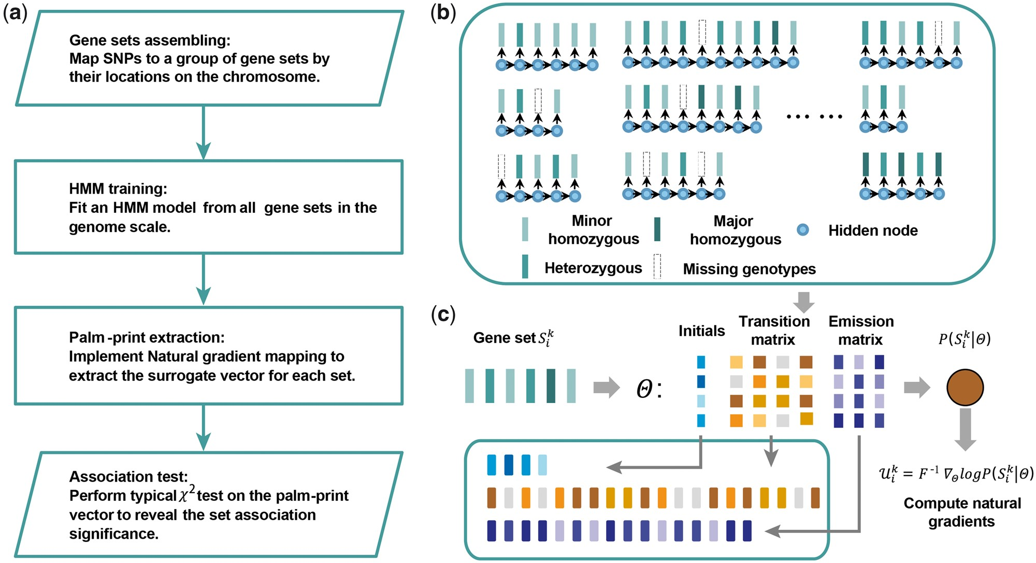
Figure 1 An overview of PALM. (A) A flowchart of PALM. The PALM was trained on a HMM with all gene sets and extracted ...
Notes:
Figure 1 An overview of PALM. (A) A flowchart of PALM. The PALM was trained on a HMM with all gene sets and extracted palm-prints were outputs for association tests. (B) Details of training the HMM. The parameters in the HMM were optimized to account for the sequential information in the observed genotypes with missing values. (C) Extraction of the palm-print. PALM used natural gradient mapping to induce a surrogate feature vector in the parameter space of the HMM.
Unless provided in the caption above, the following copyright applies to the content of this slide: © The Author 2017. Published by Oxford University Press. All rights reserved. For Permissions, please email: journals.permissions@oup.comThis article is published and distributed under the terms of the Oxford University Press, Standard Journals Publication Model (https://academic.oup.com/journals/pages/open_access/funder_policies/chorus/standard_publication_model)

Slide 2
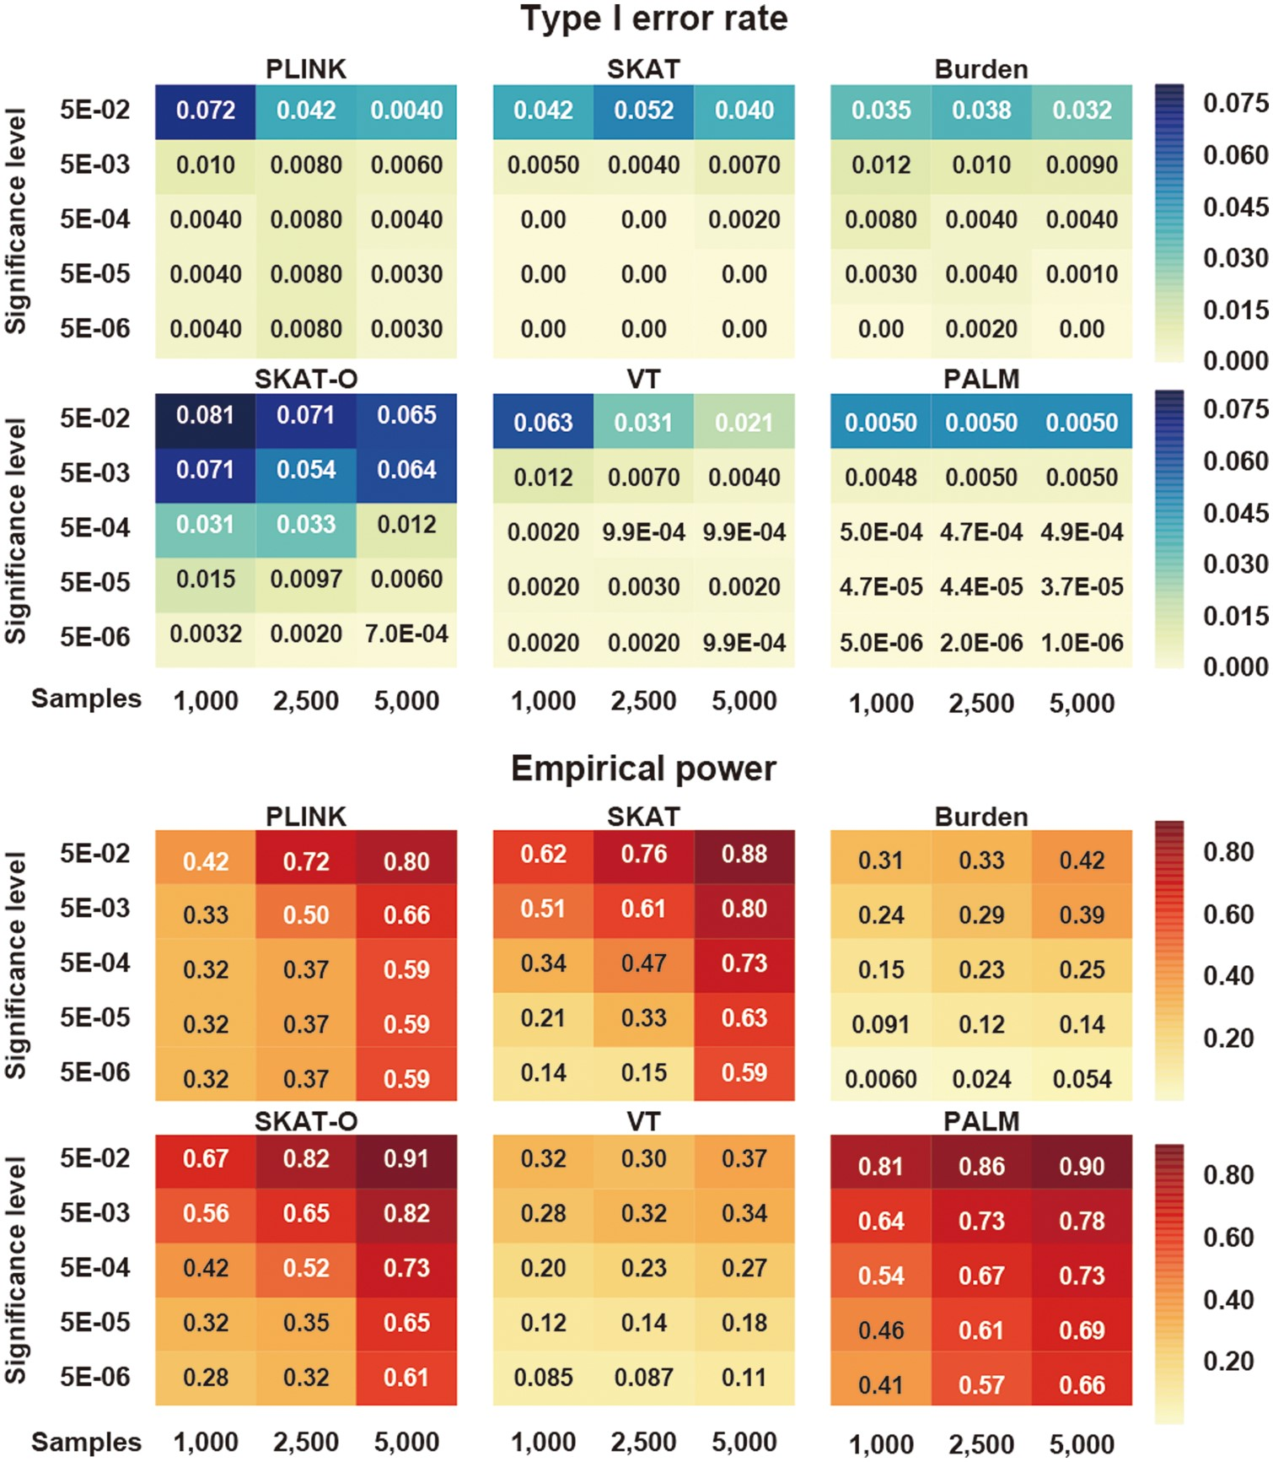
Figure 2 Simulation results obtained from a single-SNP association assumption on 100 randomly selected sets. The ...
Notes:
Figure 2 Simulation results obtained from a single-SNP association assumption on 100 randomly selected sets. The average type I error rates and empirical powers were computed under different significance levels (a) and sample sizes. A susceptibility SNP was assumed to additively increase the risk ratio by 0.2.
Unless provided in the caption above, the following copyright applies to the content of this slide: © The Author 2017. Published by Oxford University Press. All rights reserved. For Permissions, please email: journals.permissions@oup.comThis article is published and distributed under the terms of the Oxford University Press, Standard Journals Publication Model (https://academic.oup.com/journals/pages/open_access/funder_policies/chorus/standard_publication_model)

Slide 3
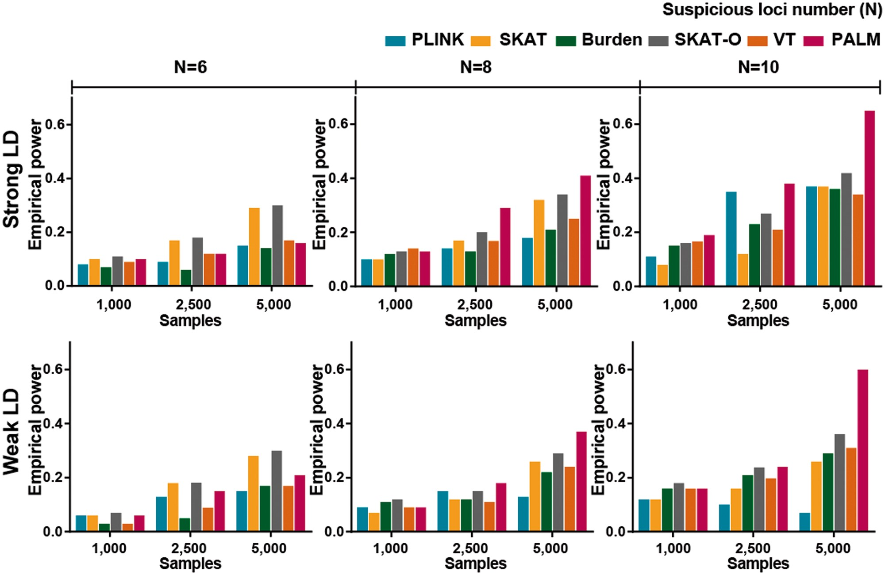
Figure 3 Simulation results obtained from multi-SNP association assumptions on synthetic strong/weak LD structures. ...
Notes:
Figure 3 Simulation results obtained from multi-SNP association assumptions on synthetic strong/weak LD structures. For each set, the effect SNP number was incrementally increased from 5 to 10 with a weak individual influence (i.e. increase the risk ratio by 0.03). Empirical powers were computed under a = 0.05 with different sample sizes.
Unless provided in the caption above, the following copyright applies to the content of this slide: © The Author 2017. Published by Oxford University Press. All rights reserved. For Permissions, please email: journals.permissions@oup.comThis article is published and distributed under the terms of the Oxford University Press, Standard Journals Publication Model (https://academic.oup.com/journals/pages/open_access/funder_policies/chorus/standard_publication_model)

Slide 4
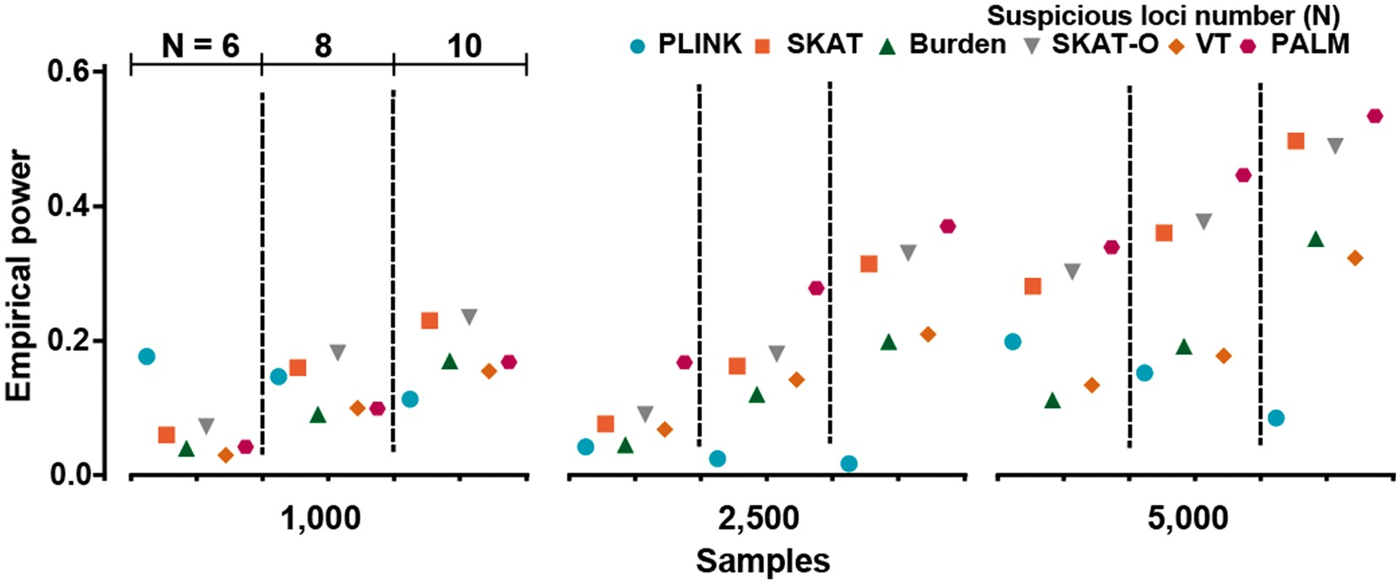
Figure 4 .Simulation results obtained from multi-SNP association assumptions on 100 randomly selected genes. A total ...
Notes:
Figure 4 .Simulation results obtained from multi-SNP association assumptions on 100 randomly selected genes. A total of 5–10 SNPs in each set were assumed to increase the risk ratio of disease by 0.02. Powers were computed as the average results of all sets under a = 5E-04.
Unless provided in the caption above, the following copyright applies to the content of this slide: © The Author 2017. Published by Oxford University Press. All rights reserved. For Permissions, please email: journals.permissions@oup.comThis article is published and distributed under the terms of the Oxford University Press, Standard Journals Publication Model (https://academic.oup.com/journals/pages/open_access/funder_policies/chorus/standard_publication_model)

Slide 5
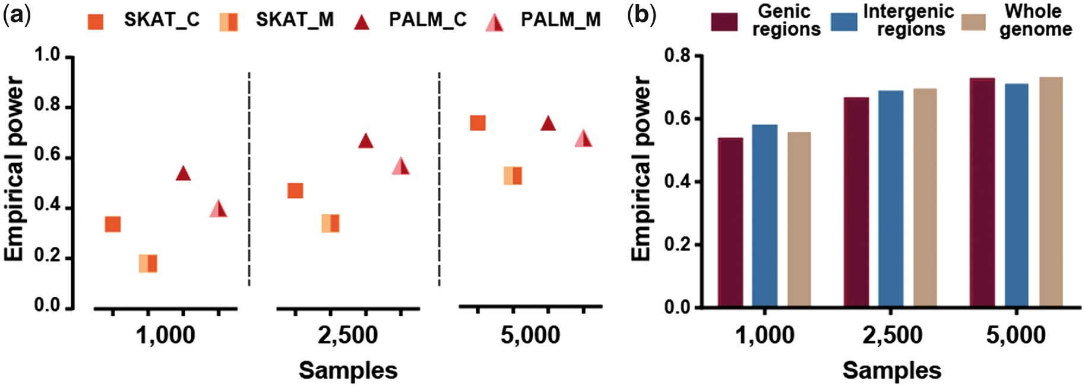
Figure 5 (A) The robustness of PALM in treating missing values under a single-SNP association assumption. PALM_C ...
Notes:
Figure 5 (A) The robustness of PALM in treating missing values under a single-SNP association assumption. PALM_C (resp. PALM_M) reported the empirical powers (a = 5E-04) of PALM from complete (resp. incomplete) gene sets. The results of SKAT_C and SKAT_M were also reported for comparisons. (B) Simulation results obtained on genic, intergenic and whole genome regions. For the latter two conditions, 10 kb bins were used to partition the non-genic/whole genome regions to form SNP sets. Then empirical powers were computed under the same process as single causal SNP simulation.
Unless provided in the caption above, the following copyright applies to the content of this slide: © The Author 2017. Published by Oxford University Press. All rights reserved. For Permissions, please email: journals.permissions@oup.comThis article is published and distributed under the terms of the Oxford University Press, Standard Journals Publication Model (https://academic.oup.com/journals/pages/open_access/funder_policies/chorus/standard_publication_model)

Slide 6
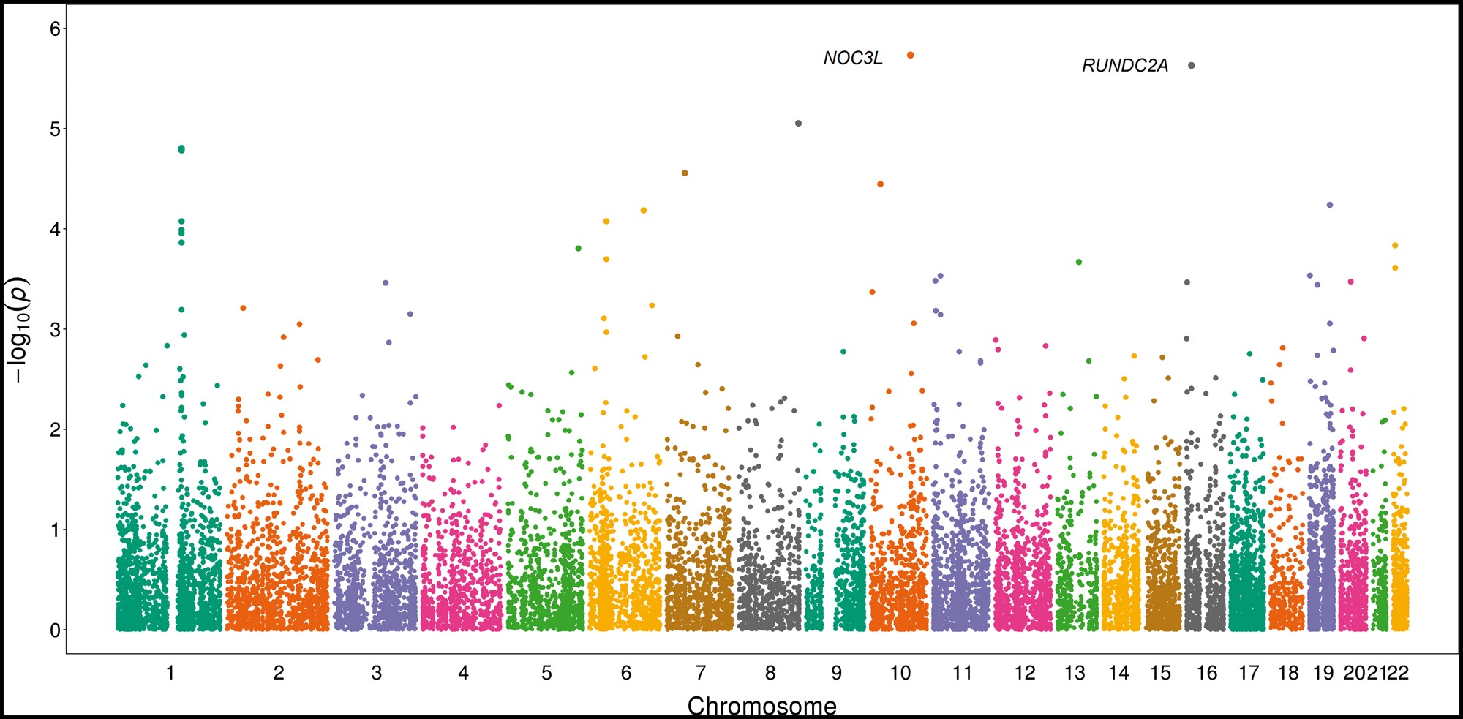
Figure 6 The application of PALM to gastric cancer GWAS. PALM was applied to 19 956 gene sets to perform set-based ...
Notes:
Figure 6 The application of PALM to gastric cancer GWAS. PALM was applied to 19 956 gene sets to perform set-based associations in genome-wide assessments. P-values for all sets are plotted on a –log10 scale; different colors indicate different chromosomes.
Unless provided in the caption above, the following copyright applies to the content of this slide: © The Author 2017. Published by Oxford University Press. All rights reserved. For Permissions, please email: journals.permissions@oup.comThis article is published and distributed under the terms of the Oxford University Press, Standard Journals Publication Model (https://academic.oup.com/journals/pages/open_access/funder_policies/chorus/standard_publication_model)

