Slide 1
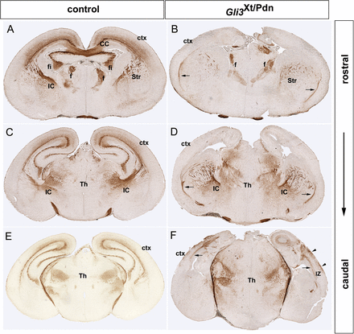
Figure 1. The Gli3 mutation affects fibre tract development in the forebrain. Neurofilament (NF) staining on coronal ...
Notes:
Figure 1. The Gli3 mutation affects fibre tract development in the forebrain. Neurofilament (NF) staining on coronal sections of the P0 control (A,C,E) and Gli3Xt/Pdn (B,D,F) brains. (A,B) The mutant rostromedial cortex is highly dysmorphic and the corpus callosum and the hippocampal commissure is absent in the mutant. (A–D) The control neocortex contains a dense array of neurofilament+ axons in its intermediate zone (IZ), while the rostral and intermediate neocortex strikingly lack NF+ fibers in the mutant. Moreover, thalamocortical axons (TCAs) cross the striatum and have entered the neocortex in control embryos. TCAs do not penetrate into the Gli3Xt/Pdn cortex but project along the PSPB (arrows in B,D). (E,F) Neurofilament+ cortical fibers were observed only in the caudal most neocortex and in ectopic positions in the marginal zone (arrowheads). CC, corpus callosum; f, fornix; fi, fimbria; IC, internal capsule; Str, striatum; Th, thalamus.
Unless provided in the caption above, the following copyright applies to the content of this slide: © The Author 2012. Published by Oxford University Press. All rights reserved. For Permissions, please e-mail: journals.permissions@oup.com

Slide 2
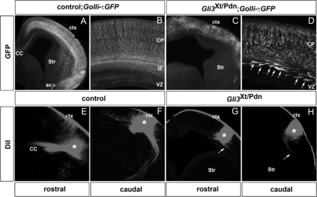
Figure 2. The Golli-τGFP transgene and axon tracing reveal growth defects of cortical axons in P0 Gli3^{Xt/Pdn} ...
Notes:
Figure 2. The Golli-τGFP transgene and axon tracing reveal growth defects of cortical axons in P0 Gli3Xt/Pdn brains. (A–D) GFP immunofluorescence in control;Golli-τGFP and Gli3Xt/Pdn;Gollit-τGFP P0 pups. In controls, GFP labels the callosal and corticofugal projections of a subset of subplate and layer VI neurons. The enlarged area in (B) shows a densely populated IZ and parallel organized dendrites projecting toward the pial surface. (C,D) The Gli3Xt/Pdn contains few but highly fasciculated GFP+ axons (arrows) while dendrites are disorganized. (E,F) DiI labeling (asterisks) of fiber tracts in P0 control brains labels callosal projections (A) and corticofugal projections at rostral and caudal levels, respectively. (G,H) In rostral Gli3Xt/Pdn brains, few and short fibers (arrow) were labeled with DiI, while some axon bundles project a short distance along the corticostriatal boundary at caudal levels (arrow) but do not enter the striatum (H). CP, cortical plate; ctx, cortex; IZ, intermediate zone; VZ, ventricular zone.
Unless provided in the caption above, the following copyright applies to the content of this slide: © The Author 2012. Published by Oxford University Press. All rights reserved. For Permissions, please e-mail: journals.permissions@oup.com

Slide 3
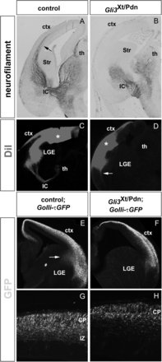
Figure 3. Defective development of cortical projections in E14.5 Gli3^{Xt/Pdn} brains. (A,B) ...
Notes:
Figure 3. Defective development of cortical projections in E14.5 Gli3Xt/Pdn brains. (A,B) Gli3Xt/Pdn embryos lack neurofilament staining in the neocortex. Thalamocortical fibres are present in the lateral ganglionic eminence (LGE) but do not enter the neocortex. (C,D) Placement of DiI crystals (asterisks) in the control neocortex reveals CTAs projecting toward the thalamus and retrogradely labels TCAs. In Gli3Xt/Pdn embryos, only a few fibers projecting along the PSPB are labeled with DiI (arrow). (E–H) Labeling of cortical projections using Golli-τGFP transgenic mice. (E,G) In control embryos, GFP immunofluorescence reveals cortical axons in the IZ with corticofugal axons crossing the PSPB (arrow). (F,H) Golli-τGFP expression is severely reduced in Gli3Xt/Pdn embryos and corticofugal axons do not project into the LGE. LGE, lateral ganglionic eminence.
Unless provided in the caption above, the following copyright applies to the content of this slide: © The Author 2012. Published by Oxford University Press. All rights reserved. For Permissions, please e-mail: journals.permissions@oup.com

Slide 4
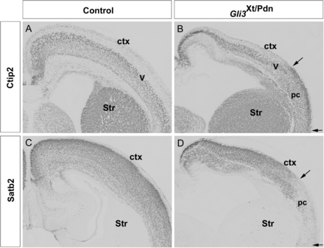
Figure 4. Corticospinal motor neurons and callosal neurons are formed in Gli3^{Xt/Pdn} mutants. ...
Notes:
Figure 4. Corticospinal motor neurons and callosal neurons are formed in Gli3Xt/Pdn mutants. (A,C) In control P0 embryos, Ctip2 and Satb2 label corticospinal motor neurons in layer V and upper layer callosal neurons, respectively. (B,D) Both types of neuron are present in the Gli3Xt/Pdn neocortex, but the piriform cortex (pc) expands medially. Arrowheads in (B,D) mark the extend of the piriform cortex.
Unless provided in the caption above, the following copyright applies to the content of this slide: © The Author 2012. Published by Oxford University Press. All rights reserved. For Permissions, please e-mail: journals.permissions@oup.com

Slide 5
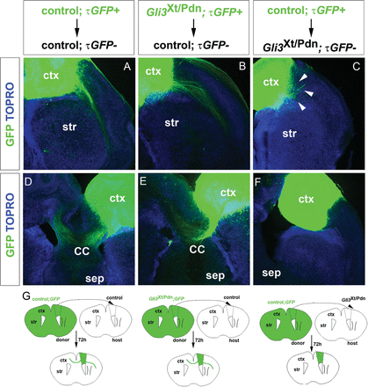
Figure 5. Environmental defects are primarily responsible for axonal growth defects in the Gli3^{Xt/Pdn} ...
Notes:
Figure 5. Environmental defects are primarily responsible for axonal growth defects in the Gli3Xt/Pdn neocortex. (A,D) Homotopic transplantation of control;τGFP cortex into control cortex leads to axon outgrowth laterally and medially from the transplant toward the striatum (A) and the contralateral hemisphere (D), respectively. Only a few axons project along the pial surface. (B,E) GFP+ axons from a Gli3Xt/Pdn cortical transplant similarly grow laterally (B) and medially (E) into the control host tissue, although more axons migrate along the pial surface. (C,F) The growth of control;τGFP+ axons is severely inhibited after transplantation of control;τGFP+ neocortex into Gli3Xt/Pdn cortex. Arrows in (C) indicate short axon fibers growing from the transplant into the host cortex. (G) Schematic representation of the transplantation assay and transplantation results. sep, septum; Str, striatum.
Unless provided in the caption above, the following copyright applies to the content of this slide: © The Author 2012. Published by Oxford University Press. All rights reserved. For Permissions, please e-mail: journals.permissions@oup.com

Slide 6
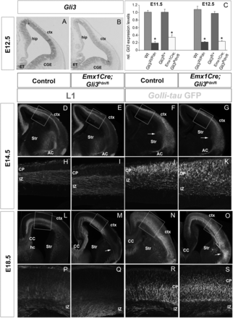
Figure 6. Growth of cortical axons is not affected in the Emx1Cre;Gli3^{Pdn/flox} cortex. (A,B) Gli3 in situ ...
Notes:
Figure 6. Growth of cortical axons is not affected in the Emx1Cre;Gli3Pdn/flox cortex. (A,B) Gli3 in situ hybridization showing reduced Gli3 expression levels in the E12.5 dorsal telencephalon while expression in the caudal ganglionic eminence (CGE) is not affected. (C) Representative example of qRT-PCR analyses revealing reduced Gli3 expression levels in the cortex of Gli3Xt/Pdn and Emx1Cre;Gli3Pdn/flox embryos. Asterisks (*) denote statistically significant changes with P ≤ 0.05 (Mann–Whitney test). (D–K) L1 and GFP immunofluorescence in E14.5 embryos with the indicated genotypes. These stainings reveal dense cortical axons in the IZ and the anterior commissure in control embryos and conditional mutants. Note that very few corticofugal axons have yet penetrated the LGE in mutant embryos (arrows in F and G). (L–S) Cortical axons in E18.5 conditional mutants grow normally but show pathfinding defects. Only few fibers enter the striatum while many fibers project along the PSPB (arrows in M and O). ac, anterior commissure; hc, hippocampal commissure.
Unless provided in the caption above, the following copyright applies to the content of this slide: © The Author 2012. Published by Oxford University Press. All rights reserved. For Permissions, please e-mail: journals.permissions@oup.com

Slide 7
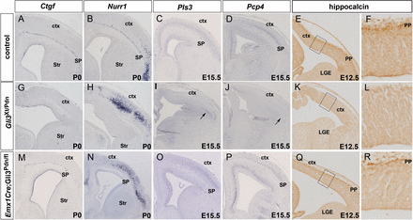
Figure 7. Subplate neurons are largely absent in Gli3^{Xt/Pdn} embryos. (A,B) Ctgf and Nurr1 mark different ...
Notes:
Figure 7. Subplate neurons are largely absent in Gli3Xt/Pdn embryos. (A,B) Ctgf and Nurr1 mark different subset of subplate neurons in P0 control brains. Nurr1 is also expressed in lateral cortical plate neurons (B). (G,H) The subplate expression of Ctgf and Nurr1 is lost in Gli3Xt/Pdn animals while Nurr1 expression in piriform neurons expands into more medial cortical regions. (C,D,I,J) E15.5 control embryos show Pls3 and Pcp4 expression in subplate cells, whereas both markers are expressed only in the lateral most region of the Gli3Xt/Pdn neocortex (arrows). (E,F,K,L) Hippocalcin labels prospective subplate neurons in the preplate of E12.5 control embryos. In Gli3Xt/Pdn embryos, hippocalcin staining in the preplate is missing. (M–R) Expression of these subplate markers is not altered in Emx1Cre;Gli3Pdn/flox cortex but note the medial expansion of Nurr1 expression in cortical plate neurons (N). ctx, cortex; SP, subplate; Str, striatum.
Unless provided in the caption above, the following copyright applies to the content of this slide: © The Author 2012. Published by Oxford University Press. All rights reserved. For Permissions, please e-mail: journals.permissions@oup.com

