Slide 1
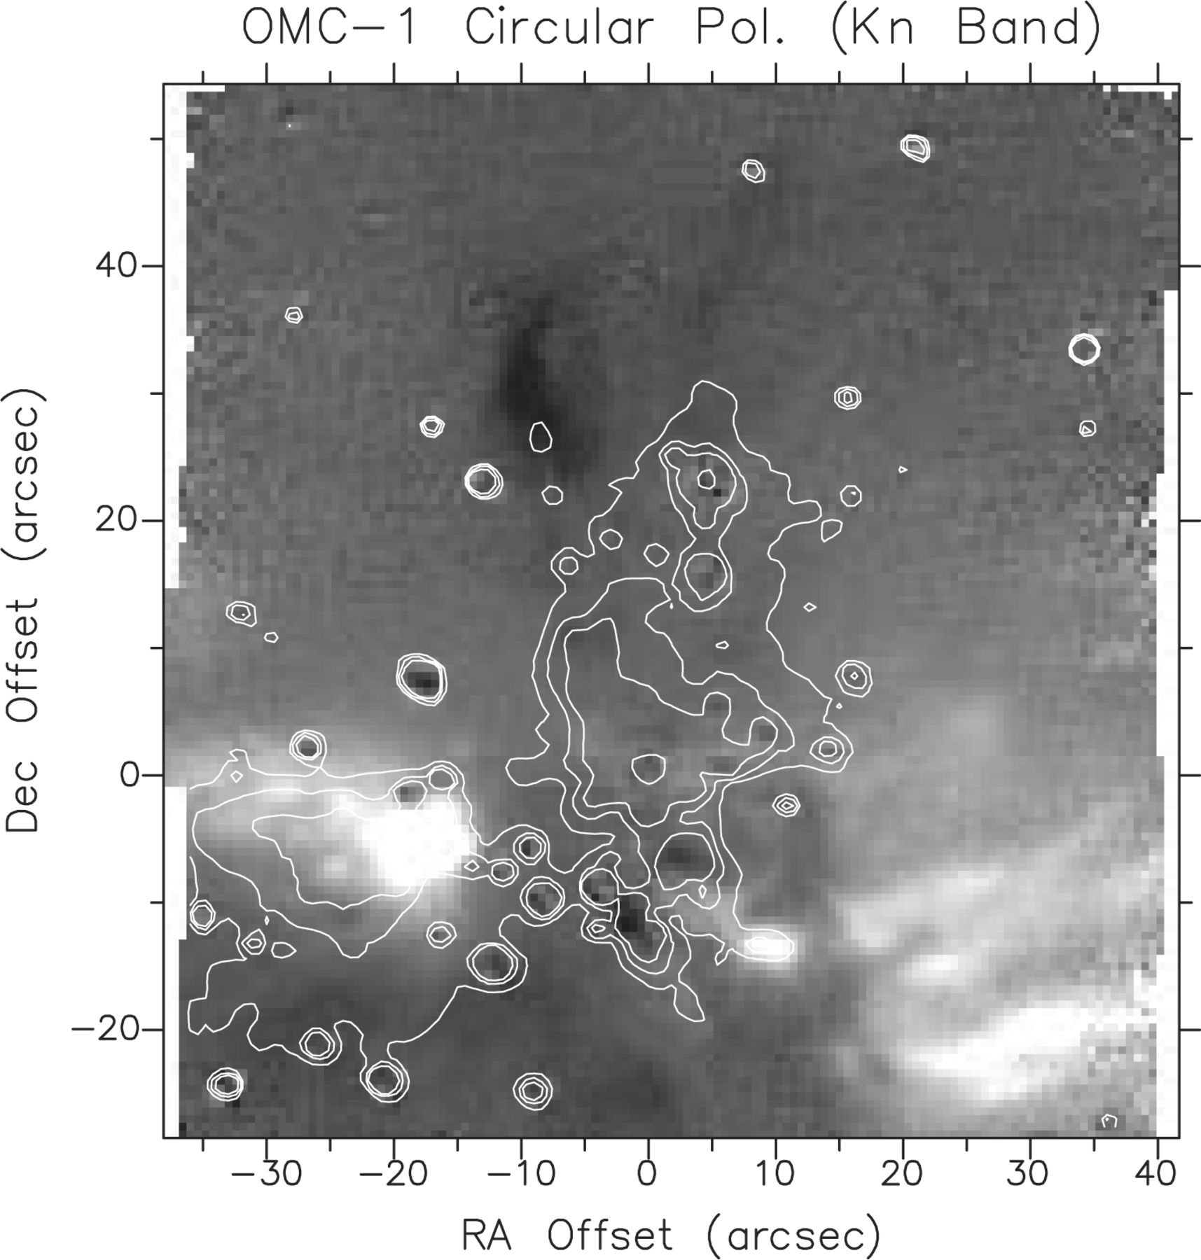
Figure 1. K_{n}-band circular polarization image of the core region of OMC-1. The circular polarization is ...
Notes:
Figure 1. Kn-band circular polarization image of the core region of OMC-1. The circular polarization is scaled between −5 per cent (black) and +10 per cent (white). Overlaid are surface brightness contours outlining the positions of field stars and the diffuse emission. Offsets are west relative to the BN object.
Unless provided in the caption above, the following copyright applies to the content of this slide: © 2000 RAS

Slide 2
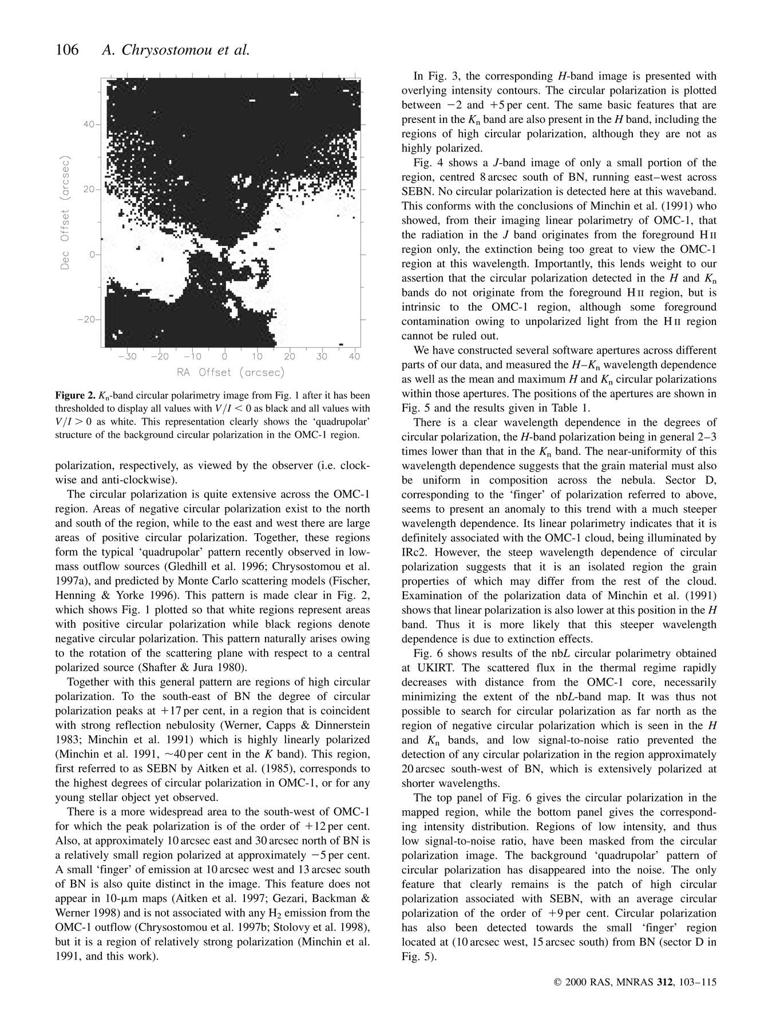
Figure 2. K_{n}-band circular polarimetry image from Fig. 1 after it has been thresholded to display all values ...
Notes:
Figure 2. Kn-band circular polarimetry image from Fig. 1 after it has been thresholded to display all values with VI0 as white. This representation clearly shows the ‘quadrupolar’ structure of the background circular polarization in the OMC-1 region.
Unless provided in the caption above, the following copyright applies to the content of this slide: © 2000 RAS

Slide 3
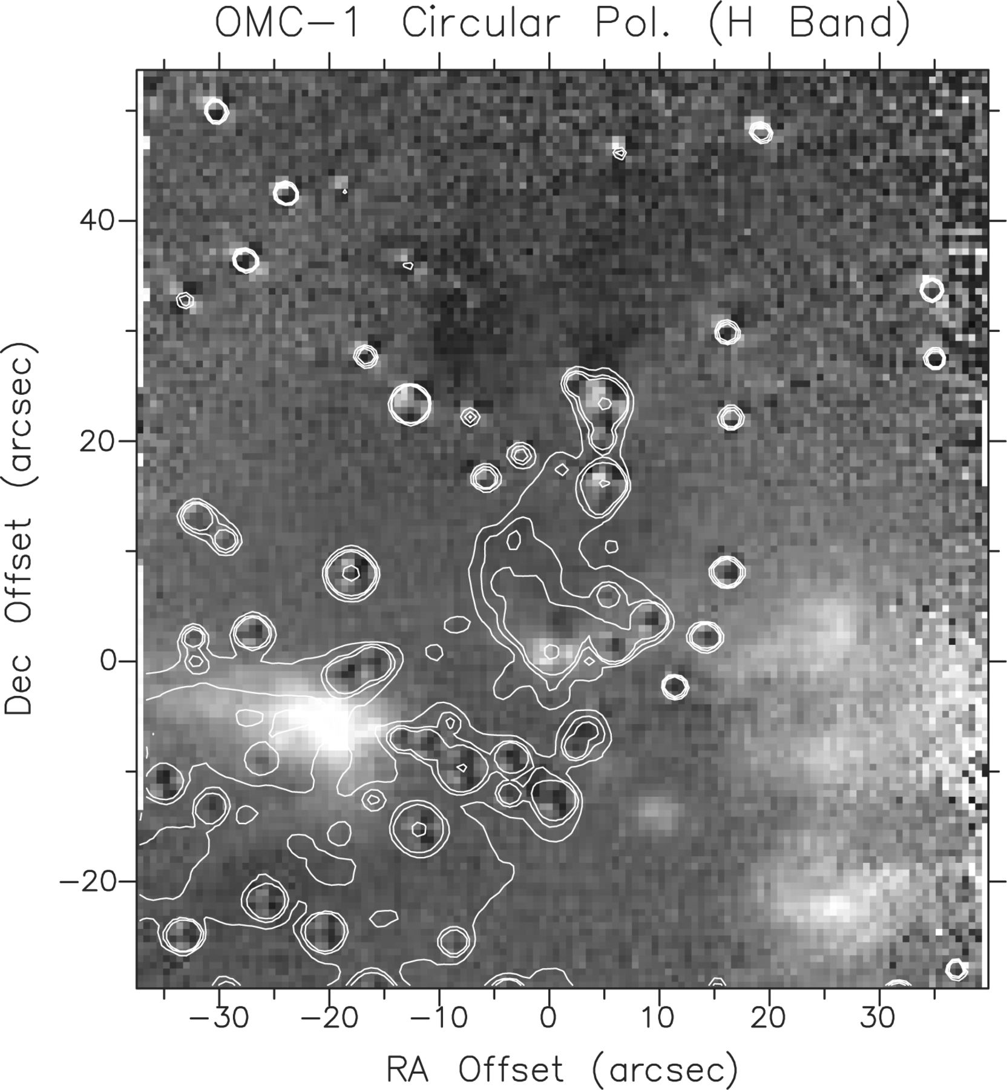
Figure 3. As Fig. 1, but for the H band. The circular polarization is scaled between −2 per cent (black) and +5 per ...
Notes:
Figure 3. As Fig. 1, but for the H band. The circular polarization is scaled between −2 per cent (black) and +5 per cent (white). Offsets are west relative to the BN object.
Unless provided in the caption above, the following copyright applies to the content of this slide: © 2000 RAS

Slide 4
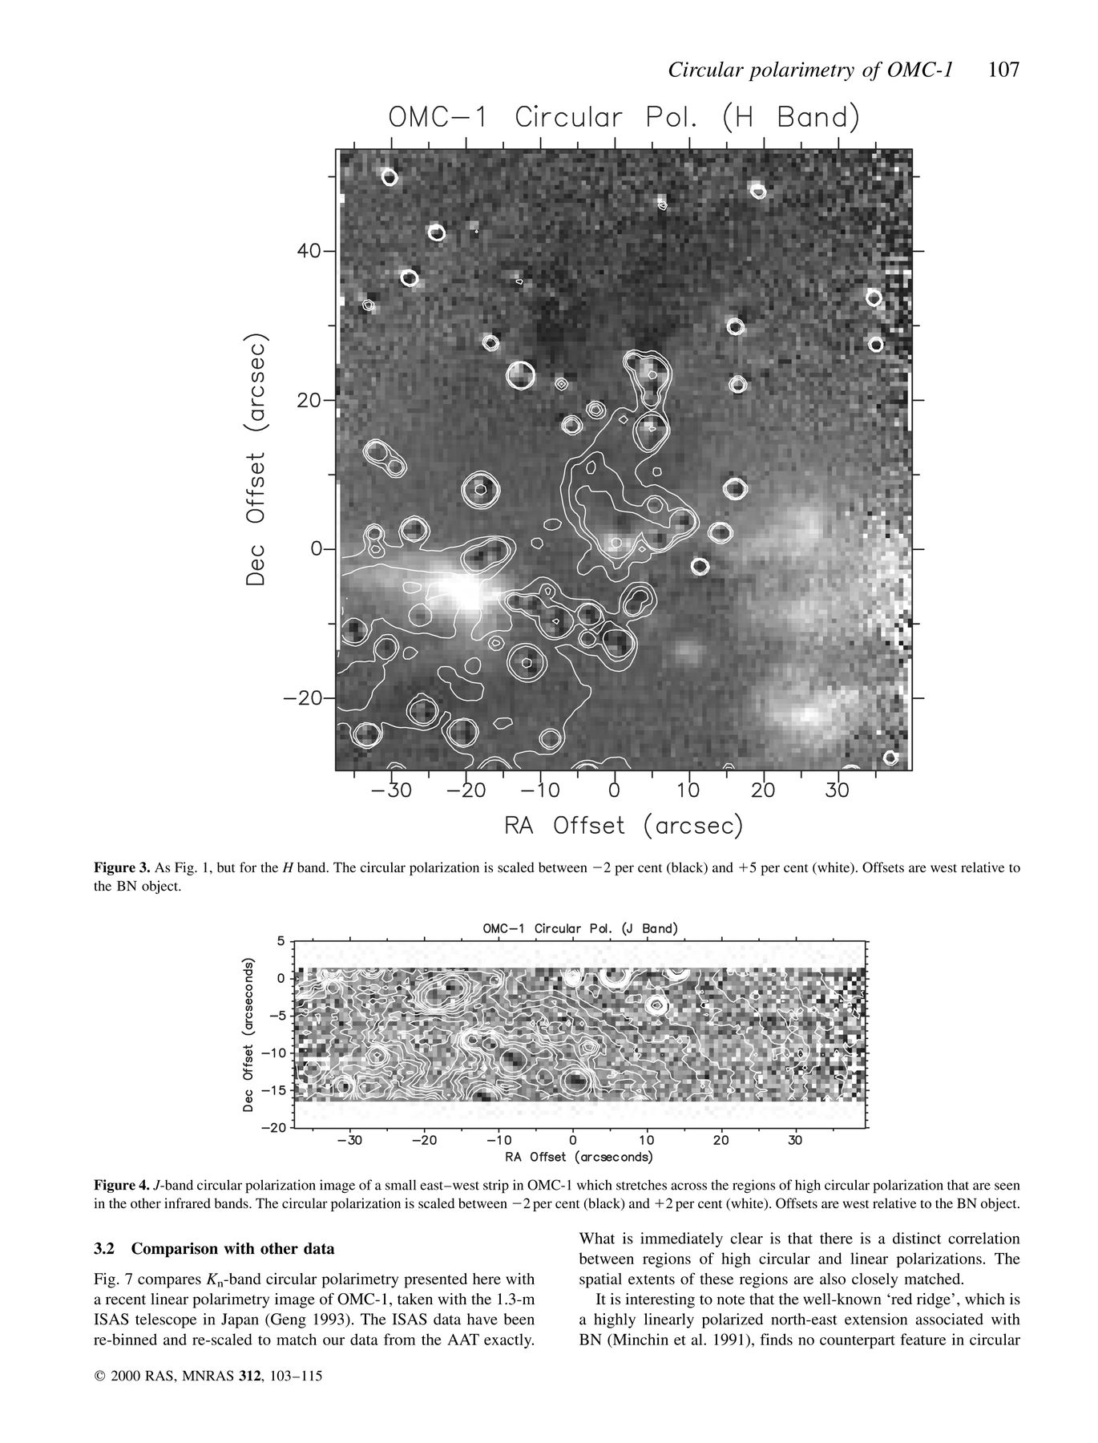
Figure 4. J-band circular polarization image of a small east—west strip in OMC-1 which stretches across the regions of ...
Notes:
Figure 4. J-band circular polarization image of a small east—west strip in OMC-1 which stretches across the regions of high circular polarization that are seen in the other infrared bands. The circular polarization is scaled between −2 per cent (black) and +2 per cent (white). Offsets are west relative to the BN object.
Unless provided in the caption above, the following copyright applies to the content of this slide: © 2000 RAS

Slide 5
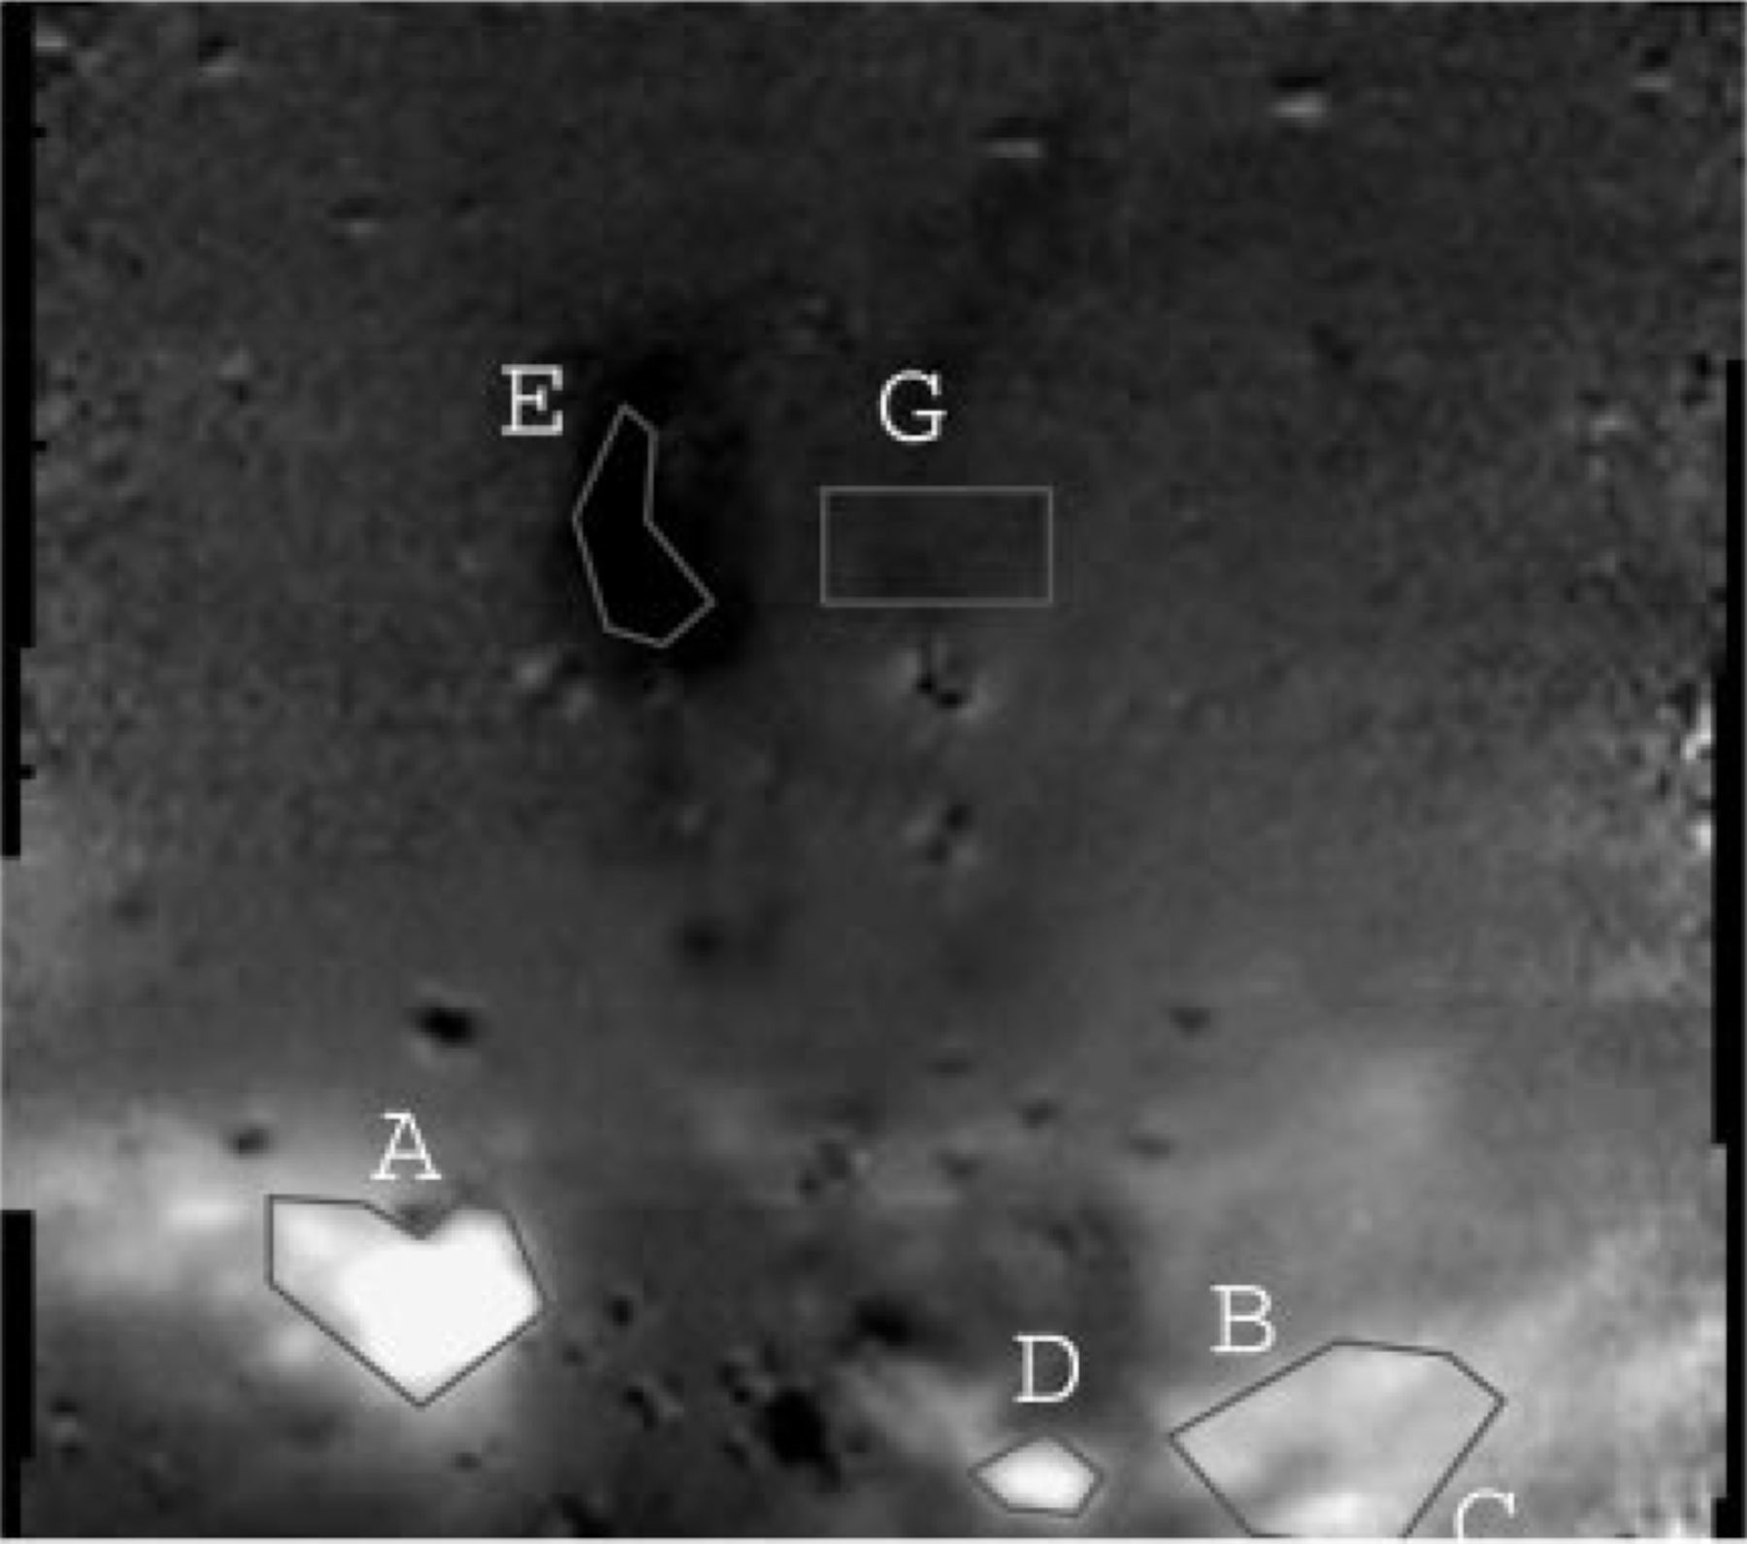
Figure 5. K_{n}-band circular polarization image with sectors A–G, used as software apertures inTable 1, ...
Notes:
Figure 5. Kn-band circular polarization image with sectors A–G, used as software apertures inTable 1, outlined.
Unless provided in the caption above, the following copyright applies to the content of this slide: © 2000 RAS

Slide 6
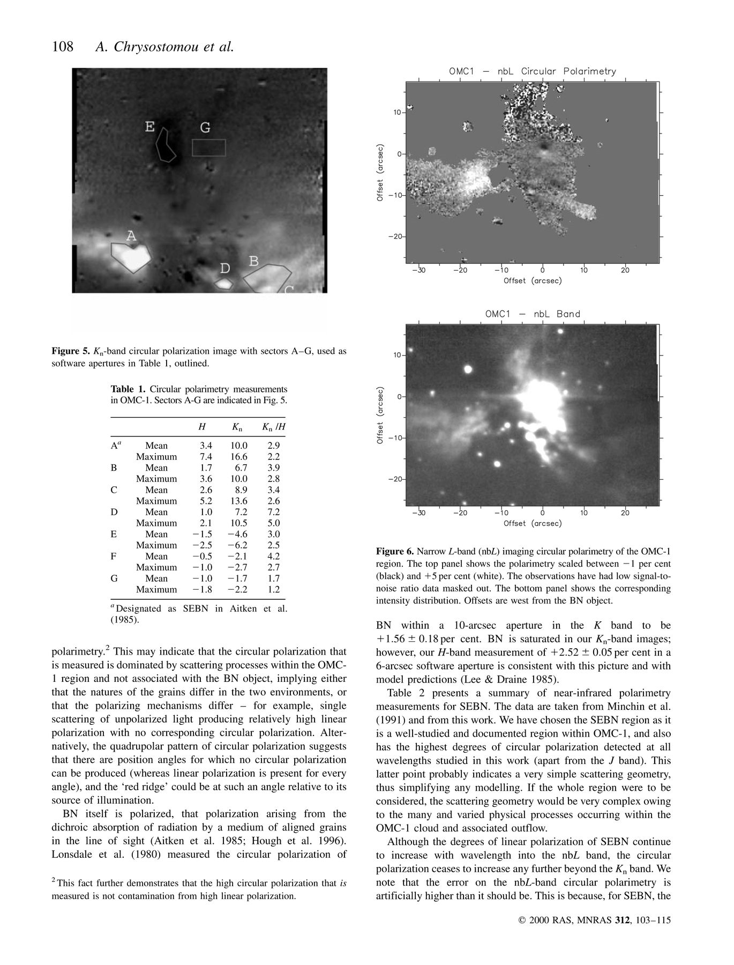
Tabel 1. Circular polarimetry measurements in OMC-1. Sectors A-G are indicated in Fig. 5.
Notes:
Tabel 1. Circular polarimetry measurements in OMC-1. Sectors A-G are indicated in Fig. 5.
Unless provided in the caption above, the following copyright applies to the content of this slide: © 2000 RAS

Slide 7
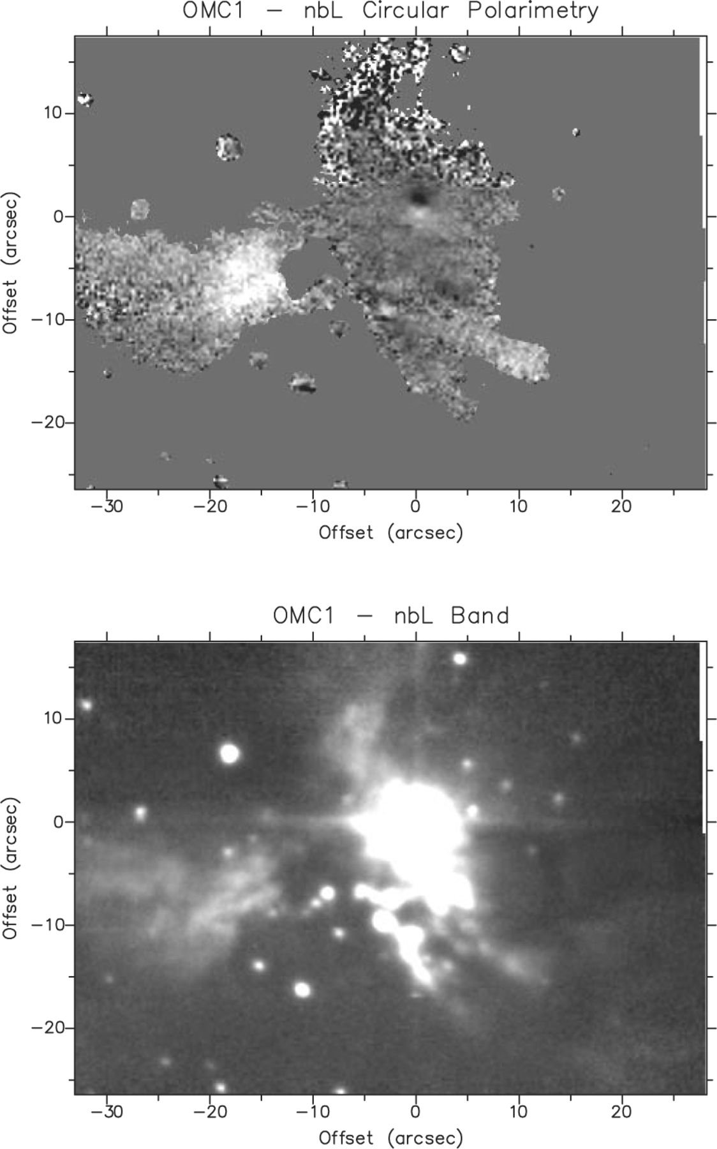
Figure 6. Narrow L-band (nbL) imaging circular polarimetry of the OMC-1 region. The top panel shows the polarimetry ...
Notes:
Figure 6. Narrow L-band (nbL) imaging circular polarimetry of the OMC-1 region. The top panel shows the polarimetry scaled between −1 per cent (black) and +5 per cent (white). The observations have had low signal-to-noise ratio data masked out. The bottom panel shows the corresponding intensity distribution. Offsets are west from the BN object.
Unless provided in the caption above, the following copyright applies to the content of this slide: © 2000 RAS

Slide 8
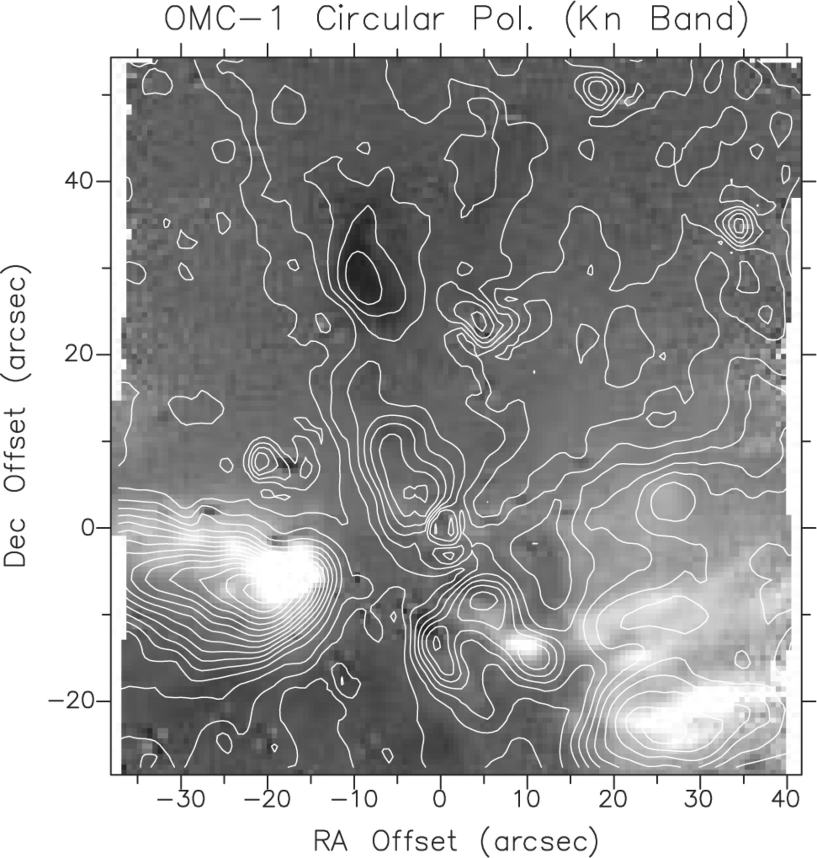
Figure 7. K_{n}-band circular polarimetry image from Fig. 1 overlaid with contours of the corresponding linear ...
Notes:
Figure 7. Kn-band circular polarimetry image from Fig. 1 overlaid with contours of the corresponding linear polarization as observed from the 1.3-m ISAS telescope in Japan (Geng 1993). Note the distinct correlation between high degrees of linear and circular polarization. A departure from this correlation is seen with the so-called ‘red ridge’ extending north-east from BN, as well as a small finger seen approximately 13 arcsec to the south of BN. These regions exhibit high linear polarization without a correspondingly high circular polarization component.
Unless provided in the caption above, the following copyright applies to the content of this slide: © 2000 RAS

Slide 9
Tabel 2. Summary of polarimetry measurements (per cent) of SEBN.
Notes:
Tabel 2. Summary of polarimetry measurements (per cent) of SEBN.
Unless provided in the caption above, the following copyright applies to the content of this slide: © 2000 RAS

Slide 10
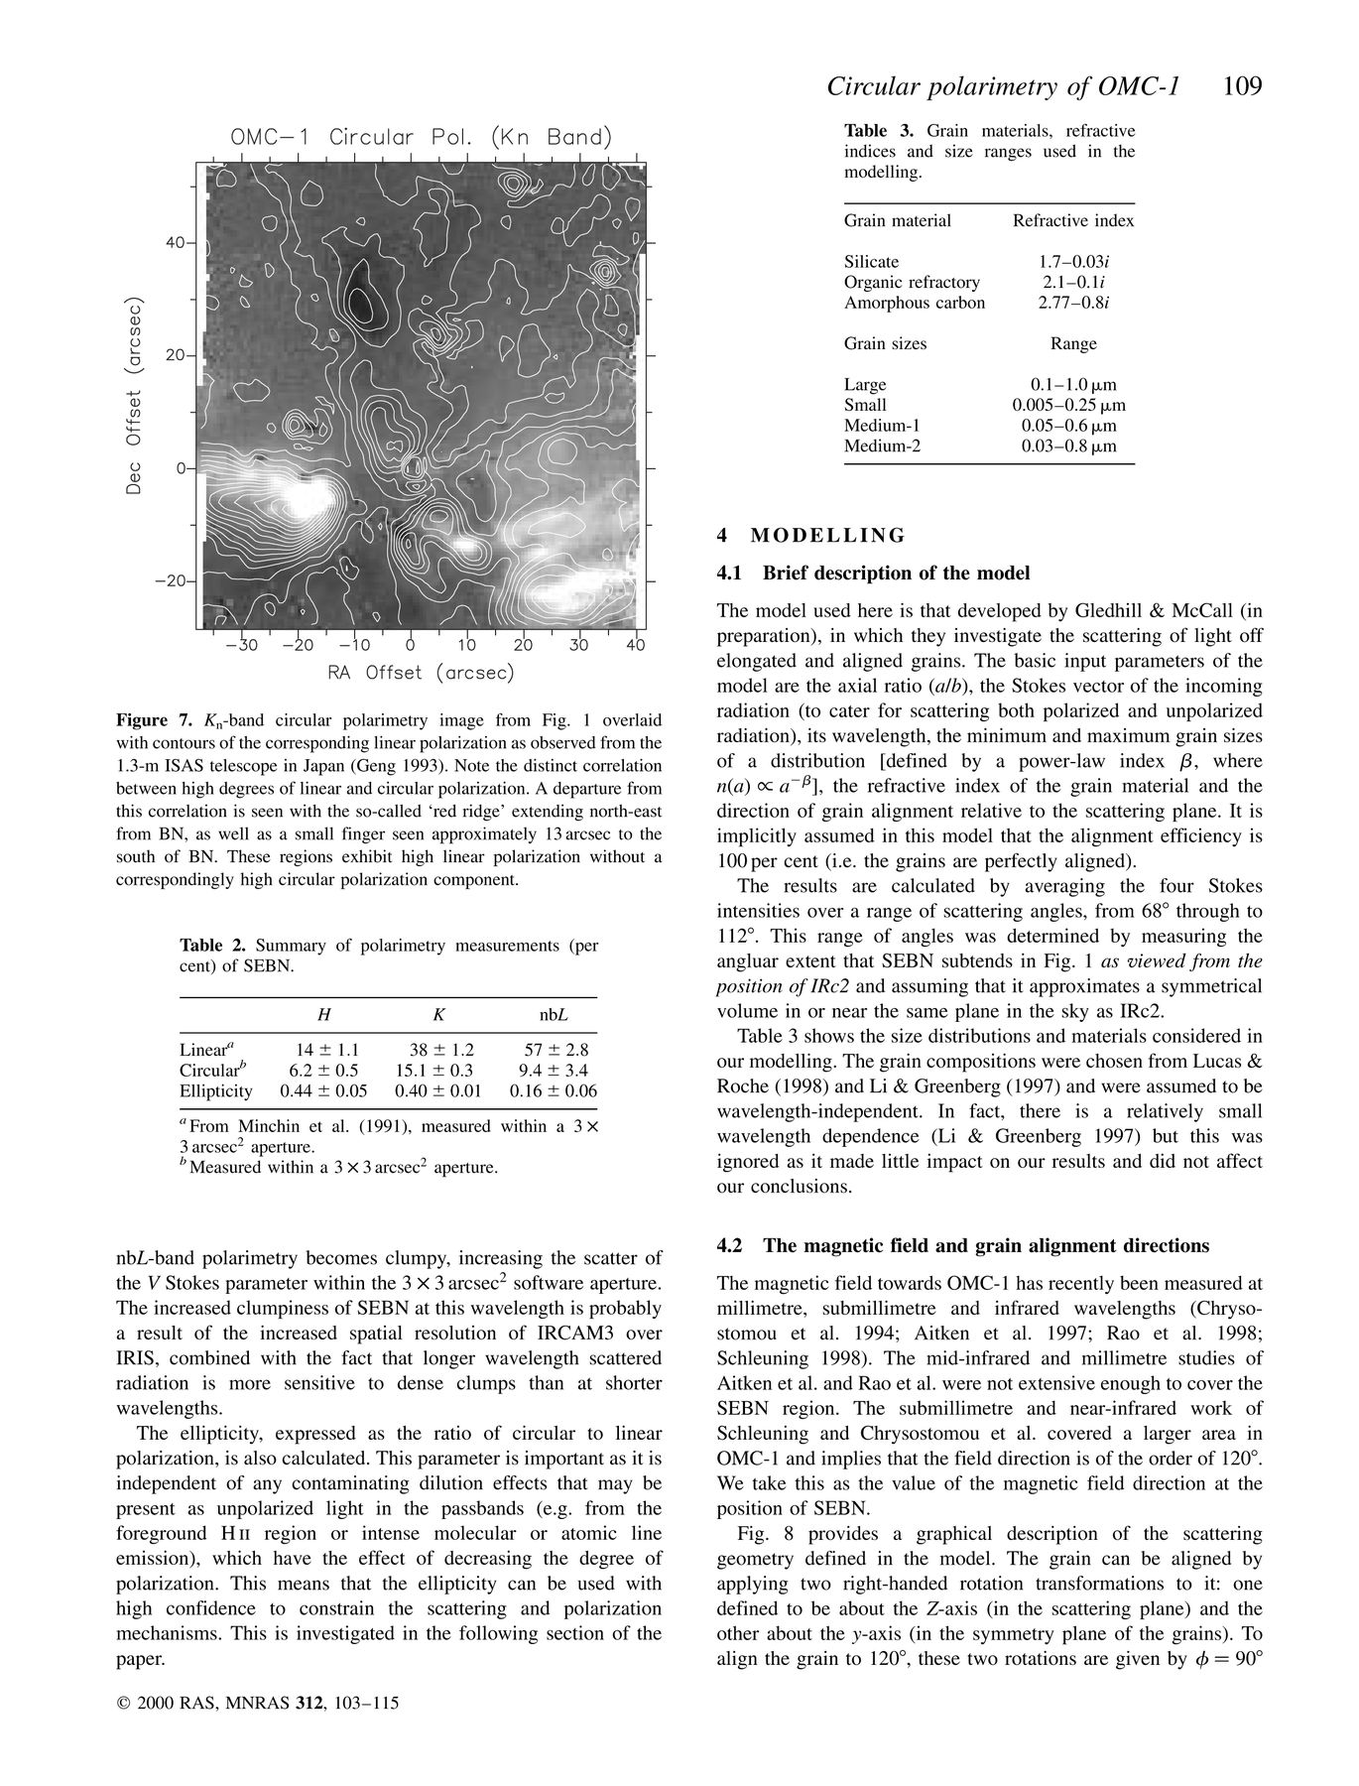
Tabel 3. Grain materials, refractive indices and size ranges used in the modelling.
Notes:
Tabel 3. Grain materials, refractive indices and size ranges used in the modelling.
Unless provided in the caption above, the following copyright applies to the content of this slide: © 2000 RAS

Slide 11
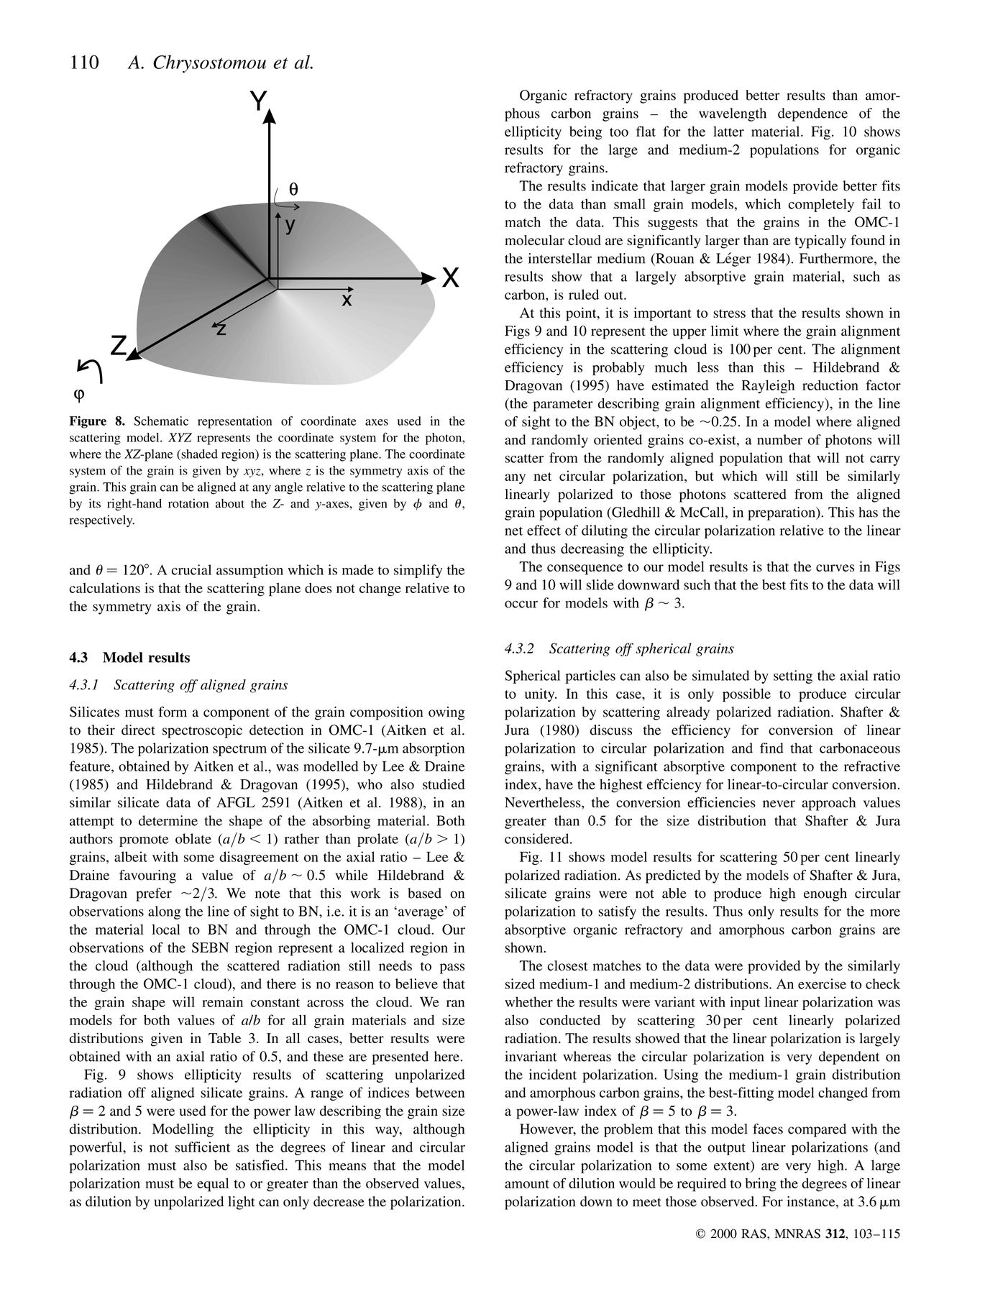
Figure 8. Schematic representation of coordinate axes used in the scattering model. XYZ represents the coordinate ...
Notes:
Figure 8. Schematic representation of coordinate axes used in the scattering model. XYZ represents the coordinate system for the photon, where the XZ-plane (shaded region) is the scattering plane. The coordinate system of the grain is given by xyz, where z is the symmetry axis of the grain. This grain can be aligned at any angle relative to the scattering plane by its right-hand rotation about the Z- and y-axes, given by φ and θ, respectively.
Unless provided in the caption above, the following copyright applies to the content of this slide: © 2000 RAS

Slide 12
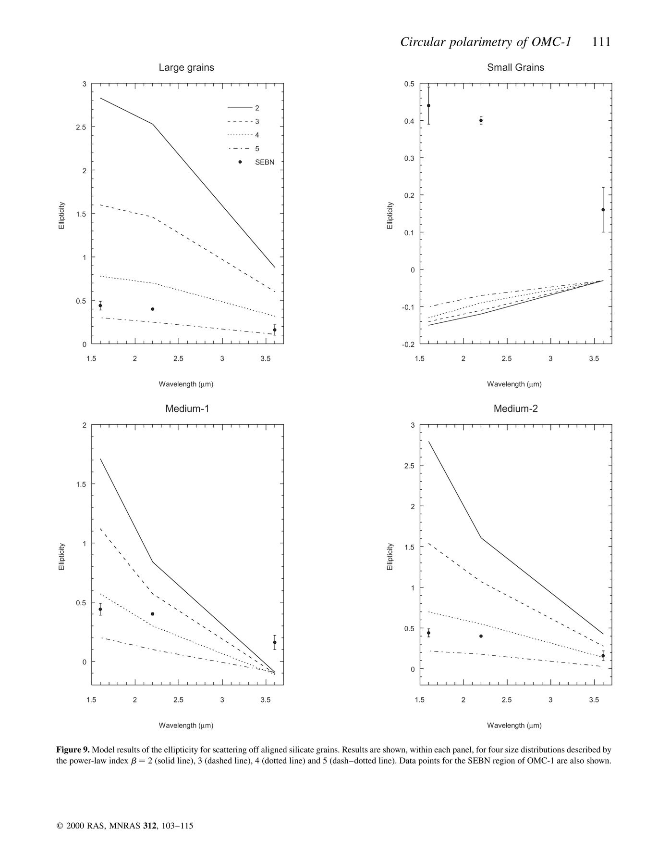
Figure 9. Model results of the ellipticity for scattering off aligned silicate grains. Results are shown, within each ...
Notes:
Figure 9. Model results of the ellipticity for scattering off aligned silicate grains. Results are shown, within each panel, for four size distributions described by the power-law index β=2 (solid line), 3 (dashed line), 4 (dotted line) and 5 (dash—dotted line). Data points for the SEBN region of OMC-1 are also shown.
Unless provided in the caption above, the following copyright applies to the content of this slide: © 2000 RAS

Slide 13
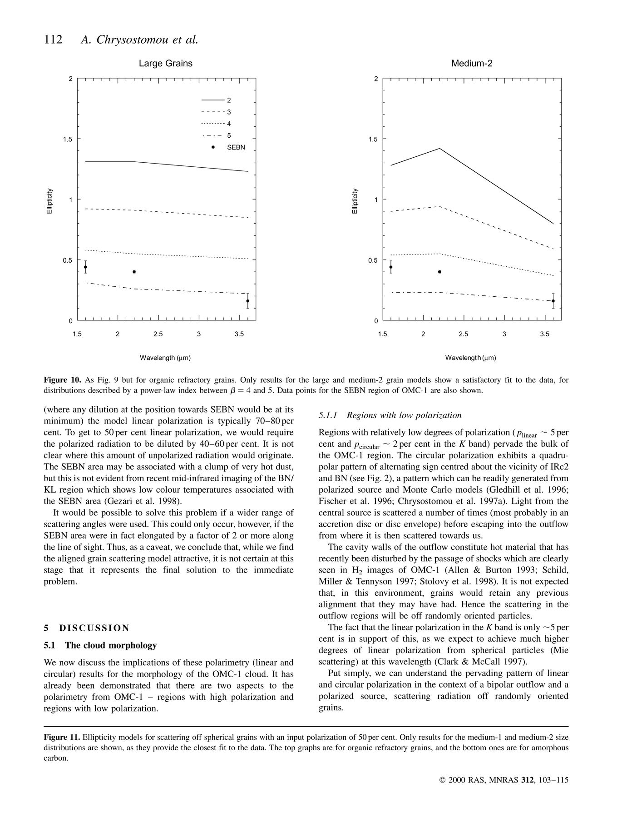
Figure 10. As Fig. 9 but for organic refractory grains. Only results for the large and medium-2 grain models show a ...
Notes:
Figure 10. As Fig. 9 but for organic refractory grains. Only results for the large and medium-2 grain models show a satisfactory fit to the data, for distributions described by a power-law index between β=4 and 5. Data points for the SEBN region of OMC-1 are also shown.
Unless provided in the caption above, the following copyright applies to the content of this slide: © 2000 RAS

Slide 14
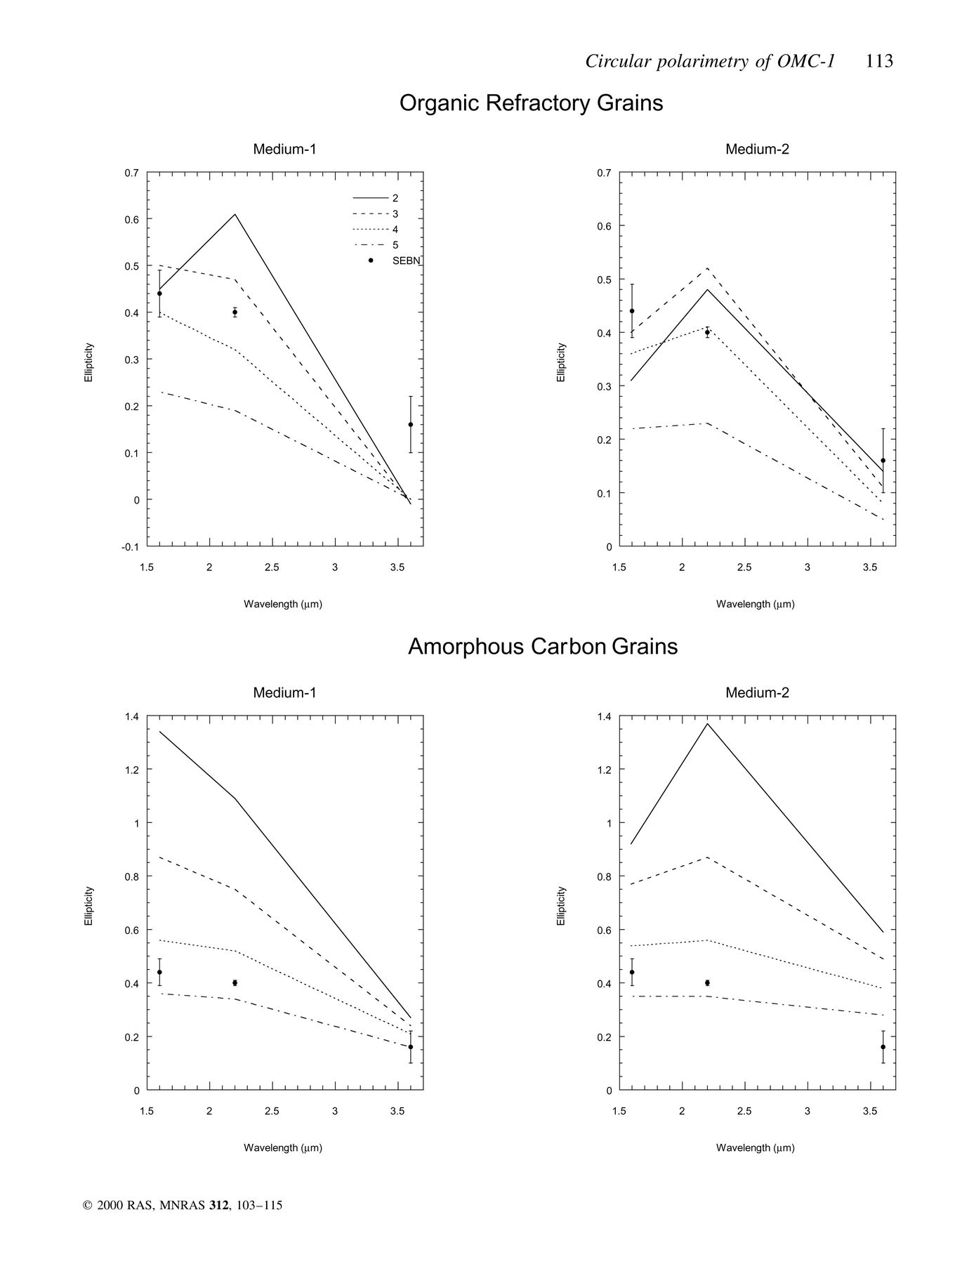
Figure 11. Ellipticity models for scattering off spherical grains with an input polarization of 50 per cent. Only ...
Notes:
Figure 11. Ellipticity models for scattering off spherical grains with an input polarization of 50 per cent. Only results for the medium-1 and medium-2 size distributions are shown, as they provide the closest fit to the data. The top graphs are for organic refractory grains, and the bottom ones are for amorphous carbon.
Unless provided in the caption above, the following copyright applies to the content of this slide: © 2000 RAS

