Slide 1
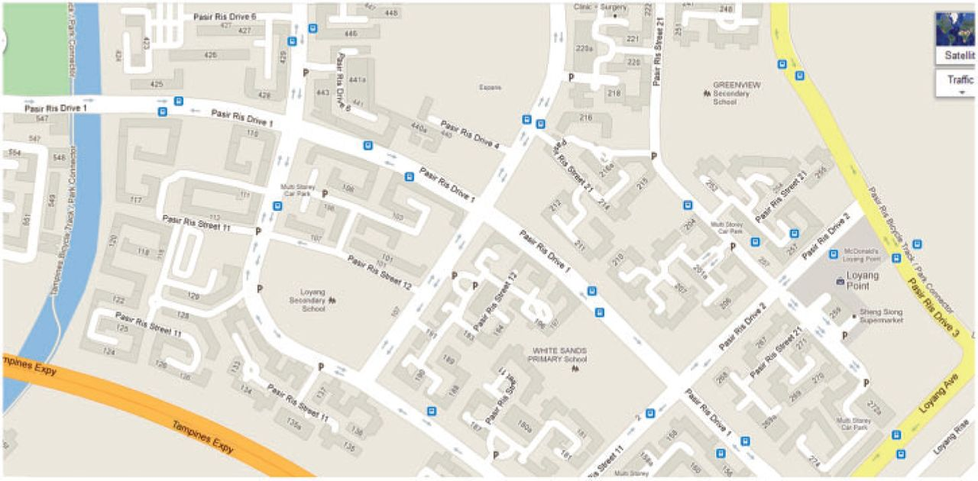
Figure 1. Map of HDB blocks and HDB neighbourhoods. Each number in the map corresponds to an HDB block. There are 4 HDB ...
Notes:
Figure 1. Map of HDB blocks and HDB neighbourhoods. Each number in the map corresponds to an HDB block. There are 4 HDB neighbourhoods in this map. Neighbourhood 1 comprises all HDB blocks between 100 and 199, neighbourhood 2 comprises all HDB blocks between 200 and 299, neighbourhoods 4 and 5 are defined in a similar manner. Source: Google Maps
Unless provided in the caption above, the following copyright applies to the content of this slide: © TheAuthor 2013. Published by Oxford University Press on behalf of The Review of Economic Studies Limited.

Slide 2
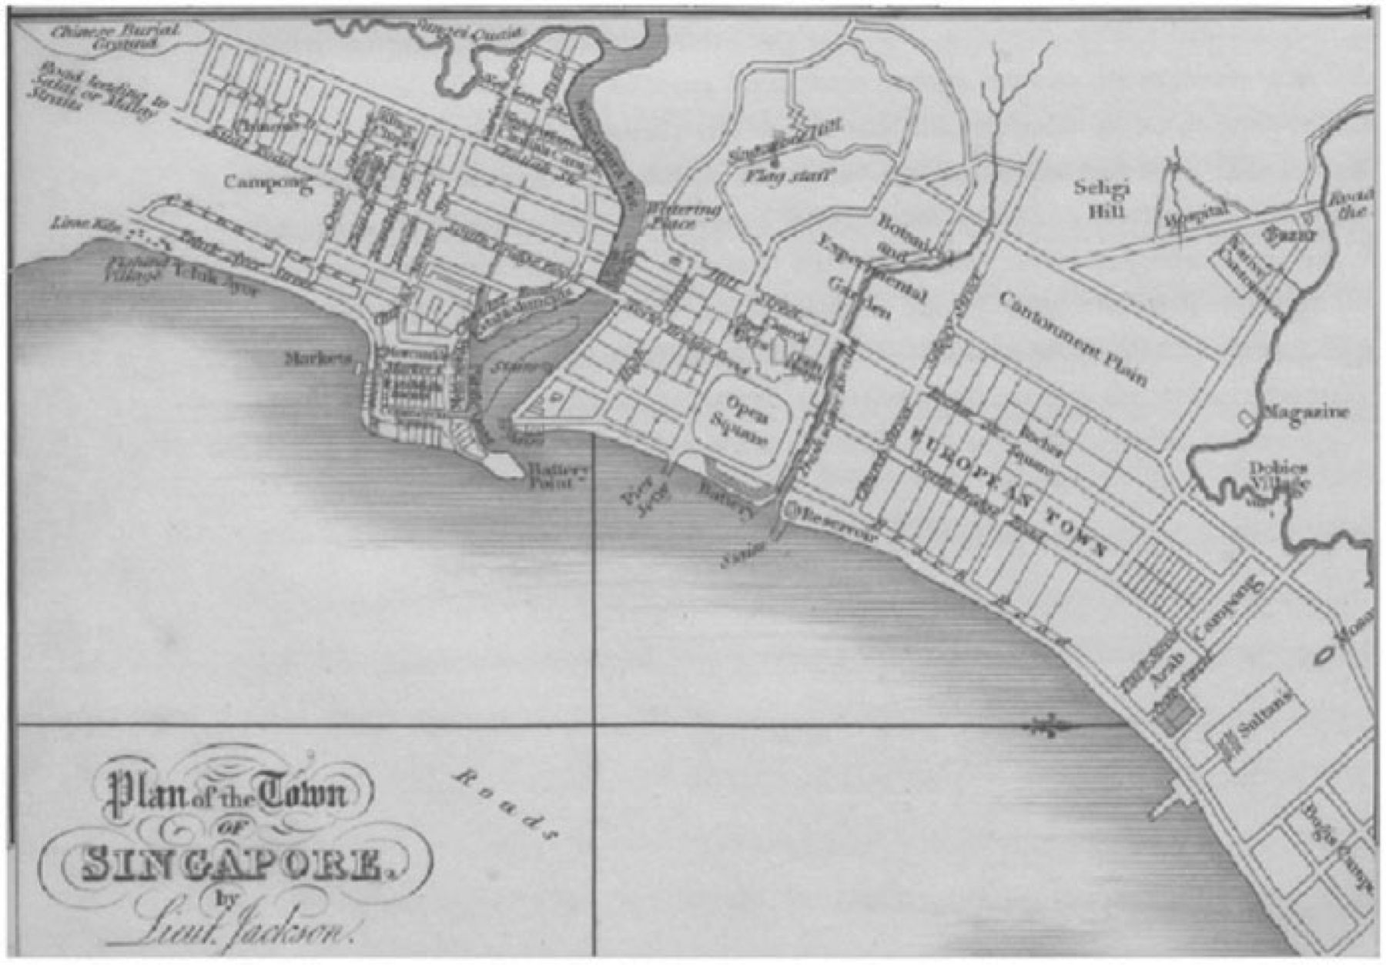
Figure 2. Map of ethnic settlements in early 19th century. The Malay settlements (“Arab Campong” and “Bugis Campong”) ...
Notes:
Figure 2. Map of ethnic settlements in early 19th century. The Malay settlements (“Arab Campong” and “Bugis Campong”) are in the south-east corner of the map, just east of the European Town. The Chinese and Indian areas are to the west of the Singapore River. Source: Crawford, 1828
Unless provided in the caption above, the following copyright applies to the content of this slide: © TheAuthor 2013. Published by Oxford University Press on behalf of The Review of Economic Studies Limited.

Slide 3
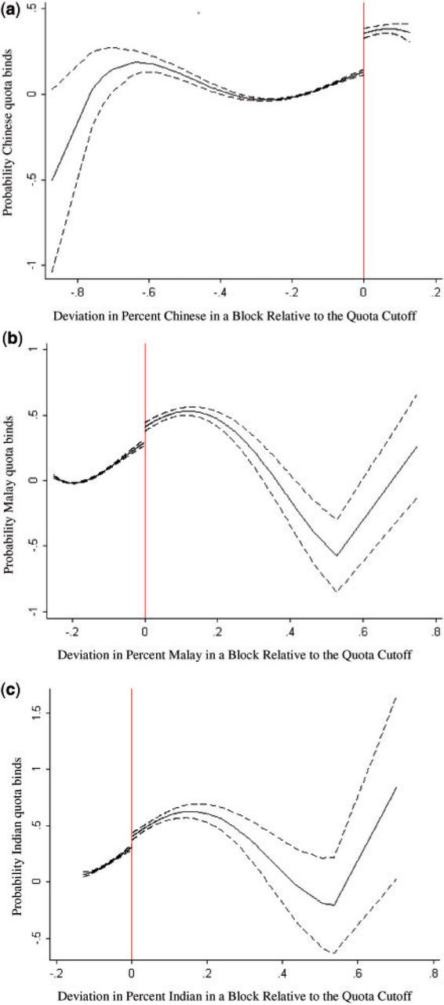
Figure 3. Testing for discontinuity in the probability that the quota binds. Each panel in this figure is constructed ...
Notes:
Figure 3. Testing for discontinuity in the probability that the quota binds. Each panel in this figure is constructed by regressing Qbt (a dummy for whether the quota is binding for block b in month t) on a dummy that is 1 when the ethnic proportions are above the block quota cutoff and fourth-order polynomials of ethnic proportions, centred around the quota cutoffs, then plotting the predicted probabilities. The dashed lines represent 95% confidence intervals. Standard errors are clustered at the block level. The coefficient estimates are 23, 12, and 10% for Chinese, Malay, and Indian quotas. (a) Probability that the Chinese quota binds. (b) Probability that the Malay quota binds. (c) Probability that the Indian quota binds
Unless provided in the caption above, the following copyright applies to the content of this slide: © TheAuthor 2013. Published by Oxford University Press on behalf of The Review of Economic Studies Limited.

Slide 4
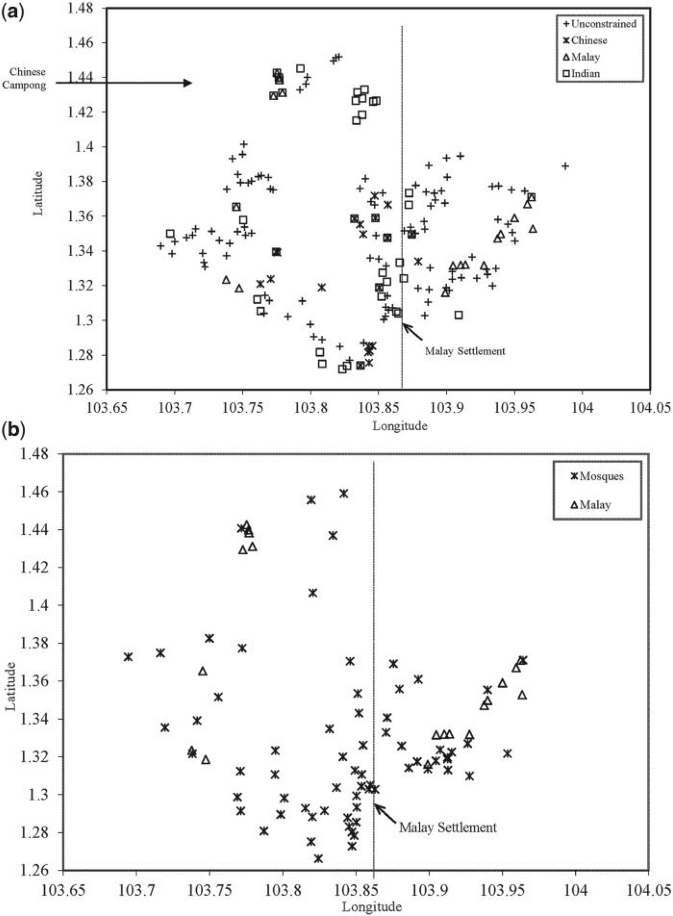
Figure 4. (a) Map of 170 neighbourhoods in 2005 comprising unconstrained neighbourhoods, Chinese-, Malay-, and ...
Notes:
Figure 4. (a) Map of 170 neighbourhoods in 2005 comprising unconstrained neighbourhoods, Chinese-, Malay-, and Indian-constrained neighbourhoods. The line indicates the Eastern tip of the early Malay settlements. (b) Map of Malay–constrained neighbourhoods and the location of mosques. The line indicates the Eastern tip of the early Malay settlements. Source: Majlis Ugama Islam Singapura (MUIS) Mosque Directory
Unless provided in the caption above, the following copyright applies to the content of this slide: © TheAuthor 2013. Published by Oxford University Press on behalf of The Review of Economic Studies Limited.

Slide 5
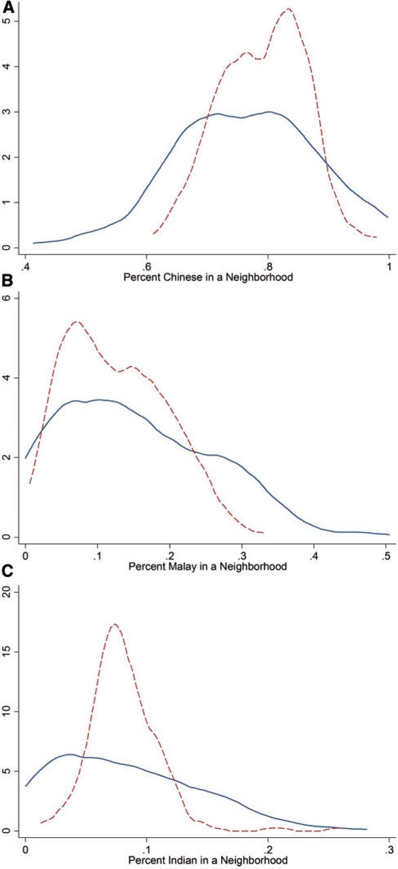
Figure 5. Density of ethnic proportions in a neighbourhood, first best and in the sample. Note that dashed lines ...
Notes:
Figure 5. Density of ethnic proportions in a neighbourhood, first best and in the sample. Note that dashed lines represent the density in the sample; solid lines represent the first-best density. (A) Percent Chinese in a neighbourhood. (B) Percent Malay in a neighbourhood. (C) Percent Indian in a neighbourhood
Unless provided in the caption above, the following copyright applies to the content of this slide: © TheAuthor 2013. Published by Oxford University Press on behalf of The Review of Economic Studies Limited.

