Slide 1
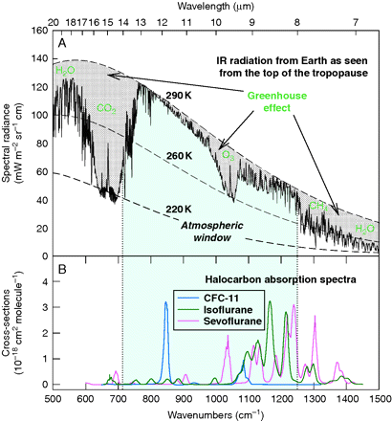
Fig 1 (a) The net upward atmospheric radiance spectrum at the tropopause.²² Dashed lines are Planck ...
Notes:
Fig 1 (a) The net upward atmospheric radiance spectrum at the tropopause.22 Dashed lines are Planck functions for blackbody emissions at 290, 260, and 220 K, respectively. (b) IR absorption bands for CFC-11 (CCl3F), isoflurane, and sevoflurane. Halogenated organic compounds absorb strongly in ‘the atmospheric window’ region.
Unless provided in the caption above, the following copyright applies to the content of this slide: © The Author [2010]. Published by Oxford University Press on behalf of the British Journal of Anaesthesia. All rights reserved. For Permissions, please email: journals.permissions@oxfordjournal.org

Slide 2
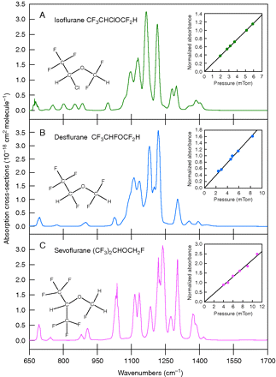
Fig 2 IR absorption spectra of the common anaesthetics, isoflurane (a), desflurane (b), and sevoflurane (c). Insets ...
Notes:
Fig 2 IR absorption spectra of the common anaesthetics, isoflurane (a), desflurane (b), and sevoflurane (c). Insets show the linearity of IR absorption as a function of pressure.
Unless provided in the caption above, the following copyright applies to the content of this slide: © The Author [2010]. Published by Oxford University Press on behalf of the British Journal of Anaesthesia. All rights reserved. For Permissions, please email: journals.permissions@oxfordjournal.org

