Slide 1
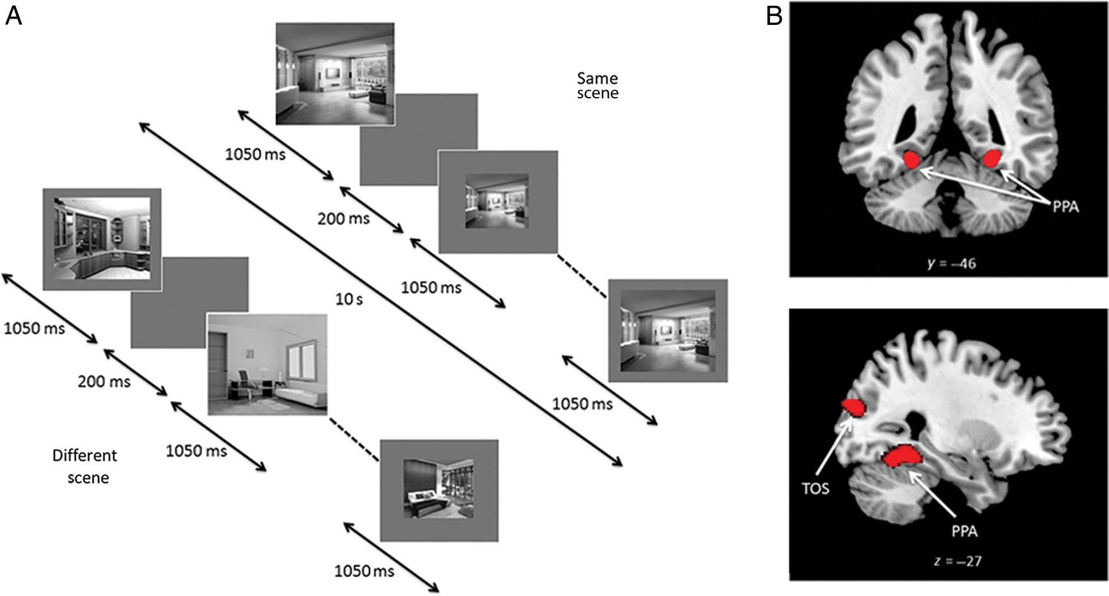
Figure 2. (A) Block-design format used in Experiments 2 and 3 (Experiment 3 shown). (B) Scene-selective bilateral PPA ...
Notes:
Figure 2. (A) Block-design format used in Experiments 2 and 3 (Experiment 3 shown). (B) Scene-selective bilateral PPA and TOS from a representative participant identified with the localizer scan.
Unless provided in the caption above, the following copyright applies to the content of this slide: © The Author 2014. Published by Oxford University PressThis is an Open Access article distributed under the terms of the Creative Commons Attribution License (http://creativecommons.org/licenses/by/3.0/), which permits unrestricted reuse, distribution, and reproduction in any medium, provided the original work is properly cited.

Slide 2
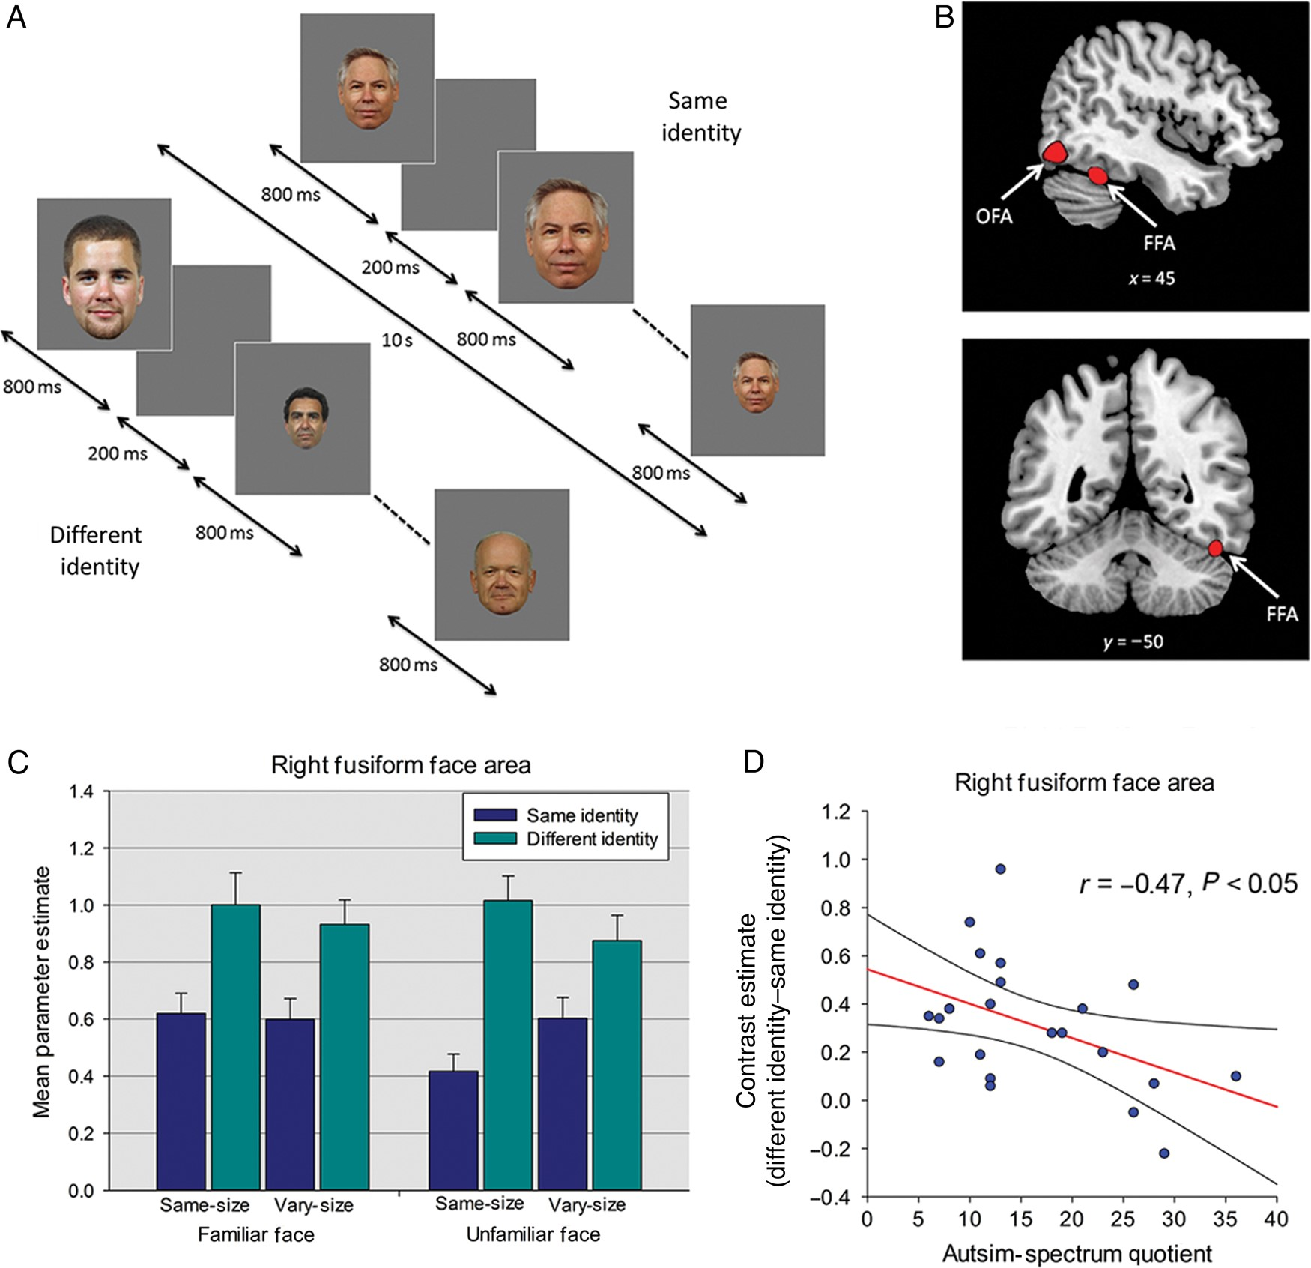
Figure 1. (A) Block-design format used in Experiment 1-RS to faces (B) Face-selective right FFA and right OFA from a ...
Notes:
Figure 1. (A) Block-design format used in Experiment 1-RS to faces (B) Face-selective right FFA and right OFA from a representative participant identified with the localizer scan. (C) Parameter estimates (+1 SD) from Experiment 1 for each of the different- and same-identity conditions in right FFA. (D) Relationship between AQ and RS (different-identity–same-identity) in right FFA. Plot shows contrast estimates of RS (across Image Size and Familiarity) plotted against individual measures of AQ. The regression line and 95% confidence intervals are shown.
Unless provided in the caption above, the following copyright applies to the content of this slide: © The Author 2014. Published by Oxford University PressThis is an Open Access article distributed under the terms of the Creative Commons Attribution License (http://creativecommons.org/licenses/by/3.0/), which permits unrestricted reuse, distribution, and reproduction in any medium, provided the original work is properly cited.

Slide 3
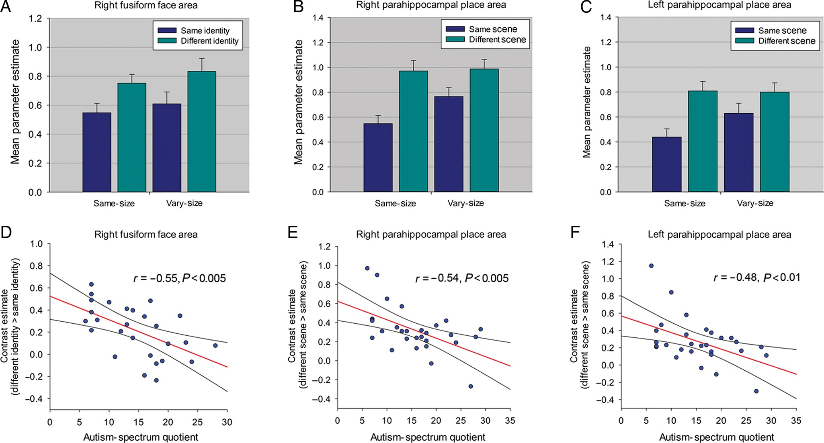
Figure 3. (A) Parameter estimates (+1 SD) for same- and different-identity conditions in right FFA in Experiment 2. (B) ...
Notes:
Figure 3. (A) Parameter estimates (+1 SD) for same- and different-identity conditions in right FFA in Experiment 2. (B) Parameter estimates (+1 SD) for all same- and different-scene conditions in right PPA and (C) left PPA in Experiment 3. (D) Relationship between AQ and RS in right FFA in Experiment 2. (E) Relationship between AQ and RS in right PPA and (F) left PPA in Experiment 3. All scatter plots show contrast estimates of RS (across Image Size) plotted against individual measures of AQ. Regression line and 95% confidence intervals are shown.
Unless provided in the caption above, the following copyright applies to the content of this slide: © The Author 2014. Published by Oxford University PressThis is an Open Access article distributed under the terms of the Creative Commons Attribution License (http://creativecommons.org/licenses/by/3.0/), which permits unrestricted reuse, distribution, and reproduction in any medium, provided the original work is properly cited.

Slide 4
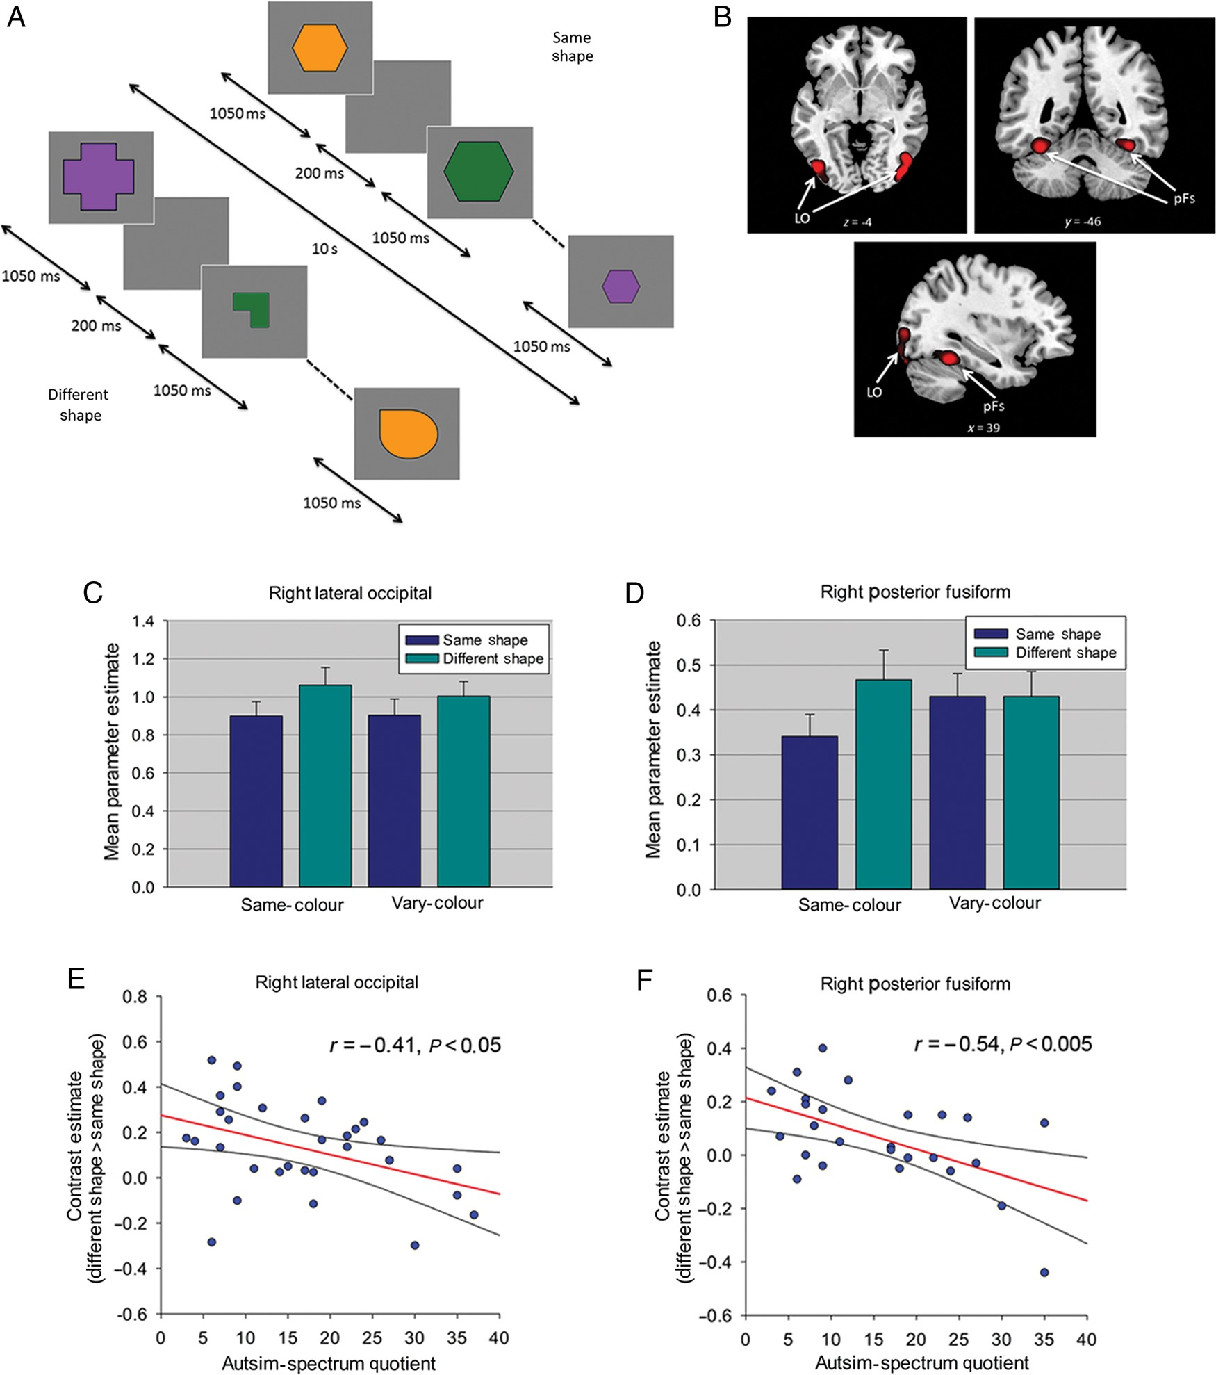
Figure 4. (A) Block-design format used in Experiment 4. (B) Object-selective LO and pFs from a representative ...
Notes:
Figure 4. (A) Block-design format used in Experiment 4. (B) Object-selective LO and pFs from a representative participant identified with the localizer scan. (C) Parameter estimates (+1 SD) for same- and different-shape conditions in right LO and (D) right pFs in Experiment 4. (E) Relationship between AQ and RS in right LO and (F) right pFs in Experiment 4. Both scatter plots show contrast estimates of RS (across Color) plotted against individual measures of AQ. Regression line and 95% confidence intervals are shown.
Unless provided in the caption above, the following copyright applies to the content of this slide: © The Author 2014. Published by Oxford University PressThis is an Open Access article distributed under the terms of the Creative Commons Attribution License (http://creativecommons.org/licenses/by/3.0/), which permits unrestricted reuse, distribution, and reproduction in any medium, provided the original work is properly cited.

