Slide 1
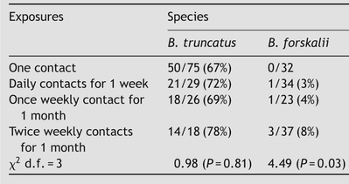
Table 1 Experimental infection rates in Bulinus truncatus and B. forskalii
Notes:
Table 1 Experimental infection rates in Bulinus truncatus and B. forskalii
Unless provided in the caption above, the following copyright applies to the content of this slide: © Royal Society of Tropical Medicine and Hygiene 2007

