Slide 1
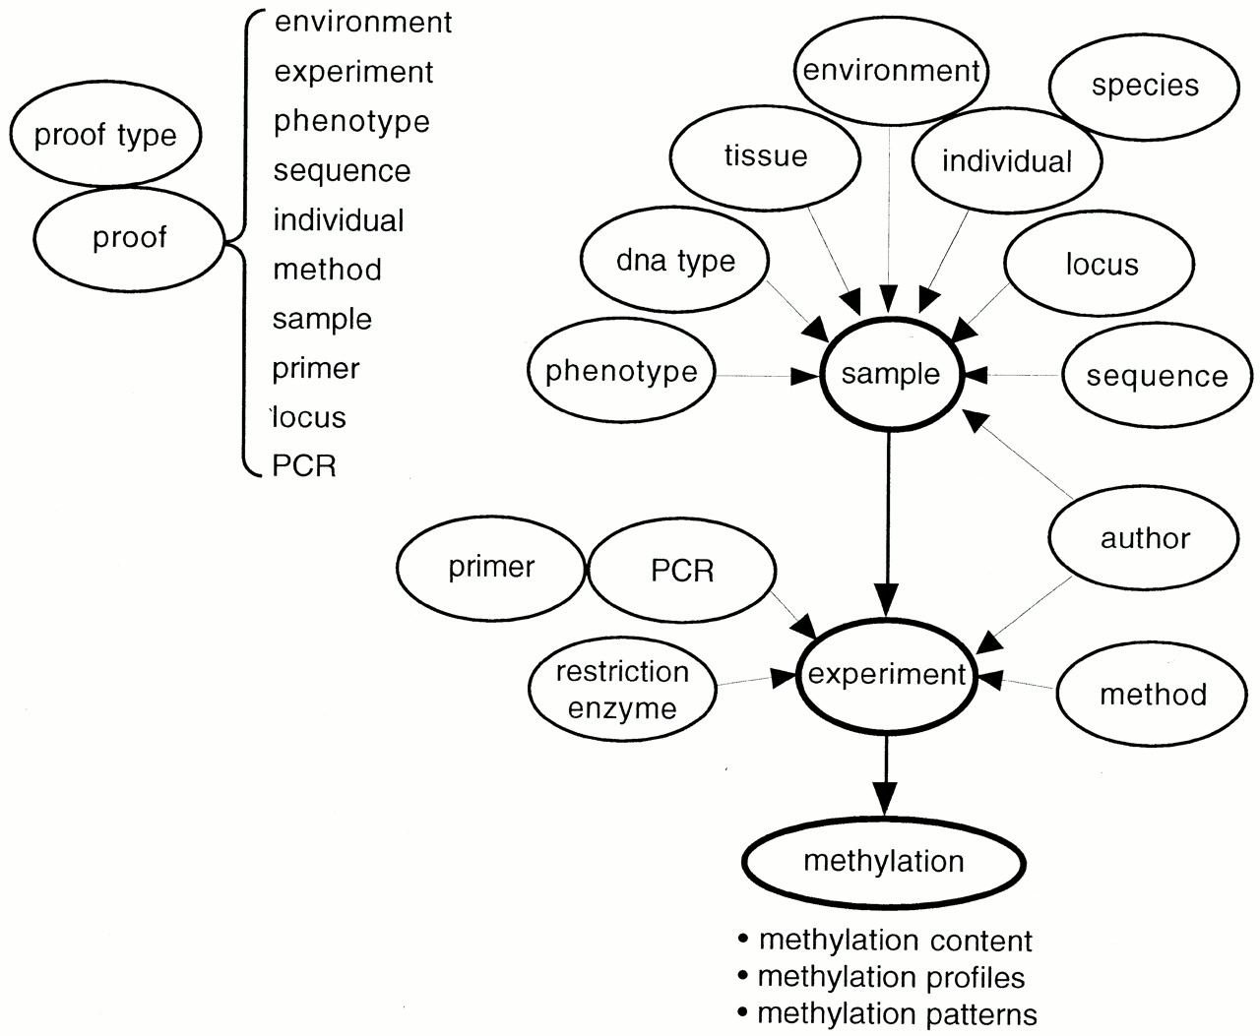
Figure 1. The structure of MethDB. Each circular element represents one table in the database system. Arrows ...
Notes:
Figure 1. The structure of MethDB. Each circular element represents one table in the database system. Arrows describe 1:n relationships in the direction of the arrowhead. On one sample, or experimental target, more than one experiment can be performed. Each experiment can deliver several methylation patterns but only one methylation profile or one methylation content value. For the sake of clarity of the figure, the relation of the proof table to the other tables is displayed separately, on the upper left corner of the figure.
Unless provided in the caption above, the following copyright applies to the content of this slide:

Slide 2
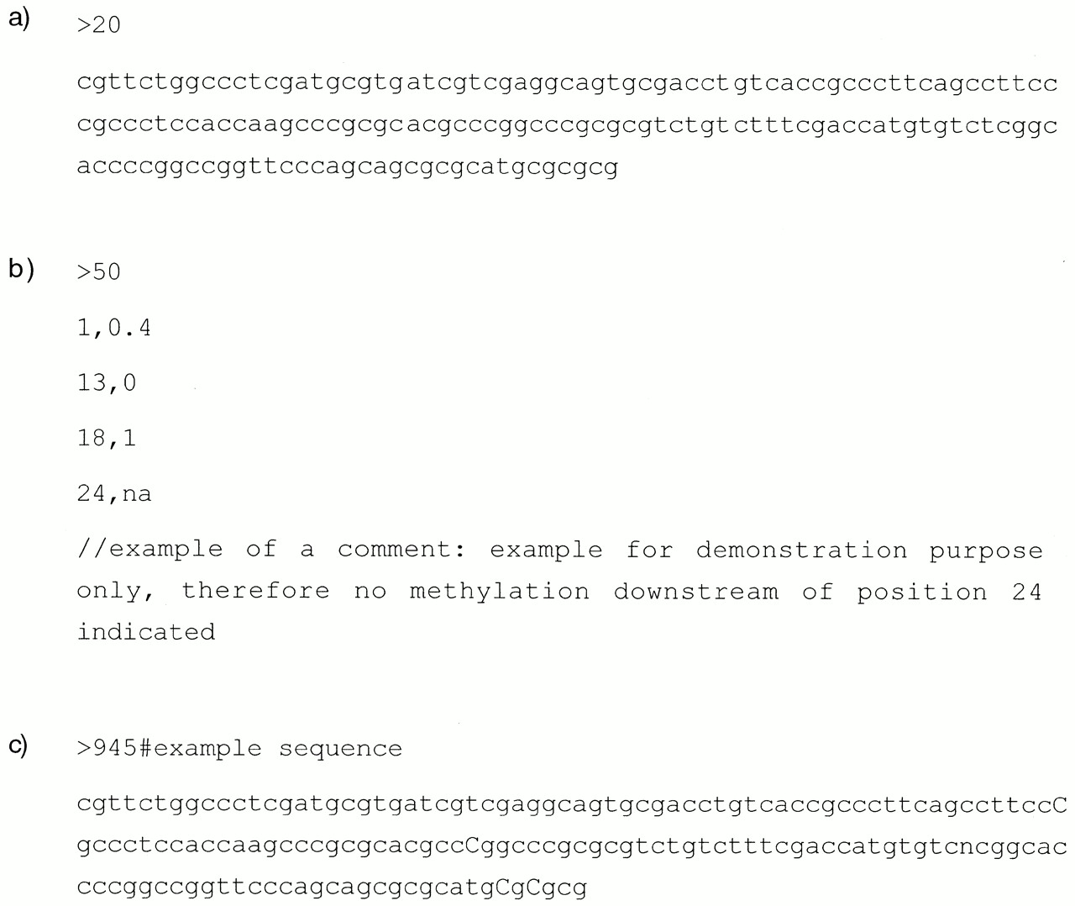
Figure 2. Examples of the different file formats used in MethDB. (a) A sequence file in FASTA format. (b) An ...
Notes:
Figure 2. Examples of the different file formats used in MethDB. (a) A sequence file in FASTA format. (b) An example for the format of the tables that are used to describe methylation profiles. (c) An example for the modified FASTA format that is used to store methylation patterns of single molecules: 5mC is indicated as upper case ‘C’ while all other nucleotide bases are written in lower case letters.
Unless provided in the caption above, the following copyright applies to the content of this slide:

Slide 3
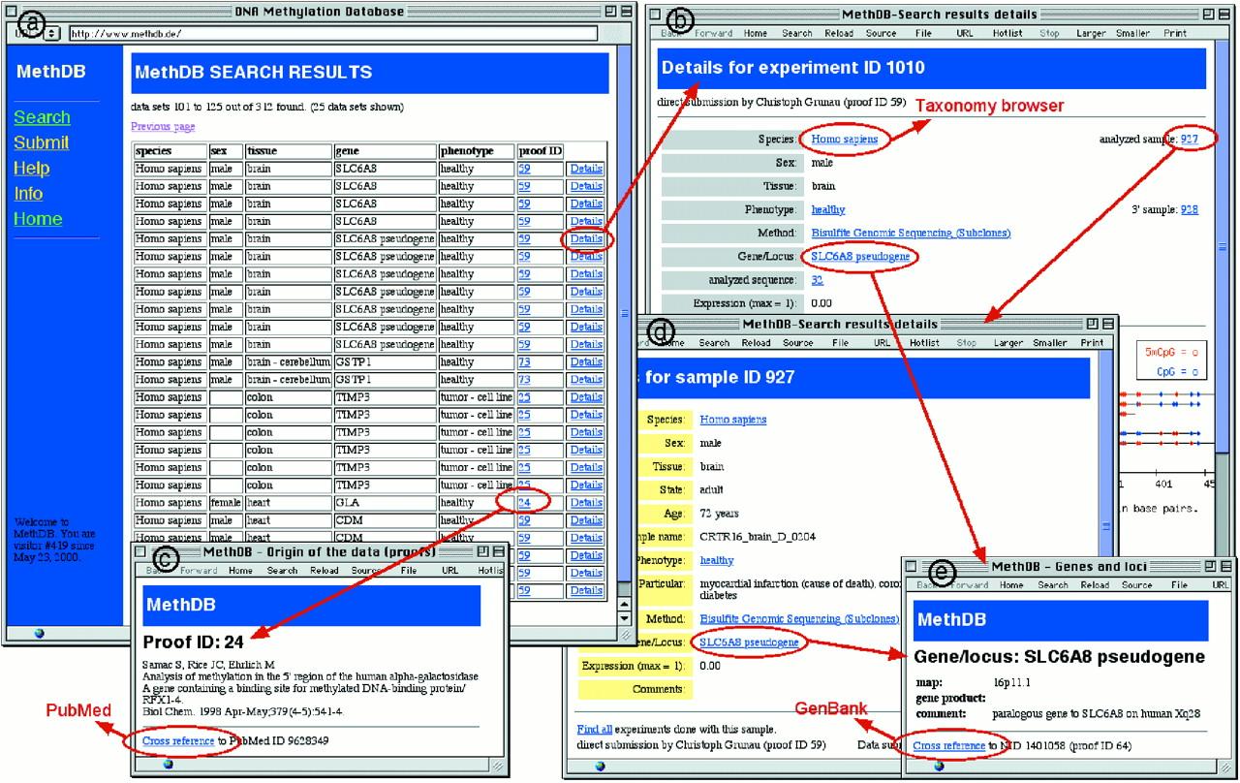
Figure 3. Example for the output of MethDB after a search for methylation profiles and patterns. Initial ...
Notes:
Figure 3. Example for the output of MethDB after a search for methylation profiles and patterns. Initial result of a request to MethDB is a table (a). Each line of the table represents an individual experiment. A click on the ‘Details’ link brings the user to a window that shows detailed information about the experiment and displays the methylation data in a graphical form (b). Further clickable links provide information about, for instance, the reference for the data (c), the description of the investigated sample (d) or information about the gene that was studied (e). As examples for cross-references to external databases, the links to PubMed, GenBank and the Entrez Taxonomy browser are indicated.
Unless provided in the caption above, the following copyright applies to the content of this slide:

