Slide 1
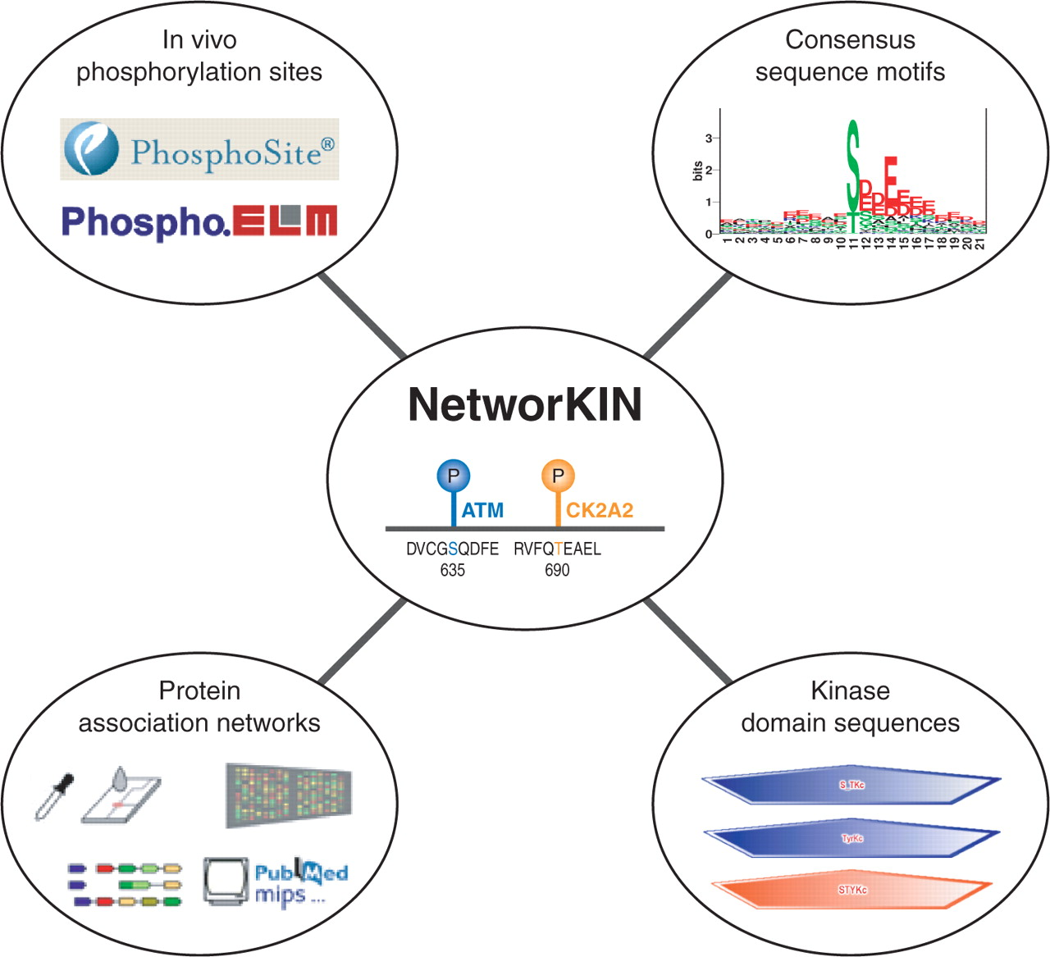
Figure 1. Overview of the NetworKIN resource. NetworKIN starts from a set of known in vivo phosphorylation sites, ...
Notes:
Figure 1. Overview of the NetworKIN resource. NetworKIN starts from a set of known in vivo phosphorylation sites, which are obtained and kept synchronized with the Phospho.ELM and PhosphoSite databases to facilitate reciprocal database cross-links. We first compare these phosphorylation sites to consensus sequence motifs from the Scansite and NetPhosK resources in order to predict possible kinase families responsible for the phosphorylation. Second, we capture the kinase and substrate context using a probabilistic functional association network from the string database (12). The resulting site-specific kinase–substrate interaction network is stored in a SQL database, which is accessible via a web interface.
Unless provided in the caption above, the following copyright applies to the content of this slide: © 2007 The Author(s)This is an Open Access article distributed under the terms of the Creative Commons Attribution Non-Commercial License (http://creativecommons.org/licenses/by-nc/2.0/uk/) which permits unrestricted non-commercial use, distribution, and reproduction in any medium, provided the original work is properly cited.

Slide 2
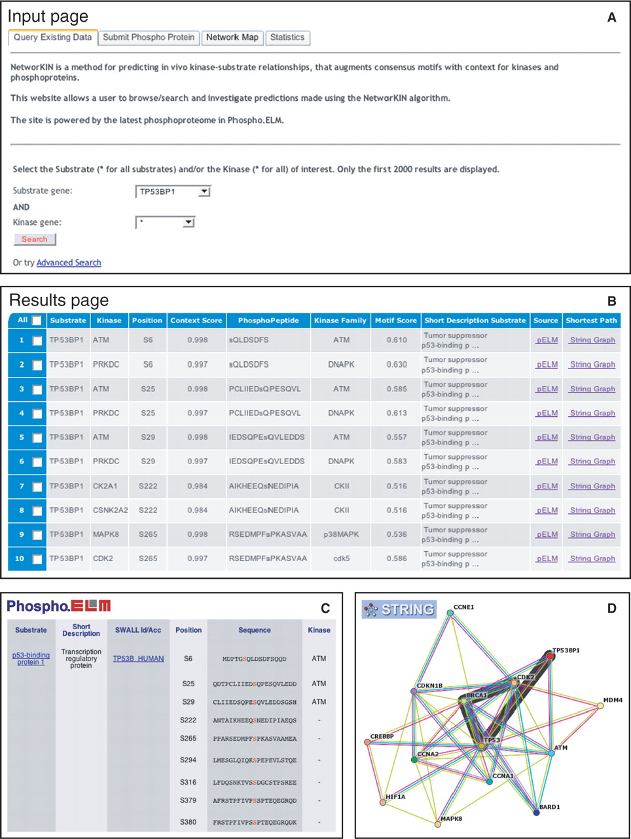
Figure 2. Using NetworKIN. A researcher is interested in the 53BP1 tumour surpressor. From the homepage of NetworKIN, ...
Notes:
Figure 2. Using NetworKIN. A researcher is interested in the 53BP1 tumour surpressor. From the homepage of NetworKIN, this protein is chosen as the substrate protein to query the database for predictions relating any kinase to specific phosphorylation sites within 53BP1 ( A ). The system returns a total of 78 relations involving 12 different kinases that are predicted to phosphorylated 39 different sites, which are presented in a tabular view ( B ), (only the first 10 predictions are shown). These predictions can now be investigated in further detail by following either the links to the Phospho.ELM and PhosphoSite databases for curated knowledge related to the sites ( C ), or by following the links to the string network viewer to visualize the most probable path in the protein assocation network, which connects the kinase and the substrate ( D ).
Unless provided in the caption above, the following copyright applies to the content of this slide: © 2007 The Author(s)This is an Open Access article distributed under the terms of the Creative Commons Attribution Non-Commercial License (http://creativecommons.org/licenses/by-nc/2.0/uk/) which permits unrestricted non-commercial use, distribution, and reproduction in any medium, provided the original work is properly cited.

